Slide 1
eduroam hosted services
Managed SP new version
A glance at usage of MSP and MIdP services
Maja Górecka-Wolniewicz
Poznańskie Centrum Superkomputerowo-Sieciowe (PCSS)
Poznan Supercomputing and Networking Center
Mobility Day – TNC25, Brighton, 9.06.2025
Public (PU)

Slide 2
Managed SP pilot
A no-effort system turning your access points into a fully functional eduroam service provider
  enable eligible institutions to outsource the technical setup of the eduroam SP
  securely manage roaming infrastructure even on IP connectivity with changing IP addresses (or NAT)
Started in September 2021
  dedicated CAT instance: https://msp-pilot.eduroam.org
  RADIUS sites installed on two machines
  guide: https://wiki.geant.org/display/H2eduroam/A+guide+to+eduroam+Managed+SP+PILOT
Current functionality
  authorised institution administrator can create and activate a Managed SP deployment
  each deployment obtains:
    unique UDP port and unique secret for standard RADIUS connection to two RADIUS servers
  each deployment can have advanced settings:
    Operator Name value - instead of a default setting of Operator-Name attribute which is unique for each deployment
    VLAN settings for own realms

Slide 3
How MSP works
NRO administrator invites via email a person to manage an institution
As an institution administrator you can create and activate a new Managed SP deployment from the MSP CAT interface https://msp-pilot.eduroam.org
You are getting parameters of two RADIUS servers ready to handle RADIUS traffic
  Operator-Name attribute is set to 1sp.d-i.hosted.eduroam.org where d is deployment ID, i is institution ID
  additional settings include custom Operator-Name, VLAN setting for realms treated as “own”
RADIUS site tasks
  freeRADIUS process: handles communication from network devices configured using provided parameters
  each accepted packet starts its way to home institution authentication server via the local radsecproxy
  all realms are proxied to the radsecproxy instance on the same host
  radsecproxy can use dynamic discovery to shorten the route to the authentication server, otherwise packets go to ETLR1/2
  Access-Accept / Access-Reject status is saved via F-Ticks in the MSP CAT database
  Other details like realm, CUI, AP identifier etc. are added to the activity log

Slide 4
New version of Managed SP
Updated CAT interface (2.2)
RADIUS server as Docker container
  Debian 12
  newest freeRADIUS 3.2.x series (3.2.7)
    enhanced role of freeRADIUS: supports client using UDP, TLS and TLS-PSK
  newest radsecproxy (1.11.2)
    radsecproxy still used for handling dynamic discovery, moving to freeRADIUS seems too risky at the moment
  easy upgrade
  straightforward deployment of new instances
  functional enhancements

Slide 5
New version of Managed SP – enhanced functionality
Following recommendations described in Deprecating Insecure Practices in RADIUS
  https://datatracker.ietf.org/doc/html/draft-ietf-radext-deprecating-radius-06
Longer shared secret – 34 characters (instead of 16 chars)
In addition to unique parameters for UDP connection each deployment obtains credentials for RADIUS over TLS or TLS-PSK:
  client private key with certificate signed by the internal eduroam CAT CA and CA certificate for RADSEC connection to two RADIUS servers via standard port 2083/TCP
  unique PSK identity and PSK hexphrase for RADIUS over TLS-PSK
On request client certificate can be signed from an uploaded CSR – in such a situation MSP CAT interface provides only client certificate and CA certificate, previous certificate is invalidated
On request client private key / certificate pair can be renewed, previous certificate is invalidated
Some improvements in deployment presentation for better readability
  copy to clipboard icons
  activity log adjustment

Slide 6
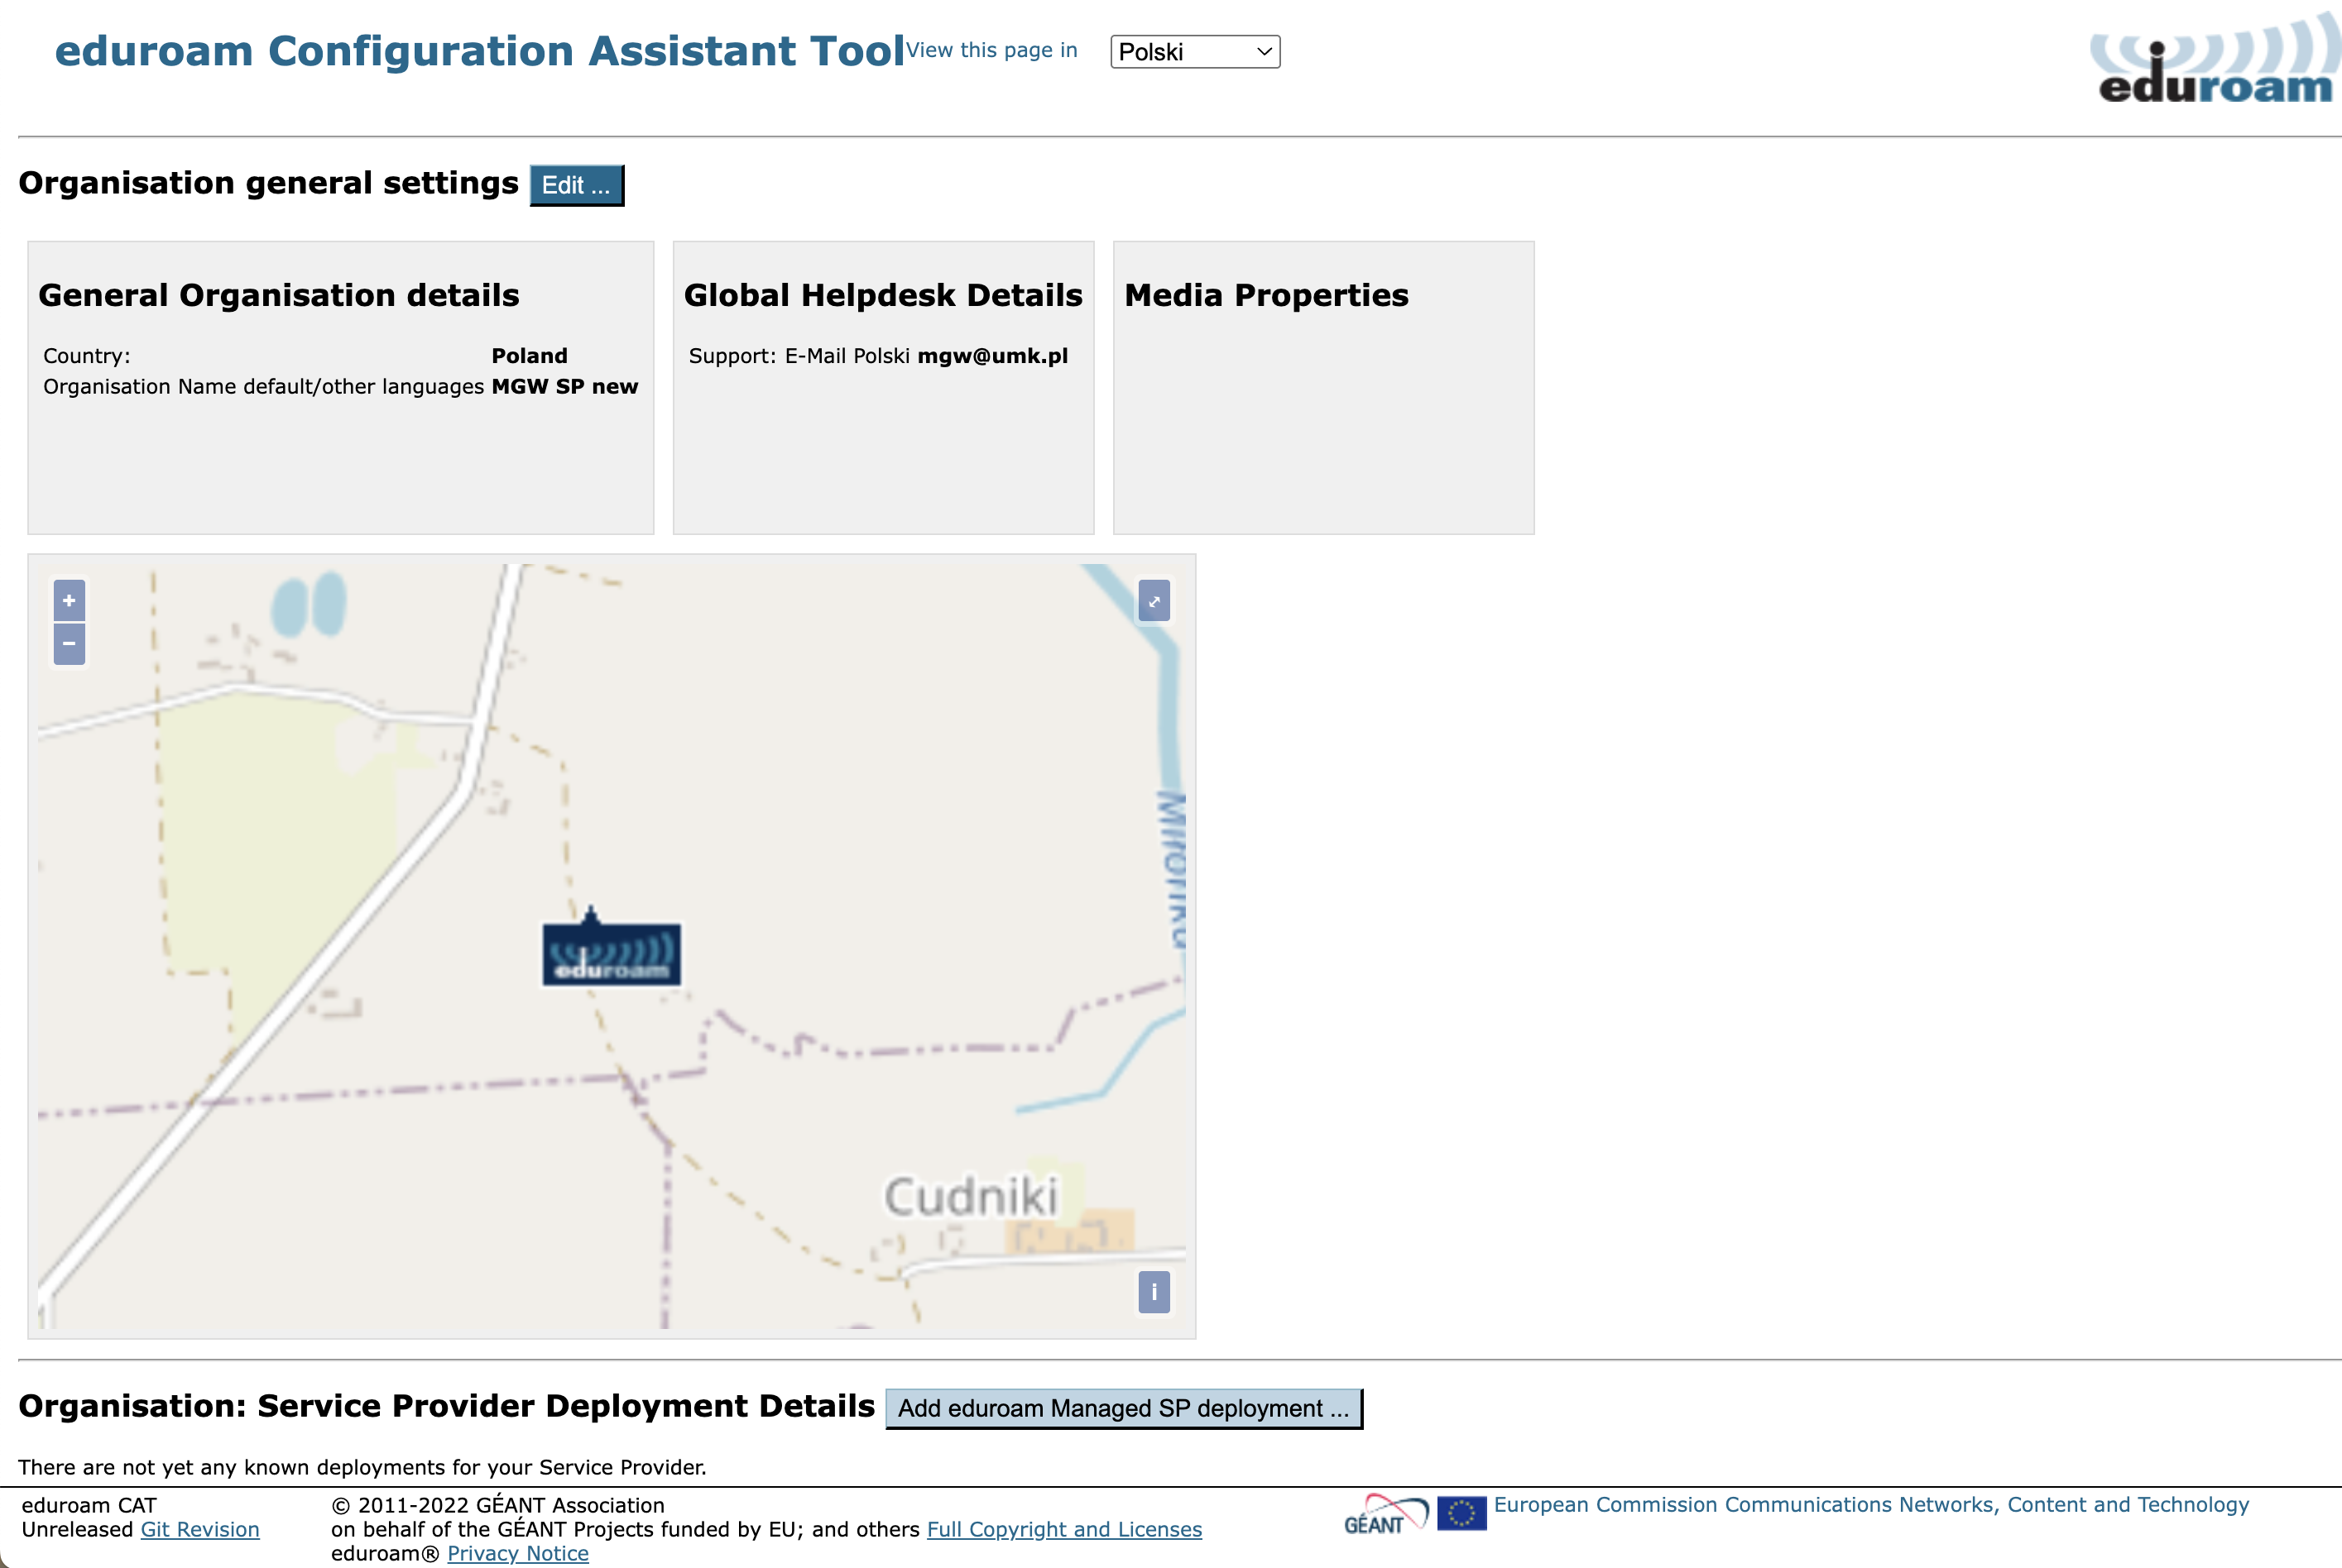

Slide 7
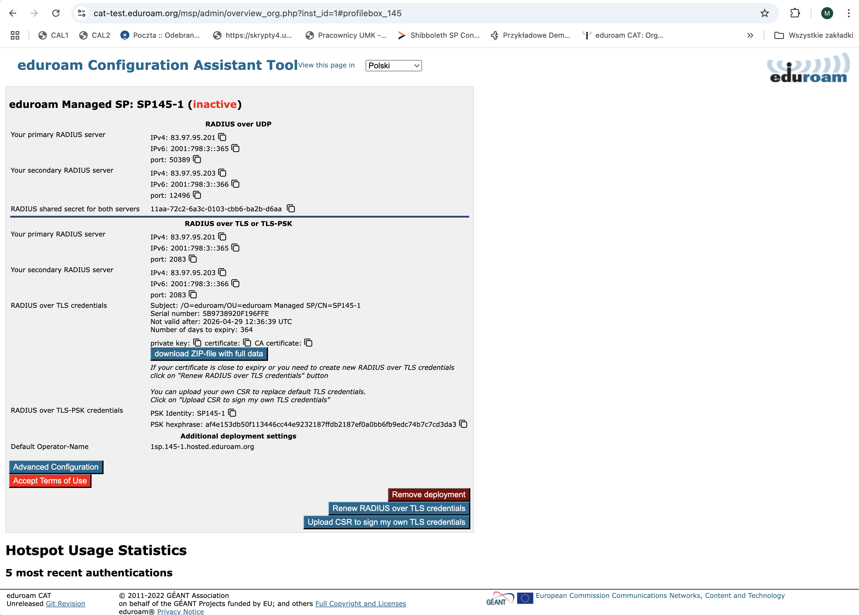

Slide 8
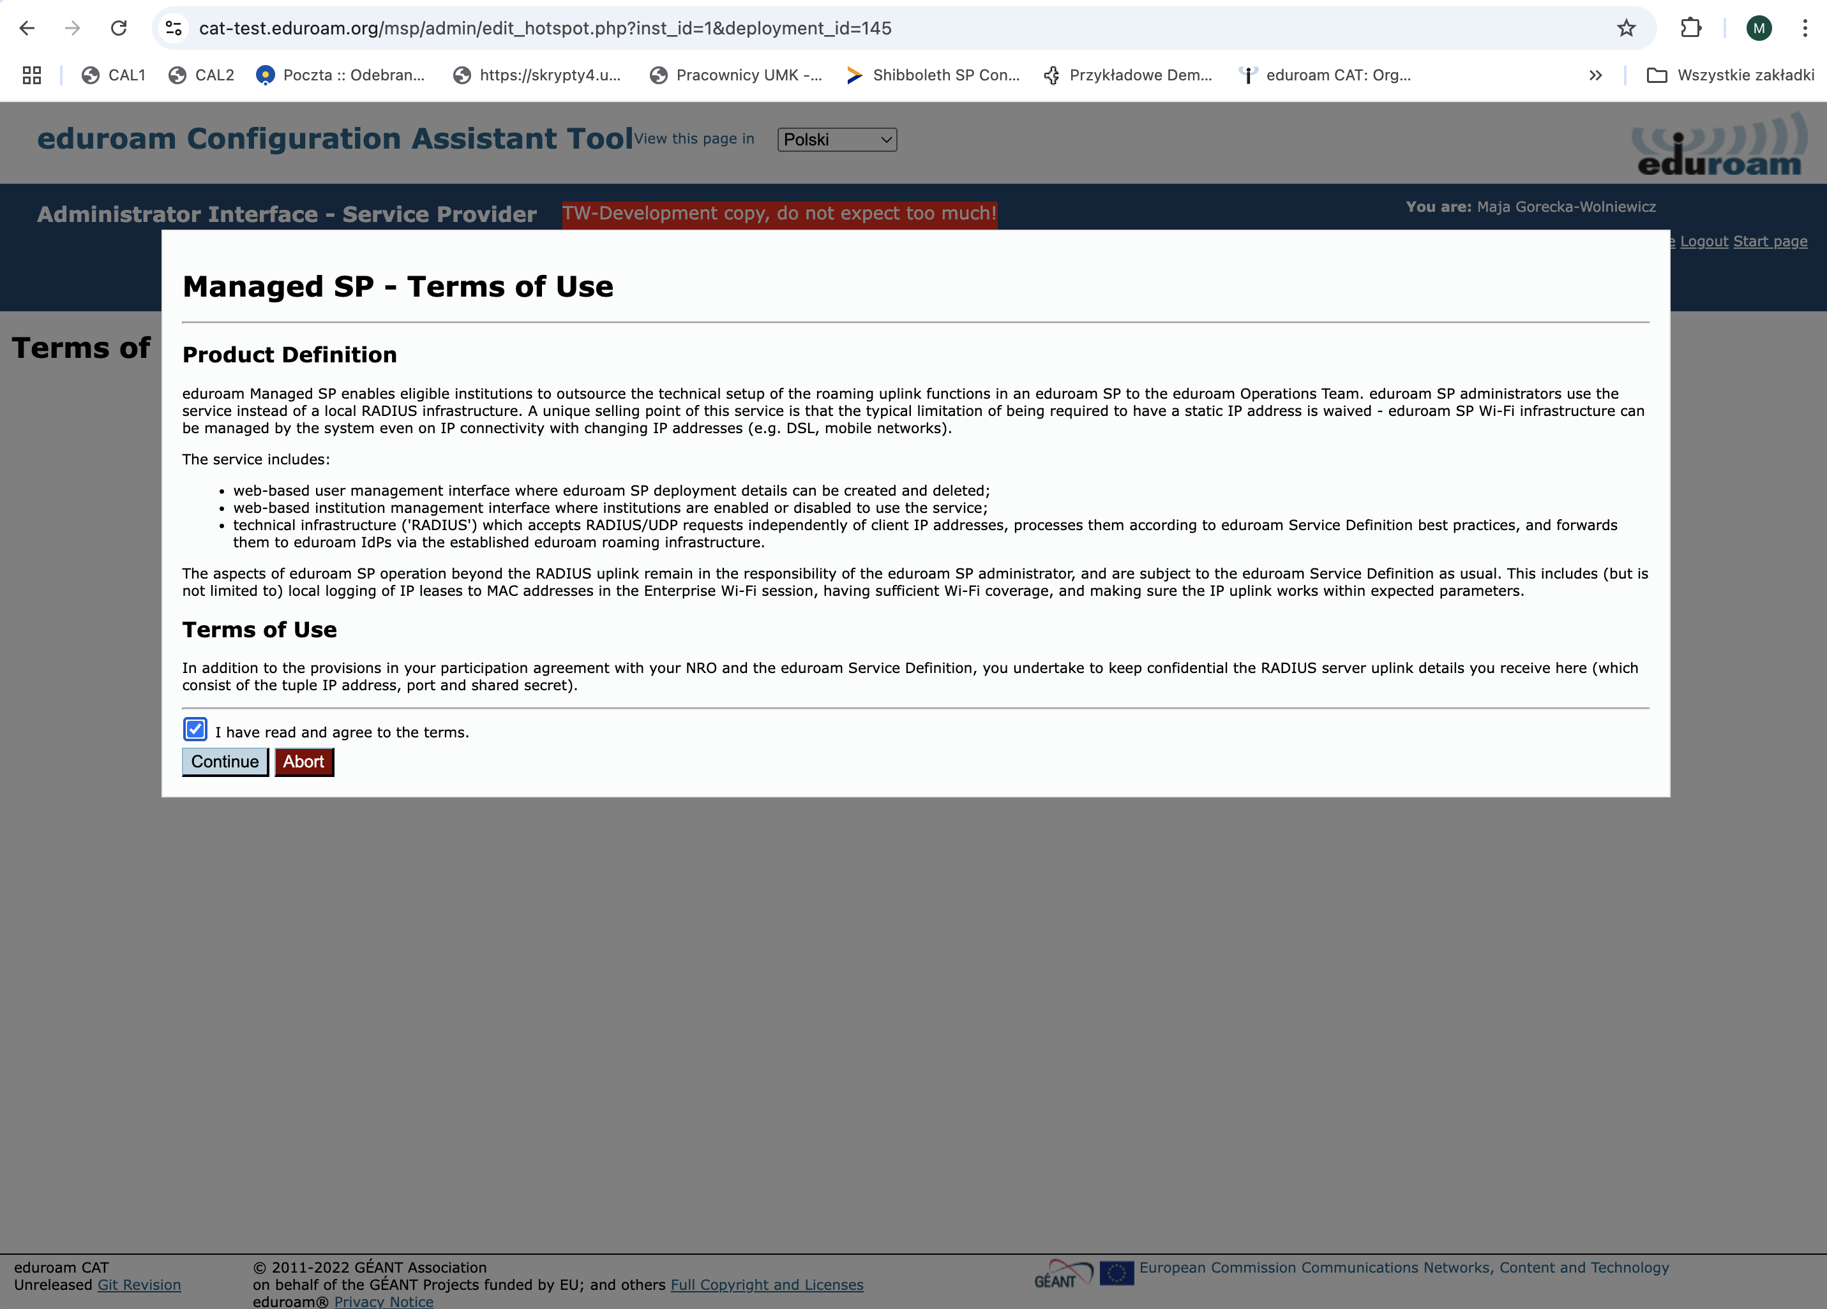

Slide 9
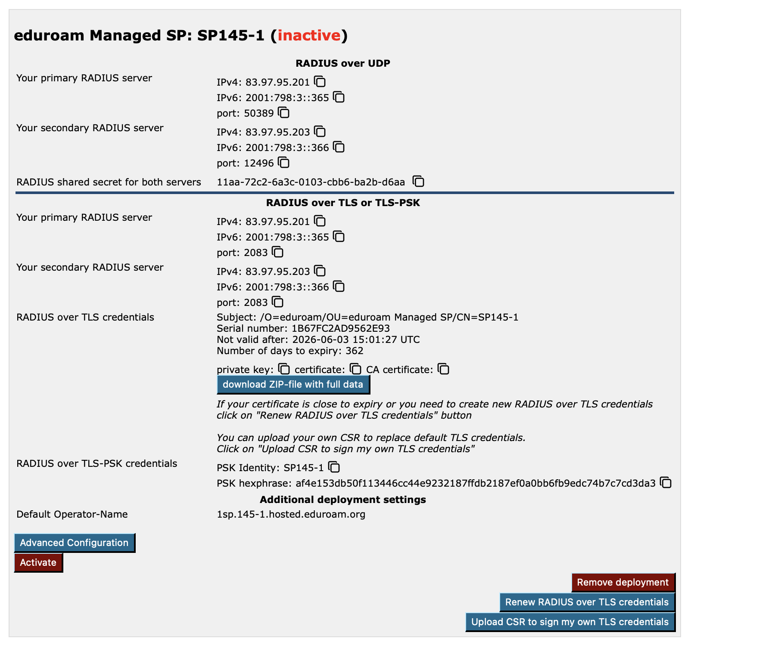

Slide 10
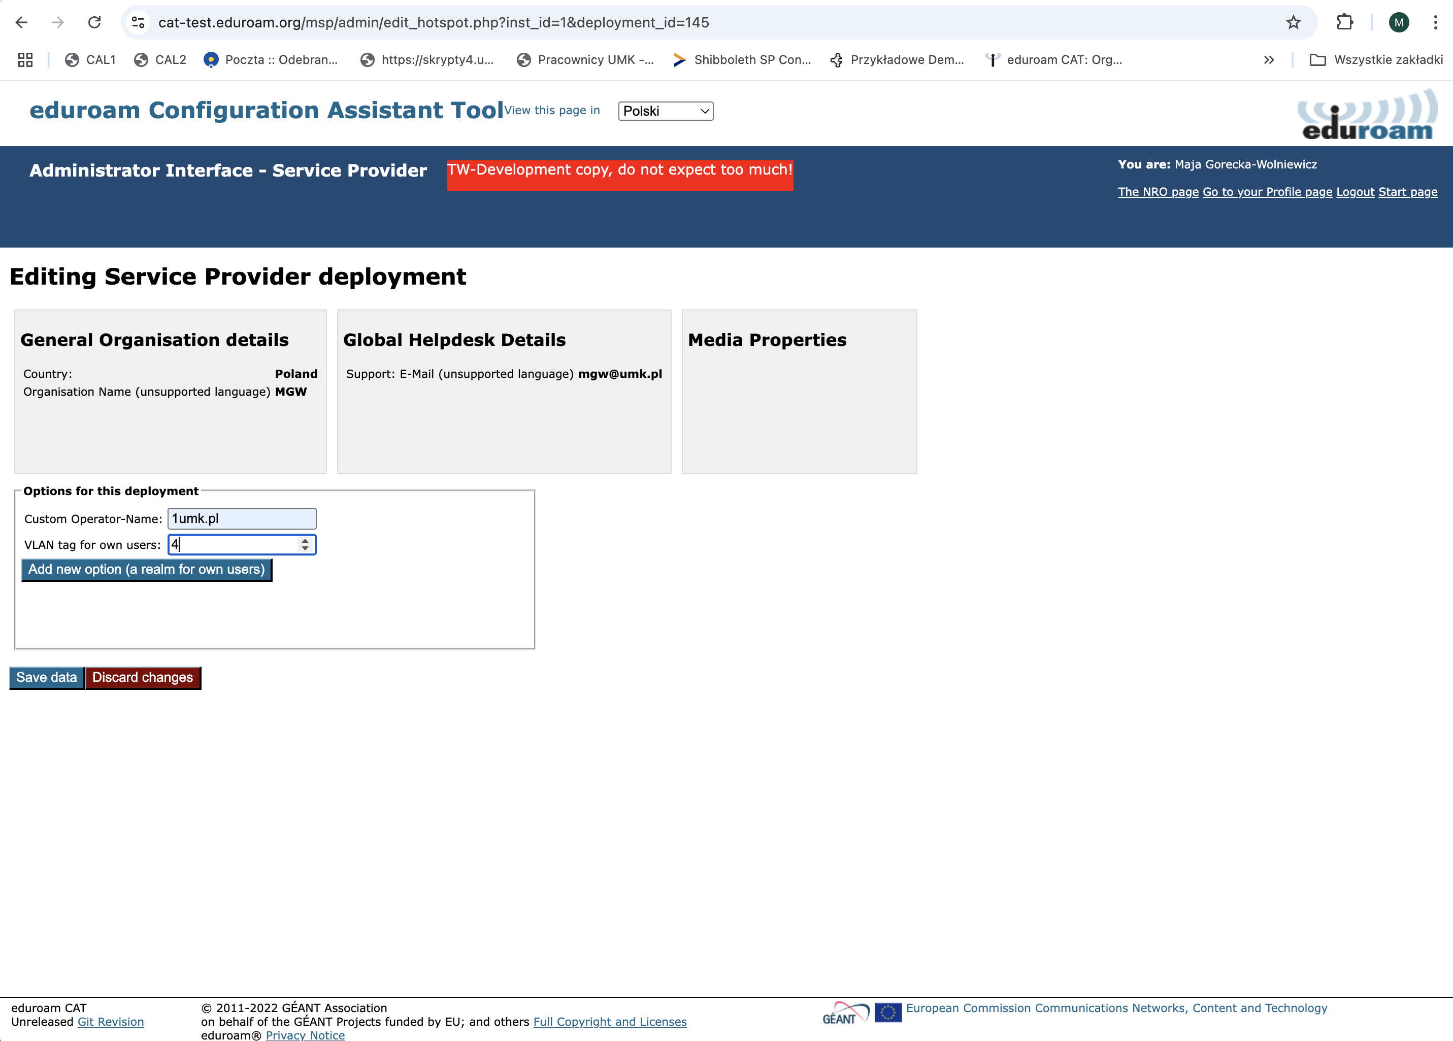

Slide 11
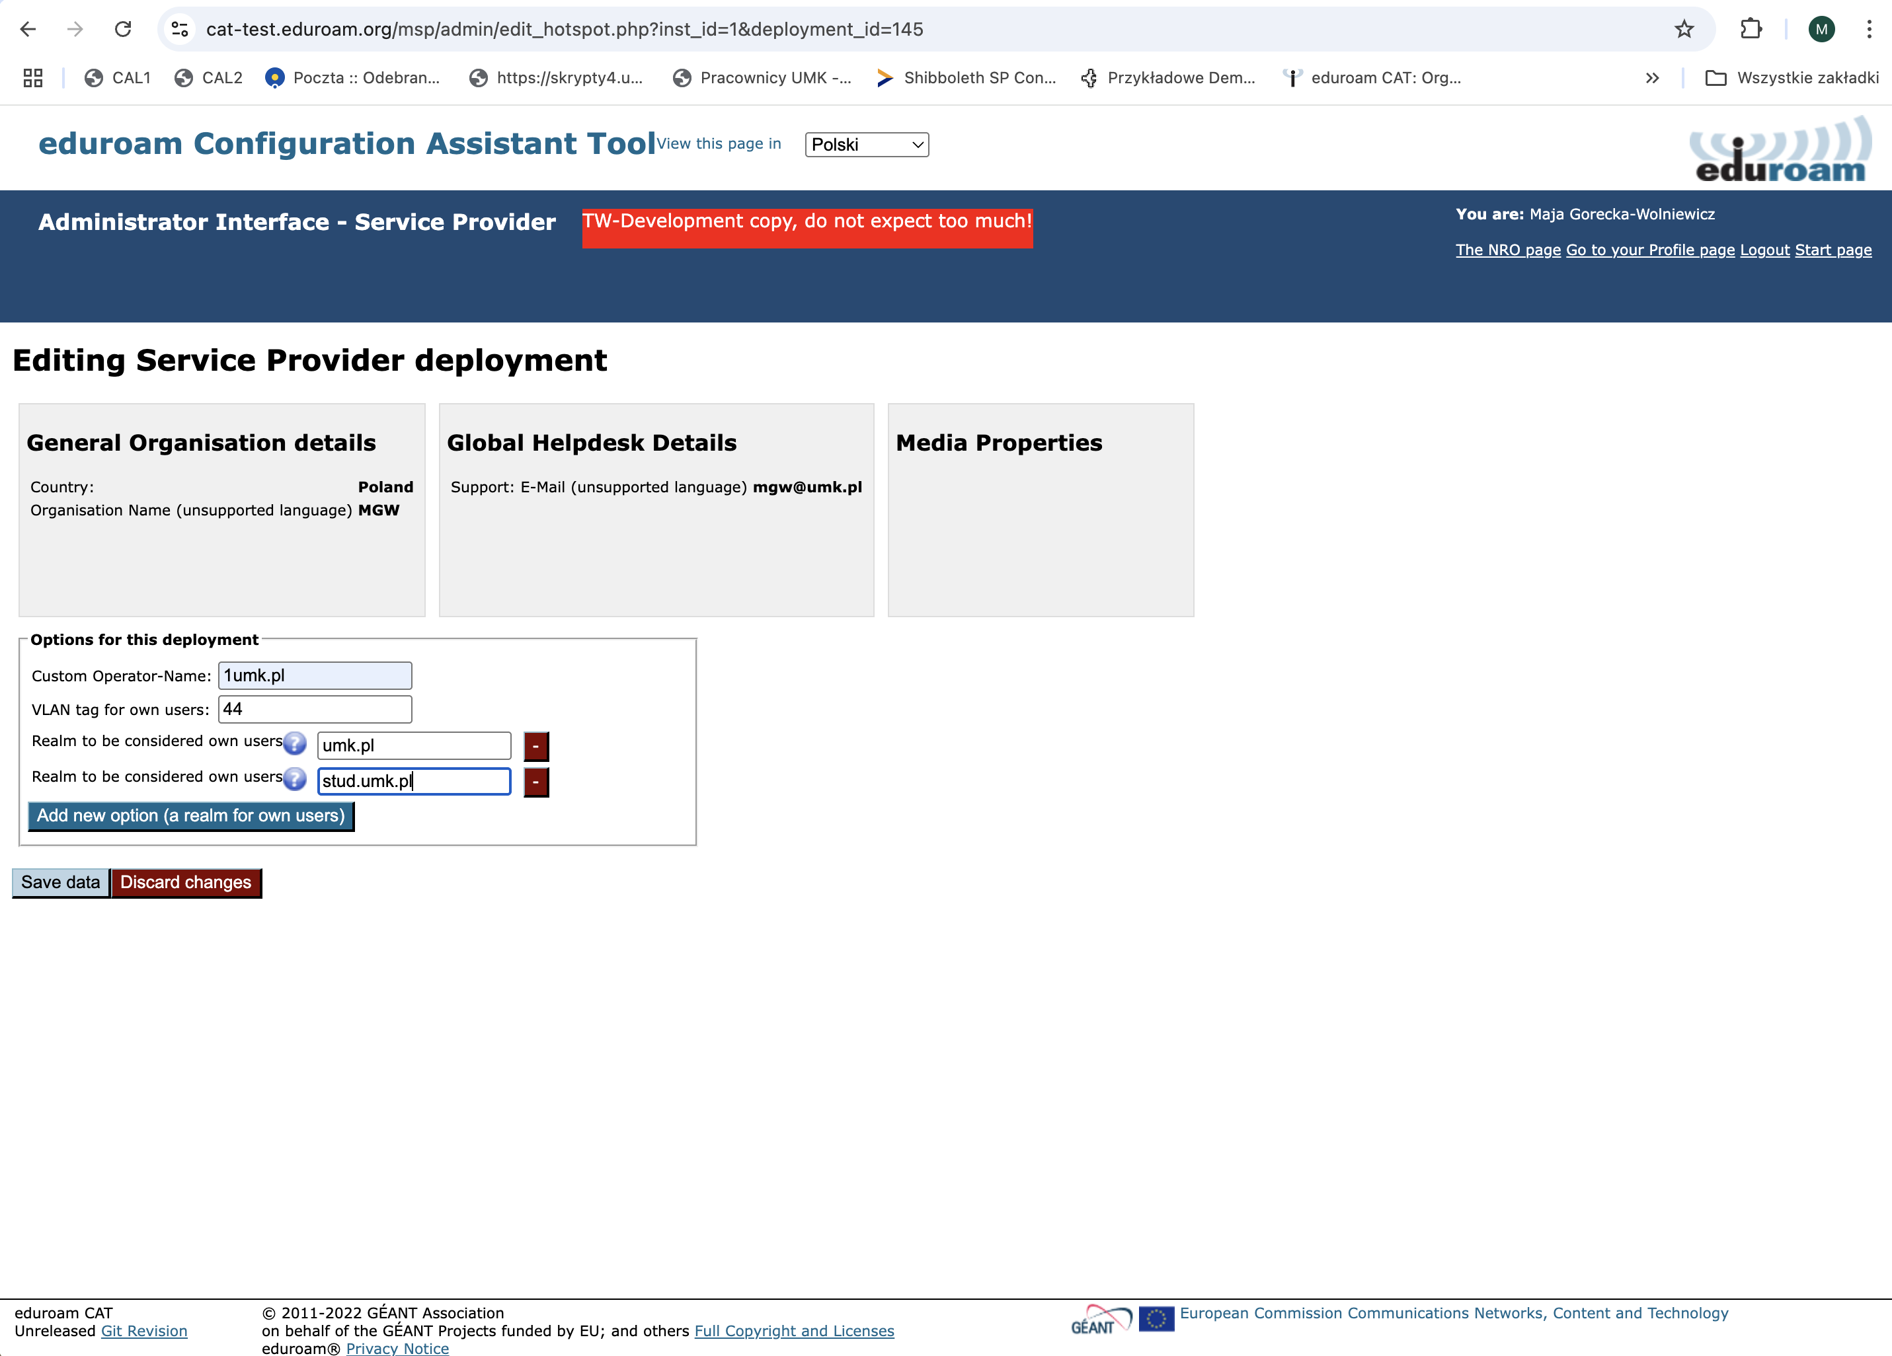

Slide 12
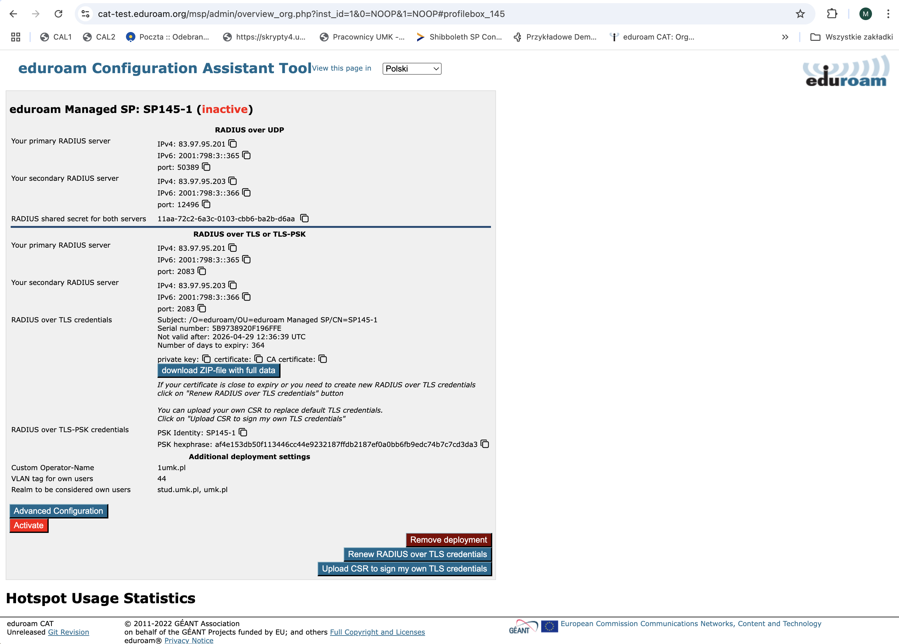

Slide 13
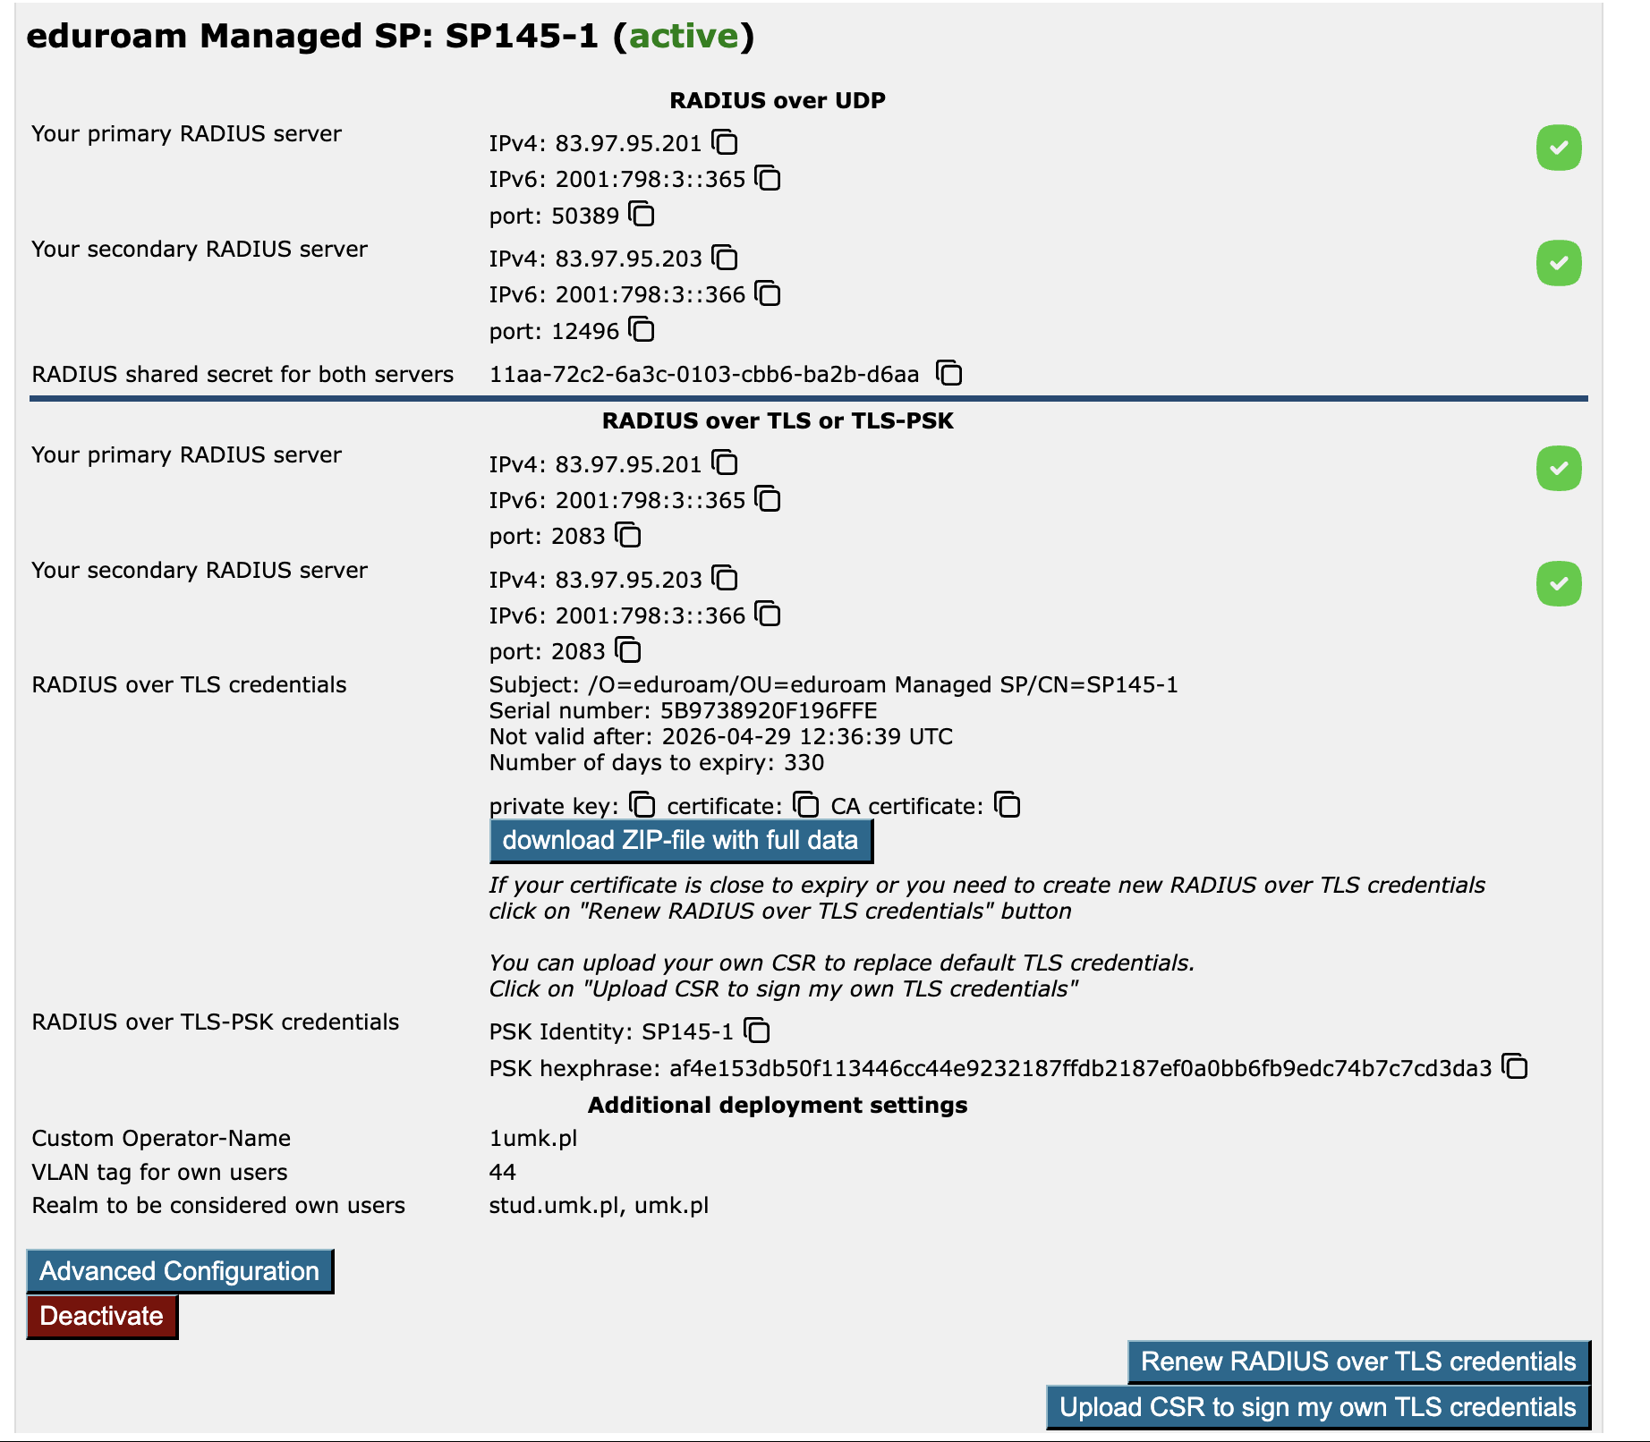

Slide 14
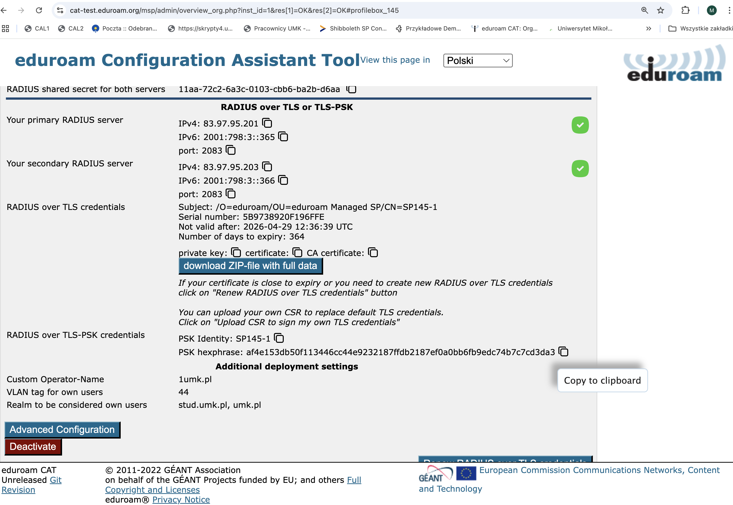

Slide 15
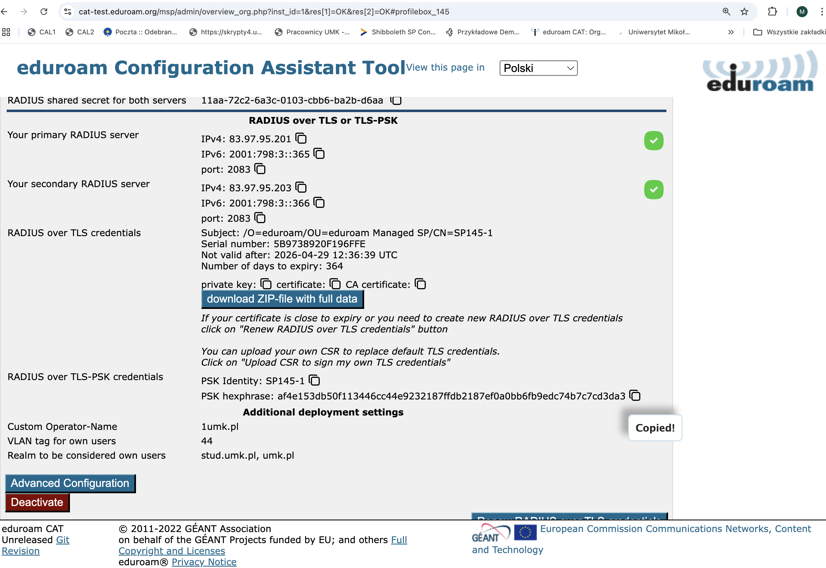

Slide 16
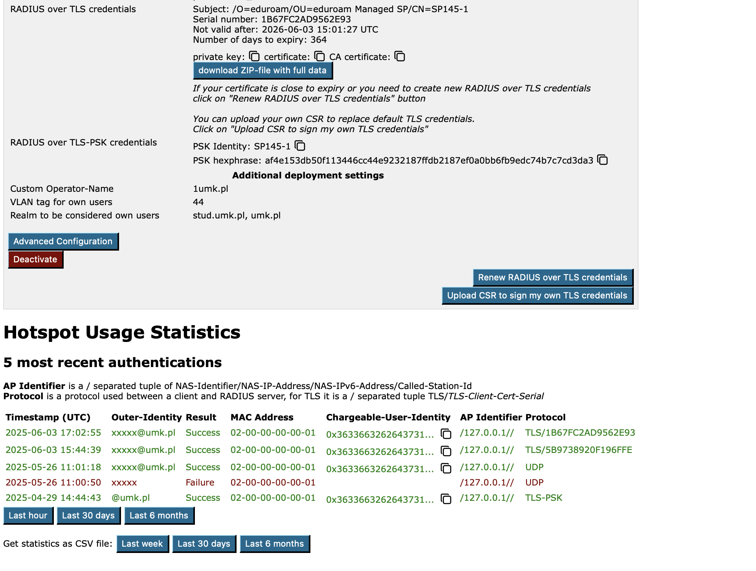

Slide 17
New version of Managed SP - transition
New version is available for testing
  https://cat-test.eduraom.org/msp
  CAT MSP database on this site contains data taken from msp-pilot.eduroam.org in February 2025
Transition to new version will be smooth
  we plan to maintain IP addresses of RADIUS servers

Slide 18
Statistics – usage of Managed SP
55 institutions from 11 countries
63 SP deployment created
56 SP deployments activated
22 active on daily basis
  7 ZA
  4 CH
  3: SE, LU
  1: FR, PT, SK
daily traffic:
  70 – 90 thousands requests
  up to 60-80% are rejects
country | active depl.
NL | 13
CH | 11
ZA | 7
PL | 5
LU | 3
PT | 3
SE | 3
CA | 2
FR | 2
SK | 2
HU | 1

Slide 19
Managed SP – some examples when it is useful
Small organization starting eduroam
Sites offering eduroam access where it is hard to setup proxy RADIUS servers - for instance no fixed IP address (e.g. conferences)
eduroam provided locally e.g. at your residence

Slide 20
Managed IdP
The official service started in March 2019
Developed to enable outsourcing the technical setup of eduroam IdP
Old CAT interface version https://hosted.eduroam.org
Old RADIUS installation
TODO:
  operating system refresh of all hosts involved
  update of CAT interface
  update of RADIUS hosts – operating system plus newest freeRADIUS
Limitation:
  the intermediate certificates (RSA and ECDSA) are valid till end of October 2028 – they must be officially extended (root CA is deposited at Geant Office)
Service description
  https://wiki.geant.org/display/gn43wp5/eduroam+Managed+IdP

Slide 21
Statistics – usage of Managed IdP
143 institutions from 37 countries
1822 accounts, 1032 valid
  the most created when MIdP started, in 2019
  only 40 created in 2020
  97 (2021), 129 (2022), 200 (2023), 193 (2024)
  over 150 accounts this year
active on daily basis
  LU, AT, FI, CH, NO, AT, PT, EE, NZ, SE, AU, FR, UK, IE
daily traffic:
  up to 4000 requests
  about 4% are rejects
country | accepts
LU | 1900
FI | 690
AT | 600
CH | 370
PT | 260
UK | 50
PT | 100
NZ | 50
EE | 40
AU | 7
IE | 2

Slide 22
Managed IdP – to whom addressed
When an institution is unable to provide good credentials to be used with eduroam service
When RADIUS authentication server cannot be provided
When an institution is unable to use the hosted geteduroam service e.g. in cases when the institution does not have access to an eduGAIN IdP

Slide 23
Thank You
The scientific work is published for the realization of the international project co-financed by Polish Ministry of Science and Higher Education from financial resources of the programme entitled "PMW"

