Slide 1


EuroHPC Performance Monitoring
Will Barber
Network Engineer in Géant
SIG-NOC, Prague
2 April 2025
Public

Slide 2

What is EuroHPC
EuroHPC is a joint undertaking by the EU, member countries and partners
Aims to create a world class Supercomputing Ecosystem
Tender for network connectivity was launched in December
GÉANT has worked with NRENs to submit a response

Slide 3
Simple view of EuroHPC Netwok : The HCSA – Core Network, Access
P3
P4
P2
NREN as“Access”
P3
P3
P2
NREN as“Access”
NREN as“Access”
P1- NREN
P5
HCSA
(looks very much like GÉANT
P1- NREN
P1- NREN
P1 - IX
P1 - IX
P1 - Cloud
Notes:
The Hyper Connected Service Area (HCSA) will be the core of the network, connected to NRENs, IX and Cloud peerings and will be the backbone of the network.
NRENs will then provide “Access” networks for connecting to the HPC sites, also referred to as PoIs
The sites have been assigned priorities for connectivity order and bandwidths

Slide 4
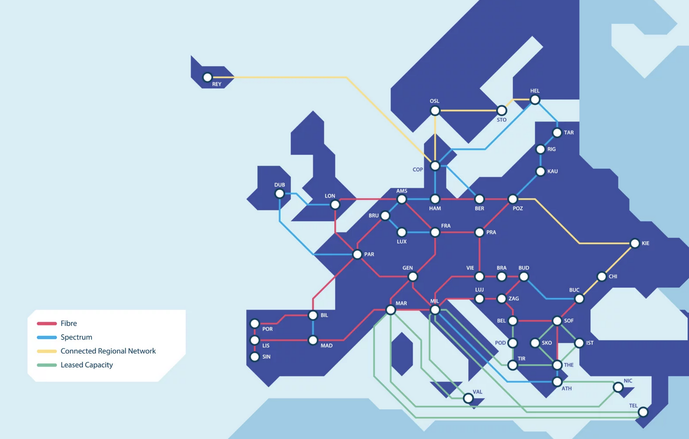
How GÉANT & NRENs fit into HCSA
GÉANTs backbone network nicely fits into the HCSA concept
IX and Cloud peerings
European wide reach
National connectivity from NRENs
Notes:
GÉANTs backbone and NREN peerings fit nicely into the HCSA requirements
IX and Cloud peerings are already in place within the backbone, although may need some upgrades to meet the requirements.
NRENs are well positioned to provide national connectivity to most of the PoI sites

Slide 5
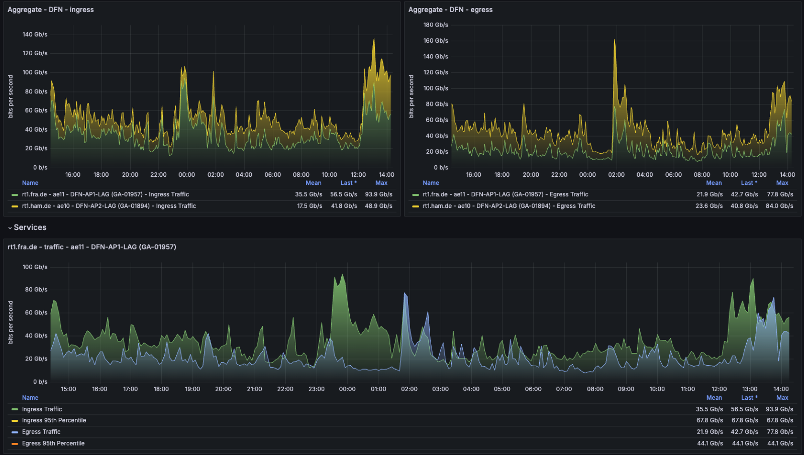
Performance Management Platform - PMP
Expectation: Demonstrate performance of the solution
  Performance metrics: Round Trip Time, Latency, Jittter, Loss, and throughput
  Requirement: Scheduled and on-demand testing
  Requirement: Probe should be able to saturate 80% of access link (!)
  Concept: End-site probes and centralised analysis tooling
    Where: GÉANT POPs (6), 100% P2 (21), 10% P3 (12), 5% P4 (2)

Slide 6
Performance Management Platform – PMP continued
Approach: Centralised router stats & packet probes, end-site throughput testers
  GÉANT centralised polling of GEANT & NREN routers
  GÉANT centralised ICMP probes – packet performance stats
  HPC POI site deployment of perfSONAR servers – throughput primarily
  HPC POI site deployment of packet blasting hardware testers (if required)

Slide 7
Centralised Performance Management Platform
Data acquisition, SNMP/Streaming Telemetry/API integration via:
  GÉANT and NREN router SNMP/ST/API polling, SNMP traps, BGP community-based traffic accounting, etc.
  GÉANT-hosted telegraf polling infrastructure
    ping and traceroute probes targeting HPC <> NREN ptp link IPs – providing RTT, jitter, packet loss
  HPC POI-hosted PMP probe data
    perfSONAR servers upto 100G
    Teledyne LeCroy Xena 1RU hardware testers (or similar)
Data reporting:
  BRIAN/Grafana EuroHPC dashboard
    Traffic stats - HPC access links, NREN access links
    perfSONAR test stats – throughput, etc.
    Telegraf ICMP probe stats – GEANT <> HPC end site ping probes, RTT, jitter, loss, etc.
  MADDASH perfSONAR matrix
  perfSONAR Toolkit UI / Measurement Archive for detailed analysis and troubleshooting

Slide 8


Standard PMP Testing
HPC PoI site standard probes
  Build on PerfSONAR as the basis – some 40 sites could need a probe/server
    Delivers RTT, latency (OWAMP), jitter, packet loss and ”link saturation” up to 100G
    Aim to be flexible in how this is delivered (site/NREN/GÉANT can provide)
    Need to have a central database, maintenance of infrastructure; test data captured in:
      GÉANT perfSONAR Measurement Archive // pS-specific database
      GÉANT central InfluxDB // PMP platform database
Notes:
Main workhorse of the PMP monitoring will be perfSONAR nodes
They can provide the required tests to be scheduled
Allow for specific on-demand tests as required
Centralised reporting will require databases to be synchronised to by all nodes
Offers Grafana interfaces for reporting and user visibility.

Slide 9

Enhanced PMP Testing
2. HPC PoI site high capacity probes
  Provide an option for high-capacity link saturation => dedicated high-capacity test devices n x 100G, n x 400G
    This is not desirable for many reasons, but can be offered
    Intended only to be used (think DMC challenge):
      Infrequently
      Only inside maintenance windows
    Market engagement with a vendor
      Testers would be suitable for this purpose
      GUI, CLI, API functionality is good
      € level requires us to run procurement
Notes:
The requirement for 80% link saturation for one link on all sites with multiple connections poses problems for the higher throughput sites, with some having up to 1.2Tb connectivity
This isn’t something which is recommended by GÉANT, but a compliant solution needed to be offered.
A risk of DoS would mean that these tests would need to be carefully coordinated to avoid unintended outages being caused across wider NREN or GÉANT communities.
Discussions have been had with Teledyne LeCroy whose devices offer compliance with this requirement for up to 800G interfaces
Unfortunately due to the value of the cost this would require procurement processes to be followed with an open tender

Slide 10
Challenges and Opportunities
The timeframe for deployment and implementation of the project presents challenges
  Sourcing and installing the nodes will take time and resources
    Sites will have various requirements and rules to comply with
    Staff availability for all the works may be difficult at times during the deployments
perfSONAR is well understood and known within the GÉANT community, which will help deployment
  Opportunity to work on testing it at higher throughputs is possible
Involvement with a major project will be good for GÉANT and NREN community
Notes:
Possible for up to 400Gbps testing opportunities on pS nodes, will be tested to confirm if it is an alternative to dedicated devices.

Slide 11

Thank You
Any questions?
www.geant.org
© GÉANT Association
As part of the GÉANT 2020 Framework Partnership Agreement (FPA), the project receives funding from the European Union's Horizon 2020 research and innovation programme under Grant Agreement No. 856726 (GN4-3).

