Slide 1


EuroHPC Hyper-connectivity
Sebastiano Buscaglione, Network Architect @ GÉANT

Slide 2
EuroHPC and the JU
With the EuroHPC Regulation 2021/1173 (July 2021) the EC establishes a JU (Joint Undertaking):
  For the implementation of the initiative on European High Performance Computing, a Joint Undertaking within the meaning of Article 187 of the Treaty on the Functioning of the European Union (TFEU) (the ‘European High Performance Computing Joint Undertaking’, the ‘Joint Undertaking’) is hereby established for a period until 31 December 2033.
  The mission of the Joint Undertaking shall be: to develop, deploy, extend and maintain in the Union a world-leading federated, secure and hyper-connected supercomputing, quantum computing, service and data infrastructure ecosystem; to support the development and uptake of demand-oriented and user-driven innovative and competitive supercomputing systems based on a supply chain that will ensure components, technologies and knowledge limiting the risk of disruptions and the development of a wide range of applications optimised for these systems; and, to widen the use of that supercomputing infrastructure to a large number of public and private users, and support the twin transition and the development of key skills for European science and industry.
https://eur-lex.europa.eu/eli/reg/2021/1173/oj

Slide 3
Pillars of the JU activity
Among the pillars for the JU activity:
  Infrastructure pillar, encompassing the activities for the acquisition, deployment, upgrading and operation of the secure, hyper-connected world-class supercomputing, quantum computing and data infrastructure, including the promotion of the uptake and systematic use of research and innovation results generated in the Union;
  The Joint Undertaking shall acquire the high-end supercomputers and shall own them.
  Federation of supercomputing services pillar, covering all activities for providing Union-wide access to federated, secure supercomputing and data resources and services throughout Europe for the research and scientific community, industry, including SMEs, and the public sector, in particular in cooperation with PRACE and GÉANT;

Slide 4
Hyper-connectivity
Let’s find out more about the Hyper-connectivity part:
  The Joint Undertaking should hyper-connect all the supercomputers and data infrastructures it owns or co-owns with state-of-the-art networking technologies, making them widely accessible across the Union…
What does Hyper-connected actually mean?
  ‘hyper-connected’ means a communication capability of transferring data at 10 to the power of twelve bits per second (1 Terabit per second) or beyond;
Finally - Who can use them?
  Without prejudice to Article 17(9), the use of EuroHPC supercomputers shall be open to users from the public and private sectors and shall focus on civilian applications.

Slide 5
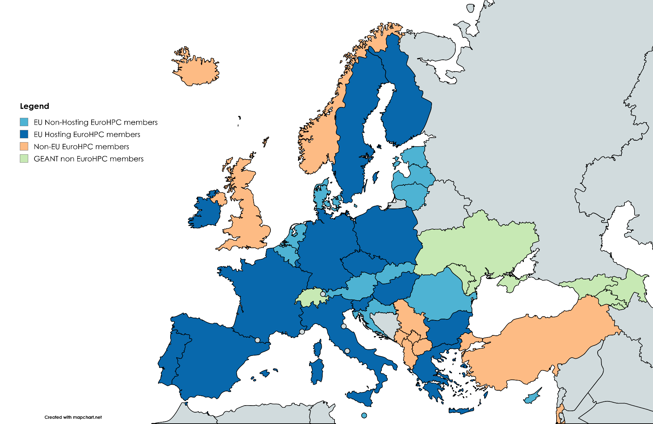
Members of EuroHPC and facilities of the JU
35 Members (all also GÉANT/NORDUnet)
All 27 EU countries + 8 Non-EU
15 HPC Hosting countries - with 3 (HPCs) in the Top10*
  Finland – LUMI*
  Sweden – Arrhenius
  Portugal – Deucalion
  Luxembourg – MeluXina
  Italy – Leonardo*
  Czech Republic – Karolina
  Spain – Marenostrum 5*
  Hungary – Levente
  France – Jules Verne
  Bulgaria – Discoverer
  Ireland – CASPIr
  Poland – EHPCPL
  Slovenia – VEGA
  Germany – Jupiter
  Greece - Daedalus
All HPC facilities are, or will be, (some they don’t exist yet!) connected to the respective NREN networks.

Slide 6
To summarise
The HPC JU is acquiring and upgrading a number of Supercomputing Facilities across the Union
The EuroHPC JU will have to connect these facilities via state-of-the-art network infrastructure
The facilities should be accessible to both private and public sector users for civilian applications ← …we know that the majority of the expected users will be from the R&E community
Finally, all of these facilities (and in fact most of the expected users) are, or will be, connected to the NREN networks
Meaning that we are well placed to be the Hyper-connectivity network provider for the JU!

Slide 7
Funding
How the EC intends to contribute funding these activities:
  The Union financial contribution to the Joint Undertaking including EEA appropriations shall be up to EUR 3 081 300 000, including EUR 92 000 000 for administrative costs, on the condition that that amount is at least matched by the contribution of Participating States, distributed as follows:
    (a) up to EUR 900 000 000 from Horizon Europe;
    (b) up to EUR 1 981 300 000 from the Digital Europe Programme;
    (c) up to EUR 200 000 000 from the Connecting Europe Facility.
  The Union financial contribution referred to in paragraph 1(c) shall be used for the interconnection of the High Performance Computing and data resources and the creation of an integrated pan-European hyper-connected High Performance Computing and data infrastructure.
This is the funding for our area!

Slide 8
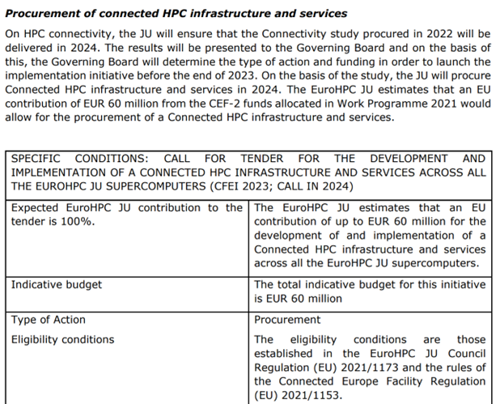
Acquisition process
The JU intends to acquire the Hyper-connectivity service via tender no matching National Funds (50%)
The tender was released in December 2024
  Initial scope and term is 4 years
  Amount allocated is 60M Euros
  Only EU countries can benefit from CEF
  300+ Points of interest to connect of which 210 mandatory
GEANT provides a bid on Match 14th (deadline for submission)
This is an Open competitive tender and another bidder has provided an offer

Slide 9
EuroHPC HyperConnectivity Service – what service?
Hyperconnectivity, or an “Enhanced IP service”:
  Basic service: Very well connected high-capacity IP transit service for EuroHPC sites
  Added: services such as
    Service performance monitoring
    Security services
    Optional connectivity services…
Basic IP service in the tender docs:
Capacity (uncongested network) is very important
Connectivity to NREN environment is important – see next slide

Slide 10
Points of Interest
Priority 1:
  All NREN connections, IXes, “Cloud parties”
  This is the HCSA – this maps onto GÉANT + NREN interconnections
Priority 2:
  Main EuroHPC sites – Supercomputers - connect to HCSA via NRENs
  Mandatory connection
  Some of these sites have very high capacity required – up to 1.2Tbps!
P3/P4 - P5/P6:
  P3/P4 – still mandatory connection – typical NREN connected sites
  P5/P6 - range of sites, quality parameter how much we can connect

Slide 11
Simple view: The HCSA – Core Network, Access
P3
P4
P2
NREN as“Access”
P3
P3
P2
NREN as“Access”
NREN as“Access”
P1- NREN
P5
HCSA
(looks very much like GÉANT)
P1- NREN
P1- NREN
The tender is for a “framework” meaning that the JU can (or not) order progressively PoIs.
However, PoIs P1 will be ordered alongside the main Network item which is called HCSA (Hyper Connectivity Service Area).
P1 - IX
P1 - IX
P1 - Cloud

Slide 12
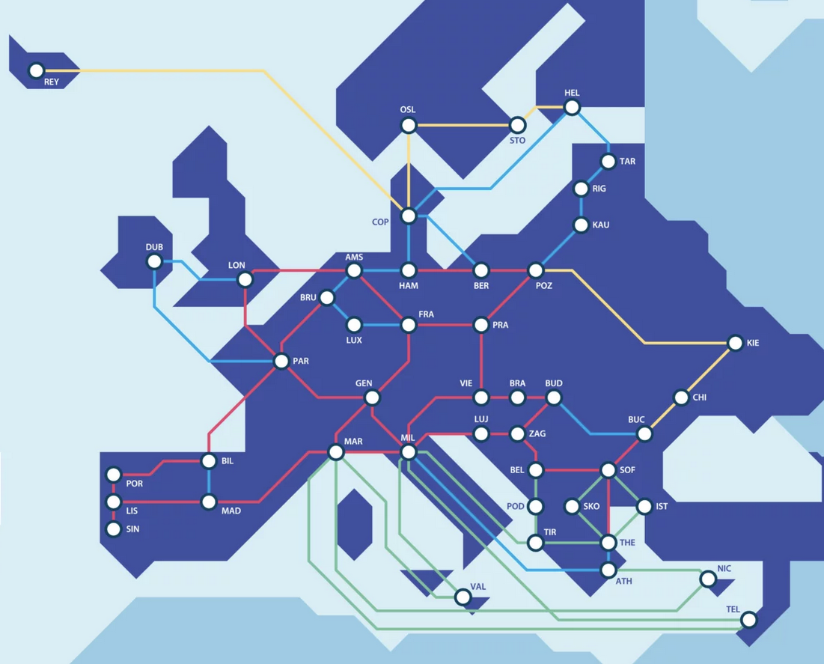
The HCSA – Core Network and Access
Core network
  Based on the the list of P1s – the HCSA is limited to
    GÉANT/NREN connections ( => GÉANT backbone)
    list of connections to IXes and cloud parties
    GÉANT already has 85% of the HCSA required connectivity
  Service expectations
    “High performance / High Capacity”
    We are in a very good position here:
      European-wide footprint
      New router platform in 2025
Access:
  NRENs to deliver “access connections” from P2/P3/P4/P5/P6 to HCSA
    Many sites already connected
    Standard NREN connectivity models supported
    Expectations on service (reporting, incident management,…)

Slide 13
What is required as part of the service
Main elements for Service Management
GÉANT will have to offer a single point of contact for the JU and manage the whole Hyperconnectivity service
Monitoring for performances and SLA management
  Telemetry
  Service Availability
  Performance measurement/testing (PMP)
Incident Management
  Processes
  Ticketing Systems “integration”
Reporting
  Periodic reporting to JU
  Possible Portal
Security Services
  CERT
  DDOS
I will focus on these two elements which are a little more complex for the management of this “multidomain” service

Slide 14
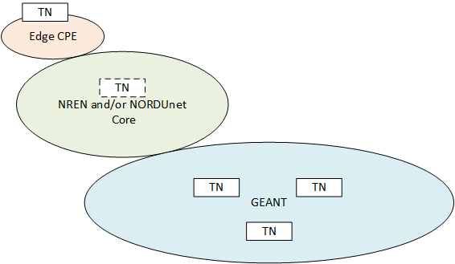
Service testing infrastructure
PM node runs a 400Gbps bandwidth test against NREN reference node.
A set of Testing Nodes will likely be deployed as part of the NREN Edge structure for major sites (ie. HPCs).
Nodes will be present in GÉANT and, optionally, NRENs and/or NORDUnet, to be able to run service validation tests (primarily Bandwidth).
Challenge is that these sites will need to run tests at 80% of the PoI bandwidth which is up to 1.2Tbps for some.

Slide 15

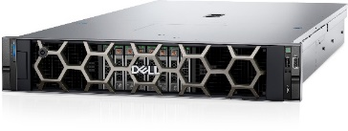
Performance Management Platform - PMP
Build on PerfSONAR as the basis – some 40 sites could need a probe/server
    Delivers RTT, latency (OWAMP), jitter, packet loss and ”link saturation” up to 100G
    Aim to be flexible in how this is delivered (site/NREN/GÉANT can provide)
    Need to have a central database, maintenance of infrastructure; test data captured in:
      GÉANT perfSONAR Measurement Archive // pS-specific database
      GÉANT central InfluxDB // PMP platform database
However, at 80% of 1.2Tbps this is not possible!
Notes:
We are likely all very familiar with perfSONAR over the last 20 years:
open-source network measurement toolkit designed for end-to-end performance monitoring across large, multi-domain research and education (R&E) networks
provides a standardized framework for active and passive network measurements
We will use perfSONAR Measurement Archive, as part of the pS software stack, but also pull perfSONAR test data into our centralised InfluxDB for ease of integration into BRIAN - where we will offer EuroHPC dashboards. All perfSONAR installations will be integrated under our central management as we must manage test and test schedule parameters as part of the EuroHPC requirements.
We will configure a rolling schedule of packet probe (Ping, OWAMP) and throughput tests (iperf3) between all HPC POI perfSONAR boxes and central GEANT boxes. If it’s required, we can also schedule tests running HPC node to HPC node. We will leave sufficient unallocated time in the schedule to allow for on-demand testing.

Slide 16

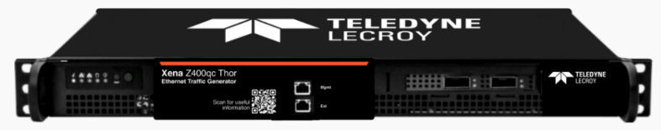
Performance Management Platform – PMP - continues
For very high-capacity sites we need to provide another option for link saturation => dedicated high-capacity test devices n x 100G, n x 400G
    This is not advisable for many reasons, but can be offered
    Intended only to be used (think DMC challenge):
      Infrequently
      Only inside maintenance windows
    Market engagement with Teledyne LeCroy
      Testers would be suitable for this purpose
      GUI, CLI, API functionality is good
      € level requires us to run procurement
But – we are also working to see if we can bring PerfSONAR to test at x400G!
Notes:
Not advisable … but testers must be offered to be compliant with this tender, as it requires “upto 80% throughput” saturation on HPC POI access links. In some cases this is 1.2 Tbps, meaning 960 Gbps of test traffic.
Therefore, as perfSONAR will top out around 200 Gbps for TCP and circa 300-400 Gbps for UDP/RDMA, we will need to deploy higher-capacity devices, too.
Further discussion will be needed between GÉANT, EuroHPC JU, and end-sites themselves, because we GÉANT don’t believe this level of testing is a good idea; it is not warranted in our view. Running 400, 800 Gbps of test traffic could cripple networks, starting at the HPC end-site access link itself.
Pending that discussion, we have made a compliant bid, in which we propose that if these are to be deployed, then the
Realistic use will look like DMC challenge – testing scheduled once per year, highly co-ordinated, maintenance windows and necessary operational steps if required, etc. so that we don’t create a DoS weapon..
Market engagement with Teledyne LeCroy
Their Testers would be suitable for this purpose
The GUI, CLI, and API functionality is comprehensive and intuitive
The level of spend requires us to run procurement, so no guarantee it will be THESE testers in use
XenaCompact as reference, tester spec will be like
1RU chassis
Xena port modules 100G, 400G, 800G as required
fPGAs to generate high traffic volume in terms of bps and pps
Able to craft custom test stream headers and payloads to desired specifications, TCP header, UDP header, PRBS etc.

Slide 17
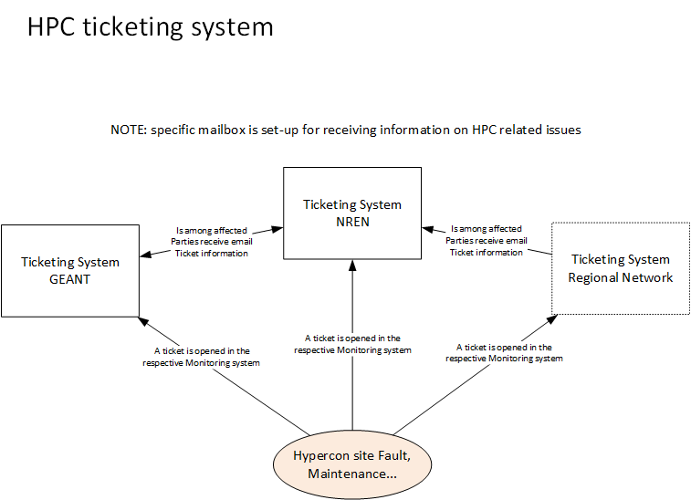
Ticketing System
GEANT will need to be able to have a centralised view of the state of the service – in particular “semi-realtime” awareness of Incidents and Maintenances Impacting PoIs.
NRENs ticketing systems should be configured to list GÉANT HPC address among the “affected parties” for all sites belonging to EuroHPC. This is generally relatively simple.

Slide 18
A possible timeline
We can expect tender results in the next 2/3 weeks
Signature – depending on processing time, could be up to Oct 2025
Tender requires HCSA within 6-months of ordering (at signature expected)
PoIs will be onboarded during a period of about 18-24months from start
  PoI onboarding requires a relatively complex process as the sites have to accept being connected first (for P3/4 as the JU does not own or control these sites)
  Not all PoIs are expected to join
  Exact onboarding Process for PoIs will be defined by GÉANT and approved by the JU
Full run until Month 48
Cannot go into lot more details as there is a submitted bid for the tender and result is not yet available.

Slide 19

Thank You
Any questions?
Sebastiano.Buscaglione@geant.org
www.geant.org
© GÉANT Association
As part of the GÉANT 2020 Framework Partnership Agreement (FPA), the project receives funding from the European Union's Horizon 2020 research and innovation programme under Grant Agreement No. 856726 (GN4-3).

