Slide 1


SIG-NOC – Procurement
Procurement of optical- and network equipment
Olaf Verschoor
GÉANT Head of Procurement

Slide 2
Procuring Network equipment
Procuring Network is just like a ‘regular’ procurement, but…
  There are a limited number of manufacturers available
  OEMs or resellers are not always interested to sell
  Support / maintenance might be single source
  Install base
  End-of-life / Exit strategy
  Monitoring- and other tools
  Knowledge
  Are we really willing to look at alternatives?

Slide 3
Invest in tender preparation
  Understand your position in the market
  Talk to the market
  ‘Sell your procurement’
Tender
  Specification, find the right balance
  Vendor lock in
  Exit strategty
Do’s and Don’ts

Slide 4
Steps in the Procurement process
1
Procurement preparation
2
Specifying
3
Selecting
4
Contracting
5
Ordering
6
Delivery, use
and admin
7
Aftercare
Strategic
Procurement
Tactical Procurement
Operational Procurement

Slide 5
Steps in the Procurement process
Here you have the biggest influence
1
Procurement preparation
2
Specifying
3
Selecting
4
Contracting
5
Ordering
6
Delivery, use
and admin
7
Aftercare

Slide 6
Invest in tender preparation
Market engagement
  Market research
  Market consultation

Slide 7









Market research
Who is the child in the candystore?
S
U
P
P
L
I
E
R
N
R
E
N

Slide 8
High
LEVERAGE ITEMS Exploitation of full purchasing power Targted pricing strategies / negotiations Alternatives available Strategy -> competiton | STRATEGIC ITEMS Develop long term relations Collaboration and innovation Scarity (not many alternatives) Strategy -> cooperation
NON CRITICAL ITEMS Product standardisation Process effciency (catalogue, automization) Alternatives available Strategy –> reduce suppliers / process simplification | BOTTLENECK ITEMS Low control of suppliers Targted pricing strategies / negotiations Alternatives available Strategy –> secure delivery / develop alternatives
Financial impact
Low
High
Kraljic matrix
Supply risk

Slide 9
Invest in tender preparation
Market engagement
  Market research
  Market consultation
Information gathering
  Internal expertise
  External sources (industry association, fairs, desk research)
  (N)REN Community

Slide 10
Tender
Specification, finding the right balance

Slide 11
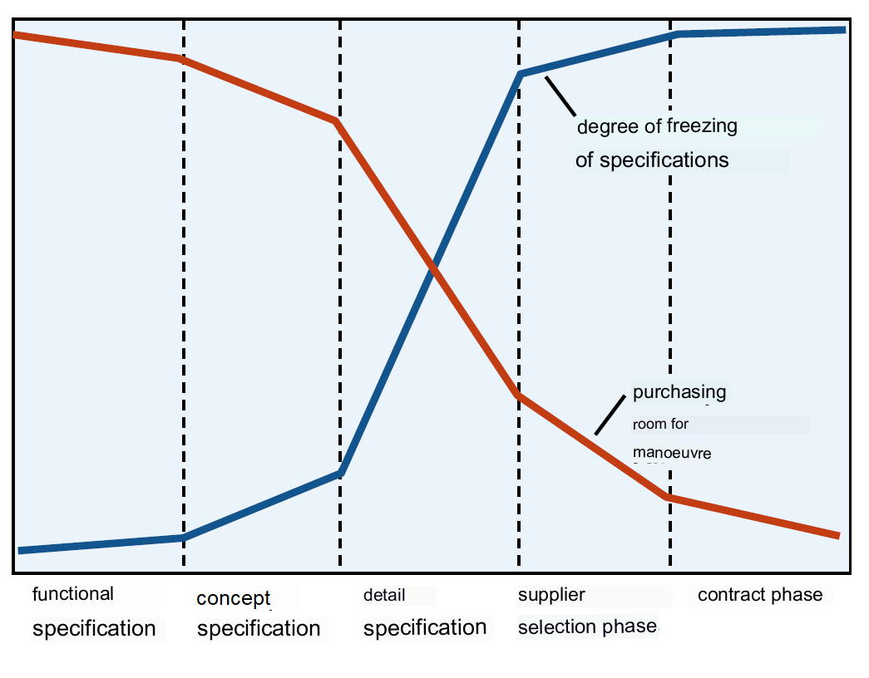
Specifications
The purchasing maneuvering room becomes smaller as the specifications are more explicitly defined.

Slide 12
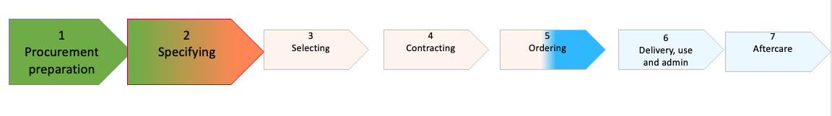
Tender
Specification, finding the right balance
Vendor lock in
  What is causing the vendor lock in?
  Open standards
  Multiple source
Add requirements for:
  Supporting 3rd part equipment
  Exit strategy / co-operation with other vendors
  Add wording that these clauses remain valid after contract ending

Slide 13
Do’s and Don’ts
Do
Know your market / targeted suppliers
Make yourself attractive
Where possible use open standards and solutions supported by more vendors
Adopt a dual source strategy when possible
Keep a critical eye on your own decisions
Use the NREN Community
  GÉANT Optical Framework
  CIENA, Ribbon, Infinera, NOKIA
Do not
Create your own vendor lock in situation
Be blinded by ‘nice to have’ features
Assume there are no other options available to you
Limit competition
Do not over complicate requirements and contractual terms

Slide 14
SIG-NOC
April 2, 2025
Garvan McFeeley
Brokerage Services
Manager

Slide 15
Themes
HEAnet’s approach
HEAnet optical procurement
HEAnet network equipment procurement
Market engagement

Slide 16

HEAnet’s approach
Early market engagement is key
Aggregation is a good thing
Clients may wish to use similar equipment
A framework is usually more useful
  Even if single supplier
  No hard-hard commitment

Slide 17

Optical procurement
Single supplier framework for >4 years
Equipment may have a 10+ year lifespan
Think about the future…
Think about product launch date
Think about product end of life
Think about support end of life
Provisioning?
Scope in Universities?

Slide 18
Network equipment procurement
Single supplier framework for >4 years
Equipment may have a 10+ year lifespan
Think about the future…
Think about product launch date
Think about product end of life
Think about support end of life
Provisioning
API’s available
Integration into monitoring/SIEM/log
Scope in Universities

Slide 19
Market engagement sessions
One hour maximum
Meet every platform you know about
No demos
Have your list of wishes ready
Give them homework
Spend extra time in preparing your tender documents

Slide 20
Summary
Market engagement is essential
Does what you want exist?
How wet is the paint?
Do not rush or be rushed
A good think is key!
Unknown or unexpected suppliers will bid

Slide 21
THANK YOU

