Slide 1


Next Steps for NREN Crisis Management
Charlie van Genuchten
Senior Product Manager Security, SURF
Public

Slide 2
The Role of CLAW
CLAW Crisis Management Exercise
Role Playing Fictional Crisis Exercise
Mixed NREN groups / roles
Not testing your plans

Slide 3
Business Continuity for NRENs
CEO Forum Scenarios
Broken Transatlantic Data Lines
Zero-day Cyber-attack on ESA
Exit GÉANT

Slide 4
Exercising the CEOs
To develop experience and guidance for the NREN CEOs on how to deal with an extreme and possibly disruptive crisis scenario that hits multiple NRENs at the same time
To use the good ideas and insights, generated by the CEOs during the exercise, to further improve crisis preparedness of the NREN community

Slide 5
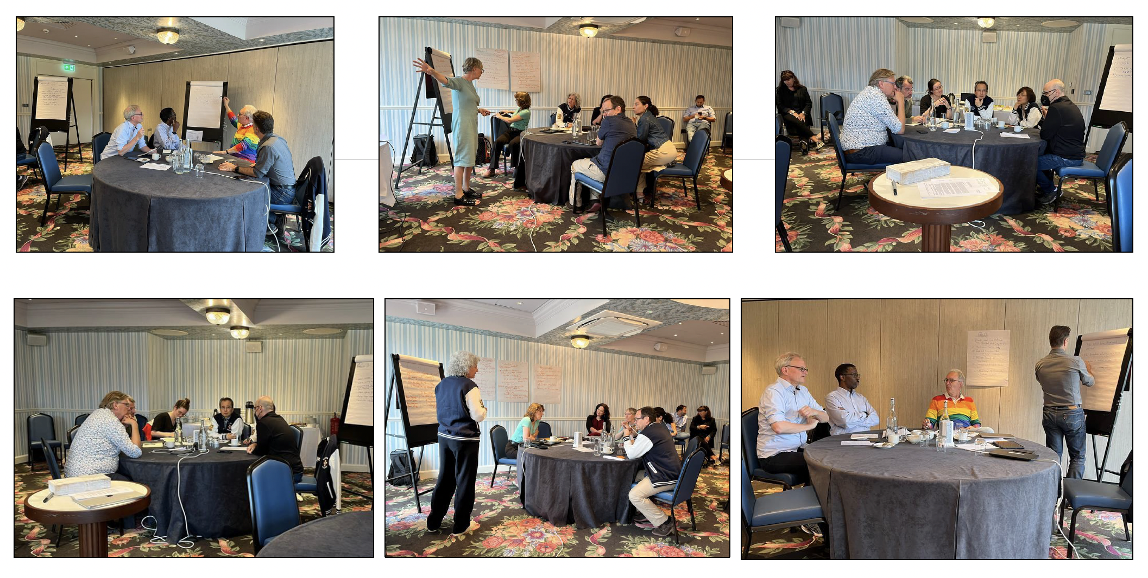
CEOs at Work – “Do I have your phone number?”

Slide 6
Introducing: European Crisis Management Exercise
Testing NREN plans / procedures directly
Testing communications with other NRENs (and ourselves!)
Awareness raising
Where are our gaps?
Do we have a shared language?

Slide 7
Timeline
First draft scenario May 21
Registration deadline – End of September
First working session with exercise leaders – December
Second working session with exercise leaders – January
TALON exercise – March 2026

Slide 8
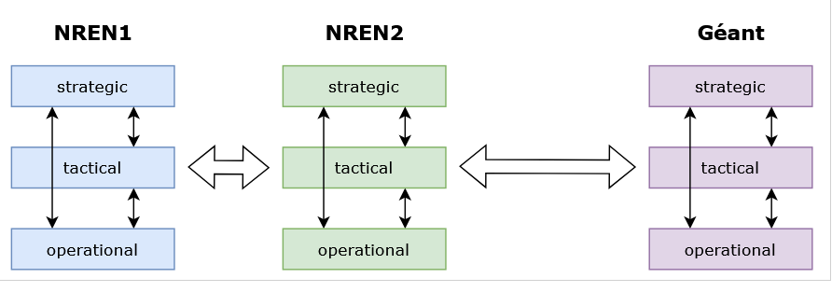
How this will work
(example with 2 NRENs and GÉANT as participants)

Slide 9
How can you help?
March 2026
Looking for up to 10 NRENs to take part
You will play as your own team in your NREN
Exercise leaders from NRENs to work with core team
What is a good scenario to test?

Slide 10

Scenario brainstorm

Slide 11
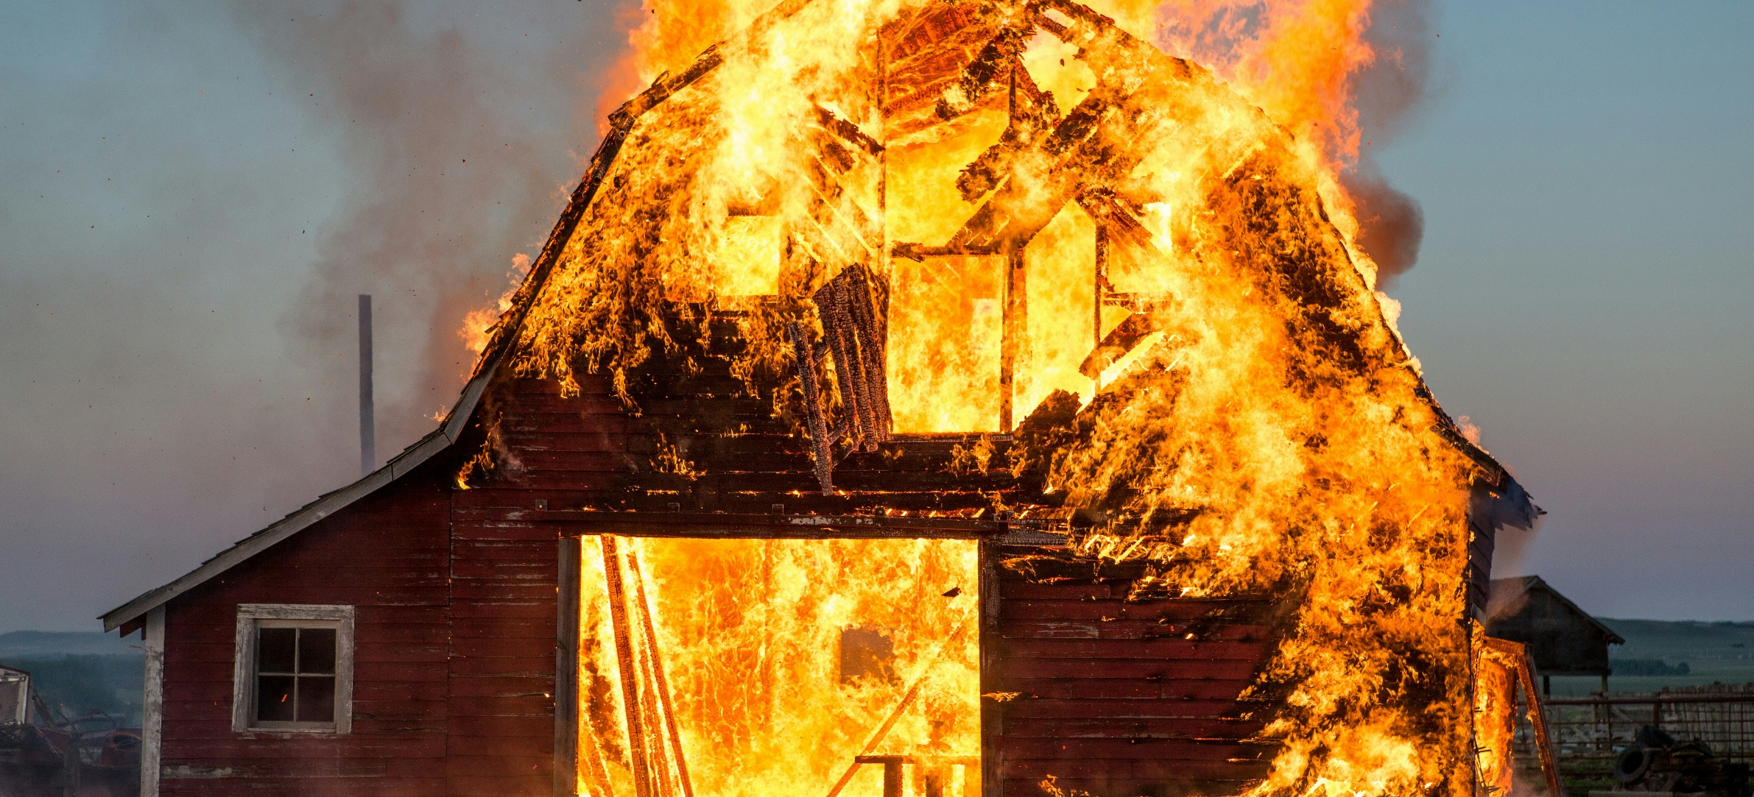
What should we test?

Slide 12
Infoshares
April 23, 15:00-16:00 CEST, register at https://events.geant.org/event/1869/
May 23, 10:00-11:00 CEST, register at https://events.geant.org/event/1870/

Slide 13

Thank You
Any questions?
www.geant.org
© GÉANT Association
As part of the GÉANT 2020 Framework Partnership Agreement (FPA), the project receives funding from the European Union's Horizon 2020 research and innovation programme under Grant Agreement No. 856726 (GN4-3).

