Slide 1
Follow the Flow with Flowmon
Proactive Threat Detection and Traffic Monitoring for NRENs

Slide 2
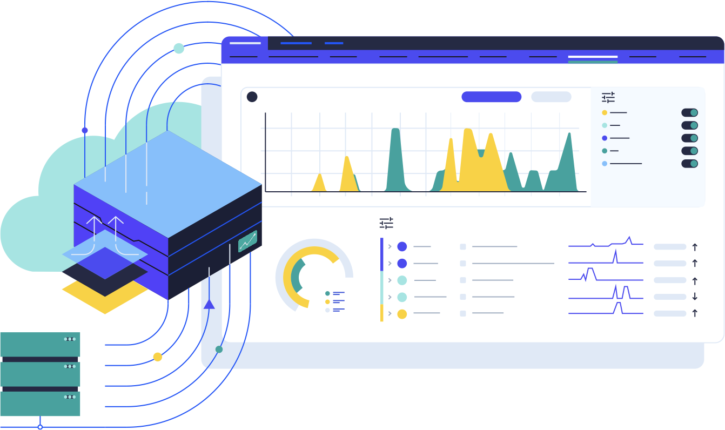
Flowmon Vision
Create a secure and transparent digital environment where people rule the network regardless of its complexity.
Flowmon is primary designed for Network and Security engineers to bring the visibility into the ”blind” networks and let simplify their network troubleshooting routines.

Slide 3
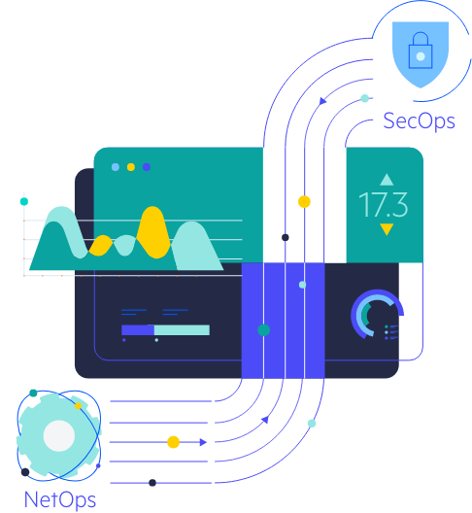

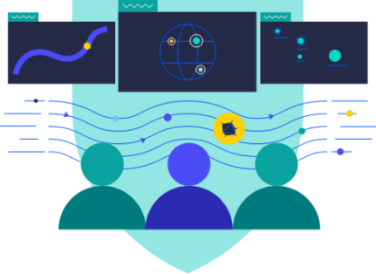
Common Goals. One Solution.
Industry’s Fastest Time-To-Value
Network Operations
Security Operations
End-User Experience Monitoring
Troubleshooting & Forensics
Forecasting & Planning
Cloud/SaaS Performance
Unknown Threat Detection
Encrypted Traffic Analysis
Detection of Insider Threats
Network Behavior Analysis
Infrastructure Design & Deployment​
Incident Monitoring & Investigation
Incident Response​
Policy Verification and Enforcement​

Slide 4





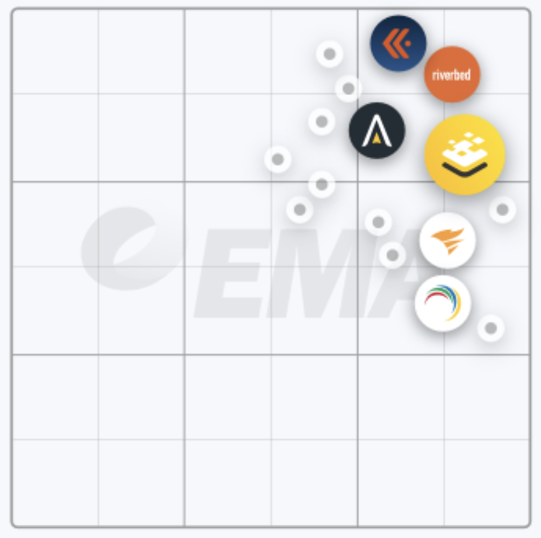

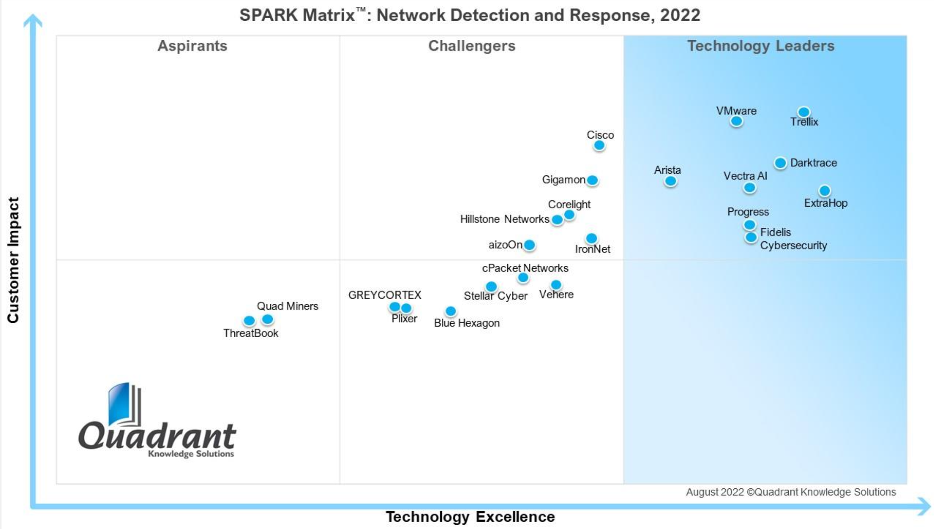
Recognized Value & Technology Leader
ÇÇ
ÇÇ
ÇÇ
ÇÇ
Recognized since 2010, listed in NDR and NPMD Market guides
Flowmon named a value leader for
NPM​​
The Network Traffic and Visibility Landscape
Flowmon recognized as Technology Leader for NDR

Slide 5

The Geant Story
Original use case – ADS/DDoS currently only ADS
Geant to provide anomaly detection for other NRENs
Now Geant only monitors their own DC
- High Sampling Refresh Rates – circa 60 flow/sec
Currently Monitoring data center traffic
Flowmon used to enhance & forward the flow data to other tooling

Slide 6
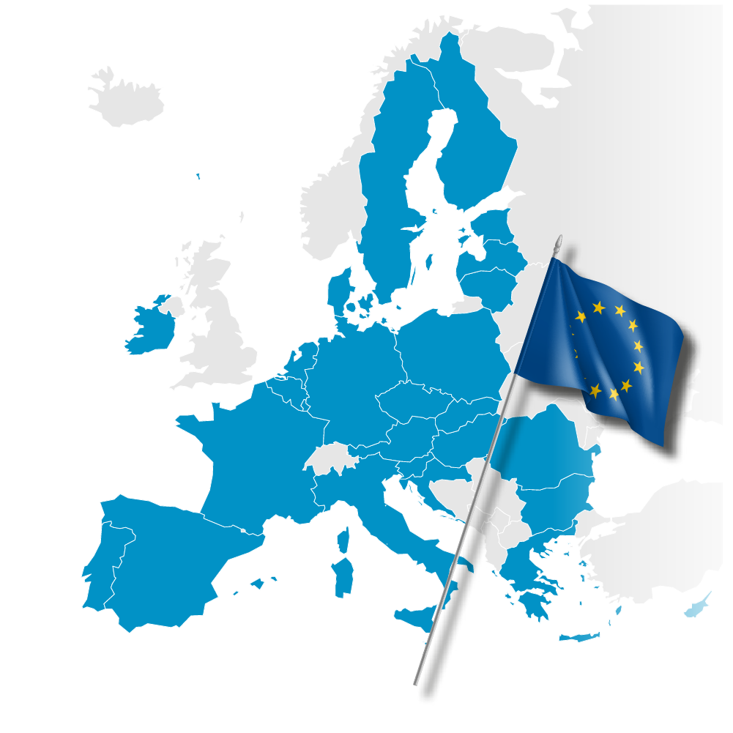
How Flowmon Helps You Comply
Important articles of EU NIS 2 Directive
Essential and Important Entities (OES/OiS)
Article 21 (2b) incident handling
Article 21 (2d) supply chain security
Article 21 (2e) security in network and vulnerability disclosure
Article 21 (2h) appropriate encryption
Article 23 (4d) incident reporting (ii) the type of threat or root cause that is likely to have triggered the incident
Cyber Security Incident Response Team (CSIRT)
Article 11 (3a) essential and important entities concerned regarding real-time or near real-time monitoring of their network and information systems
Article 11 (3d) collecting and analysing forensic data and providing dynamic risk and incident analysis and situational awareness regarding cybersecurity

Slide 7




SOC & CSIRT
Flowmon Intelligence Principles
Threat Detection
Threat Hunting
Machine Learning
Adaptive Baselining
Heuristics
Behaviour Patterns
Threat Intelligence
Individual
Algorithms
Detection
Methods
Incident Response
200+
Digital Forensics
40+
Threat and Anomaly Alerts
Event Evidence and Analyses
NetSecOps
Observability
Hybrid Cloud Monitoring
Encrypted Traffic Analysis
Long term data collection, archiving, visualization & interpretation
Root Cause Analysis
Performance Monitoring

Slide 8



Success Story 1
When Defense Wins

Slide 9

Public Sector: Real Customer Scenario
A server in DMZ running a specific proprietary application was compromised and the attacker gained control over the device.
From the initial position, the attacker tried to pivot over the network, move laterally and compromise as many devices as possible, leaving a footprint in the network.
DMZ

Slide 10
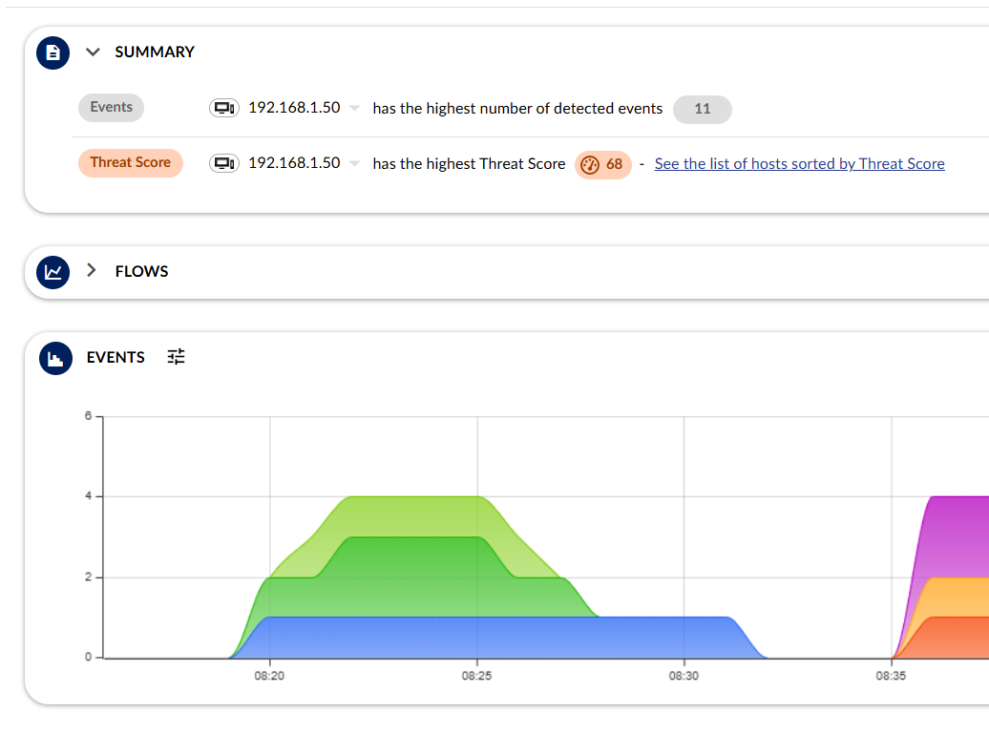
When Detection Works!
<1 hour
Threat mitigated, evidence collected, incident reported
0+45 mins
AI-powered assisted analysis
0+31 mins
Attack against Secure Shell (SSH)
0+3 mins
ICMP scanning
Time 0
Server in DMZ breached
ARP scanning

Slide 11
Success Story 2
Second-largest public university in the Czech Republic

Slide 12
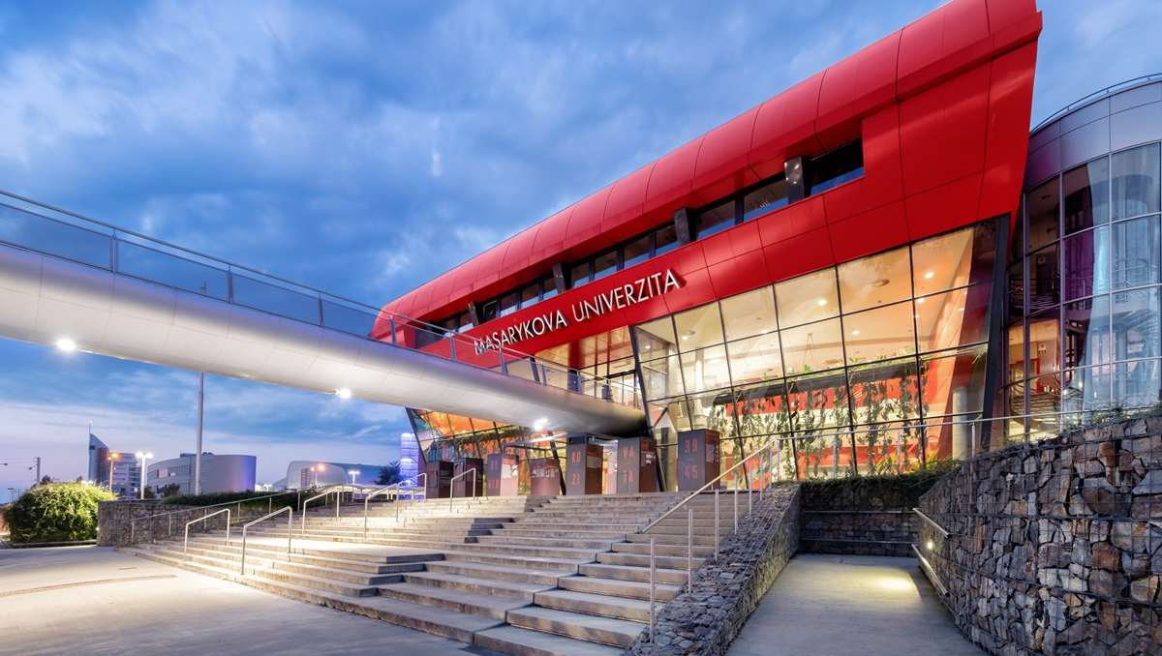



Full case study link

Slide 13

The Challenge
The need for network visibility, security assurance and incident handling capability
  5000+ employees
  40 000+ students
  15 000+ computers
  Dozens of locations
  Hundreds of servers
  2x10Gbps connectivity
  10Gbps university backbone

Slide 14
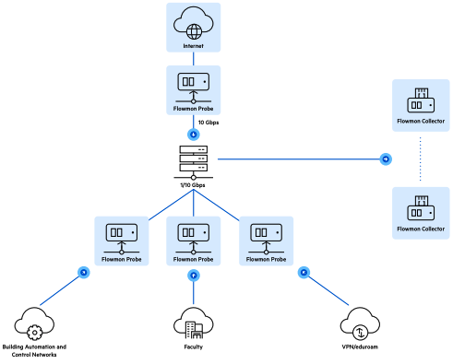
CSIRT-MU team operates
25 Flowmon Probes to assure
monitoring of all critical points
in university network

Slide 15

The Result
Outstanding network visibility and reporting
Automatic detection of security issues and policy violations
Automation of CSIRT processes and tasks
Utilization of Flowmon in research projects and education

Slide 16

Although we love to create new security monitoring tools, we also need a reliable cornerstone of the monitoring infrastructure for a routine operation of a university CSIRT. Furthermore, we welcome professional support that comes with Flowmon solution. It allows us to focus on the core of our business.“
Jan Vykopal
CSIRT (Computer Security Incident Response Team) Team Leader

Slide 17
Success Story 3
Ransomware Detection
Step by Step

Slide 18
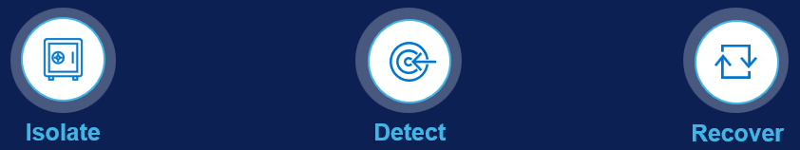
Network Layer Defense
5-30 days
1-5 days
30-180+ days
5-10 days
1 day
1 day
Ransomware Attack Stages
Discovery
Credential Access
Lateral Movement
Collection
Exfiltration
Impact
Attacker searches for vulnerabilities in the target system, network, or user to exploit them
Attacker gains access to user credentials to escalate its privileges and access sensitive information.
Attacker spreads to other systems or devices on the network, using the compromised credentials.
Attacker identifies and gathers valuable data or resources from the compromised systems.
Attacker sends the stolen data to a remote server or command and control center outside the victim’s organization.
In the final stage attacker encrypts sensitive data and demands ransom payment to restore access.
Detect a ransomware attack at every stage -- powered by Progress Flowmon
Data Layer Defense
Ransomware Defender
Notes:
Speaker Notes:
Lets look at the stages of a Ransomware attack according to the MITRE Att&ck Framework, and what offering Dell has in terms of detecting and alerting for any unusual behaviour as soon as it happens. Long before the bad actor is even close to accessing the data (Superna Ransomware Defender will kick-in when data is being accessed). And long before the bad actor has gained access to the network.
Discovery Stage -- At the start of the ransomware attack, attackers scan the network to determine where the critical data is located.
Credential Access Stage -- They find weak passwords, non-secured services or vulnerable devices and attempt to exploit them.
Lateral Movement Stage -- Once they gain access, they continue to move through the network laterally and install software that will create various types of backdoors, allow them to remotely control devices or track what users are doing including capturing various credentials in use. This is nothing but preparation for the next step which is to access valuable company data on the storage devices.
Collection and Exfiltration Stage -- After gaining access to the data, the attacker will split the data into smaller chunks and will exfiltrate the data to themselves through the network. Superna Ransomware Defender will kick-in not earlier than this stage of an attack by looking for patterns of data access that are indicative of compromise.
Impact Stage -- Finally, all the files on the compromised systems will become encrypted, whilst displaying a message from the perpetrators with their demands and timeframe for resolution. The only way to release this lock is to pay the ransom or hope that you have a restoration point that can revert the data back to its pre-encrypted uncompromised state without any loss.
The initial stages of an attack take on average of 277 days to identify a breach (according to “Cost of Data Breach Report 2022”). Imagine leaving a bad actor in your network and letting him have the freedom to do whatever he wants unnoticed for 277 days. The damage can be of any magnitude. The further a cybercriminal gets along the chain, the more difficult, and expensive it is to defeat them.
On the slide shown, the number of days above each Stage define on average how long each of the Stages take place. You can see that by the time the bad actor has reached the Collection phase, after that time really flies fast and there is little left to manage the damage.
Dell has an offering, called Progress Flowmon, that can detect a bad actor in any of the stages of a Ransomware attack. Including detection of Zero-Day attacks. This happens at the network layer, long before the thread actor is even close to accessing the data. With this proactive approach the bad actor will not get to the Collection and Exfiltration Stages. And also, you will not reactively try to protect and recover data.
The way it works:
1. Progress Flowmon will detect a bad actor and will trigger an alert to Superna Ransomware Defender to take action and protect the data.
2. Or if you have no Superna Ransomware Defender, Progress Flowmon will trigger an alert to an API driven environment- included solutions such as ECS and PowerScale, where the API may be enabled to allow instructions from 3rd party solutions to be triggered. And then a snapshot will be made.
3. Progress Flowmon can also trigger an alert to any other similar solution you have.
If you don’t have neither Progress Flowmon, nor Superna Ransomware Defender, our advise is to start with Progress Flowmon, as it offers much more proactive approach, and little to no risk the data to be encrypted or exfiltrated. It also gives you full visibility on any cyber security risks happening in the whole network, not only related to the Storage.

Slide 19





Ransomware Detection & Response
Inspired by a real customer case
Full scenario replicated in lab environment
All network activity recorded and made available for education purposes
Actors:
Compromised device (192.168.1.50)
Samba server (192.168.1.2)
RDP server (192.168.1.3)
Objectives:
Exfiltrate sensitive customer data
Encrypt the data and ask for ransom
Port Mirror
Flowmon
Samba Server
192.168. 1.2
RDP Server
192.168. 1.3
Compromised Device
192.168. 1.50

Slide 20
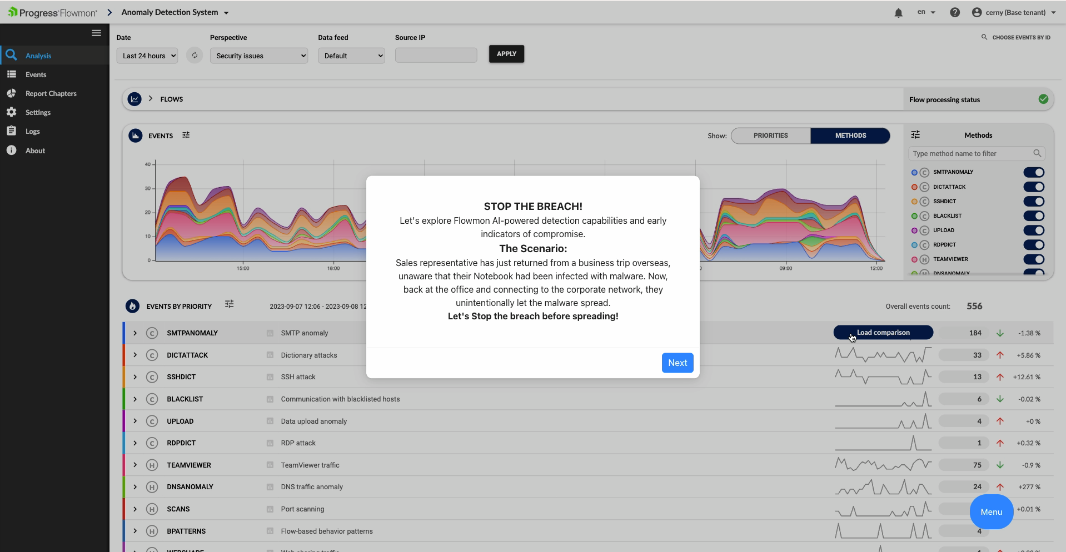

Slide 21

Get a 20-Minute Demo
Product demonstration with our expert engineer
Sizing and understanding your IT environment to provide the best value
Try Flowmon Free
Support with sizing, deployment, installation and configuration
See actionable intelligence in 30 mins
Notes:
WHAT IS NEXT?
Schedule a Personalized Demonstration: Join us for a 20-minute personalized demonstration where our expert engineers will showcase the power and capabilities of Flowmon. This demonstration will not only provide you with first-hand insights into our solution but also allow us to better understand your unique environment. By sizing and understanding your environment, we can tailor our solution to provide you with the best value and address your specific cybersecurity needs effectively.
Get a Free Flowmon Trial: Alternatively, you can opt for our Free Flowmon Trial, where we offer full support with sizing, deployment, installation and configuration. Within just 30 minutes, you'll gain access to actionable intelligence and experience the tangible benefits of Flowmon first-hand. Our team will be with you every step of the way, facilitating a seamless trial experience and helping you unlock the full potential of Flowmon for your organization.

Slide 22
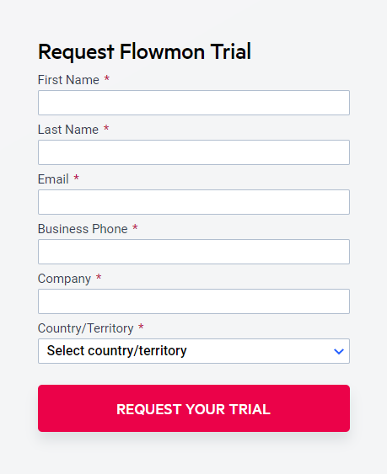
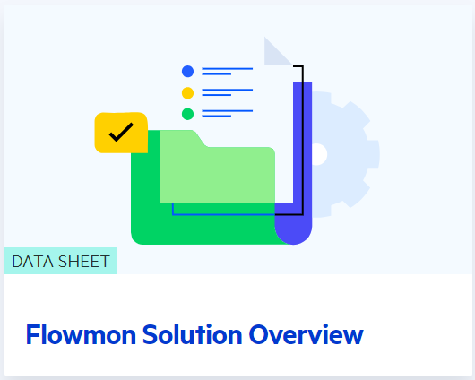





Resources
ÇÇ
Free Trial
Datasheets
Case Studies
Trust Center

Slide 23

Let’s Check Back for Questions…….

