Slide 1
Task Force Educational Activities and Services
Gyöngyi Horváth (GÉANT)
Erik Kikkenborg (NORDUnet)

Slide 2
TF-EDU background
Established 2019 January
Mailing list subscribers: 293
Steering Committee:
Erik Kikkenborg (NORDUnet)
Dragana Kupres (CARNET)
Evelien Renders (SURF)
Vegard Moen (Sikt)
Tomi Dolenc (ARNES)
Gill Ferrell (EUNIS / 1EdTech)

Slide 3
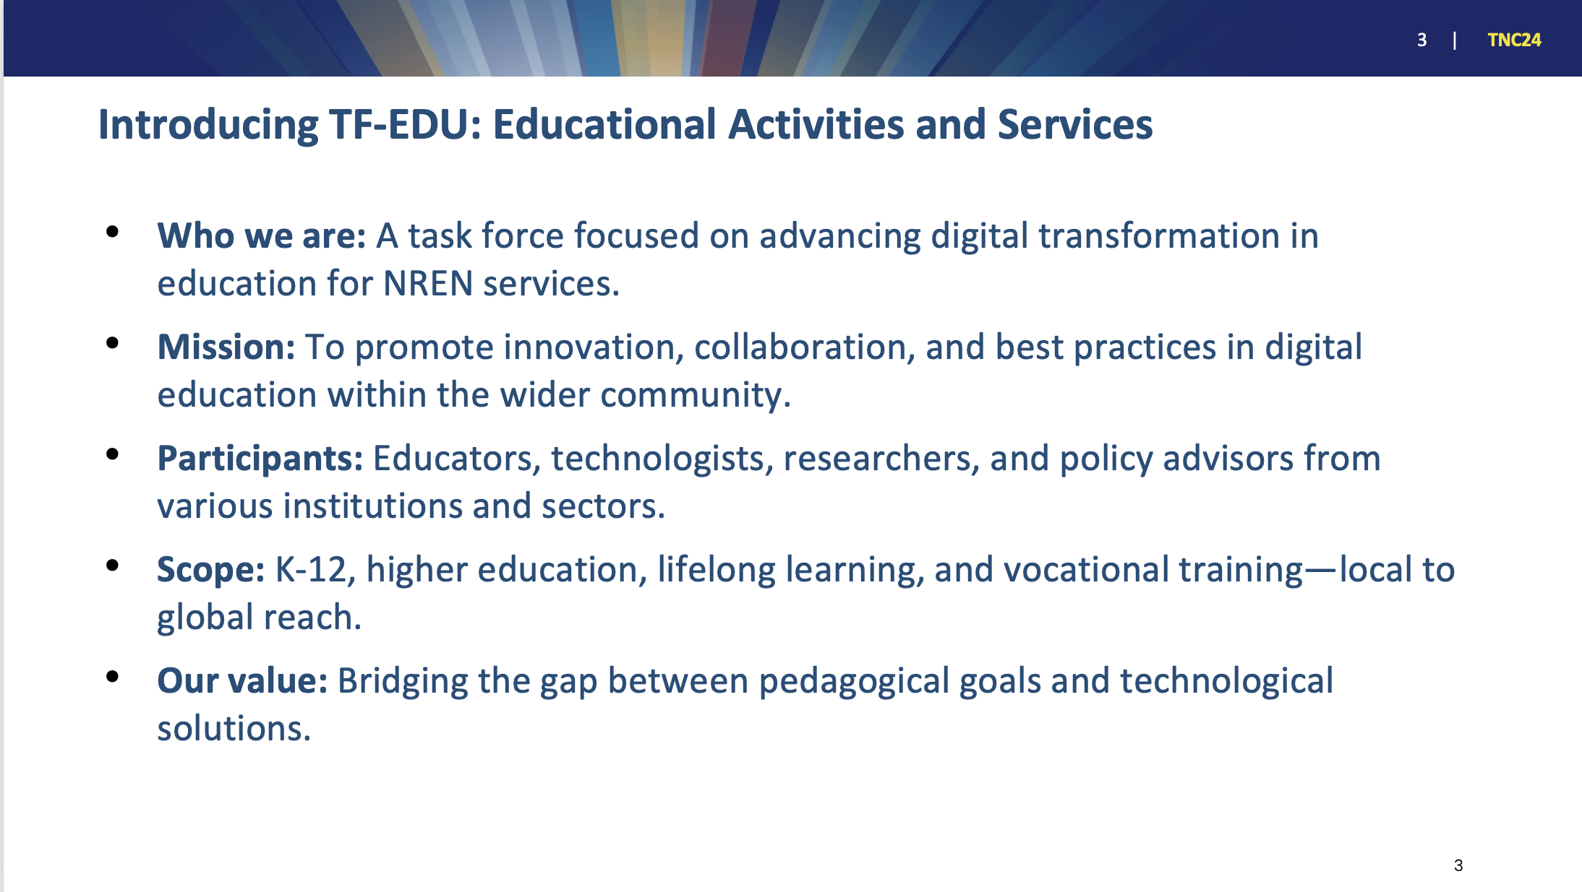

Slide 4
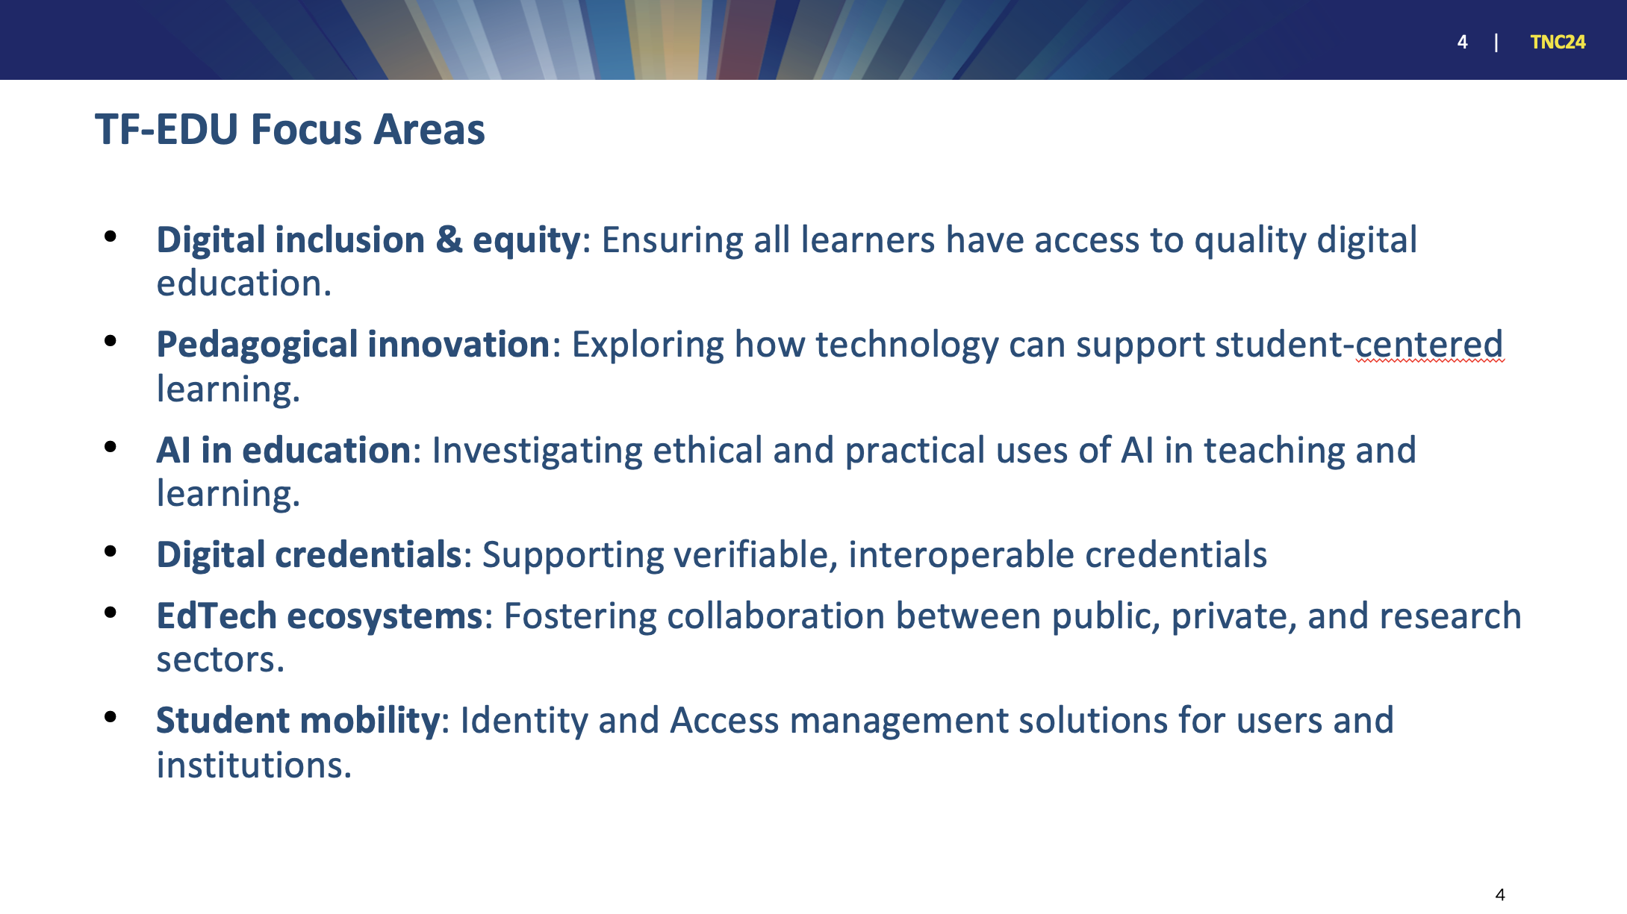

Slide 5
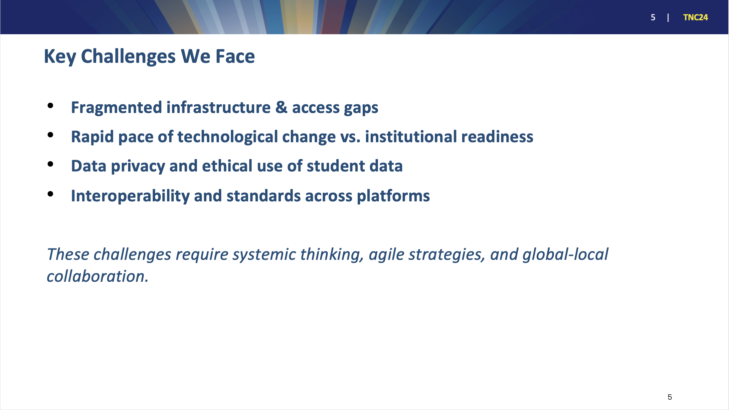

Slide 6
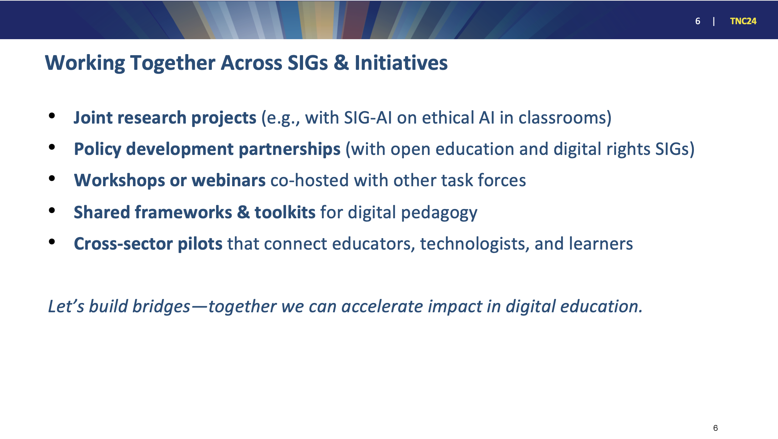

Slide 7
Thank you!
Gyöngyi Horváth (GÉANT)
Erik Kikkenborg (NORDUnet)

Slide 8
Special Interest Group - Procurement
SIG-Procurement Coordinator:
Badreddine Ajbar el Gueriri
SIG-Procurement Steering Committee member:
Monique Pellinkhof

Slide 9
In a Nutshell
“To provide collaboration to exchange experiences, ideas and knowledge on the field of procurement, with a particular focus on developments in the R&E community; This will be achieved through group meetings (online and face-to-face), the use of online collaborative tools, collating and dissemination of information or organizing pilot projects.”
Steering Committee:
John Shaile (Jisc) (Chair)
Ellena Papageorgiou (Surf)
Monique Pellinkhof (GEANT)
Stefan Arnet (Switch)
Tim De Raes (Belnet)
Coordinator:
Badreddine Ajbar el Gueriri (GEANT)
Previous meeting topics:
Kick-off
Big Tech
Artificial Intelligence
Upcoming meeting topic:
Sustainable procurement (at TNC25 Brighton)

Slide 10
Challenges:
Meeting logistics
Less representation from certain NRENs
For the future
Getting group pictures of the participants
Opportunities:
Overlapping topics
Getting group pictures of the participants

Slide 11
Special Interest Group on Cloud Interoperable Software Stacks
(SIG-CISS)
Mario Reale
Senior Research Engagement Officer – GÈANT
Prague, May 14-15, 2025
Public (PUB)

Slide 12
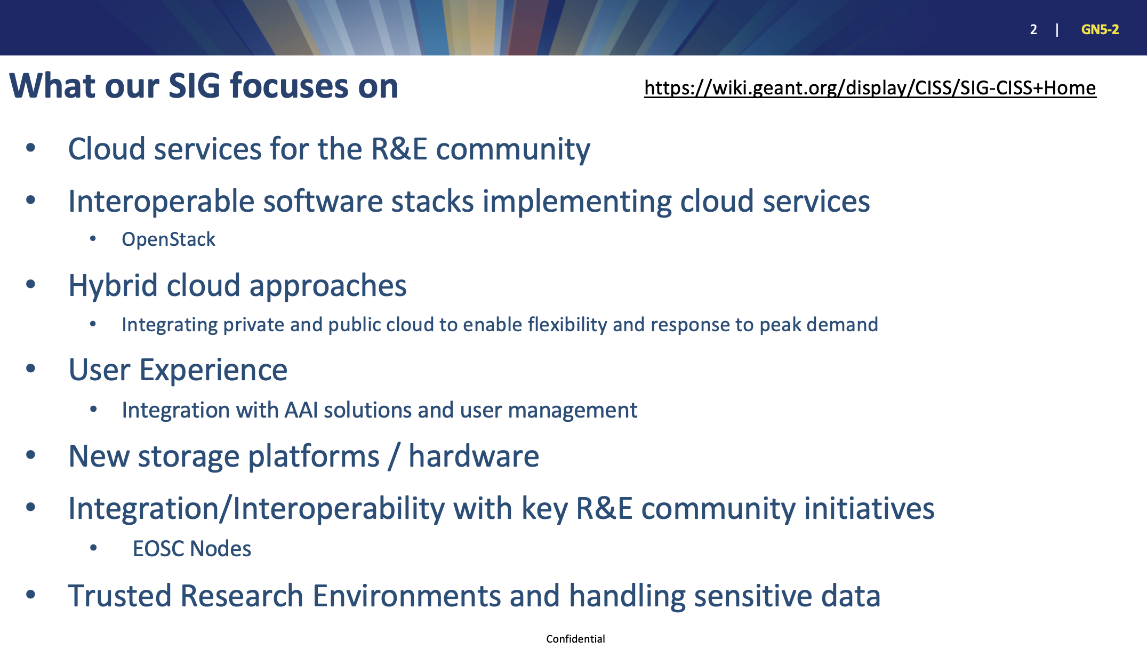

Slide 13
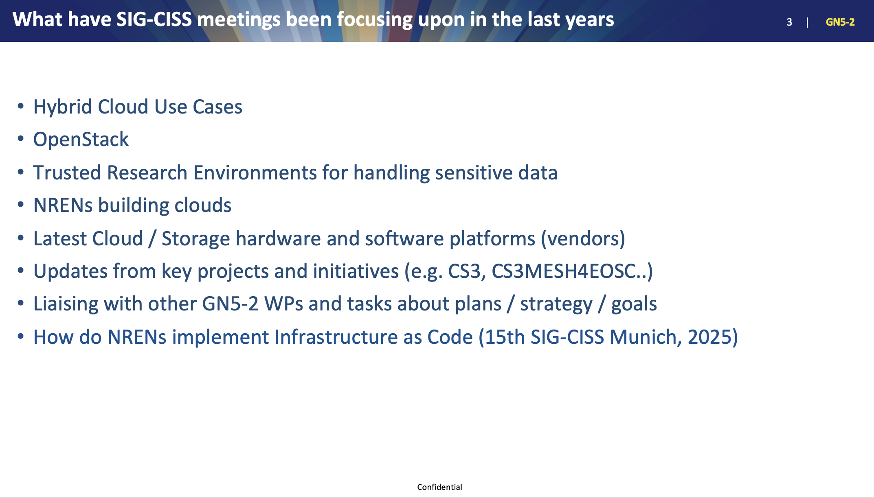

Slide 14
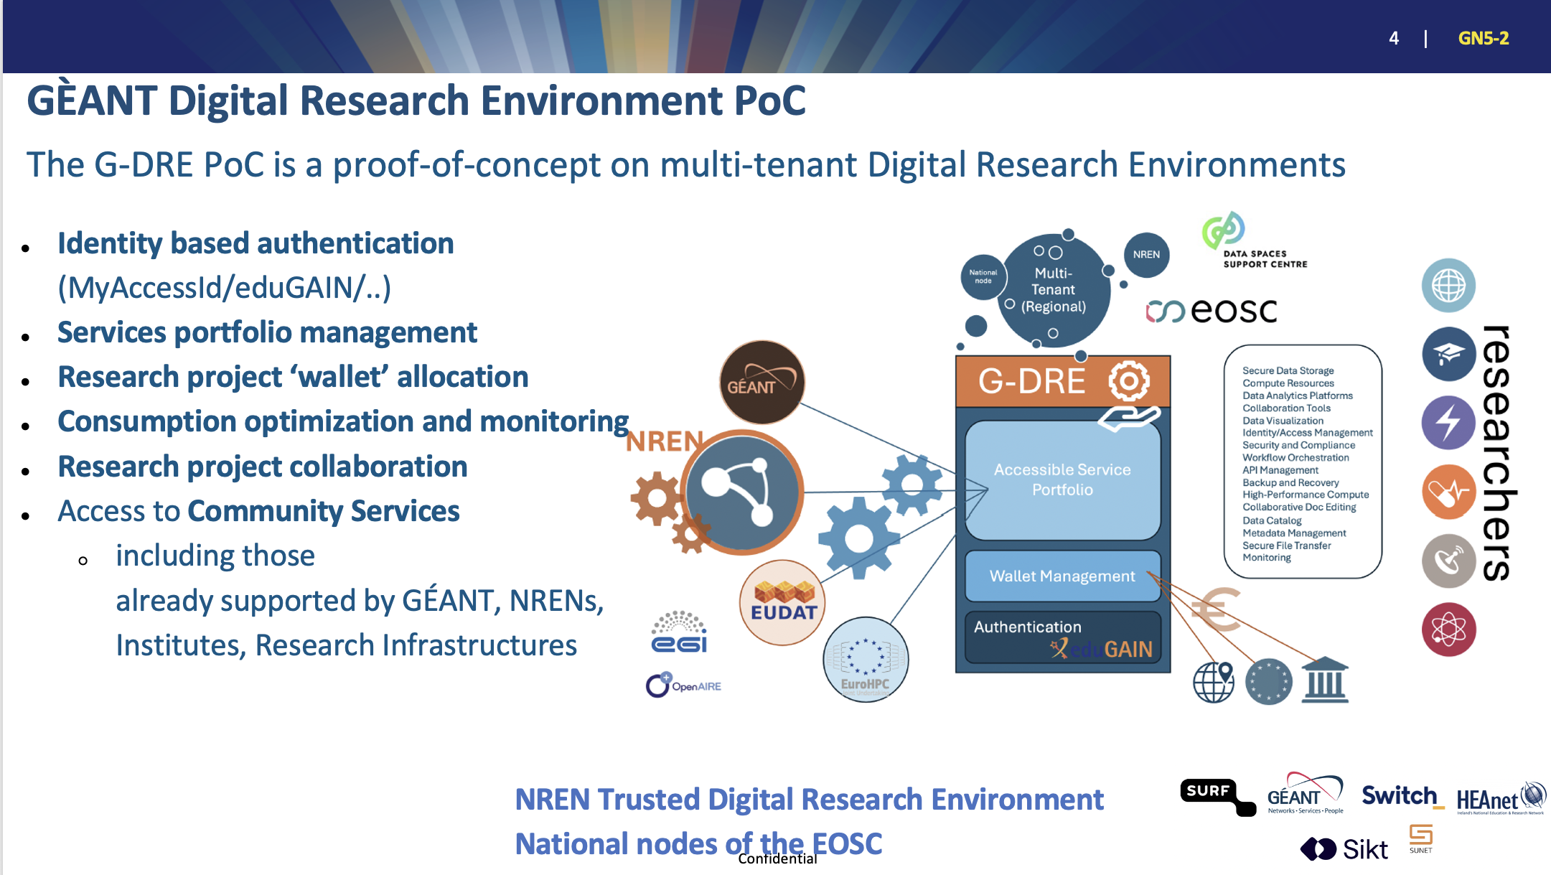

Slide 15
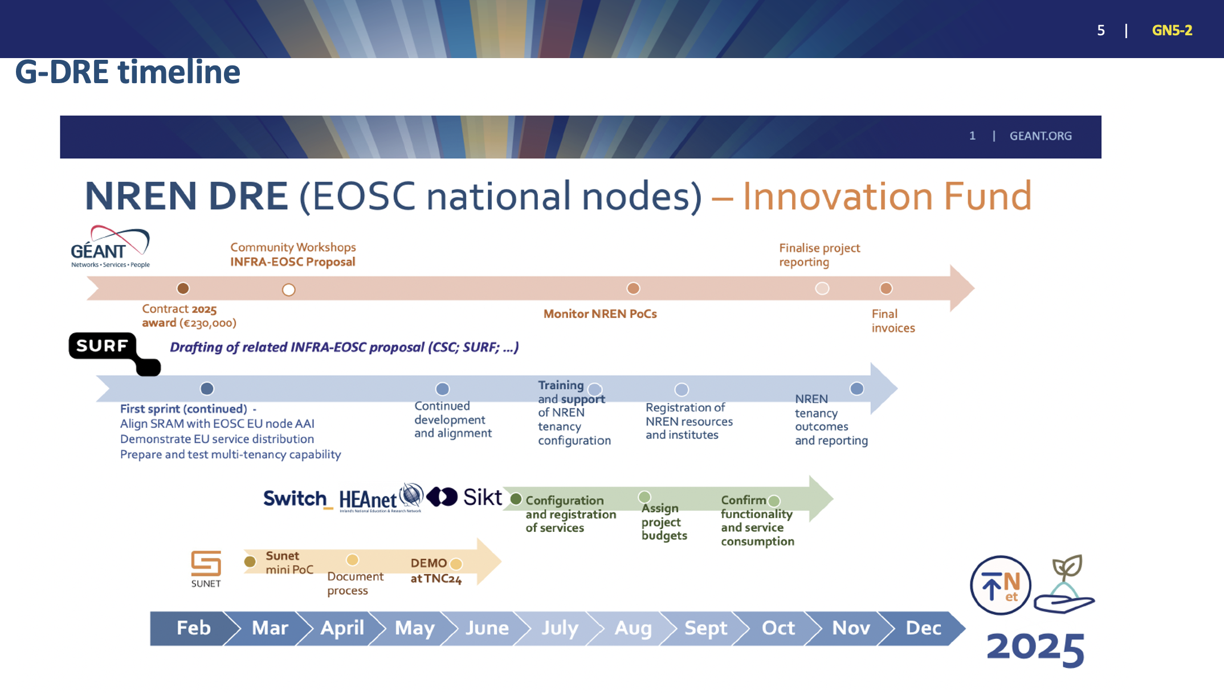

Slide 16
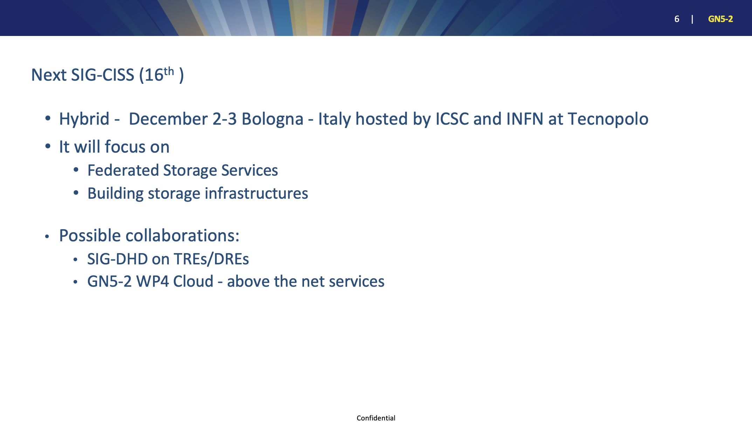

Slide 17
sig-ciss@lists.geant.org
Thank You

Slide 18
GÈANT Special Interest Group on Digital Health Data
Mario Reale
Senior Research Engagement Officer GÈANT
SIG-DHD coordinator
May 14-15, 2025
Prague
Public (PU)

Slide 19
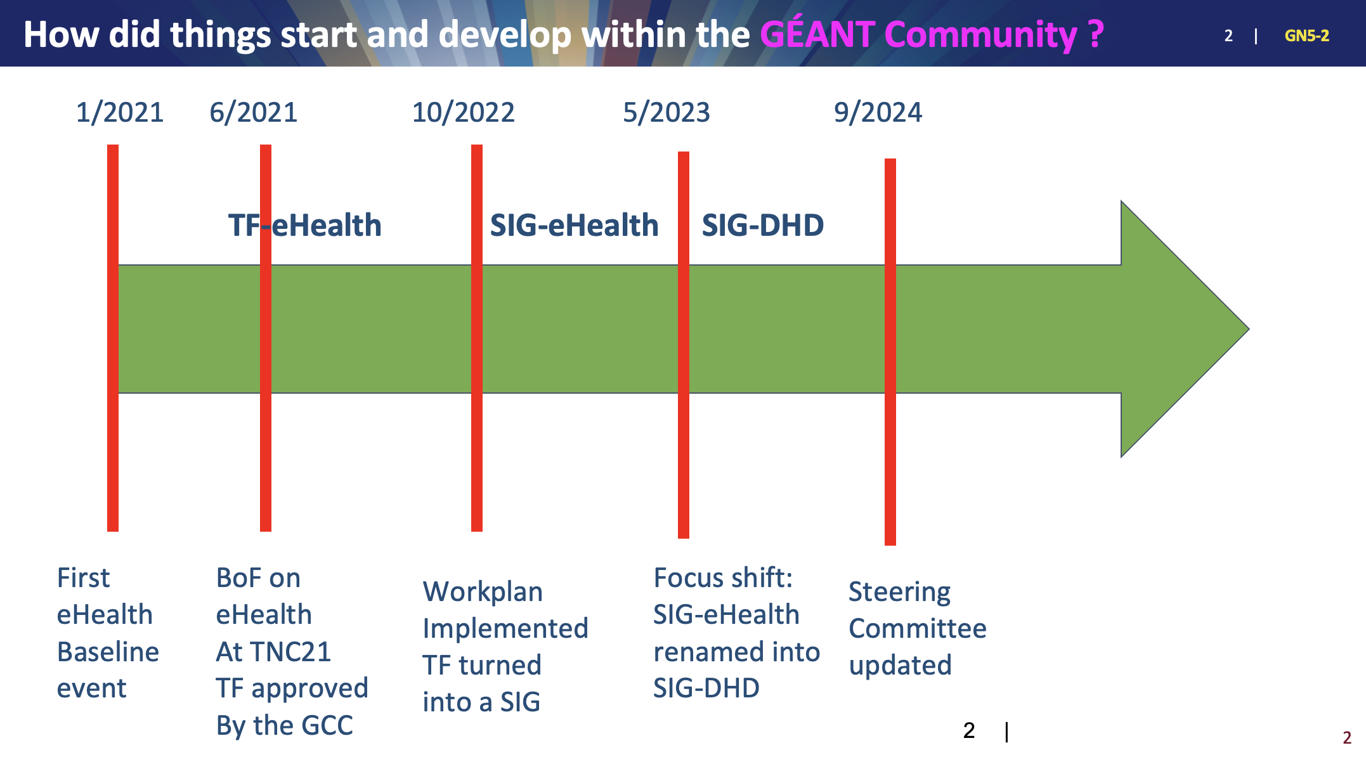

Slide 20


Slide 21
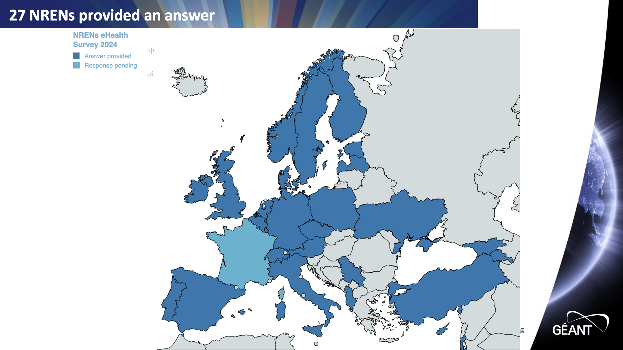

Slide 22
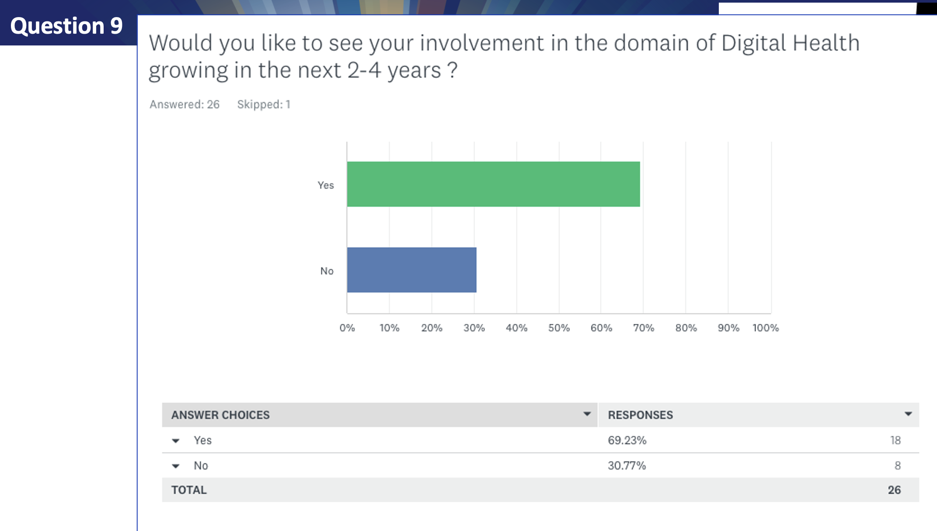

Slide 23
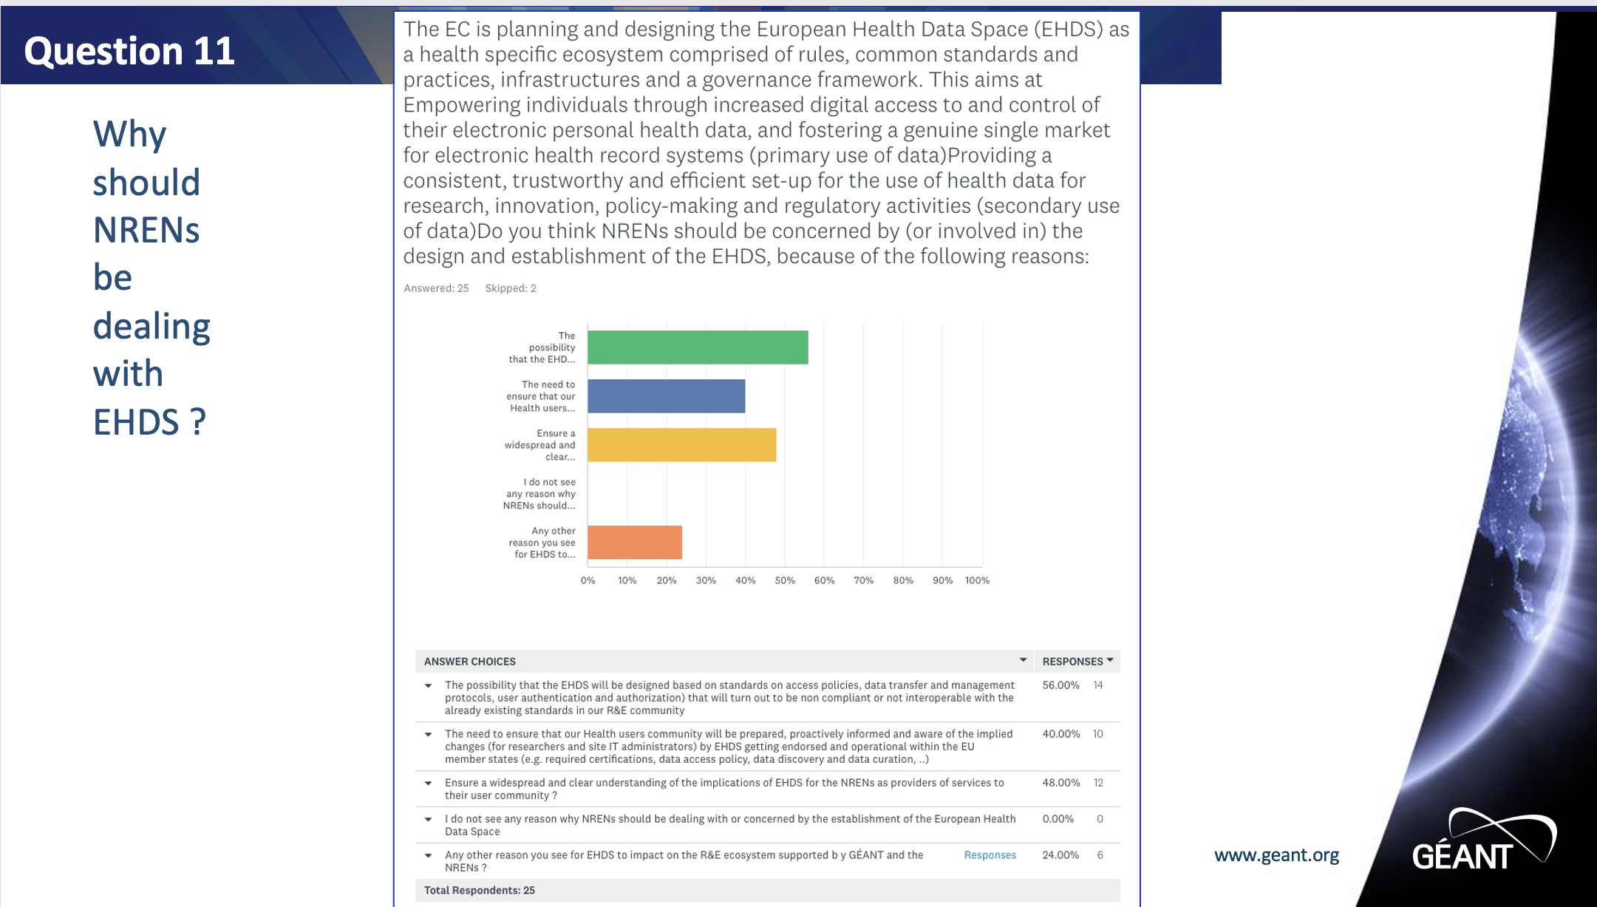

Slide 24
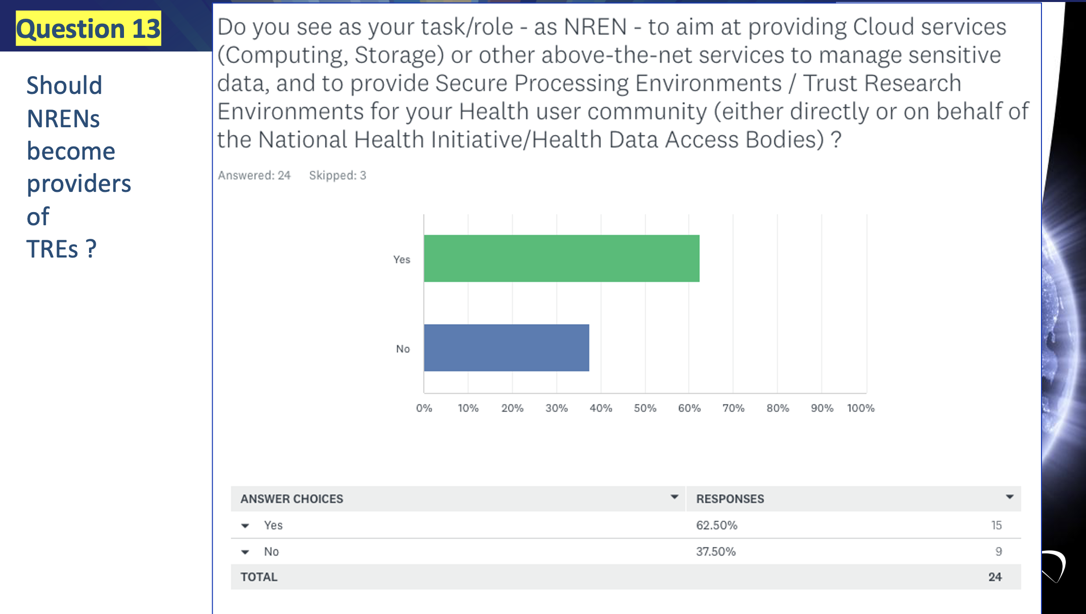

Slide 25
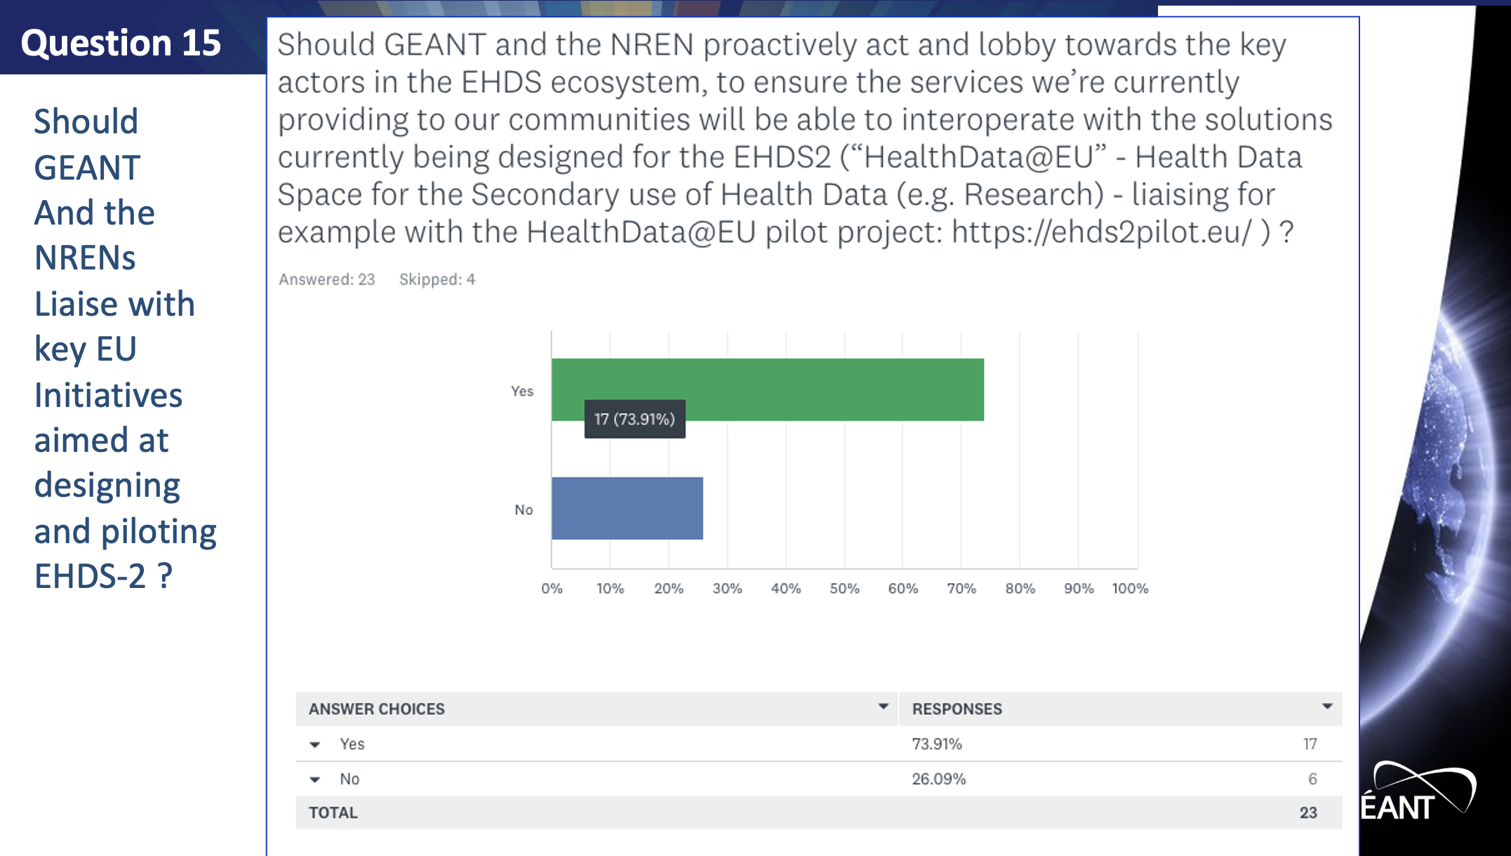

Slide 26
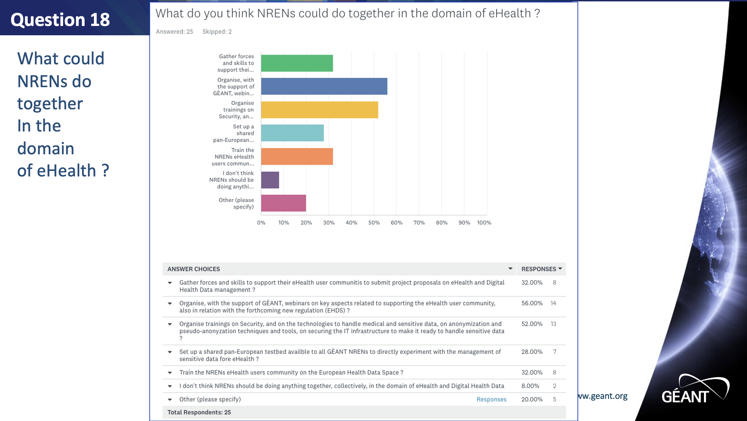

Slide 27
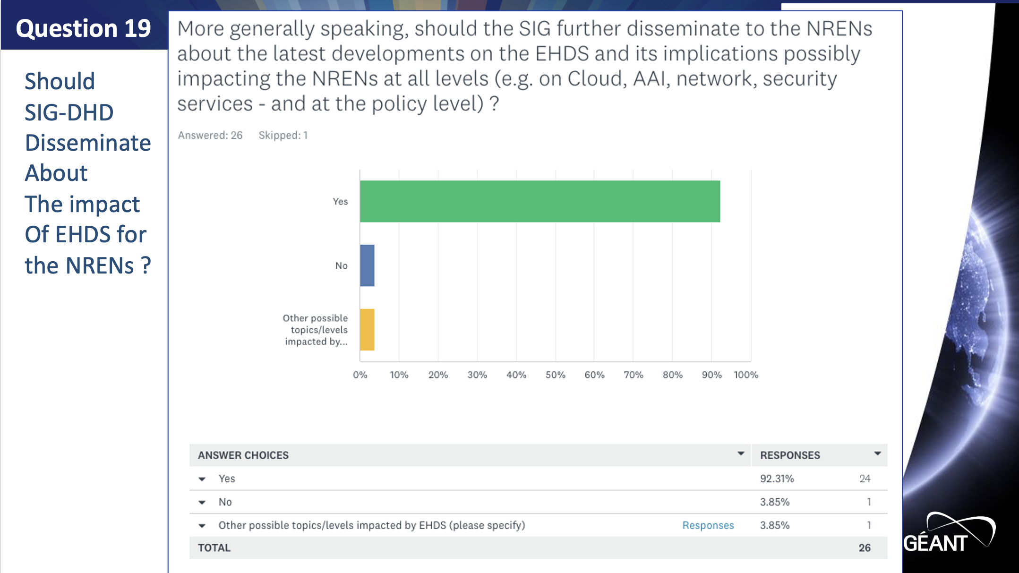

Slide 28
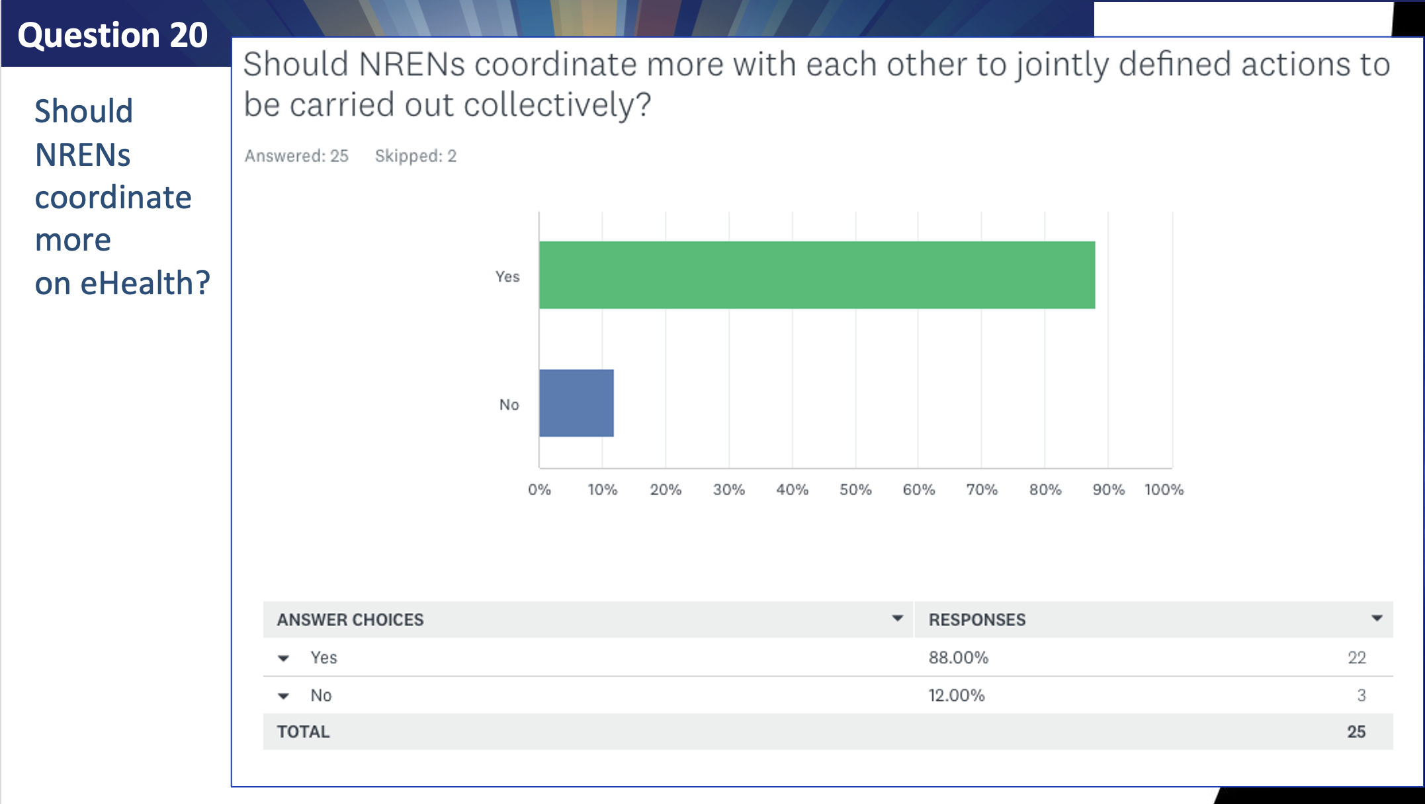

Slide 29
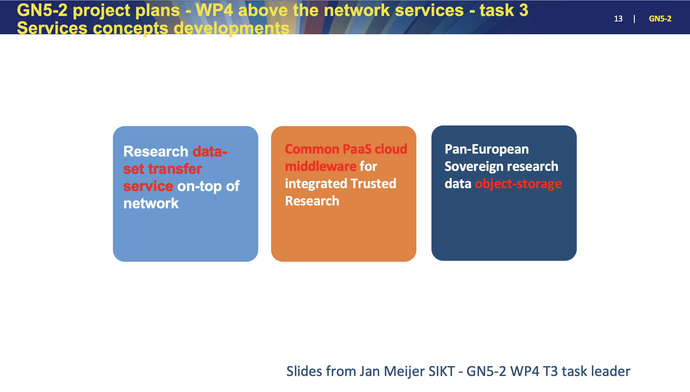

Slide 30
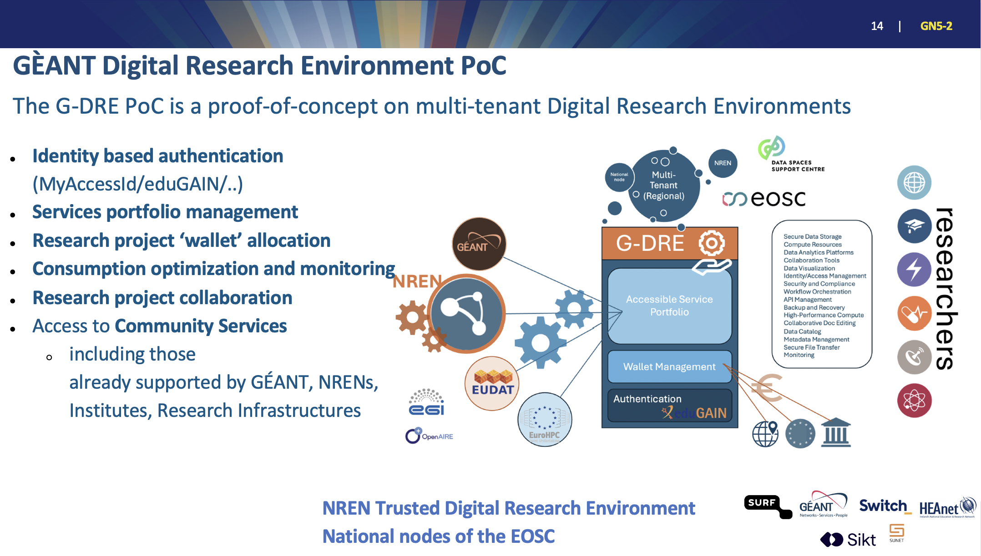

Slide 31
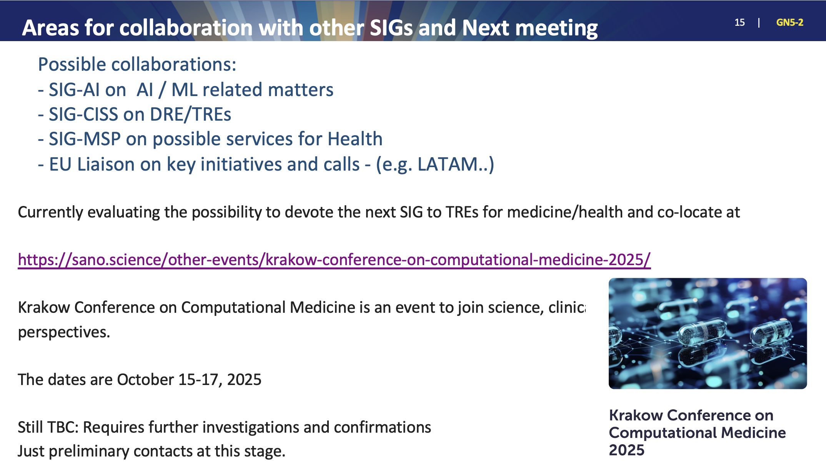

Slide 32
Thank You
Notes:
Thank you very much. Please move to the next module.

Slide 33


SIG-Marcomms Overview
Barbara Carroll (HEAnet)
Ariela Herček (Arnes)
Silvia Fiore (GÉANT)
GÉANT Community Programme Meeting, Prague
14/05/2025

Slide 34
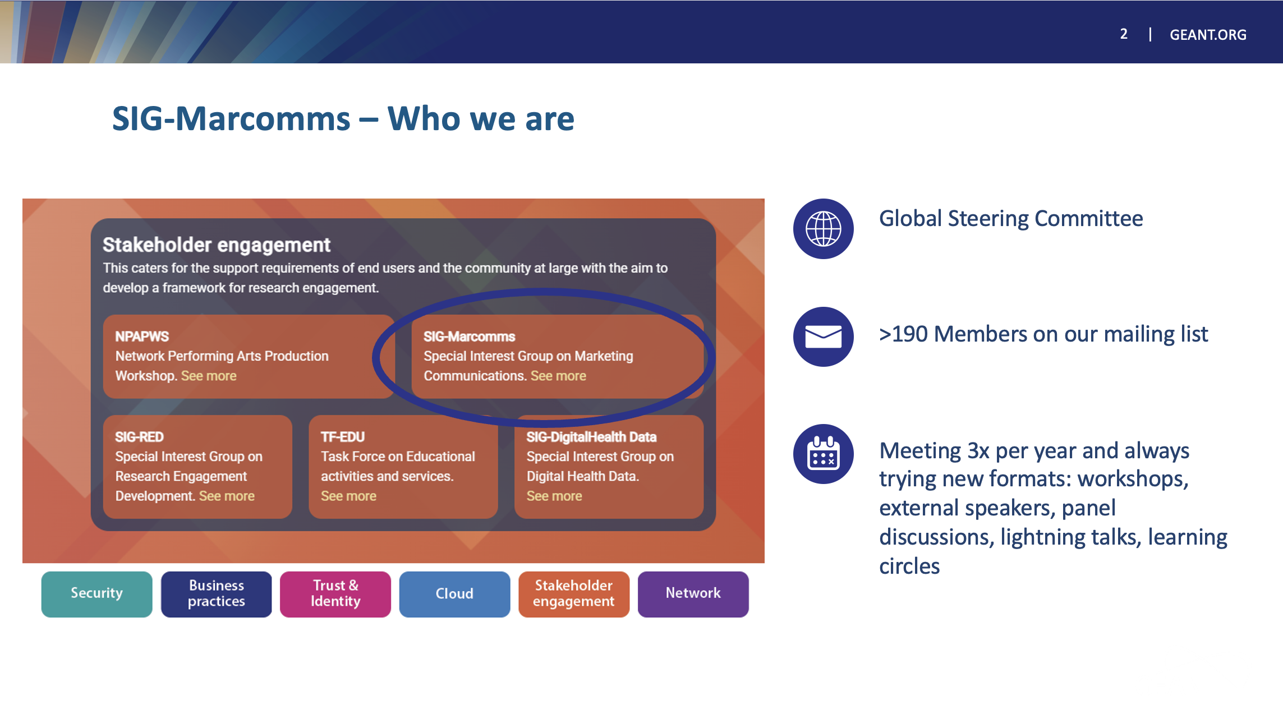

Slide 35
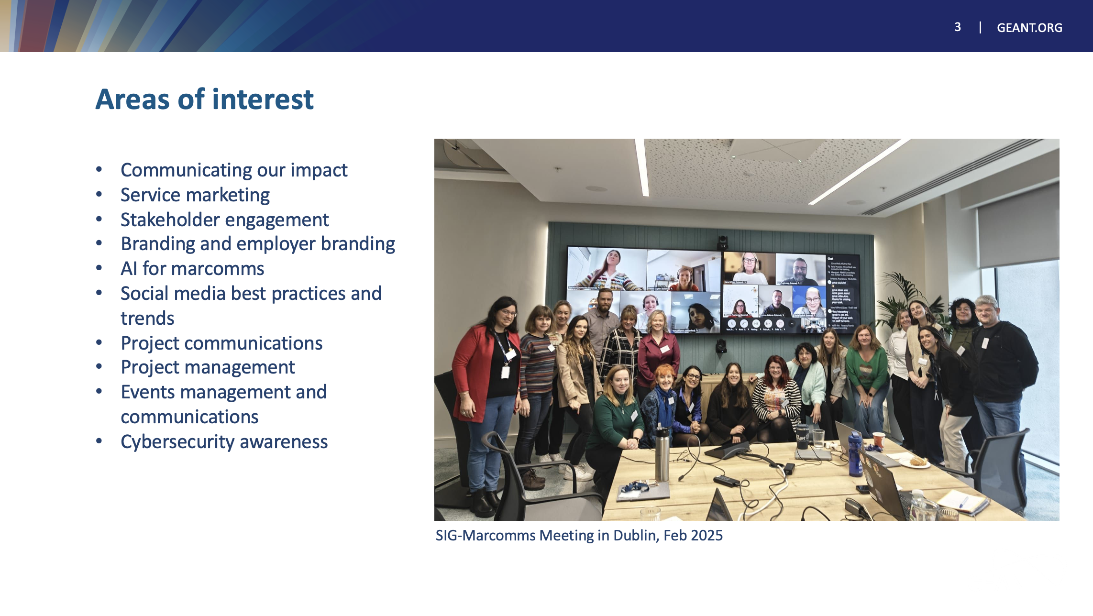

Slide 36
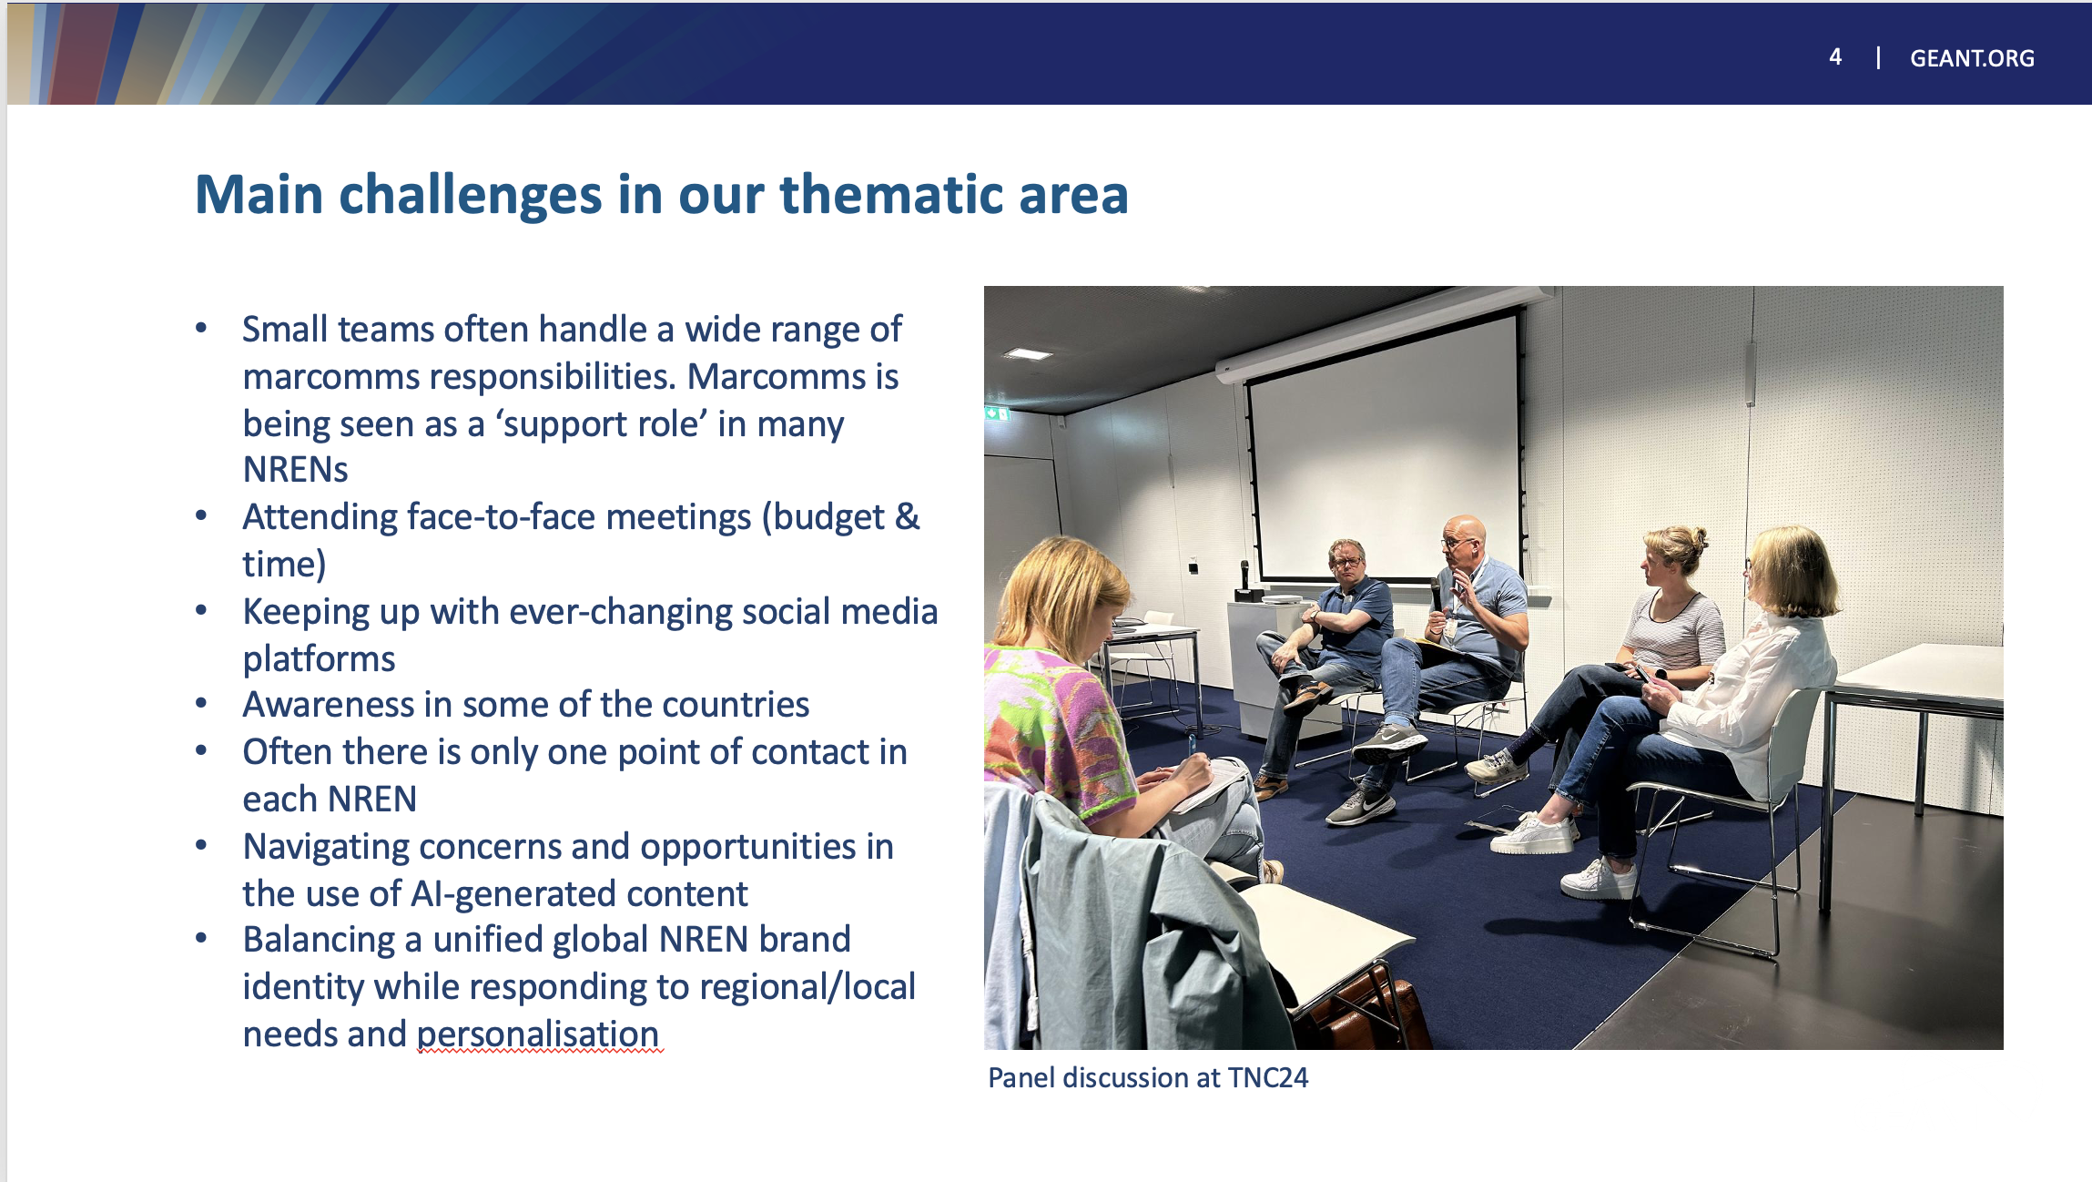

Slide 37
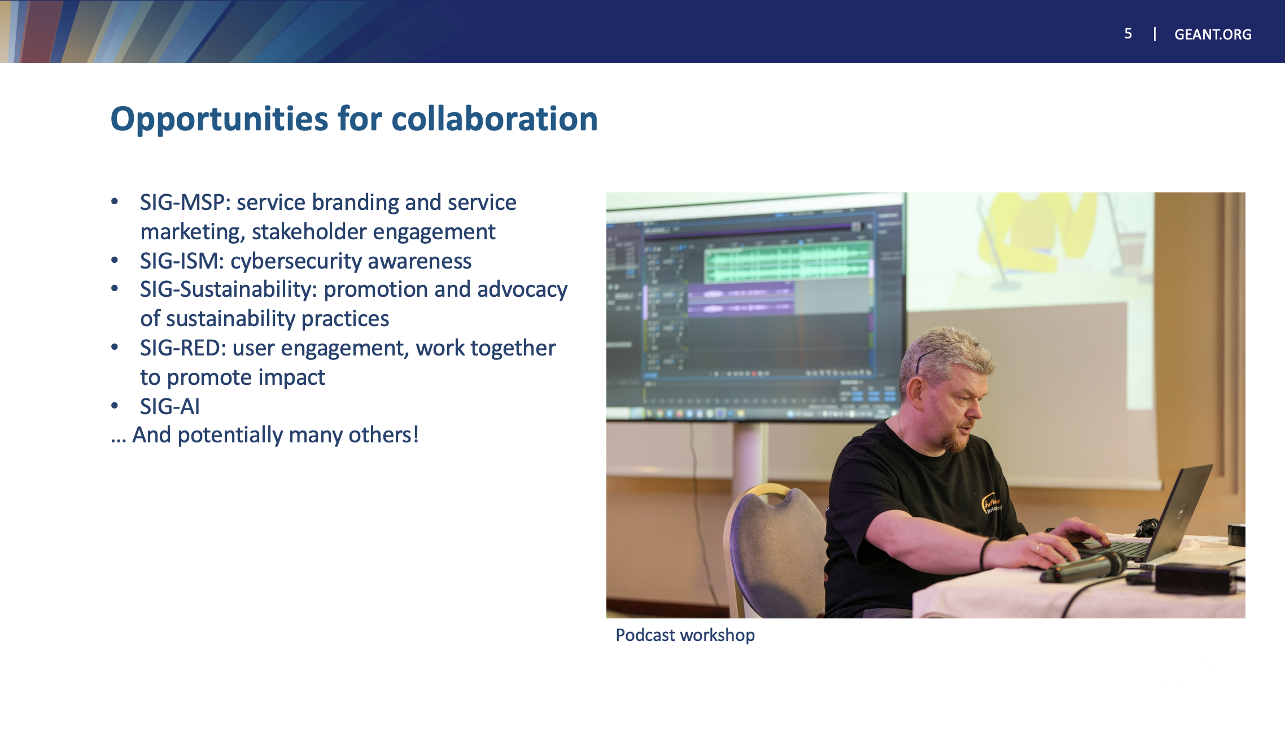

Slide 38

Thank You
Any questions?
www.geant.org

Slide 39
GÉANT Innovation Programme (GIP)
GCP Workshop
14-15.05.2025
Prague, Czech Republic
Piotr Pawałowski (PSNC) <astagor@man.poznan.pl>

Slide 40
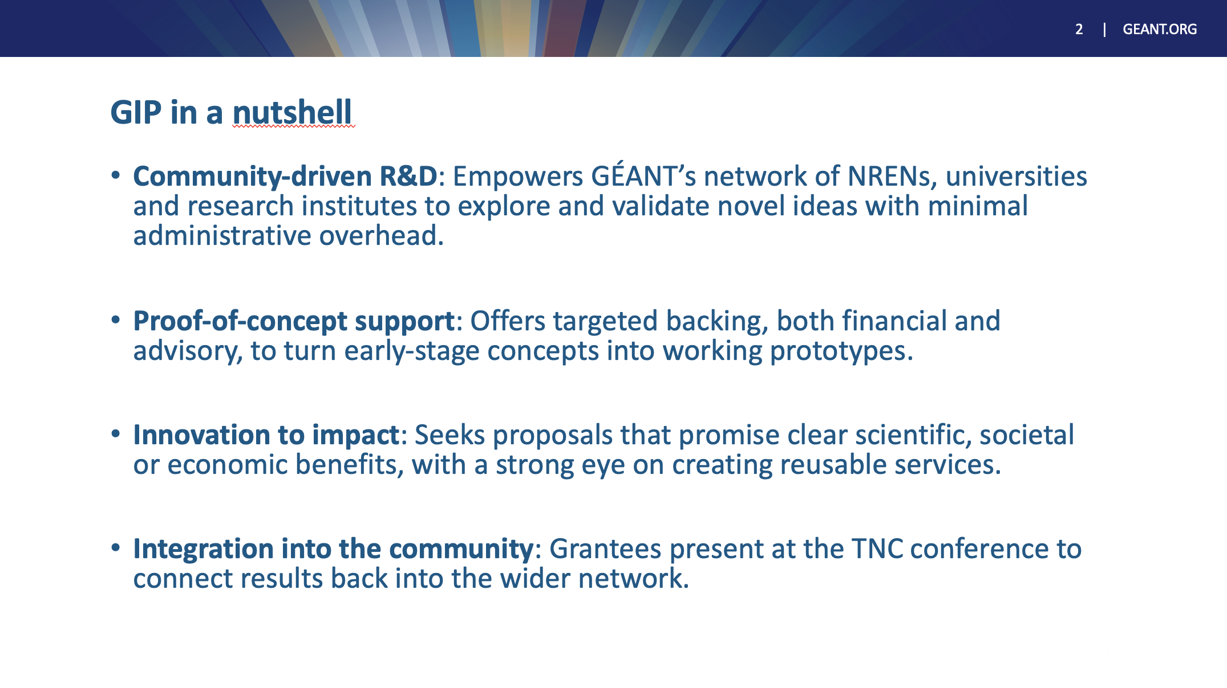

Slide 41
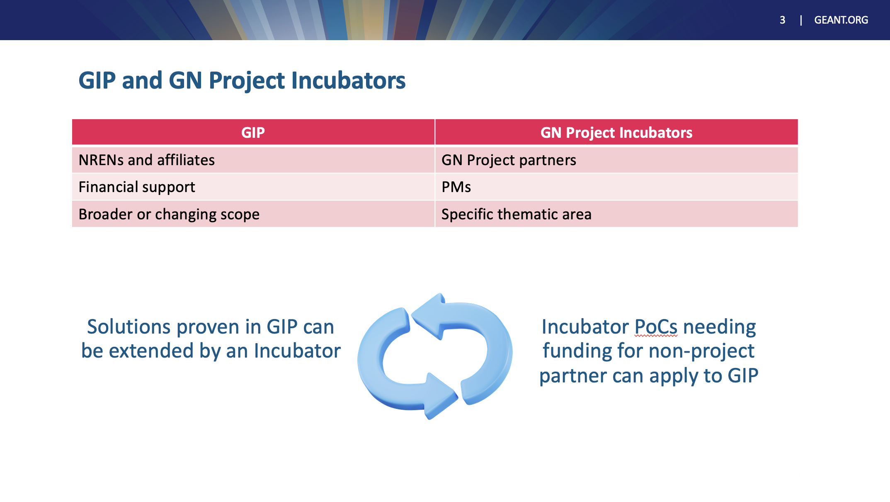

Slide 42
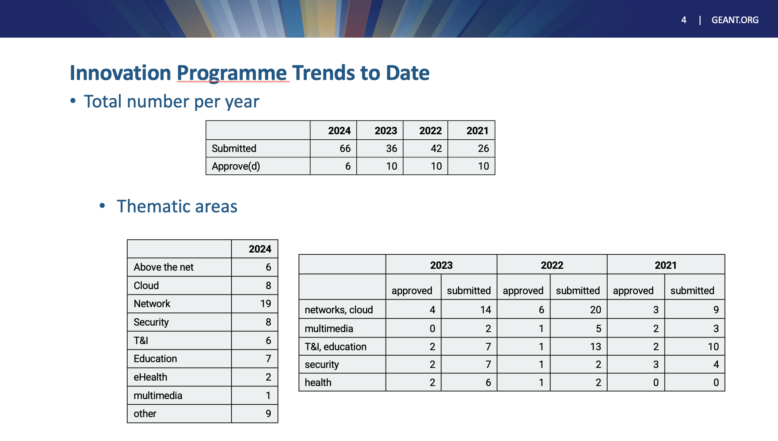

Slide 43
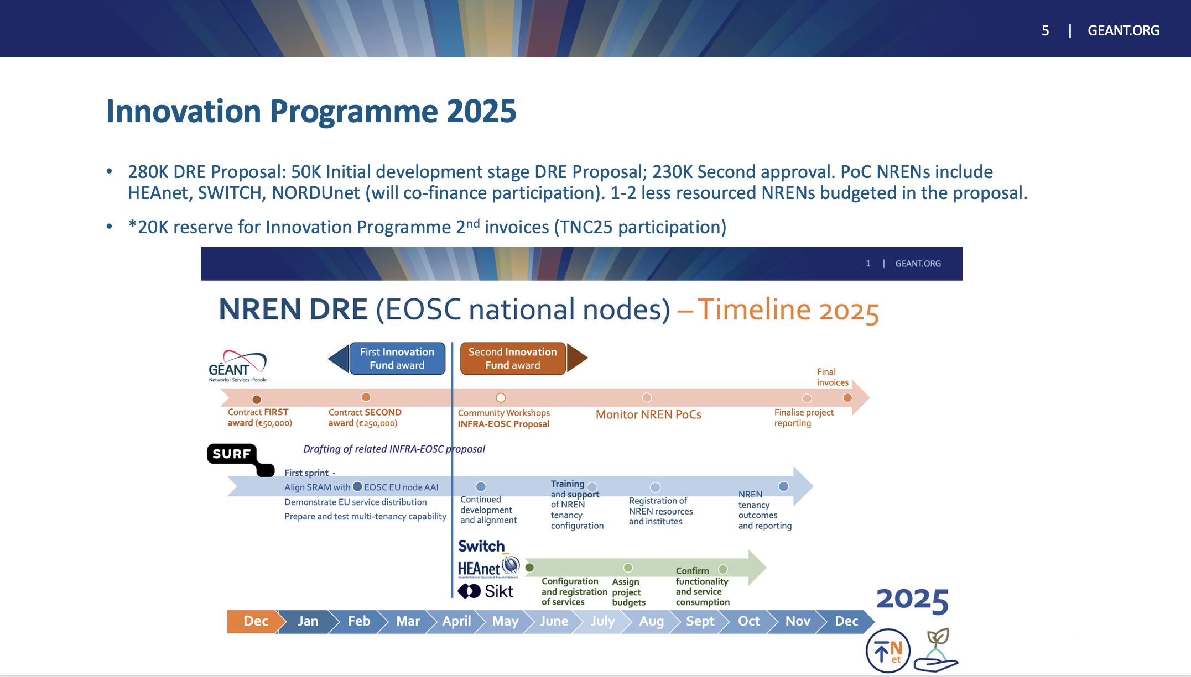

Slide 44
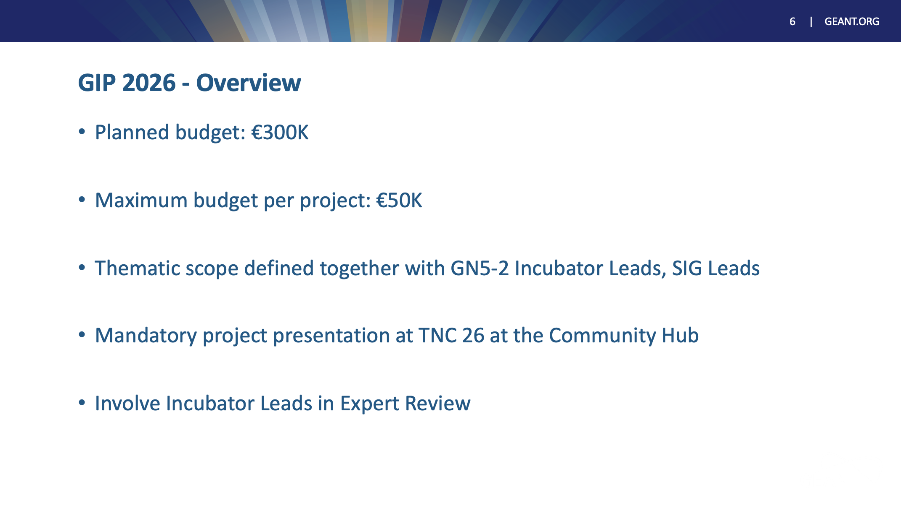

Slide 45
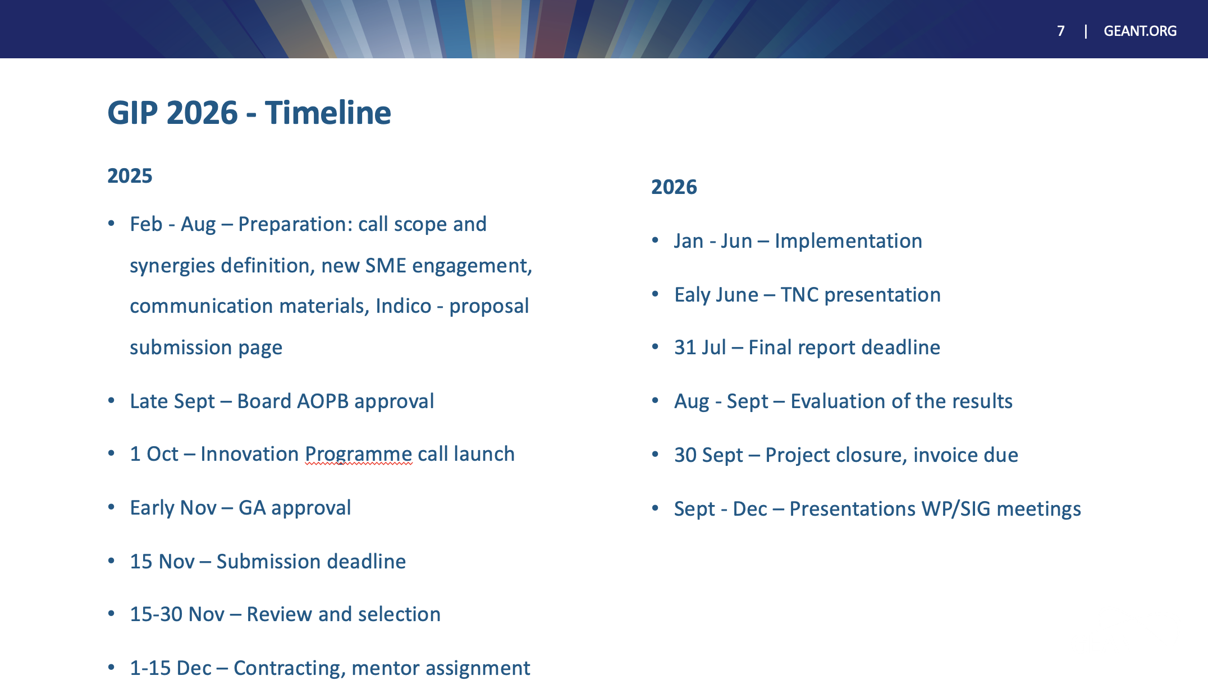

Slide 46
GÉANT Community Principles + Community of Practice for Software Solutions
Nicole Harris
Senior Trust and Security Manager
GCP Workshop, Prague
14th May 2025
Public

Slide 47
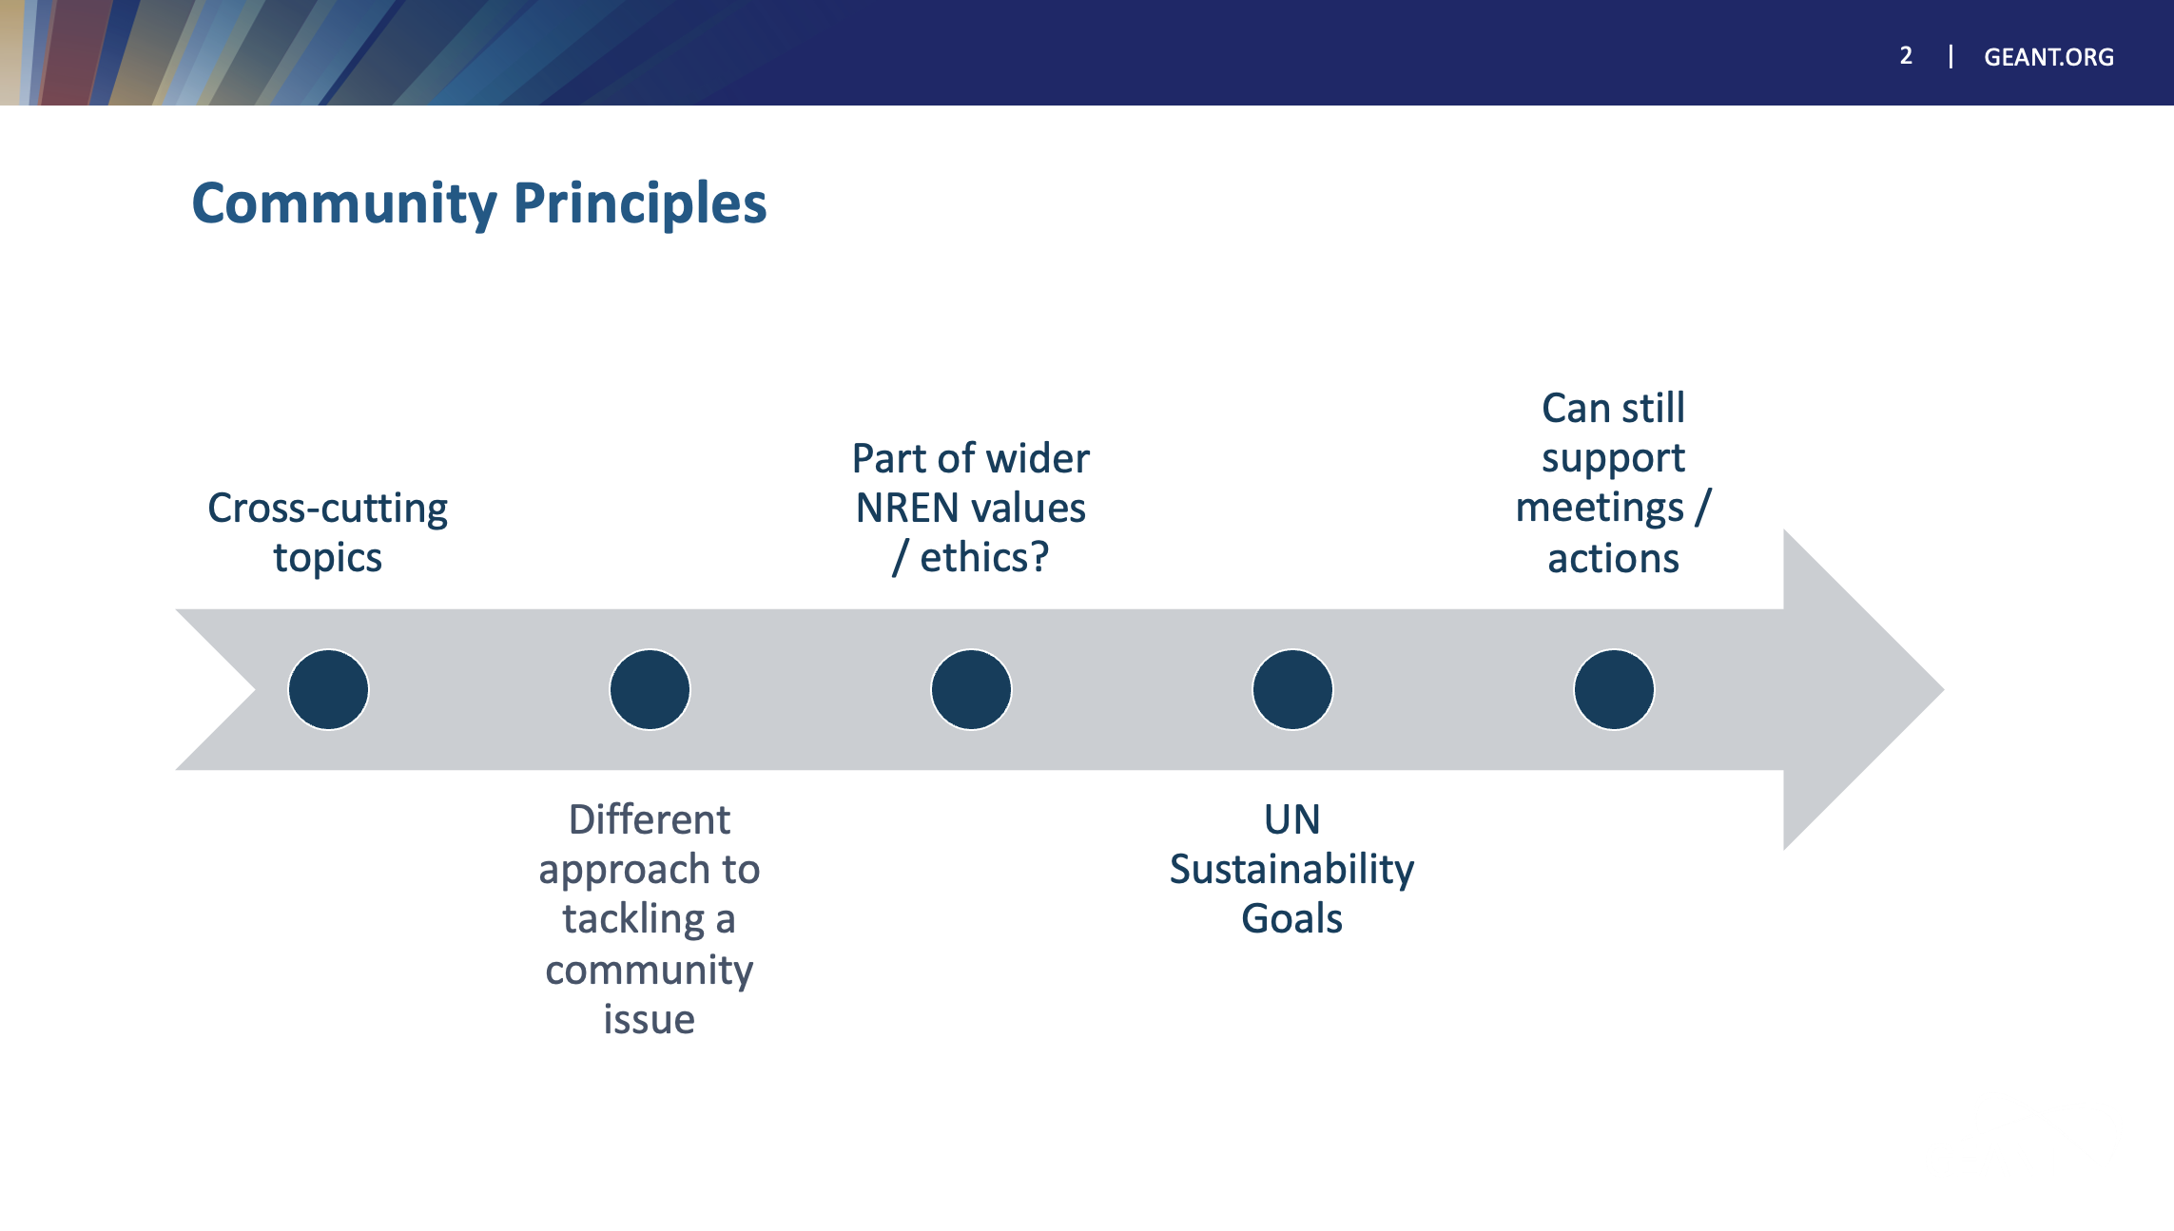

Slide 48


Slide 49
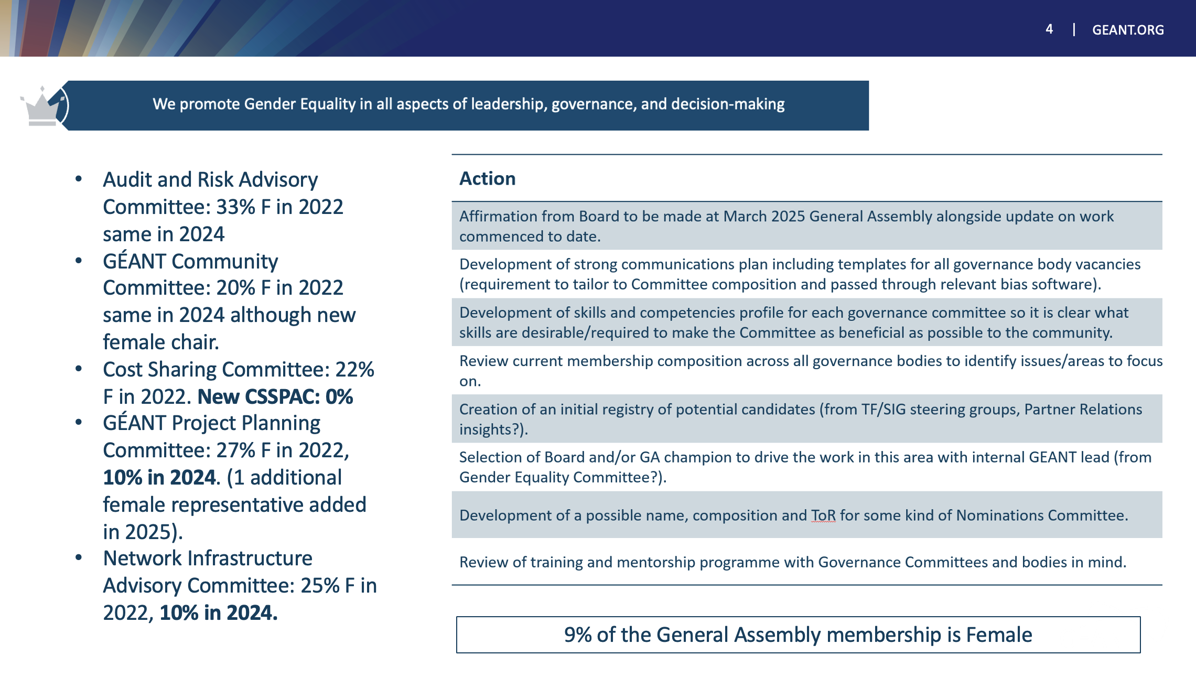

Slide 50
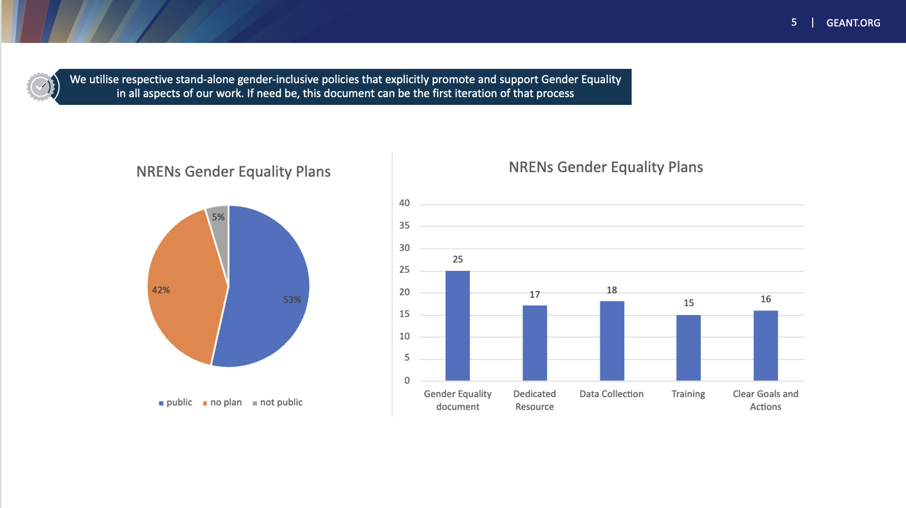

Slide 51
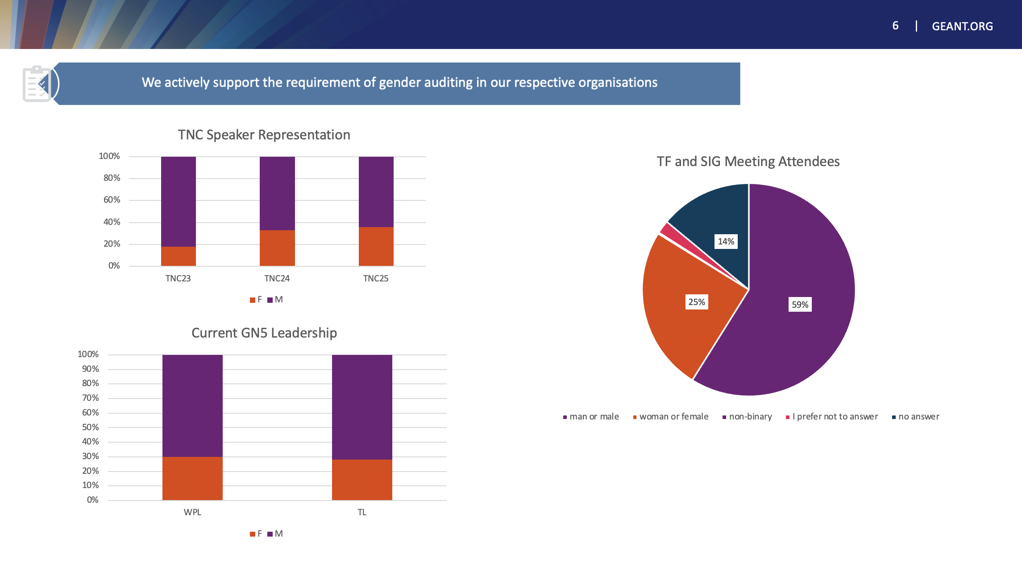

Slide 52
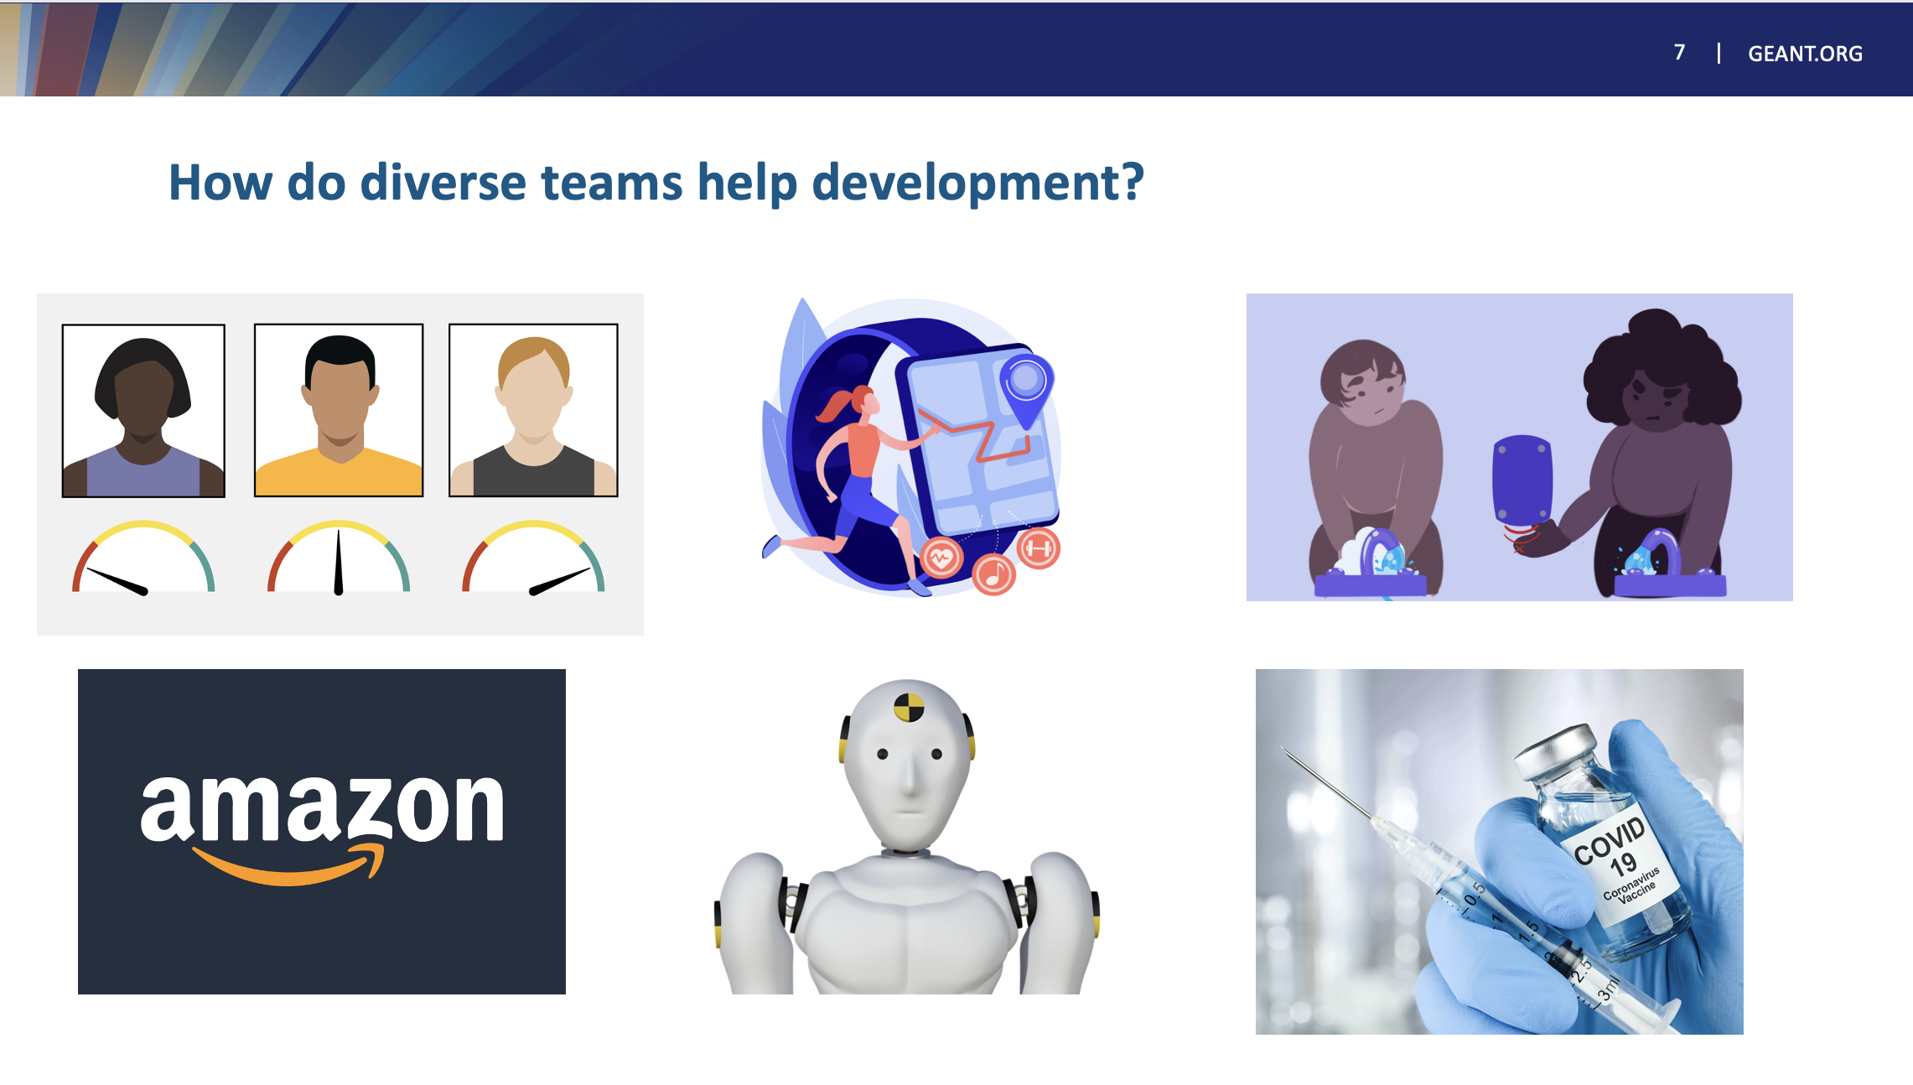

Slide 53
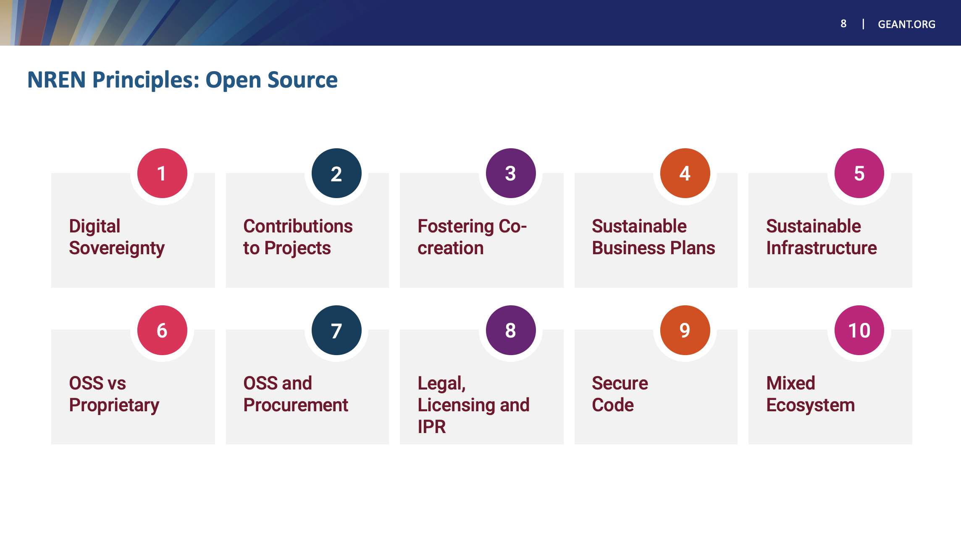

Slide 54
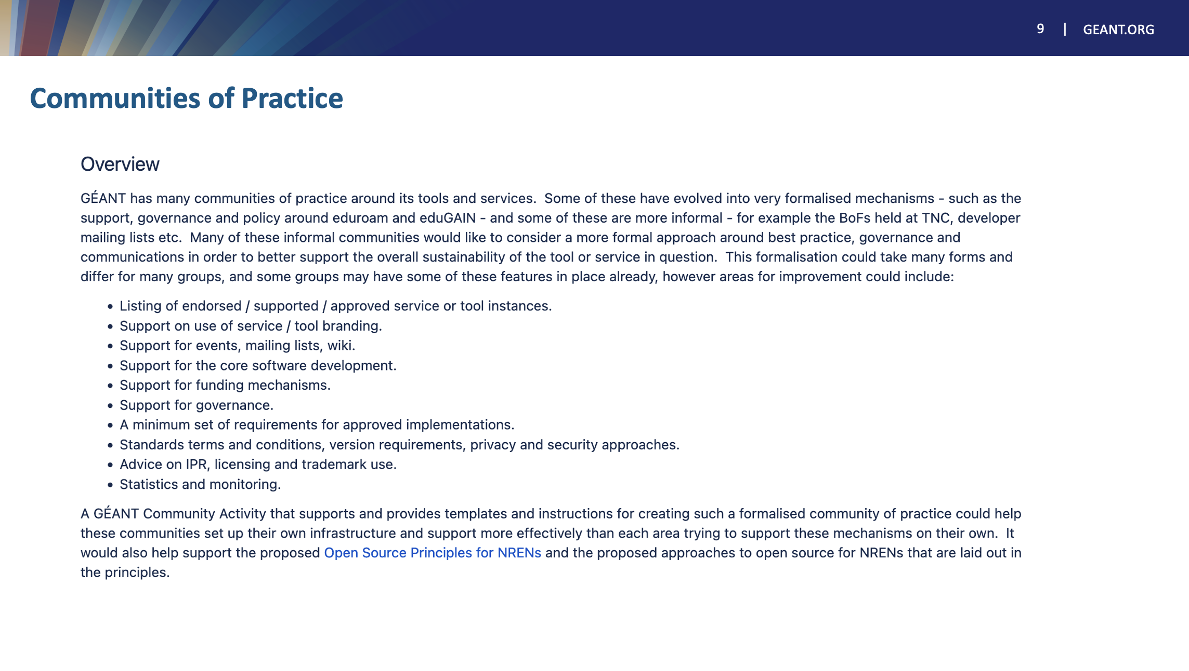

Slide 55
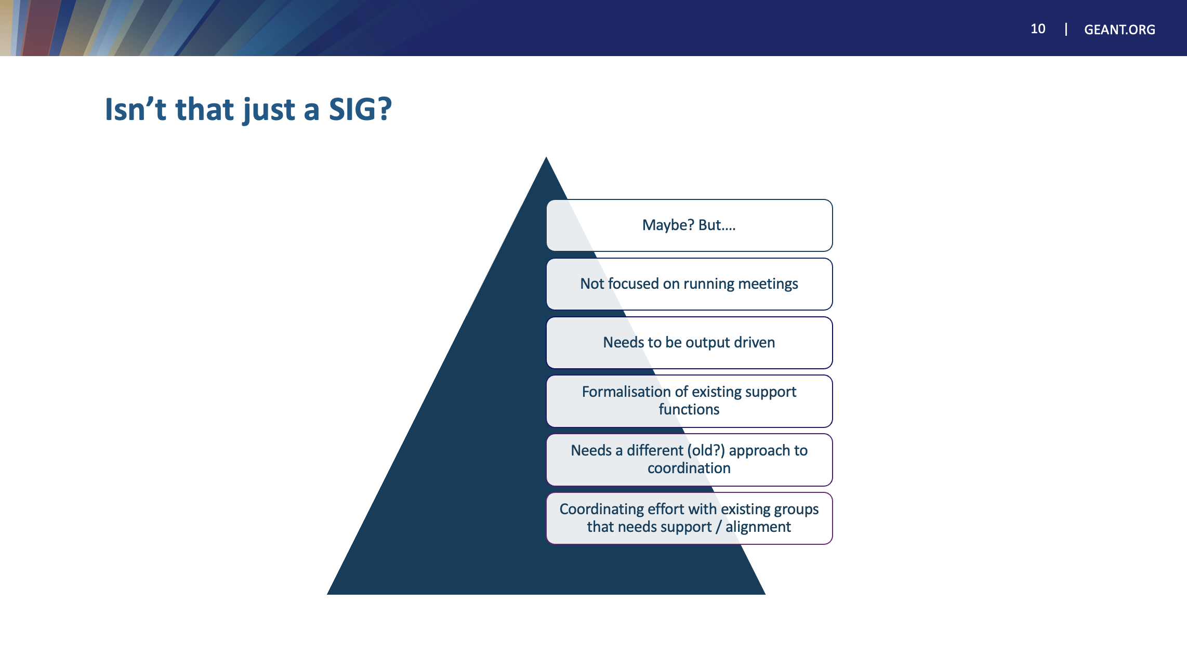

Slide 56
Thank You
Any questions?
www.geant.org

Slide 57
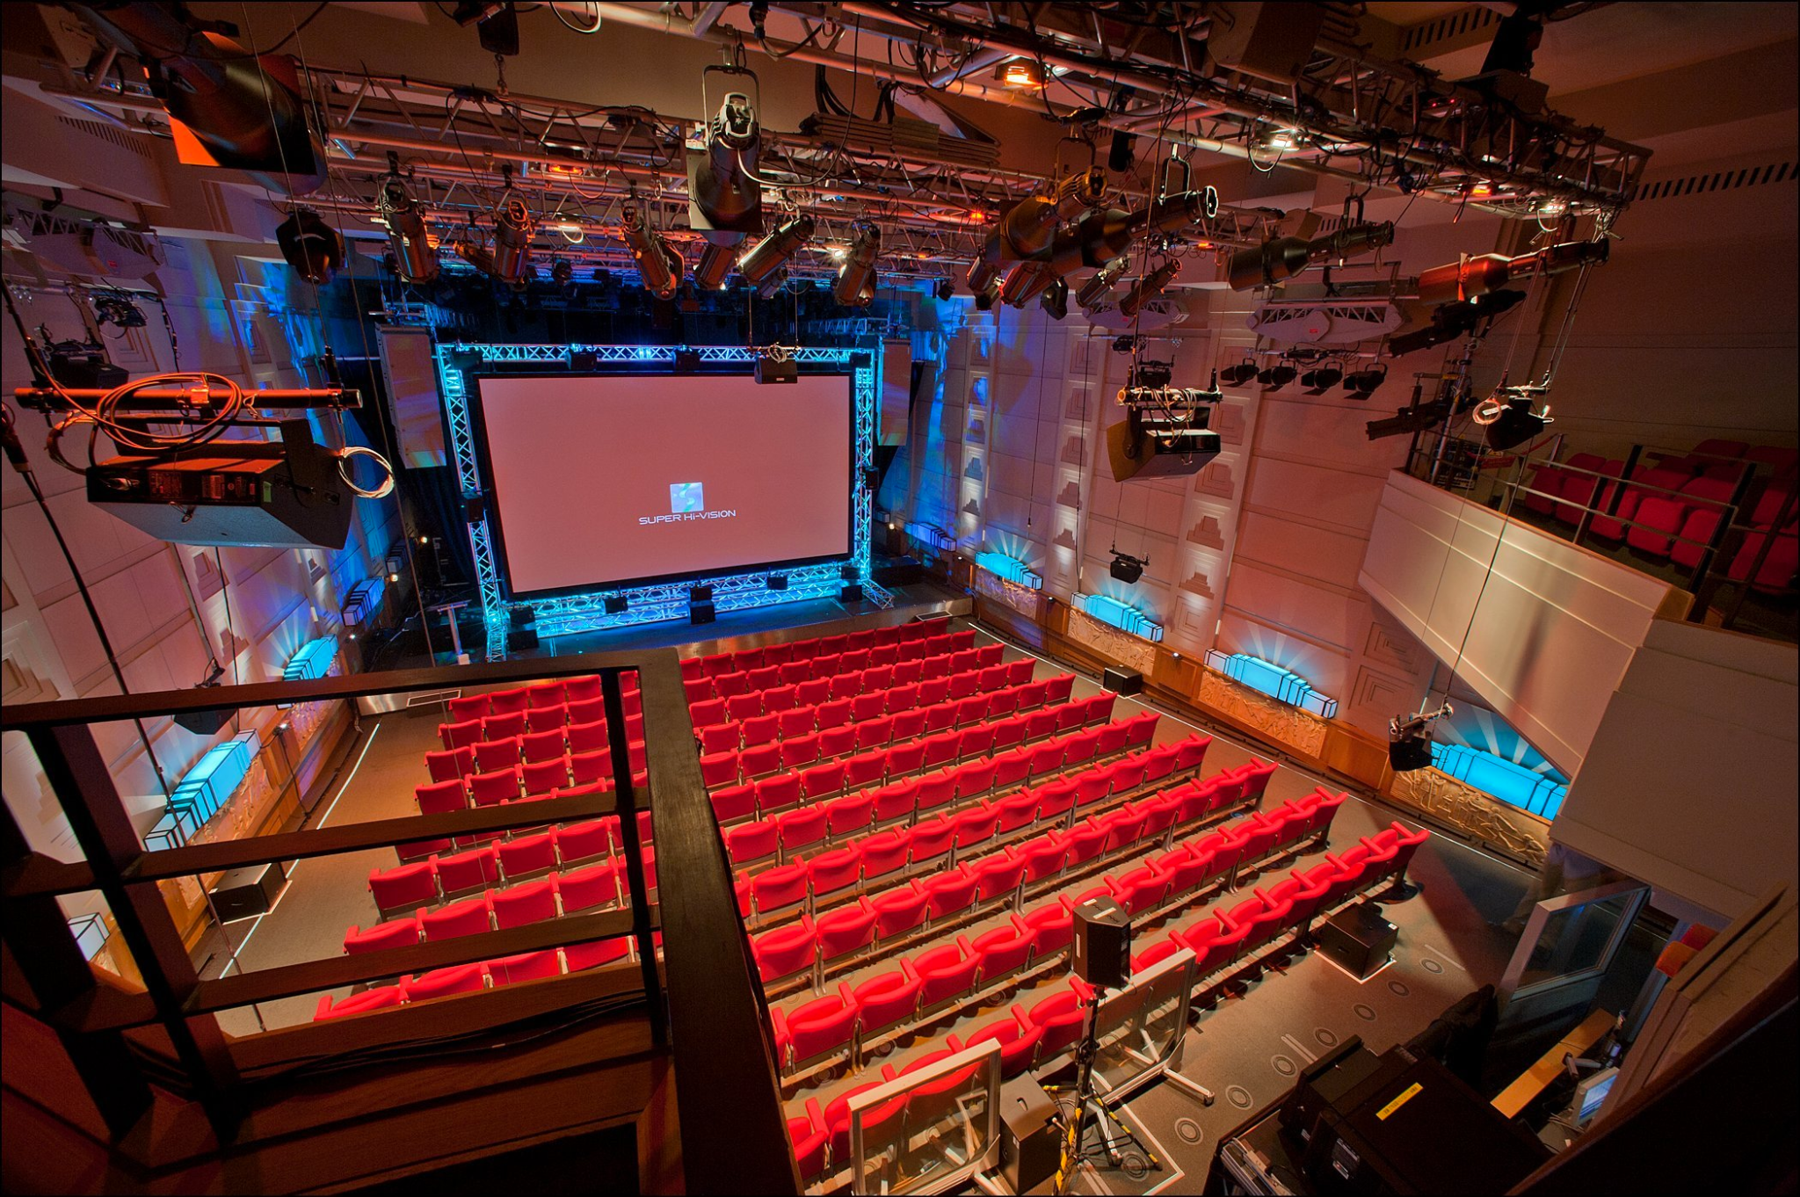
NPAPW
GCP Workshop Lightning Talk
14 May 2025

Slide 58
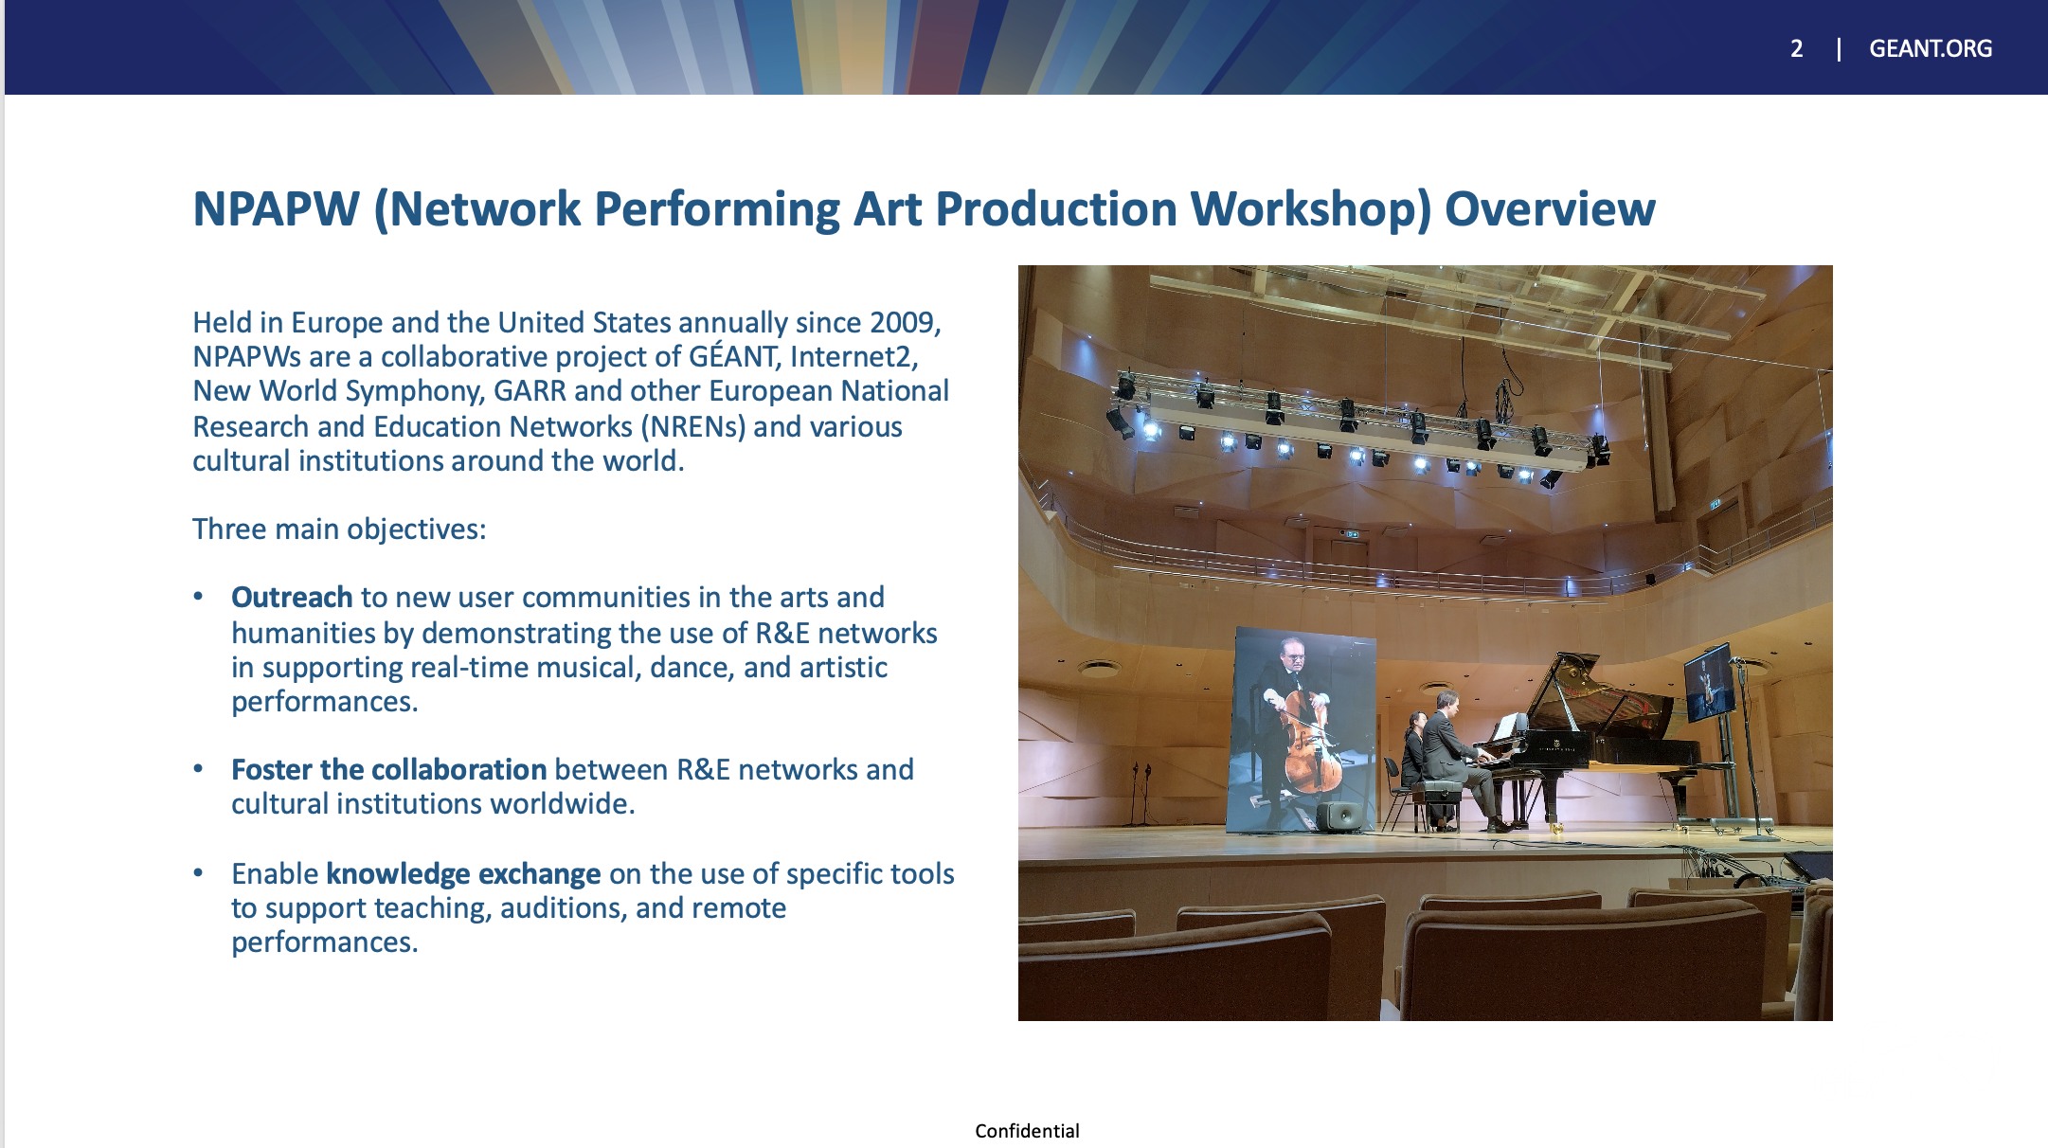

Slide 59
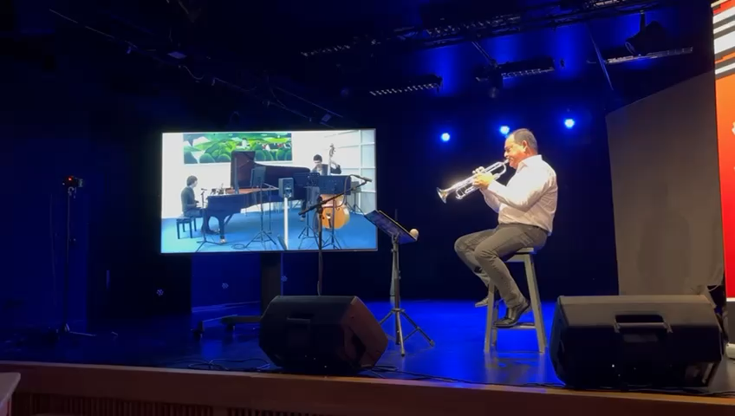
Vilnius (Trumpet) – Prague (Piano and Double Bass)

Slide 60
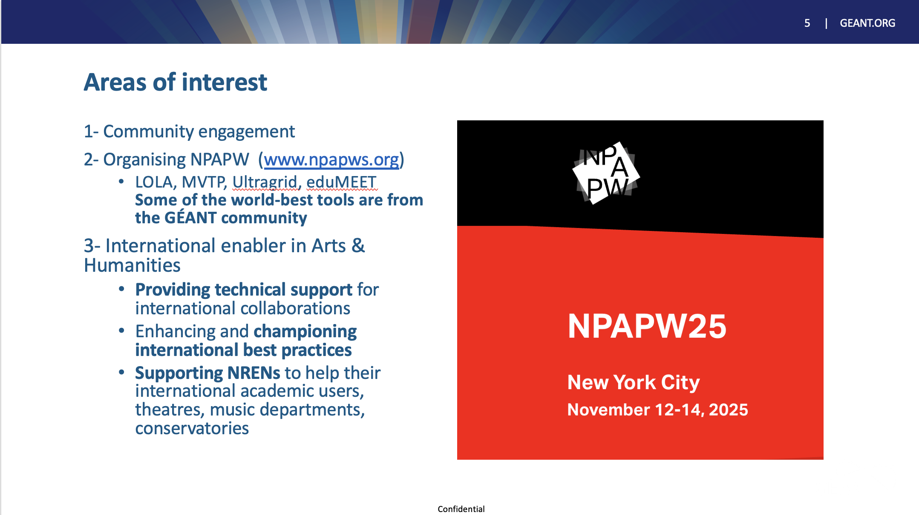

Slide 61
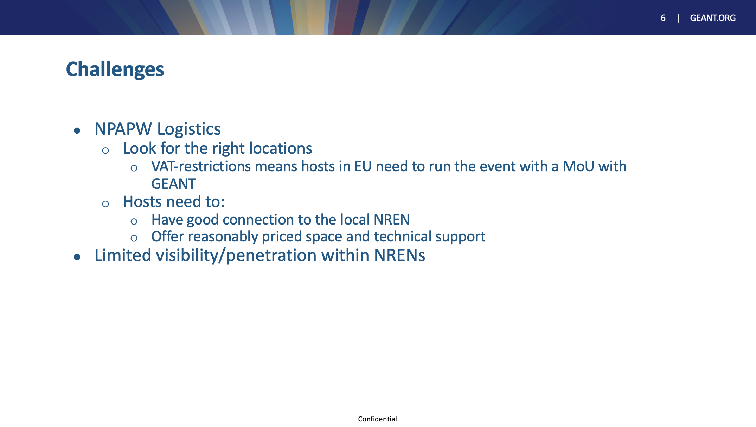

Slide 62
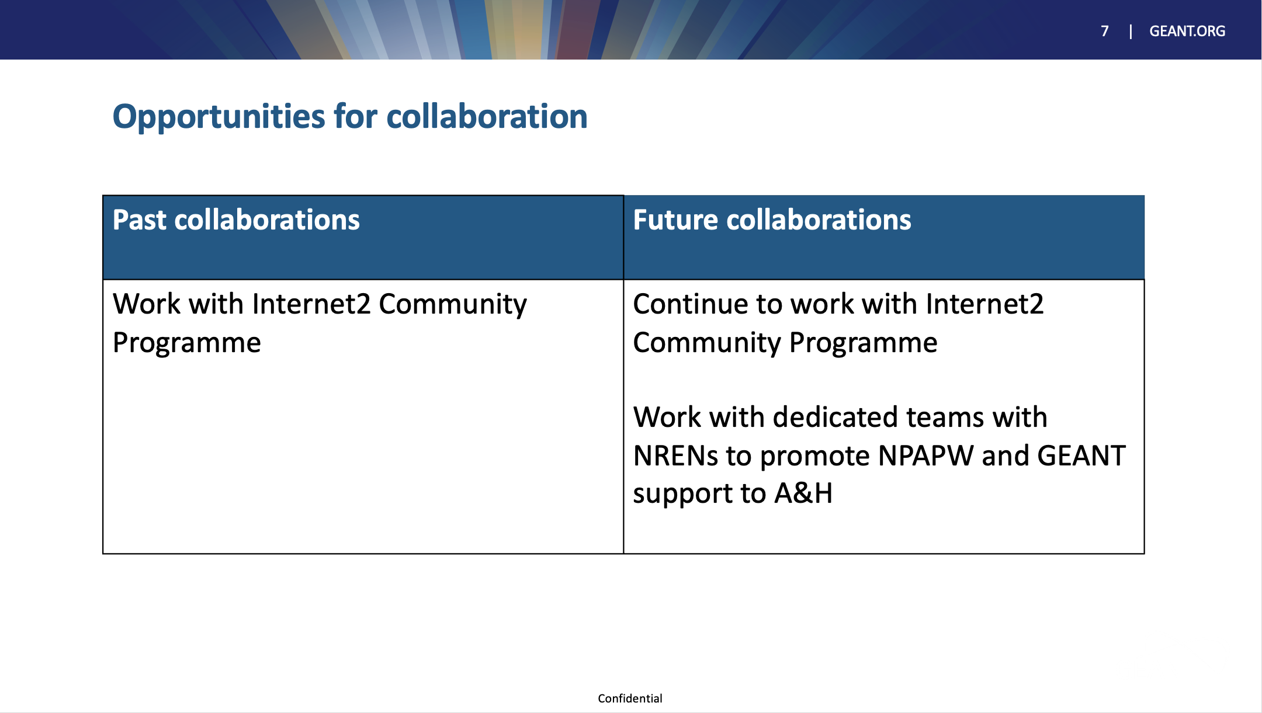

Slide 63
Coffee Break
Pair with your favourite SIG(s) and cook up your next co-located meeting!

