Slide 1


SIG-ISM
Michel Gerdes (SC chair, DFN-CERT)
GCP Workshop, Prague
14.05.2025

Slide 2
SIG-ISM
Information Security Management
New SC in 2024 – new generation – new charter?
10th Anniversary Meeting in October
Security is a broad area and has links everywhere
Legislation / Requirements / Compliance / Certification
Top-down vs. Bottom-up views
No templates or standards that can just be implemented – adaptation required
Differing requirements for NRENs
Security has no direct ROI
Every service or data has security requirements – Security is everywhere
Topics for the workshop in October

Slide 3
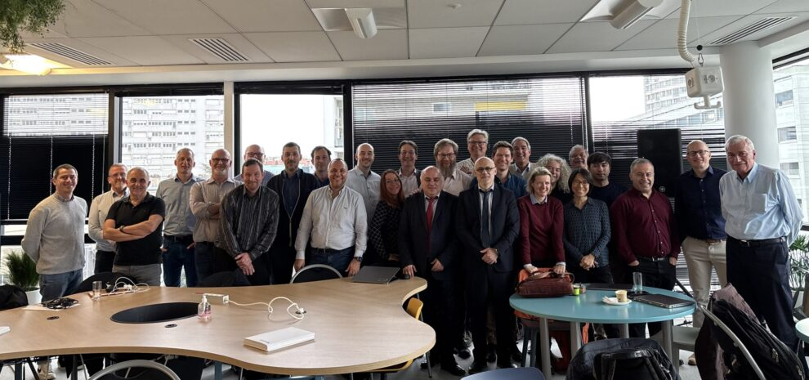
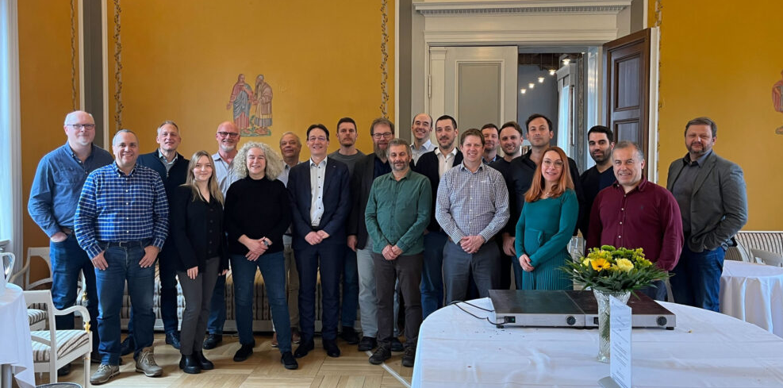
SIG-MSP
GCP Workshop Lightning Talk
14 May 2025

Slide 4
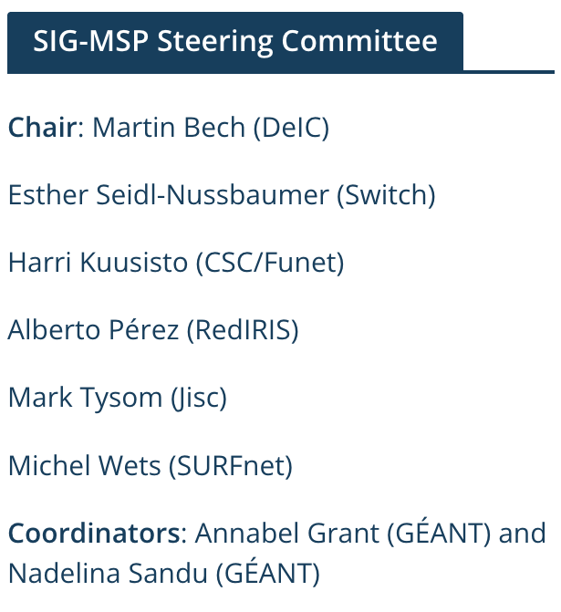
SIG-MSP Overview
MSP = Management of Service Portfolios
Former GÉANT Task Force (aka TF-MSP)
SIG established in 2016
Mailing list of 202 subscribers
2 hybrid meetings per year (+1 online)
Average nr. of participants attending a meeting (online + on-site): 40-45
Dedicated and long serving steering committee and committed members

Slide 5
Areas of interest
Service portfolio management + anything 'strategic' (rather than technical)
  strategies: strategic approaches to management and the management of services;
  product and service lifecycles;
  best practices in planning, sourcing & delivering services;
  efficiencies in economies of scale through e.g. aggregating demand, service sharing; procurement
  growing NRENs – which groups to target;
  new services in NRENs
  how EC landscape changes/ policies etc. affect NREN service portfolios

Slide 6
Challenges
Gaining new members...."beyond the usual suspects" / fresh blood
Ensuring that we get different participants to attend

Slide 7
Opportunities for collaboration
Past collaborations | Future collaborations
Joint meetings with SIG-Marcomms in 2022 & 2023 | ?????

Slide 8
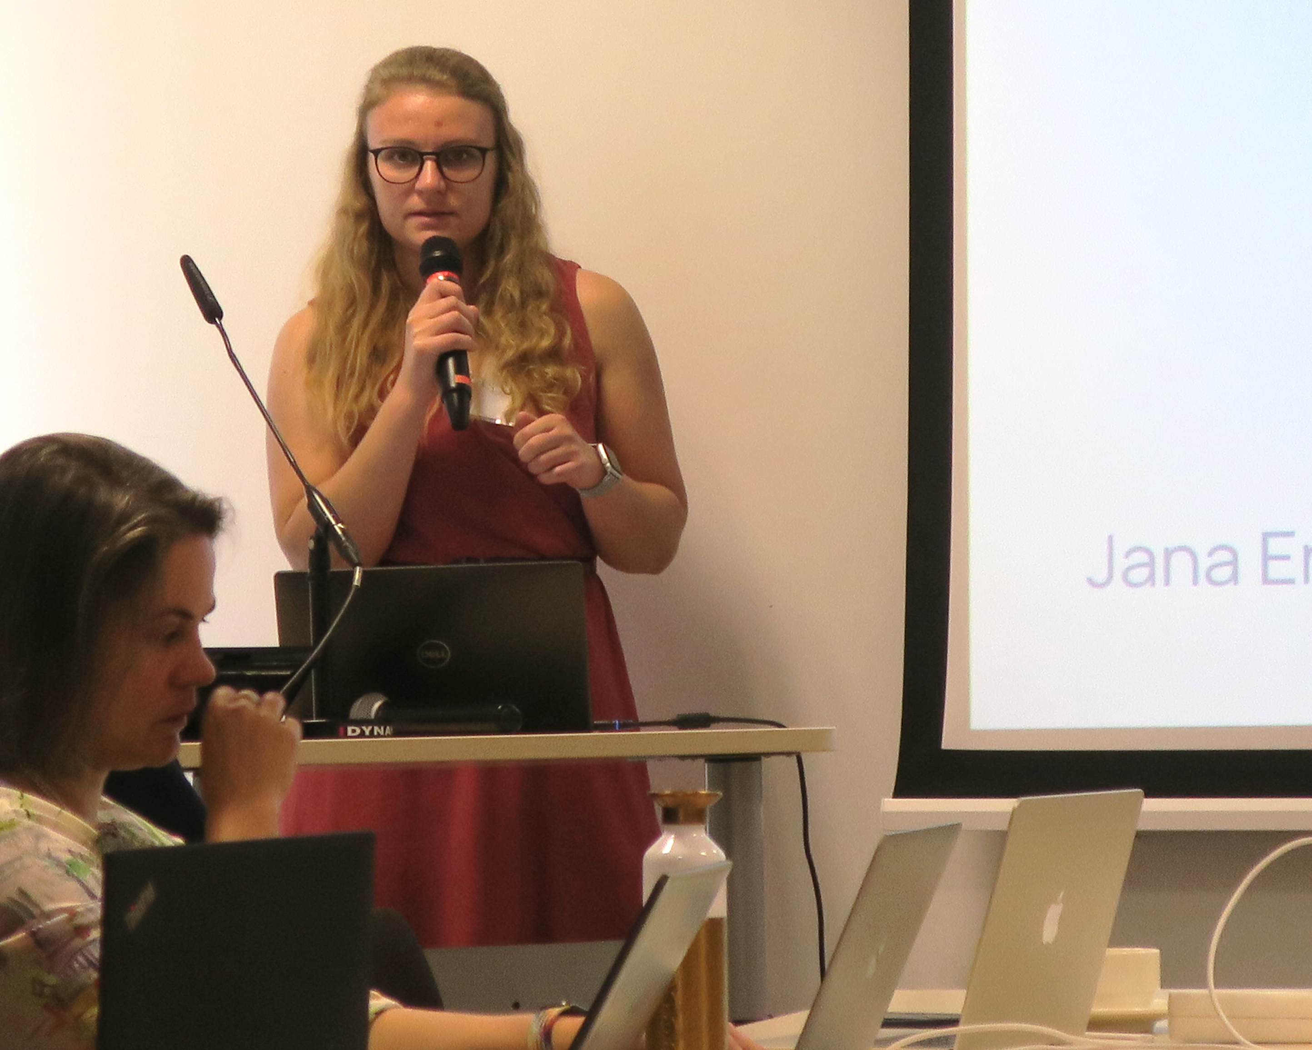
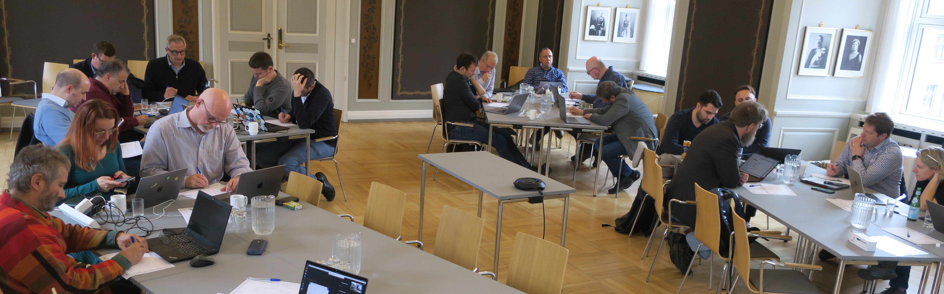
SIG-MSP – what?
Originally ”Management of Service Portfolios”
Inspiration and exchange of best practices regarding
New and existing services
Exchange of service between NRENs
Liaison between NREN management and GEANT
Overarching themes concerning NREN management like
Recruitment
Security
CRM
Organization, funding and
stakeholder relations

Slide 9
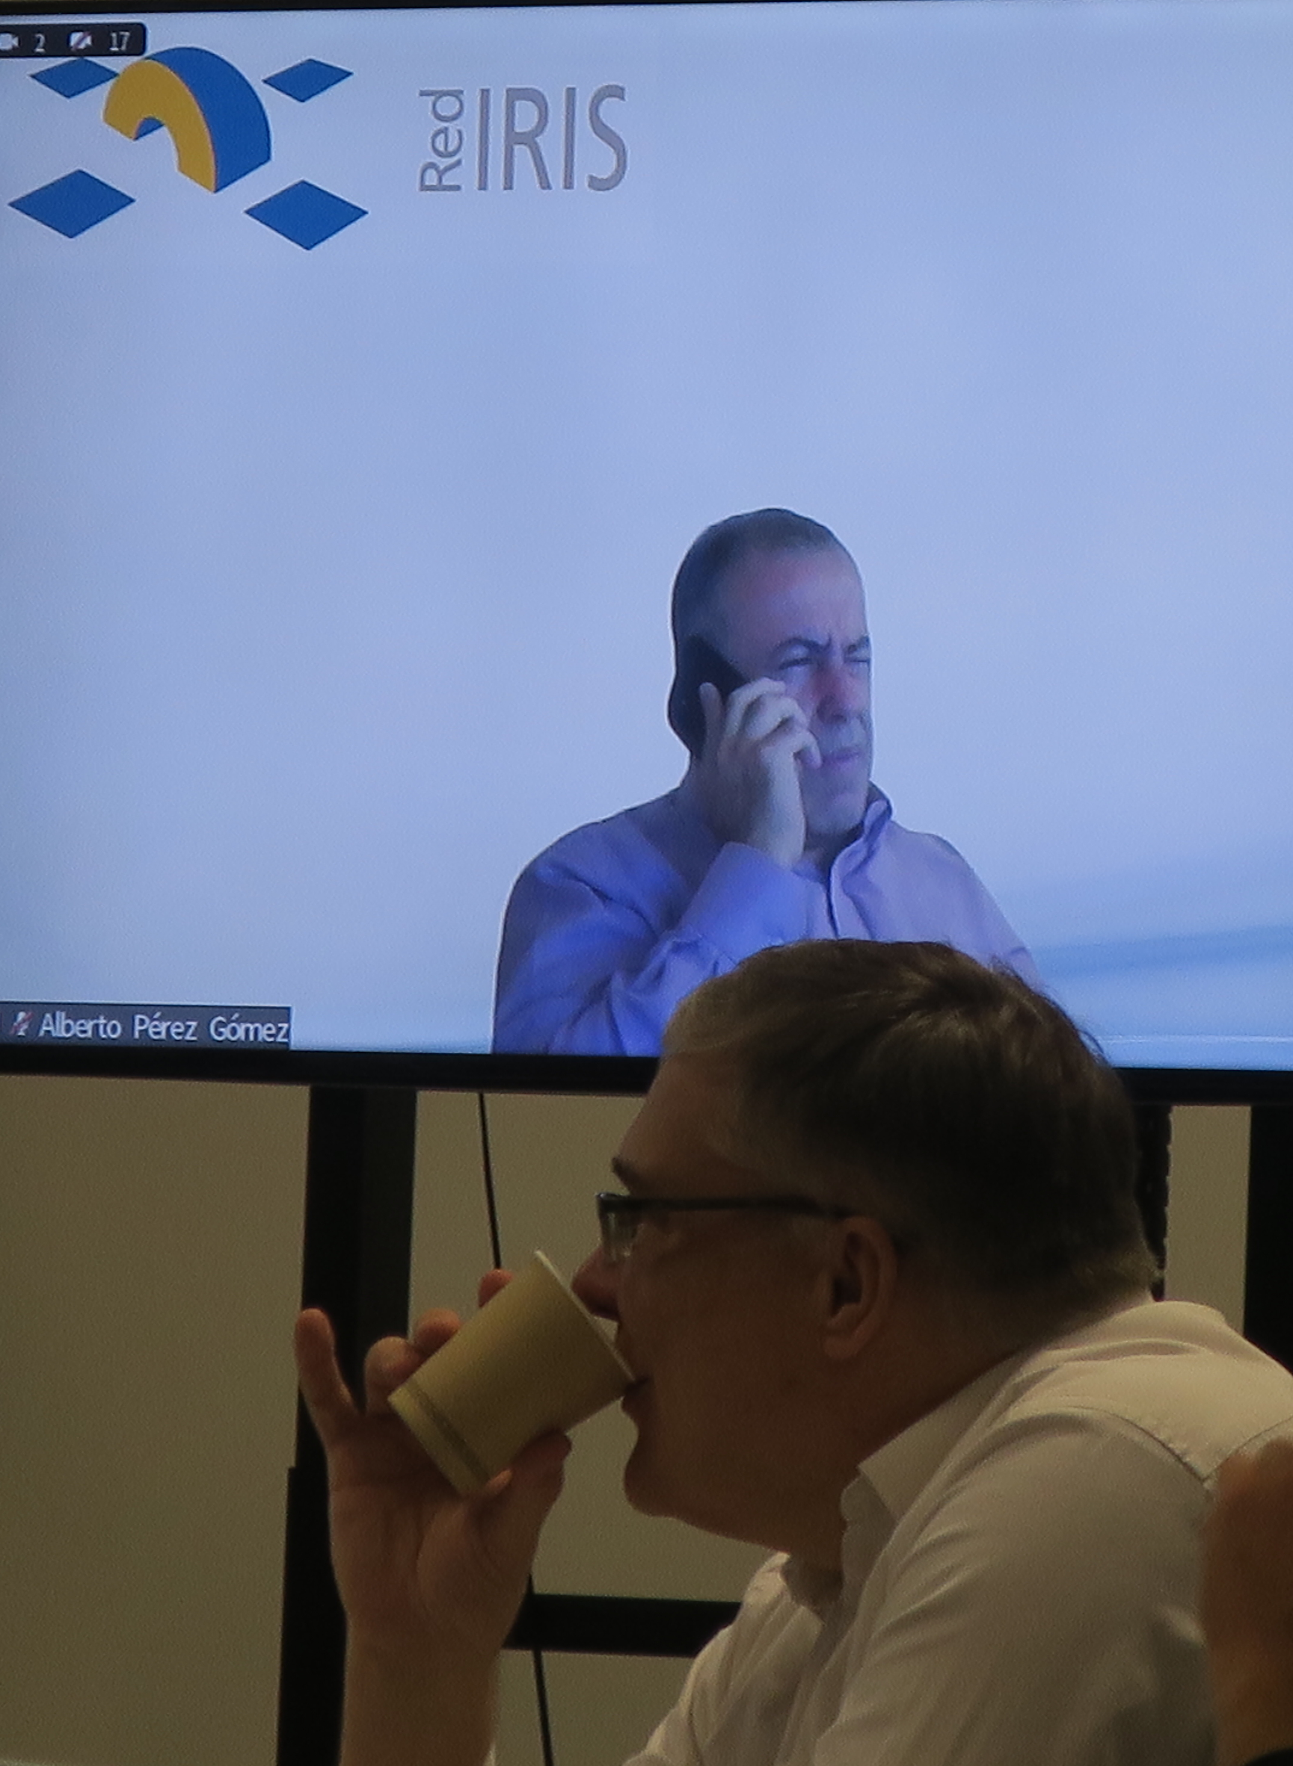
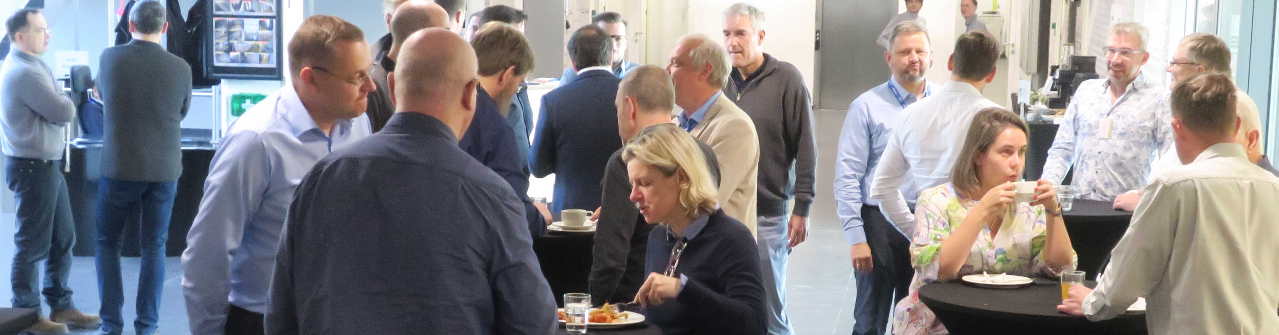
SIG-MSP – who?
NREN portfolio managers (and to some extent NREN service leads)
NREN management in general
GEANT service managers
GEANT management

Slide 10
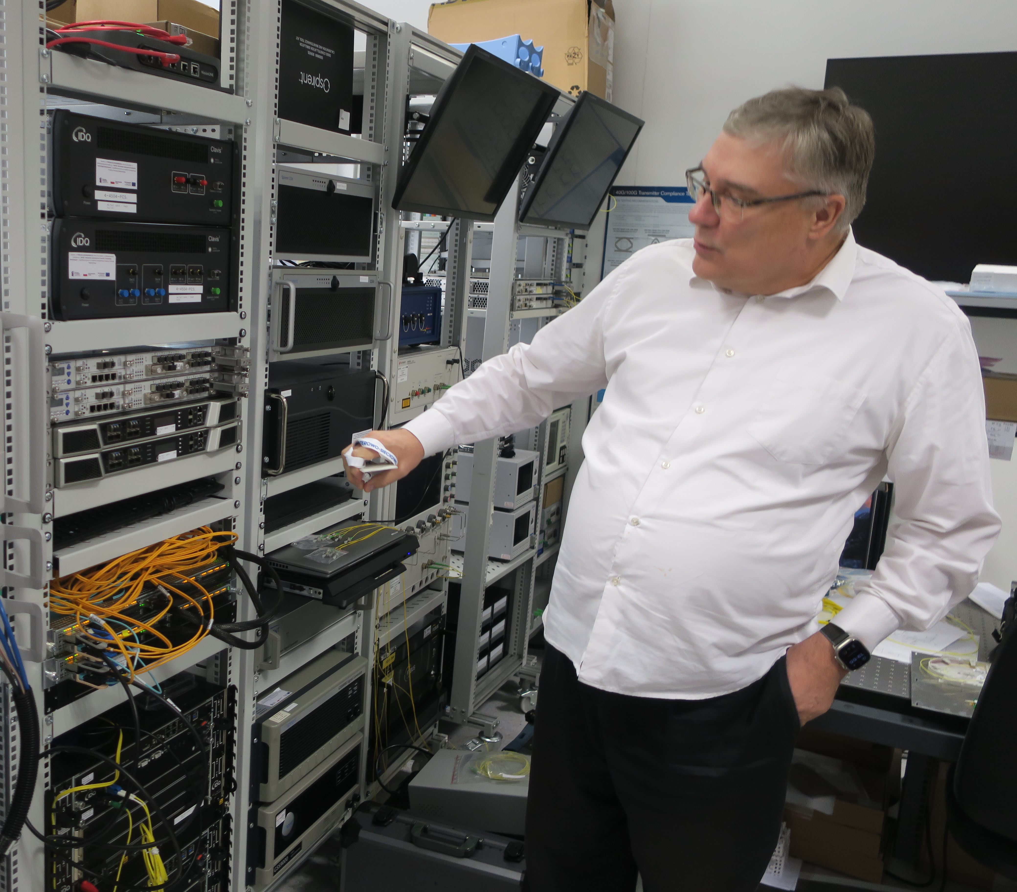
SIG-MSP – why?
NRENs are unique in their countries
NREN management has no other groups or fora with this focus
NREN staff involved in existing services go the relevant groups and for, but where do we introduce new services to the NRENs, except in SIG-MSP
NREN management can’t go to ”all” groups and infoshares, but they still need to gather inspiration and meet other NRENs
A good way to engage with the hosting NREN

Slide 11
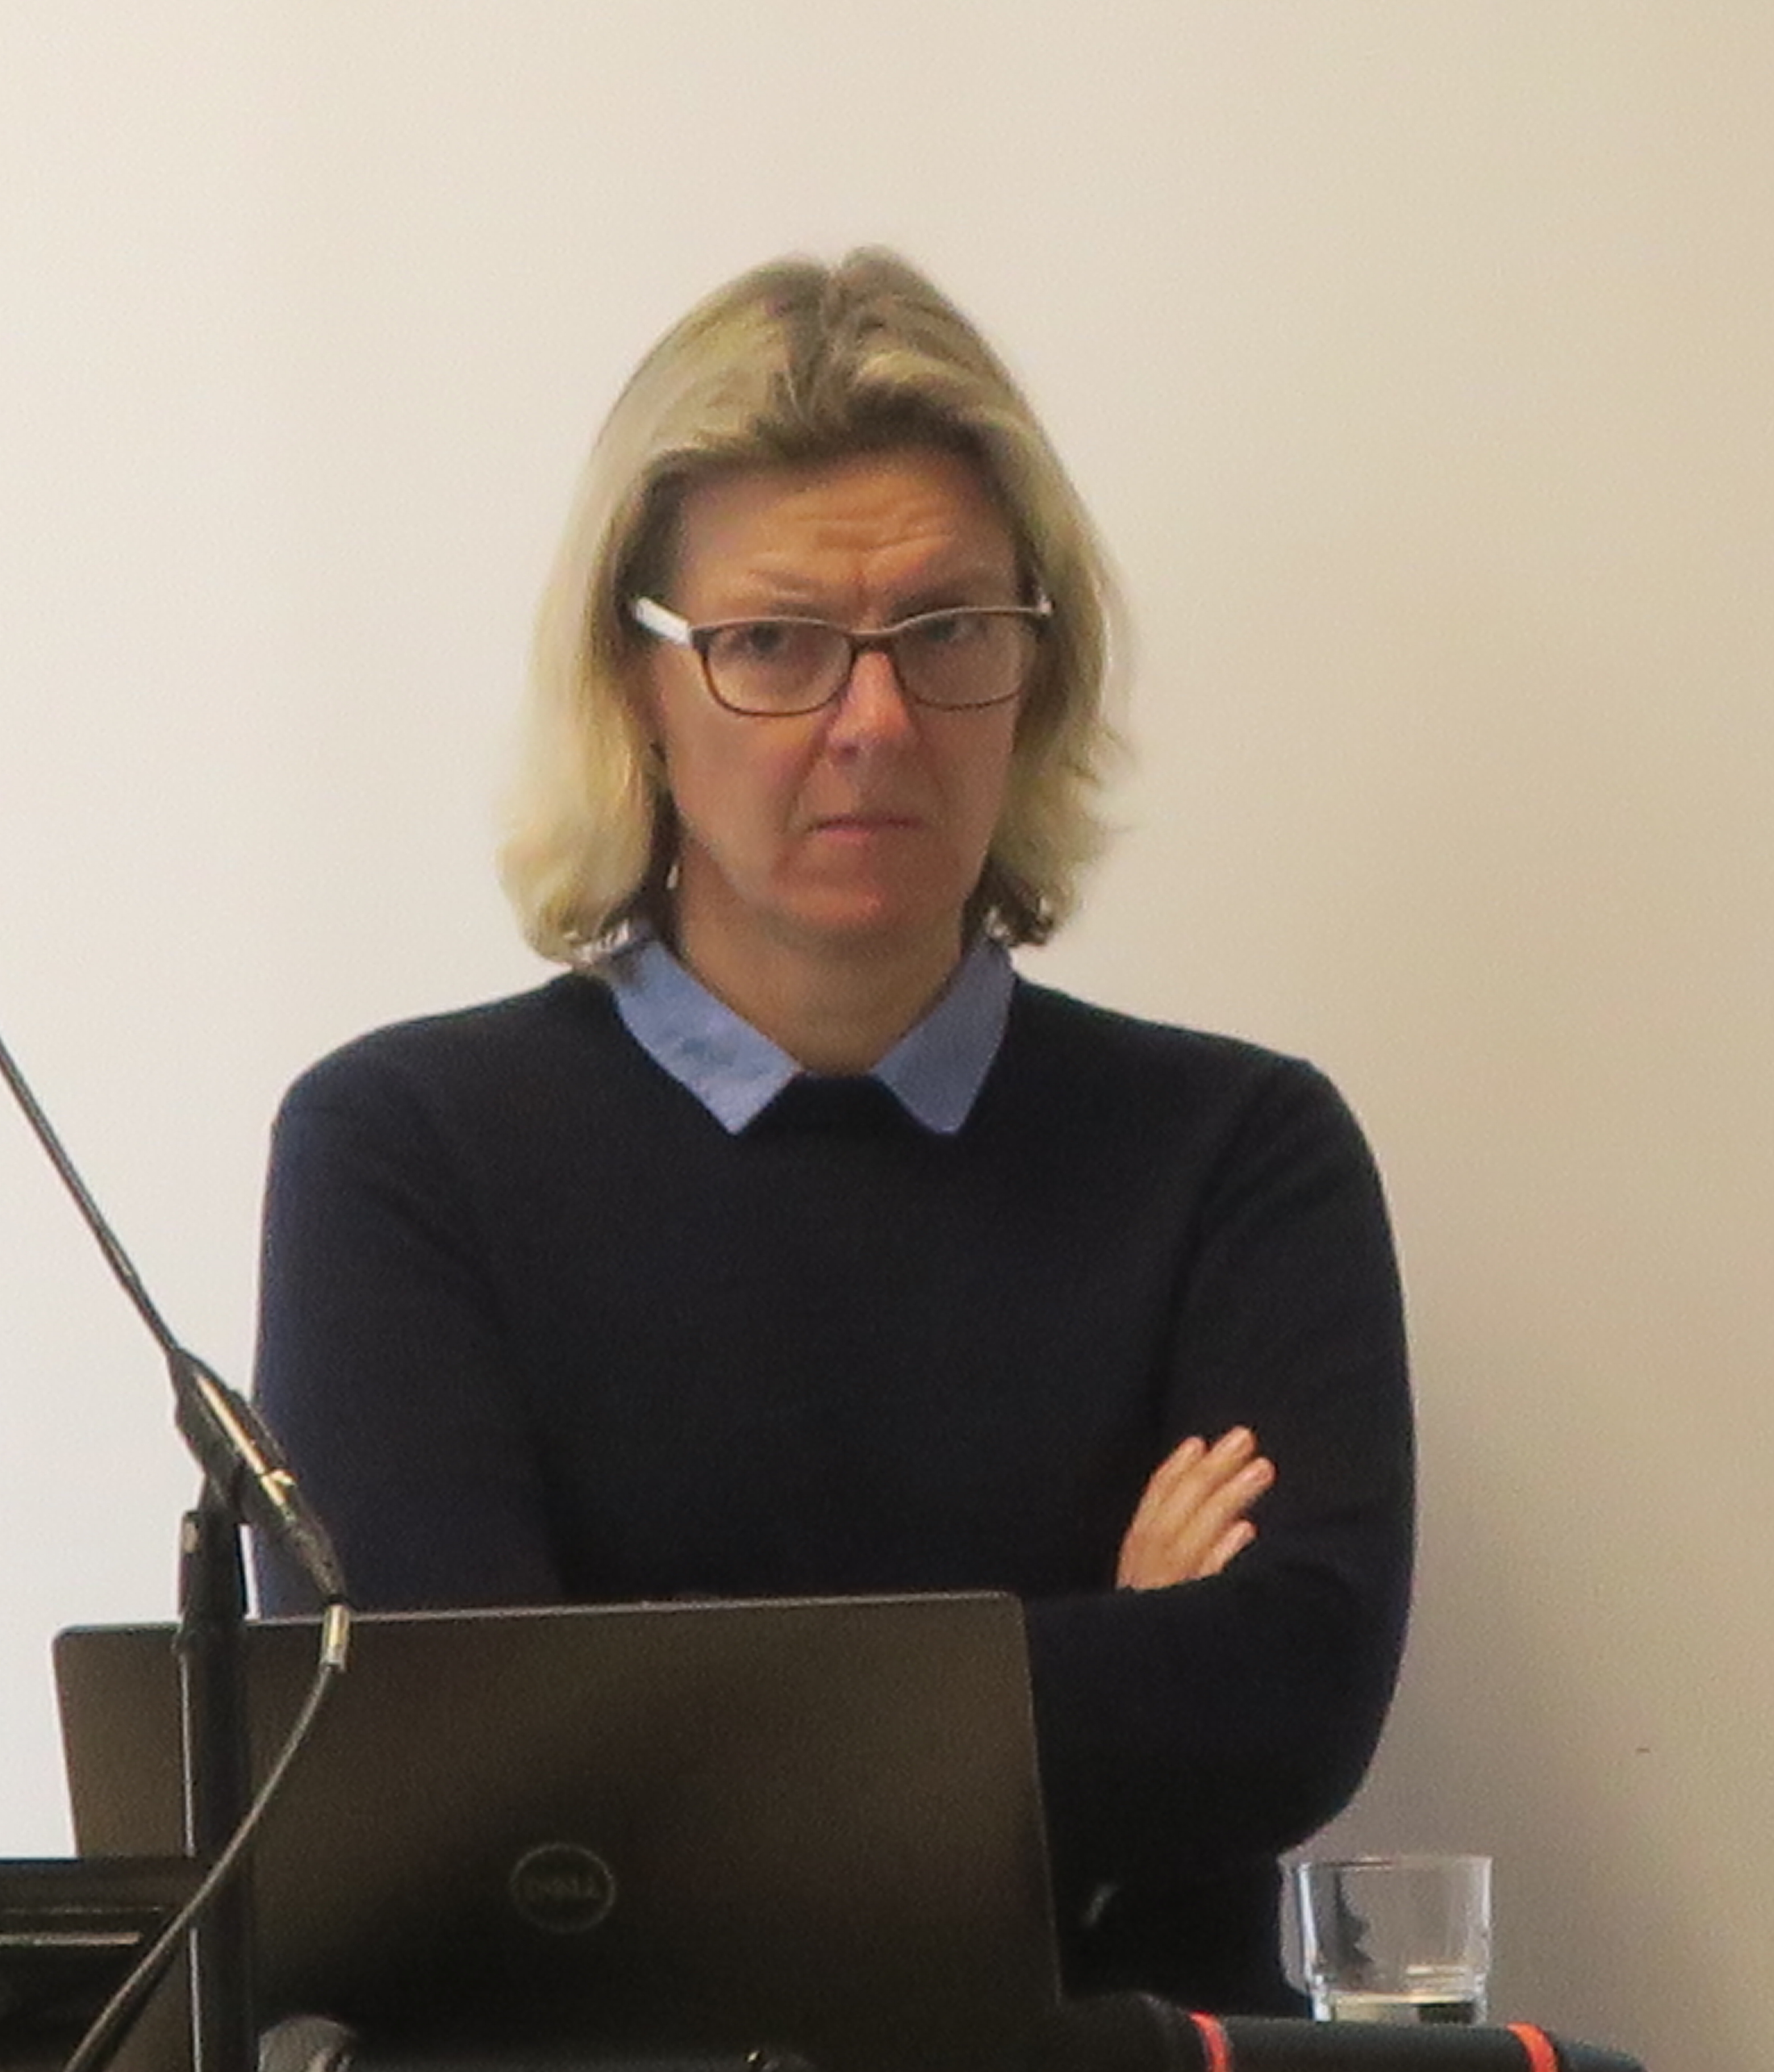
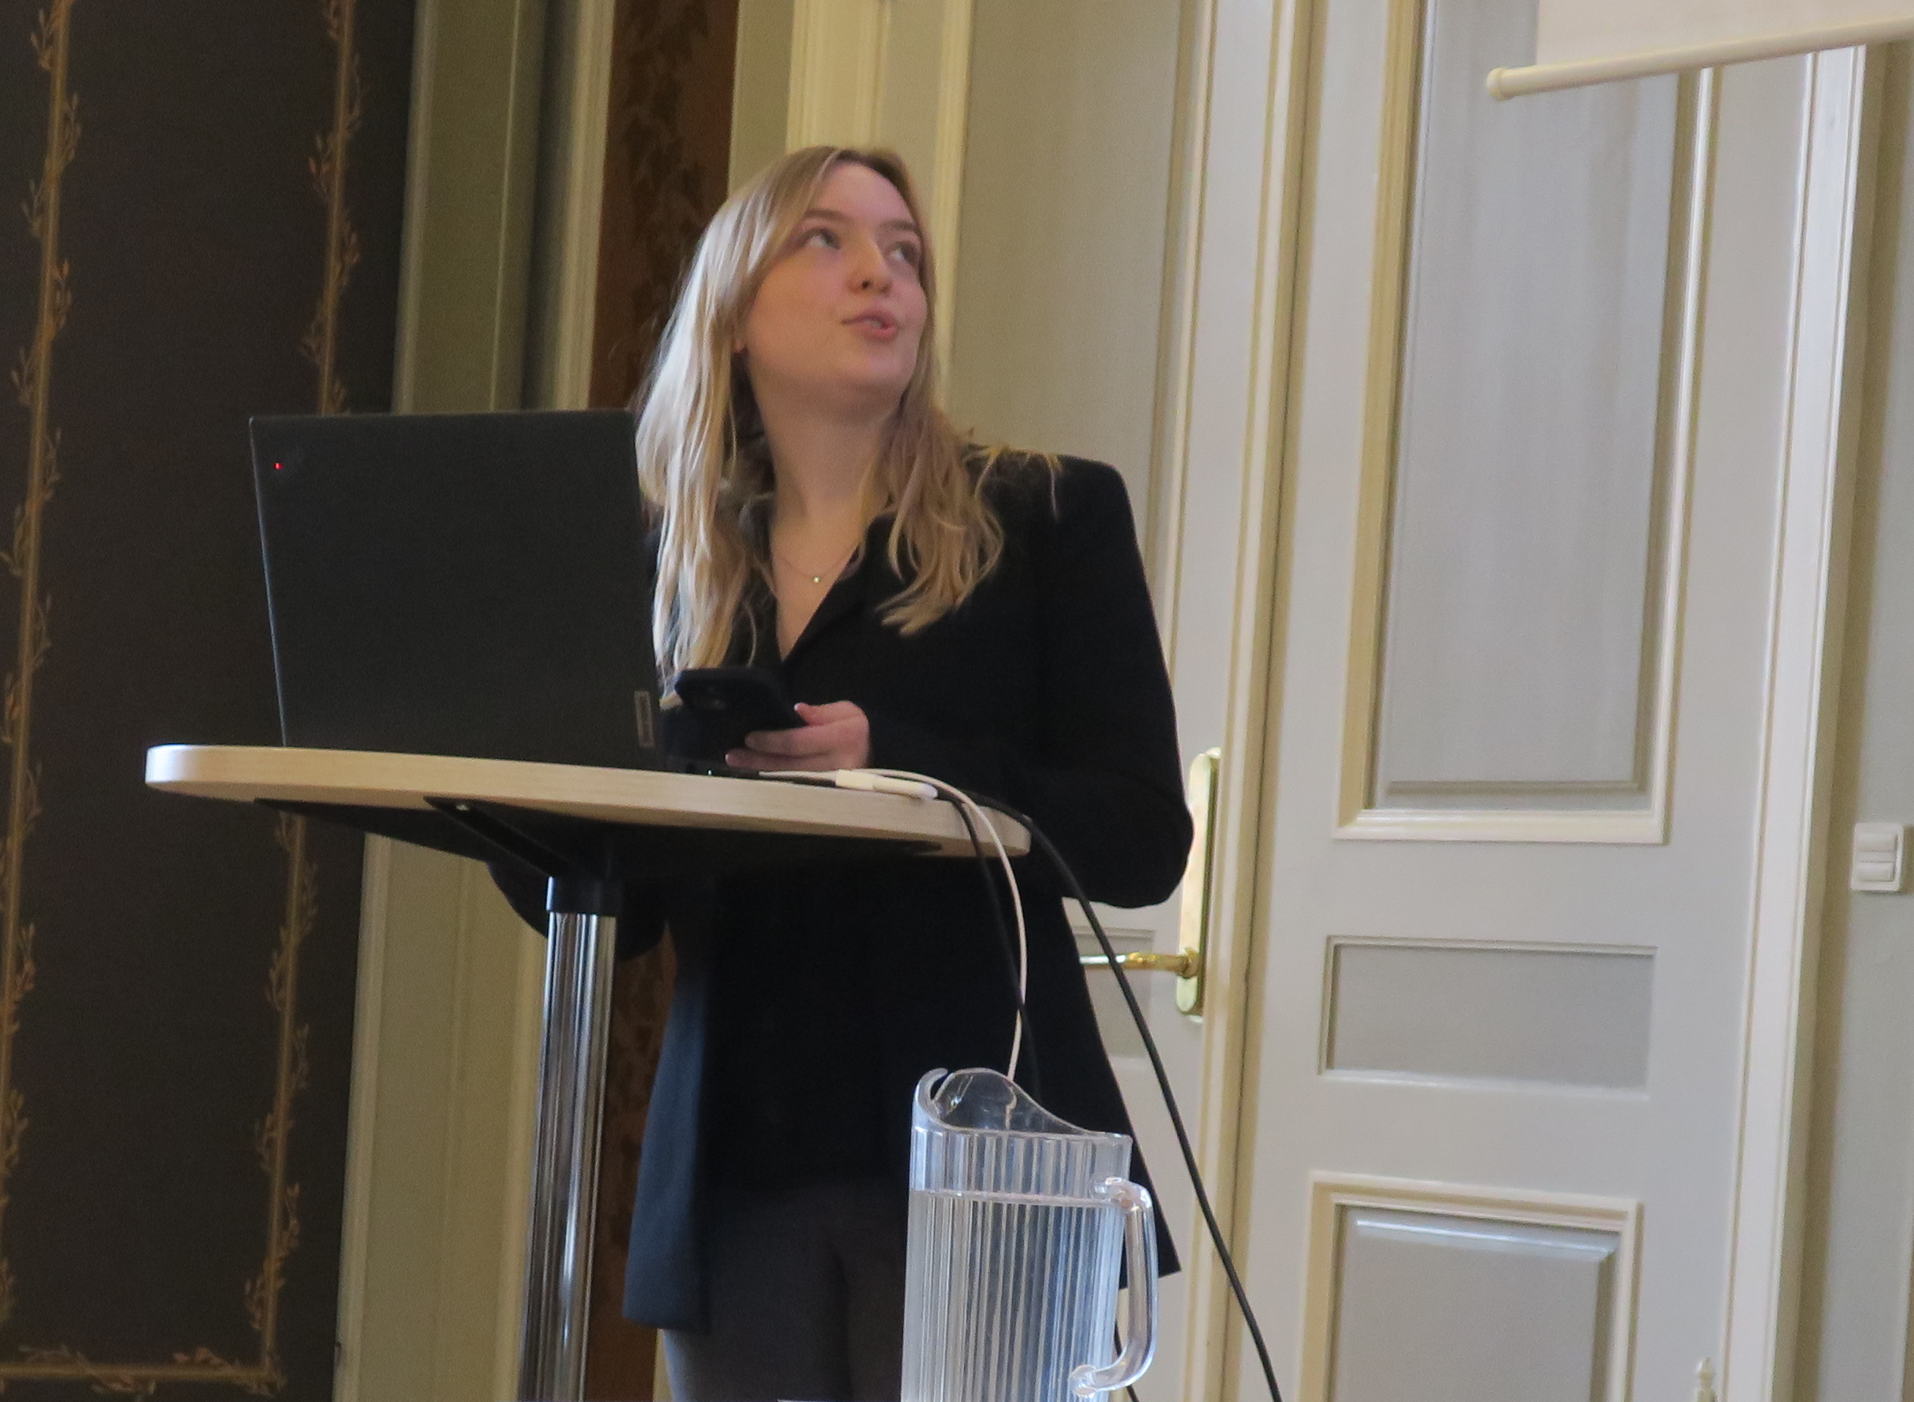
Thanks the invaluable support from GÉANT

Slide 12

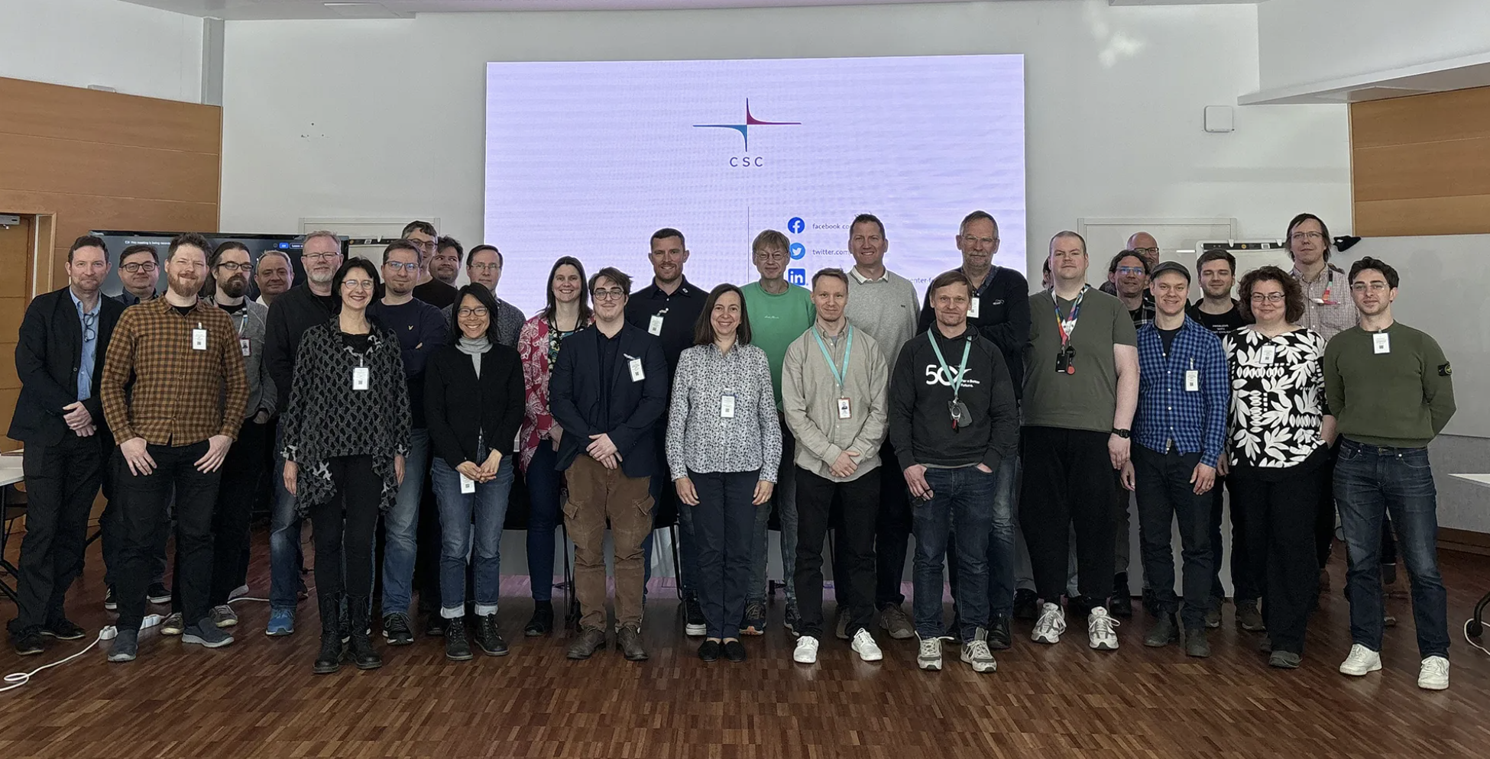
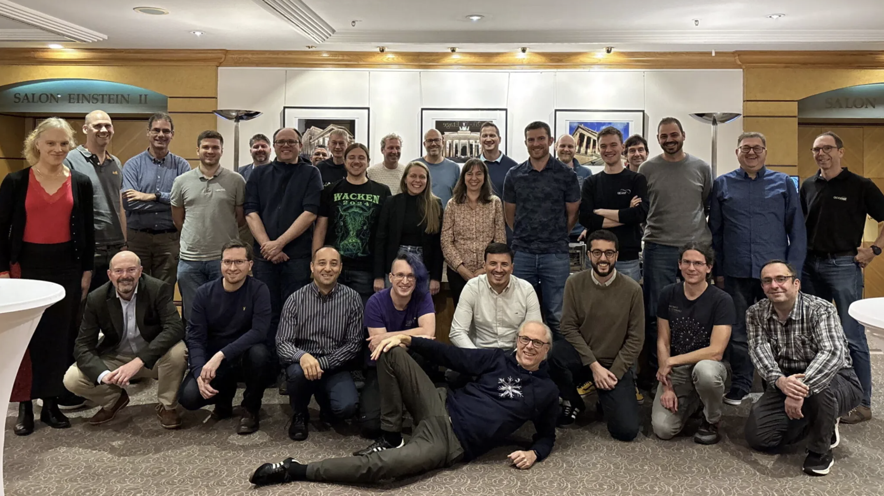
SIG-NOC
GCP Workshop Lightning Talk
14 May 2025

Slide 13
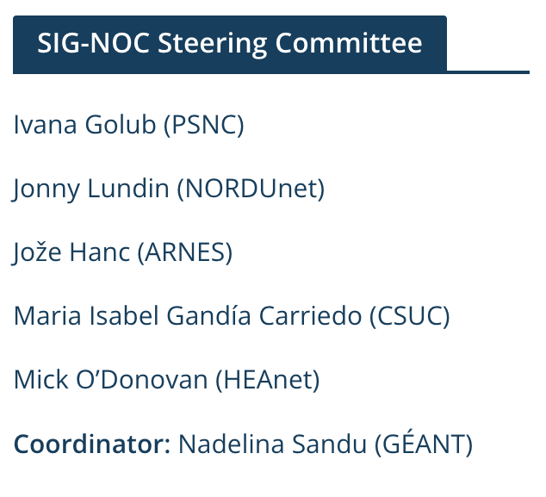
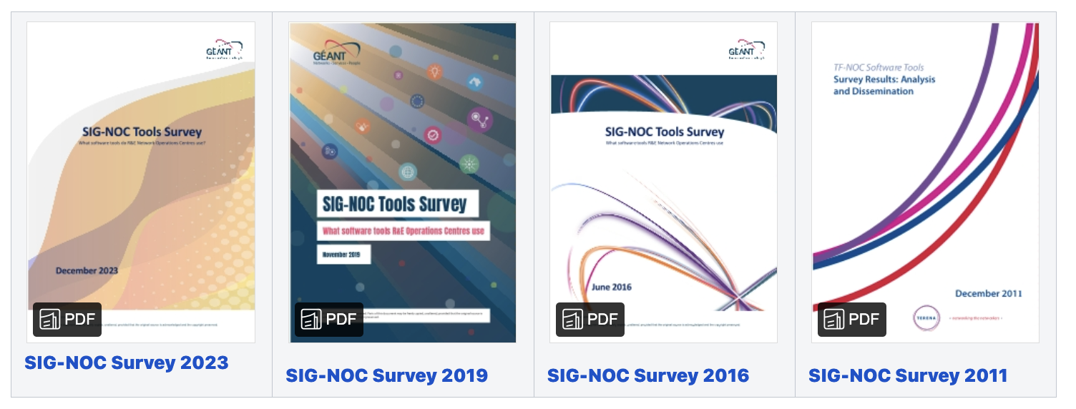
SIG-NOC Overview
NOC = Network Operations Centres
Former GÉANT Task Force (aka TF-NOC)
SIG-NOC had its first meeting in 2015
Mailing list contains 269 subscribers
2 hybrid meetings per year
  50-55 participants per meeting (online + on-site)
  leading NOC engineers and staff members
  coming from NRENs universities
SIG-NOC tools survey

Slide 14
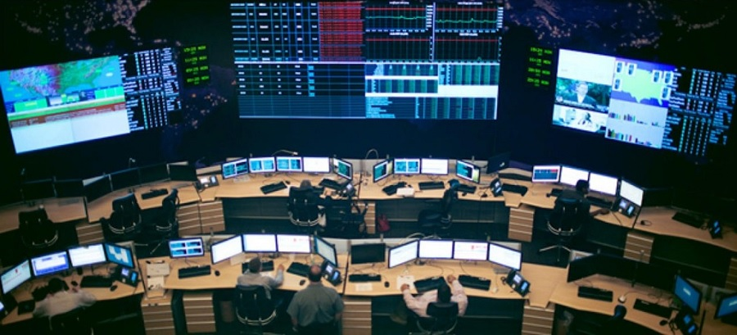
Areas of interest
Everything that helps NOC personnel in their daily work!
Network infrastructure technologies and services
NOC tools, systems and functions
Best practices, procedures, workflows
NOC organisation models and interworking
Presentations from:
NRENs, Universities, Vendors
Single / multi-domain / federation
Europe, Globally
Image source: OpServices

Slide 15
NOC Challenges
science integration
automation
skills
training
federated operations
operations
security
staffing
ai
ai for NOC
regulation
network migration
cloud networks
open source vs paid
quantum
resilience
troubleshooting
elephant flows
global integration
documentation
customer communication
funding
vulnerability management
data flows
procurement
global connectivity
integration
scalability
in-house vs external development
policy
European tools
data sharing
strengthening NOC teams
RPKI OTFN QKD PTP BGP WFO DNS MANRS CMS SOC DDoS NIS2 NetDevOps…

Slide 16
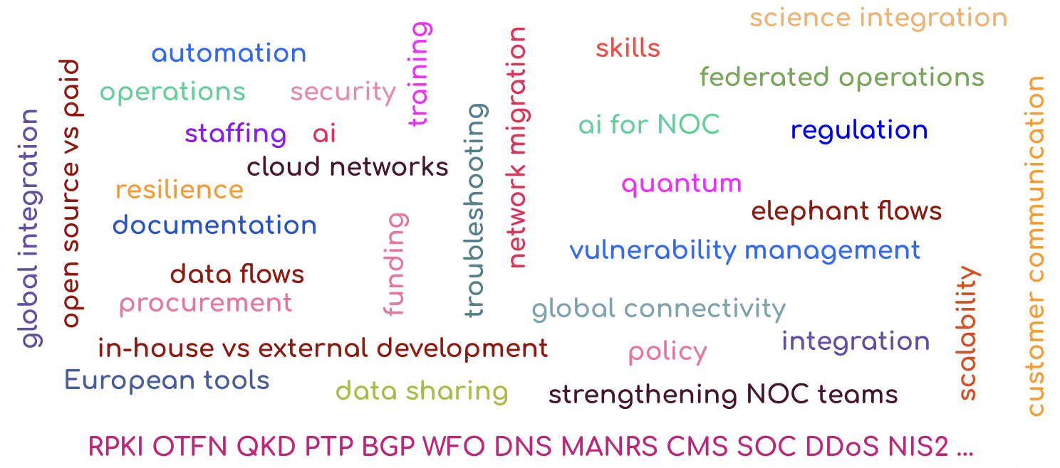
SIG-NOC Challenges
New / more people joining meetings
Self-funded in-person attendance
Proactivity - getting more talk proposals
Most of speakers are invited to present
Covering all the topic areas of interest at the wanted level and depth
Addressing the challenges:
Show must go on!
Collaboration: the GÉANT Project WPs, GNA-G and its WGs, …

Slide 17
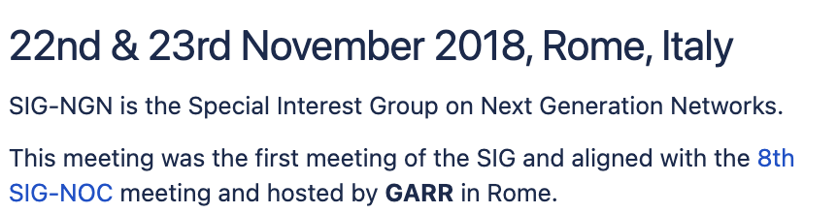
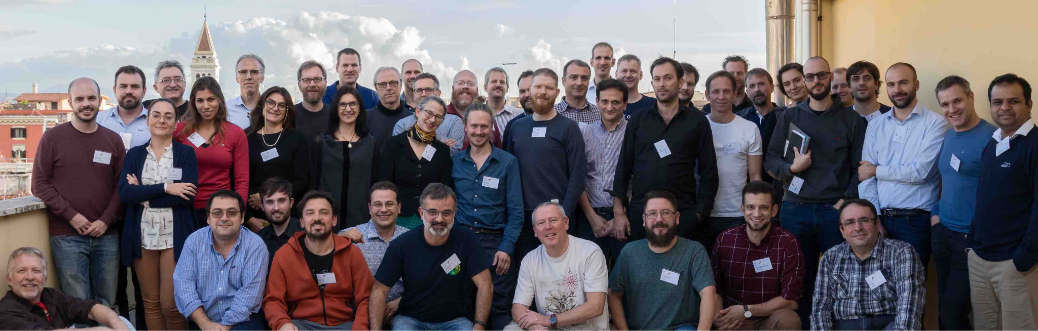
Opportunities for Collaboration
Past collaborations:
Joint meeting with SIG-NGN
21-23 Nov 2018, Rome Italy
Discussion on repeating the experience, when the calendars allow

Slide 18
Opportunities for Collaboration
Common interest (for future collaboration) with:
Quantum
TFN - Time & Frequency Network
AI: Artificial Intelligence
MSP: Management of Service Portfolios​
-Sustainability
-Marcomms: Marketing Communications​
-EDU: Educational Technologies
-ISM: Information Security Management
-Procurement
-CISS: Cloud Interoperable Software Stacks​
-NGN: Next Generation Networks
-RED: Research Engagement Development​
Possible collaboration - WHAT
NOC/Network related SIG-* update
Network support for -*
Promoting SIG-NOC work (and vice versa)
SIG-* specialty applied to NOCs
SIG-
Possible collaboration - HOW
Tailored for NOCs
Presentations
Email updates
Discussion
-DigitalHealthData: Digital Health Data

Slide 19
Thank You!
Notes:
Thanks for listening! I’m happy to take questions now.

Slide 20
SIG-NGN Overview
Lars Fischer, Mian Usman and Rudolf Vohnout
SIG-NGN SC Members

Slide 21
SIG-NGN: Next Generation Network
The Special Interest Group on Next Generation Networks (SIG-NGN) operates under the GÉANT Community Programme. We serve as an open forum where network technology experts from the research and education (R&E) community, vendors, and specialists converge to exchange knowledge, ideas, and best practices.
SIG-NGN focuses primarily on disruptive and emerging technologies that have the potential to significantly impact, improve, or advance the networking and communications to the next level.
Our Steering Committee comprises representatives from organizations such as Jisc, CERN, CESNET, ESnet, NORDUnet, and GÉANT, with coordination by Carsten Pettersson from NORDUnet.

Slide 22
Areas of Interest and Challenges
Facilitating knowledge exchange and collaboration on developments in networking technologies, network management and services.
Facilitate discussions on technologies, tools, methods, use cases, trends and best practices that will impact the evolution of R&E networks.
Recent meetings have delved into topics such as spectrum sharing, underlay and overlay networking, and intercontinental connectivity architectures, especially in the context of supporting large-scale scientific endeavours like the Square Kilometre Array (SKA) and the Large Hadron Collider (LHC).
Main Challenges in Our Thematic Area
  Scalability and Performance
  Interoperability
  Resource Sharing
  Sustainability
  Implementation Challenges

Slide 23
Opportunities for Collaboration
Collaboration is pivotal to our success. Opportunities include:
  Joint Meetings: Co-locating meetings with groups like the LHC networking group, side-meeting at network conferences and initiatives related to the SKA fosters interdisciplinary dialogue and shared learning.
  Emerging Technologies: Engaging with SIGs focusing on areas such as Time and Frequency Networks (SIG-TFN), AI (SIG-AI) or Quantum (SIG-Quantum) to explore synergies in network evolution activities.
  Emerging Technologies and Operational Realities: Interactions between emerging technologies and operational challenges. (SIG-NOC, STF)
  Community Building: Collaborating with NRENs, vendors and other stakeholders to build communities of practice around emerging networking technologies and services.

Slide 24
Any questions?

Slide 25
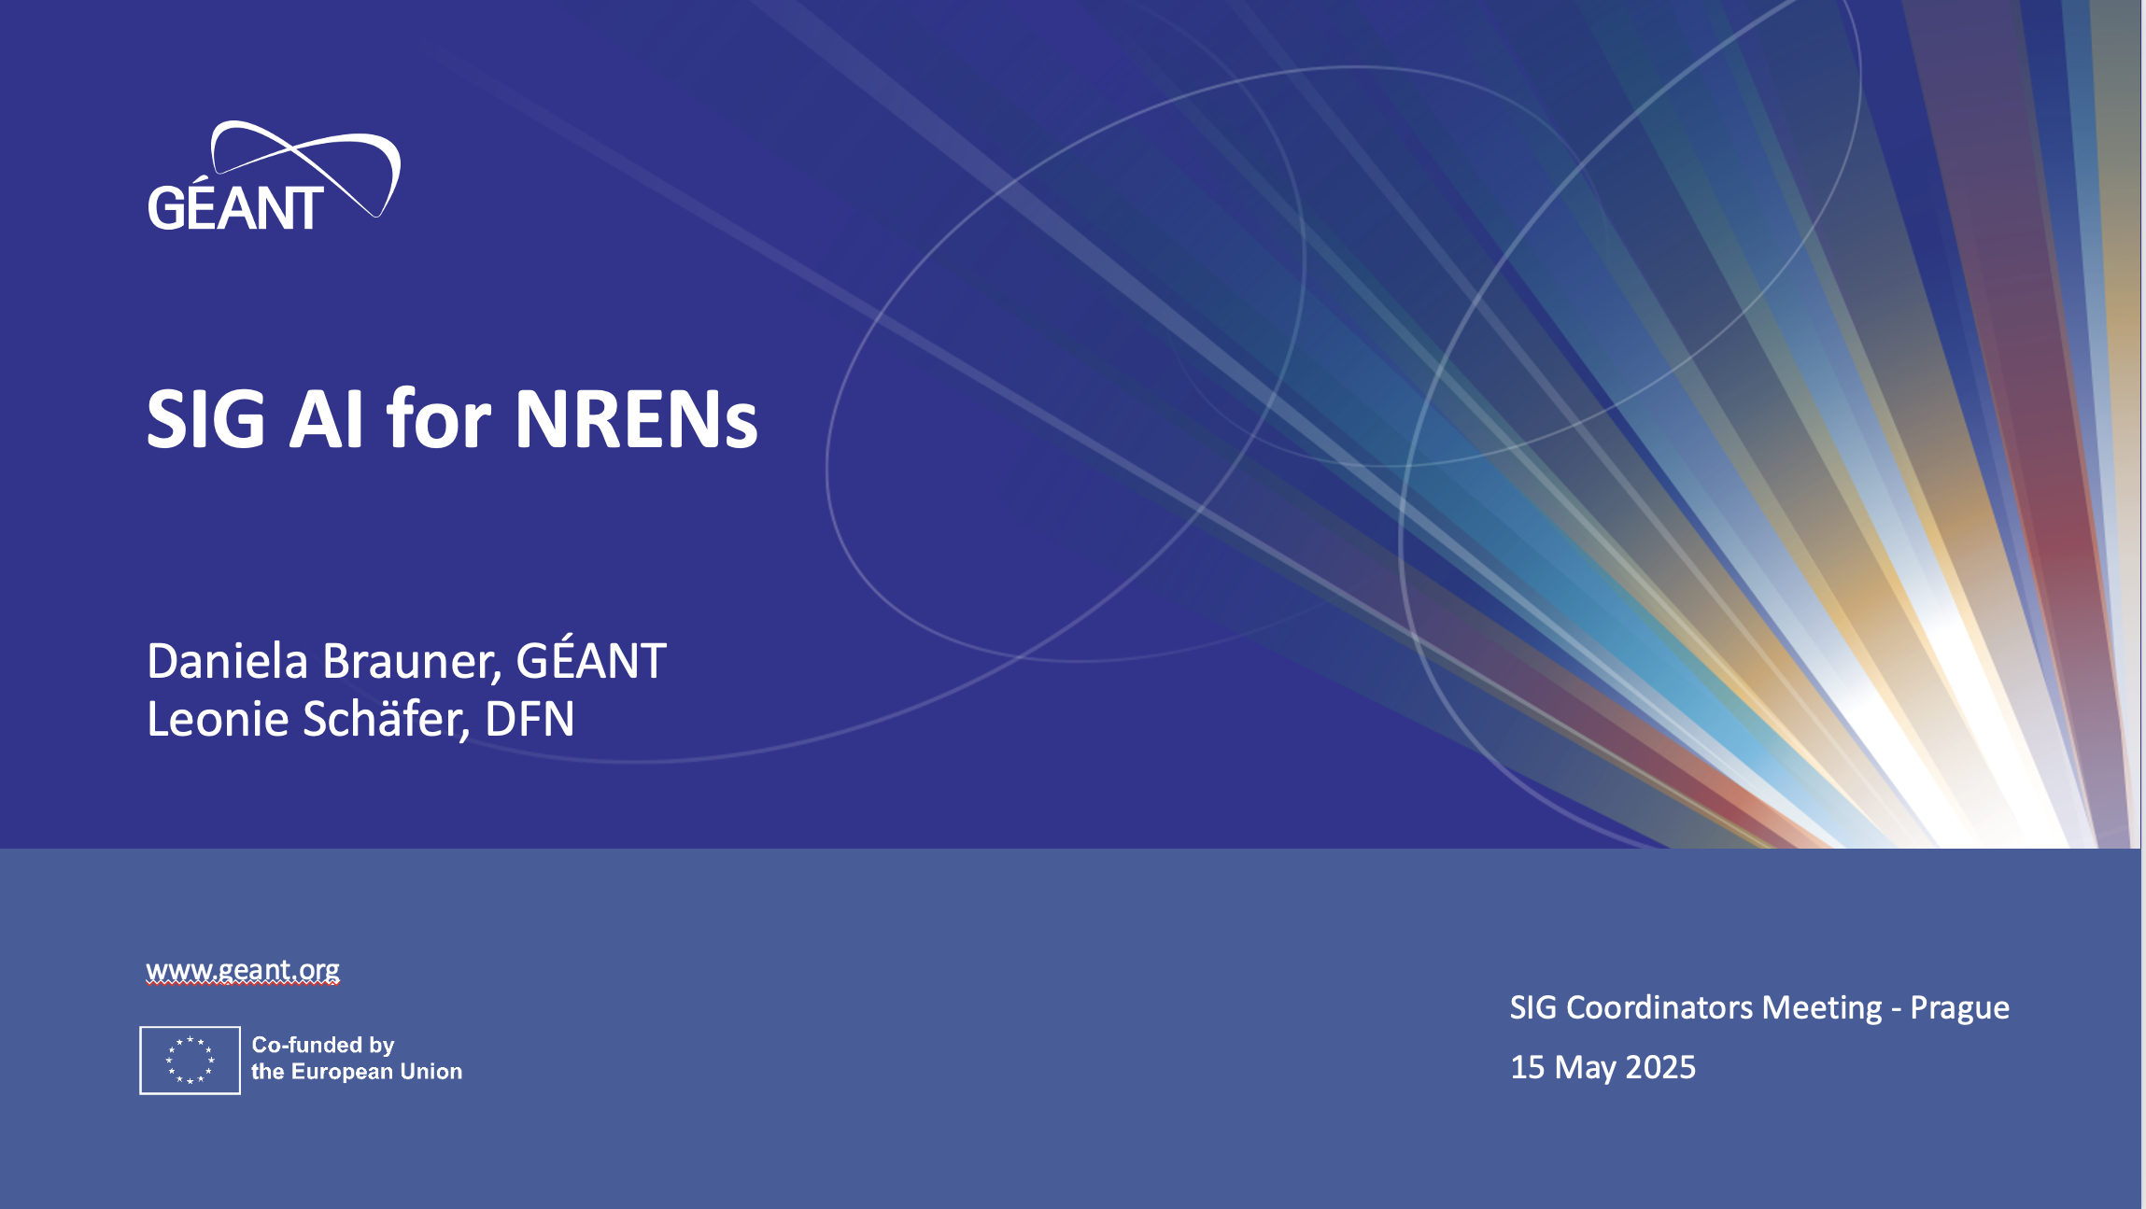

Slide 26
Who SIG-AI is?
Newly Established SIG: Started in 2024 at TNC24 in Rennes
Focus: Exploring the potential applications of AI within the context of NRENs
Horizontal Approach: Delving into various areas where AI can enhance NREN services
Areas of Exploration: Cybersecurity, Network Automation, Next
Generation Networks, Ethics, Policy, and Above-the-Net Applications
Objectives: Knowledge Sharing, Use Case Development

Slide 27
Who are we?
Coordinator: Leonie Schäfer (DFN)
Chair: Daniela Brauner (GÉANT)
Steering Committee Members:
  Hrachya Astsatryan (ASNET-AM)
  Jan Kohlrausch (DFN-CERT)
  Albert Hankel (SURF)
  Marcin Wolski (PSNC)
  Panos Louridas (GRNET)
Wiki: https://wiki.geant.org/display/SIGAI/SIG-AI+Home

Slide 28
SIG-AI Areas of interest
Cybersecurity: AI for Security and Security for AI
Network Management and Automation
Next Generation Networks
Above-the-Net Applications
AI Support for Research and Education
  AI for Research
  AI for Education
Ethics and Policies

Slide 29
SIG-AI Main challenges
Super hot topic!!!
Several uses of AI for Research and Education
Several initiatives inside and outside our community
  AI is a cross-cutting theme within the GÉANT project
Lots of discussions and initiatives inside and surrounding the community
  Several national initiatives from NRENs and other institutions
  international initiatives *partner NRENs
  EC initiatives
Other SIGs also have been discussing AI in their contexts:
  SIG NGN, SIG ISM / GÉANT Security Conference, SIG MSP, TF EDU, SIG Procurement and others.
We don’t have a clear strategy for AI in the community
  AI Factories, EU AI Act

Slide 30
SIG-AI Opportunities for collaborations
Joint meetings with different SIGs
Collaborations with other SIGs:
  SIG NGN
  SIG ISM / GÉANT Security Conference
  SIG MSP
  TF EDU
  SIG Procurement
  SIG RED
  to be continued

Slide 31
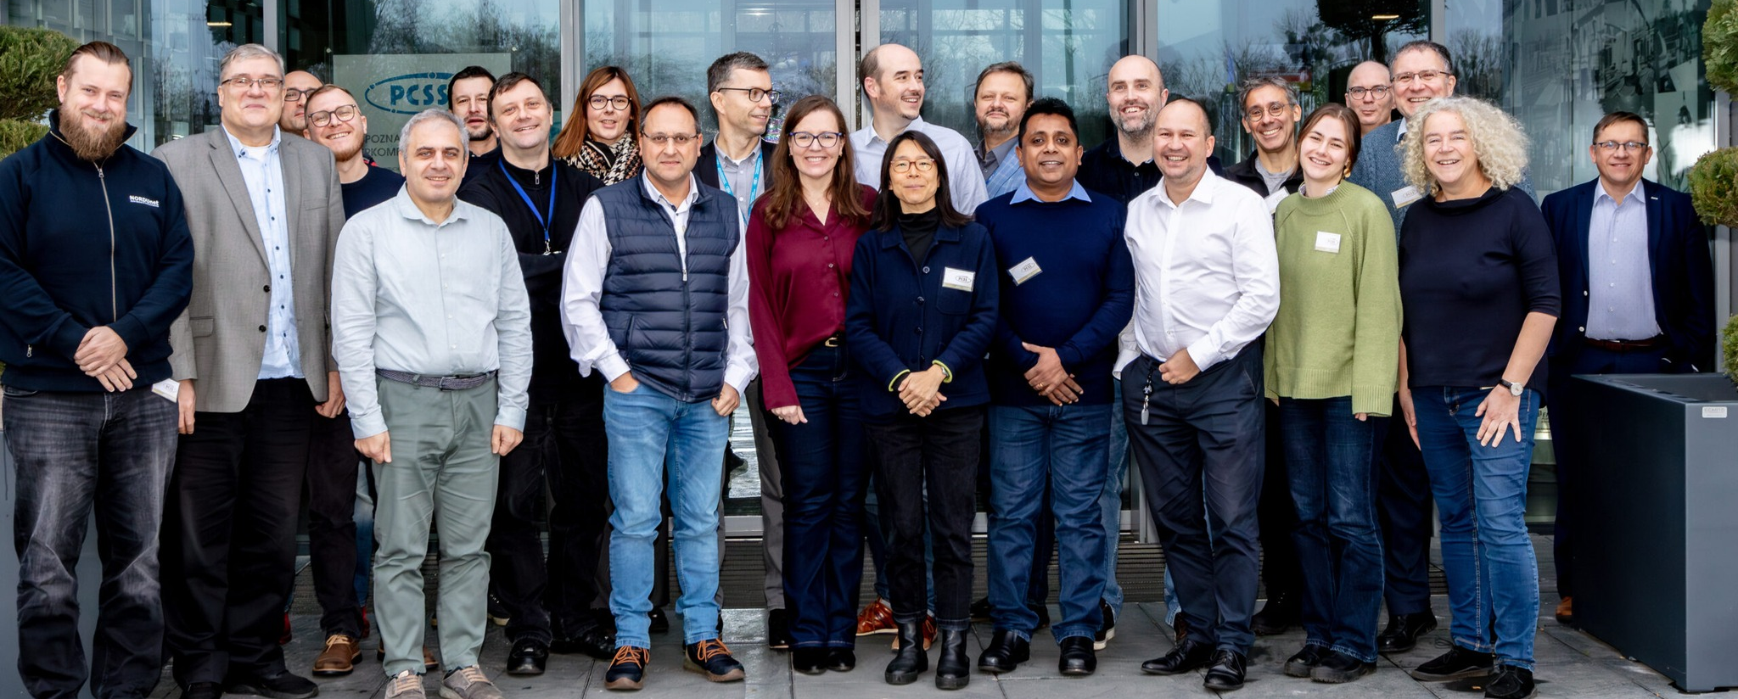




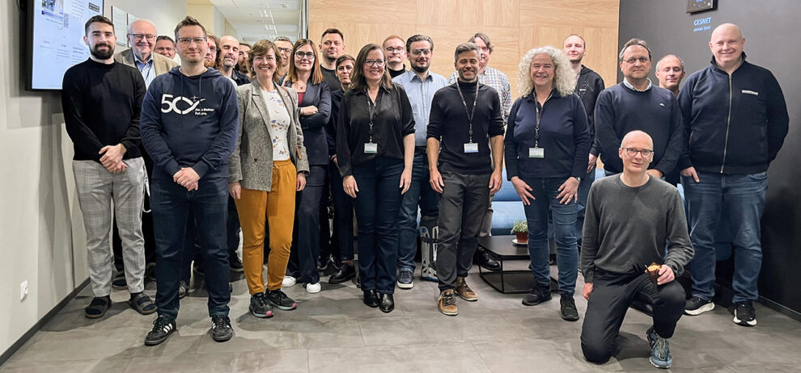
SIG-AI Roadmap
4th SIG-AI Meeting
(Copenhagen)
Jointly with TF-EDU at NCW'25
AI in Education
June/24
TNC24 – Rennes
Community Hub round tables about SIG-AI idea
September/24
Kick-off meeting SIG-AI SC
December/24
1st SIG-AI Meeting
(Poznan)
General Overview
April/25
2nd SIG-AI Meeting
(Prague)
AI & Security
Panel during GÉANT Security Days
June/25
3rd SIG-AI Meeting
(Brighton)
AI & NRENs around the Globe
September/25

Slide 32
Any questions?

Slide 33


SPECIAL INTEREST GROUP ON
RESEARCH ENGAGEMENT DEVELOPMENT
SIG-RED
14-15 of May

Slide 34
Chris Atherton (GÉANT)
Sylvia Kuijpers (SURF)
Olga Popcova (RENAM)
Daniela Brauner (GÉANT)
Victoria Moody (Jisc)
Christopher Walker (Jisc)
Eli Shmueli (IUCC)
SIG-RED Steering Committee

Slide 35
Supports research engagement development among NRENs and research infrastructures.
Creates a global forum for sharing knowledge, methods, and collaboration strategies.
Builds a community of professionals focused on innovation in research support.
Develops frameworks and best practices for national and international research engagement.
Helps NRENs stay future-ready by aligning services with current and emerging research needs.
Enhances value and visibility of NREN services to both existing and potential research users.
Strengthens communication and coordination between participating organisations.
Contributes to the global R&E community by expanding collaboration opportunities for researchers.
Why SIG-RED exists?

Slide 36
Explore how NRENs engage researcher's teams using HPC;
Coordinate Quantum computing infoshare series: learn how NRENs are involved in setting up a Quantum Computer, researcher engagement, future security challenges, high connectivity, how researchers use Quantum (use cases), etc;
Explore how NRENs engage research teams in data centers, data center sustainability and data management;
Explore how NRENs are supporting and engaging research communities, for example; the Earth Observations community.
Areas of interest

Slide 37
Main challenges
Wide scope of research areas to cover (several disciplines)
Not all NRENs have specific people to Research Engagement activities, to participate in SIG-RED
Several levels of support for researchers (departments, institution, NREN, RREN,…)

Slide 38
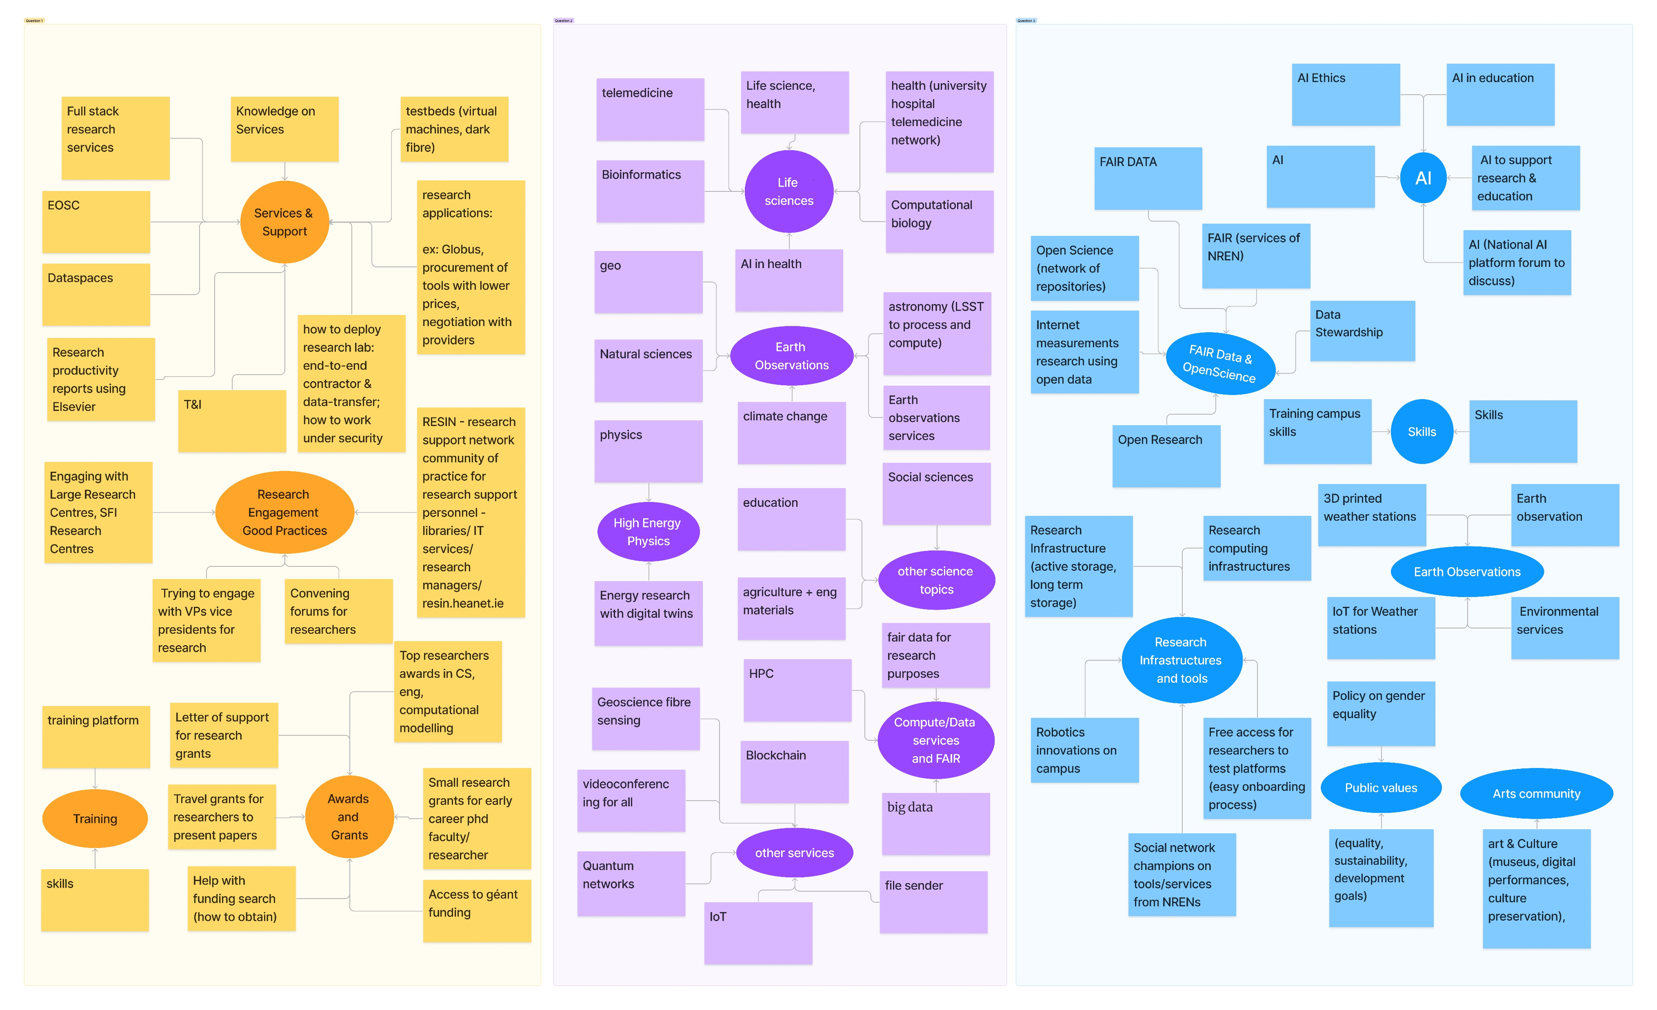
Main challenges

Slide 39
SIG-RED Activities
In person meetings at TNC
Visits to research institutes
Infoshares about research engagement stories

Slide 40
Collaboration
SIG-AI: Artificial Intelligence
SIG- Content
SIG- Quantum
SIG-NGN: Next Generation Networks
TF-EDU: Educational Technologies
AARC Engagement Group for Infrastructures

Slide 41
SIG-RED at TNC25
Research Institute Visit
University of Sussex - a leading, research-intensive university
Monday, June 9, 2025, 14:00-17:00
Department | Lab | Host
Engineering | Centre for Advanced Telecommunications and Signal Processing (CTS) https://www.sussex.ac.uk/research/centres/acmi/ | 6G Lab (Prof. M. Nekovee) V2X Lab (Prof. Z. Sheng)
Engineering | Centre for Robotics and Sensing Technologies https://www.sussex.ac.uk/research/centres/centre-for-robotics-and-sensing-technologies/ | Robotic Lab (Dr Y. Li)
Informatics | Creative Technology Group https://www.sussex.ac.uk/research/centres/creative-technology/ | HCI Lab (Dr G. Memoli)
Informatics | Foundations of Software Systems Group https://www.sussex.ac.uk/foss/research | Network management (Prof. G. Parisi) Congestion control / Security (Prof. L. Berthouze)
Physics | Sussex Centre for Quantum Technologies https://www.sussex.ac.uk/research/centres/sussex-centre-for-quantum-technologies | Ion Trap Cavity-QED Lab (Prof. M. Keller)

Slide 42
SIG-RED activity
Engaging and understanding R&E communities is critical for the sustainability and relevance of our community
14:00 | 14:15 | Overview of SIG developments
14:15 | 14:30 | Jisc Research Engagement (Chris Walker, Jisc) - confirmed
14:30 | 14:45 | Overview of the ESnet Requirements Review Program (Jason Zurawski, ESnet) - confirmed
14:45 | 15:00 | Research Engagement Usecase (Débora dos Reis, RNP) - confirmed
15:00 | 15:15 | Research Engagement HPC Usecase (SURF) - to be confirmed
15:15 | 15:30 | Discussions
15:30 | 16:00 | Coffee Break
16:00 | 17:30 | Final discussions - SIG-RED announcements (next meetings - next steps!)

Slide 43
SIG-RED activity
Amsterdam - November 19, 2024
Nikhef - the science park, the Dutch National Institute for Subatomic Physics
This event offered a unique opportunity to explore two key facilities:
  KM3NeT Assembly Area: A world-class research facility dedicated to constructing the next-generation neutrino telescopes;
  Nikhef Housing Facilities: A major data center and connectivity hub, recognized as one of the largest internet exchange points in Europe.

Slide 44
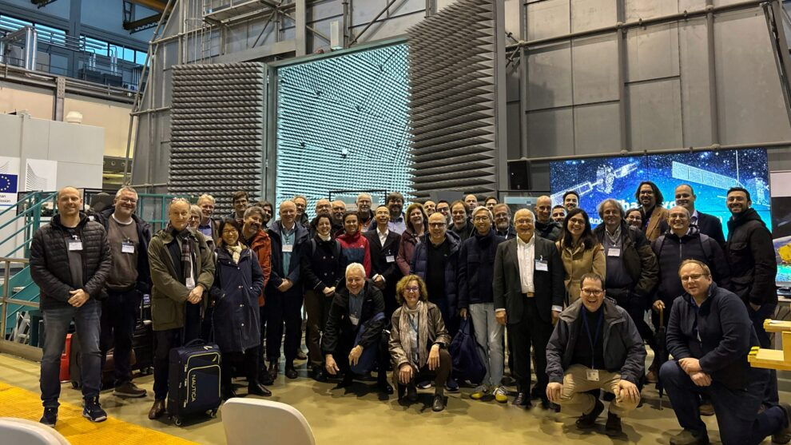
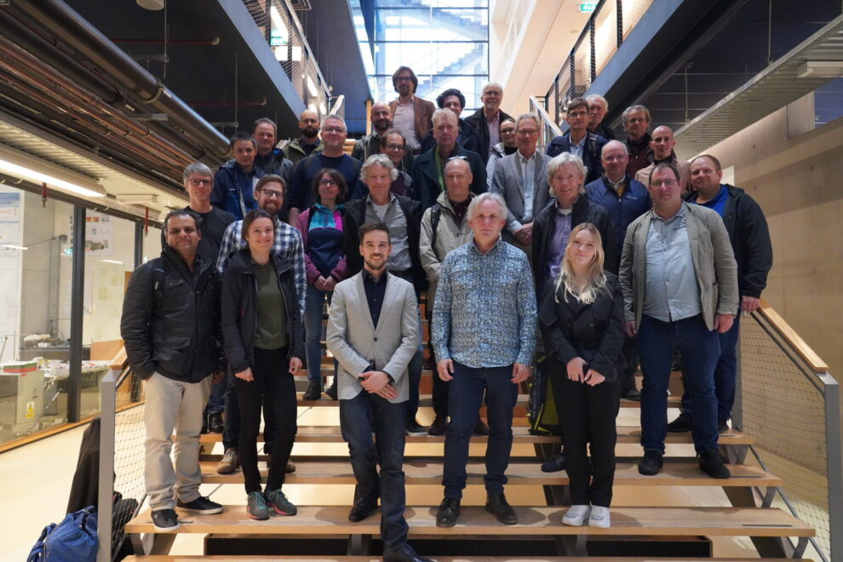
SIG-TFN
GCP Workshop Lightning Talk
14 May 2025

Slide 45
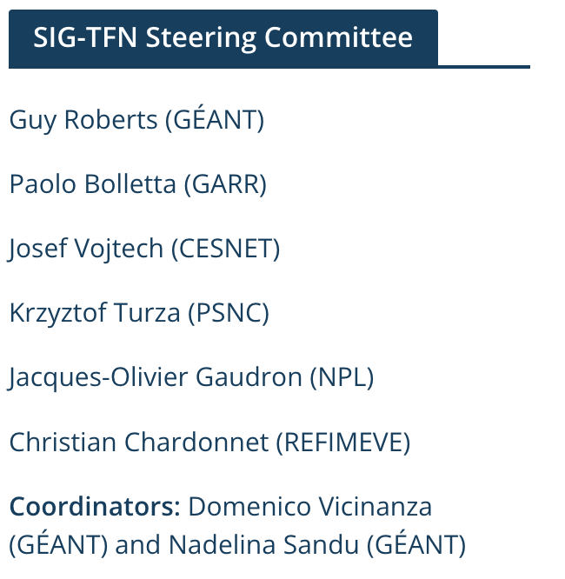
SIG-TFN Overview
TFN = Time & Frequency Network
Aims to gather and exchange experiences, ideas and knowledge on the development, deployment, testing and standardisation of Time and Frequency solutions.
Has an advisory role to GÉANT GPPC.
SIG established in February 2024.
Mailing list contains 129 subscribers
2 hybrid meetings per year
Average nr. of participants attending a meeting (online + on-site): 65-70

Slide 46

Areas of interest
Development, deployment, testing and standardisation of Time and Frequency distribution across R&E networks
Build a Core-Time/Frequency Network
Interoperability between member states
Time & Frequency tools, procedures & workflows
Atomic/optical clocks
New protocols: White Rabbit
Fiber-optic sensing

Slide 47
Challenges
Standardisation (different protocols, technologies)
Interoperability
Use cases are still either
  Very niche (mostly fundamental research)
  Or quite far in the future (low readiness level)

Slide 48
Opportunities for collaboration
Past collaborations | Future collaborations
Joint meeting with SIG-NGN | SIG-Quantum

Slide 49
SIG-Quantum
GCP Workshop Lightning Talk
14 May 2025

Slide 50
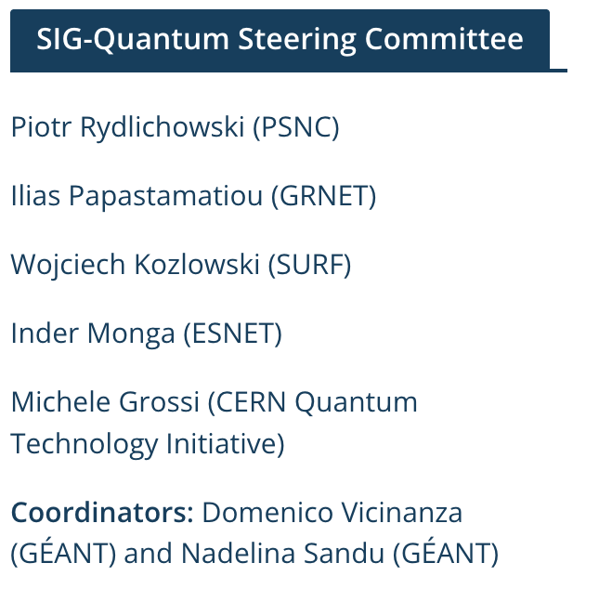
SIG-Quantum Overview
Aims to provide a forum for gathering and exchanging experiences, ideas and knowledge on the development, deployment, testing and standardisation of quantum technologies across R&E networks.
SIG established in February 2025. First year of operation.
Soft launching/kickstarting at TNC2025.
Mailing list contains 43 subscribers.

Slide 51
Areas of interest
Quantum networking
Quantum computing
Quantum sensing
Quantum cryptography
Deployment and testing of quantum solutions

Slide 52
Challenges
Expensive equipment
Lack of off-the-shelf solution
In general low technology readiness
Solutions and testbeds are likely to require big commitment/investment
  Dedicated fibre
  Dedicated equipment
  Specialised workforce

Slide 53
Opportunities for collaboration
TNC25 SIG presentation and soft launch
Potential first meeting with SIG-TFN in Paris this autumn.

Slide 54
SUSTAINABILITY
About our SIG

Slide 55
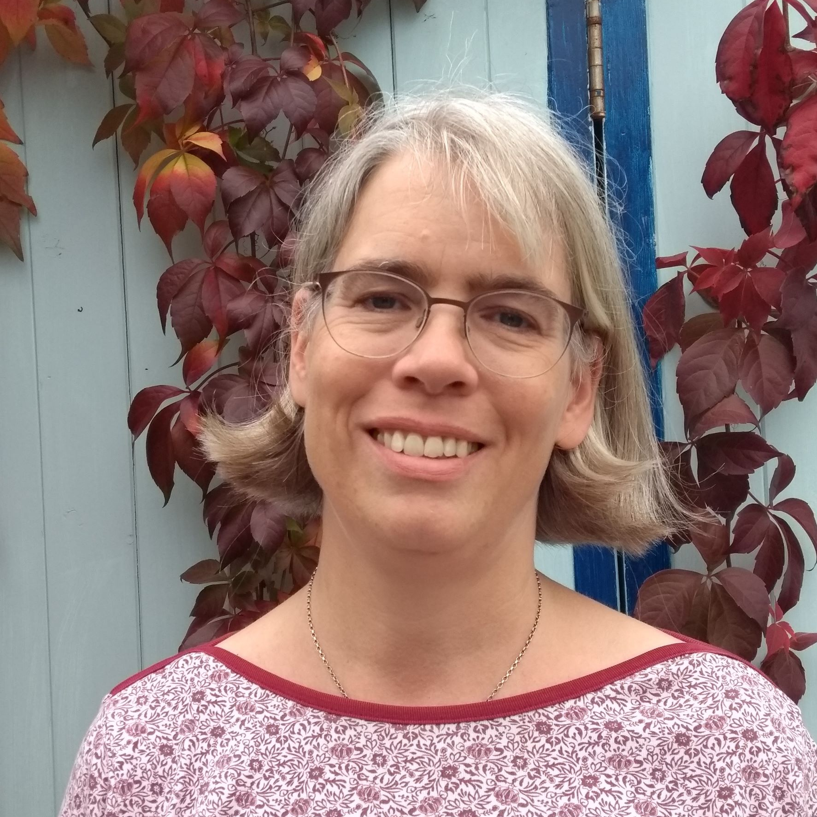
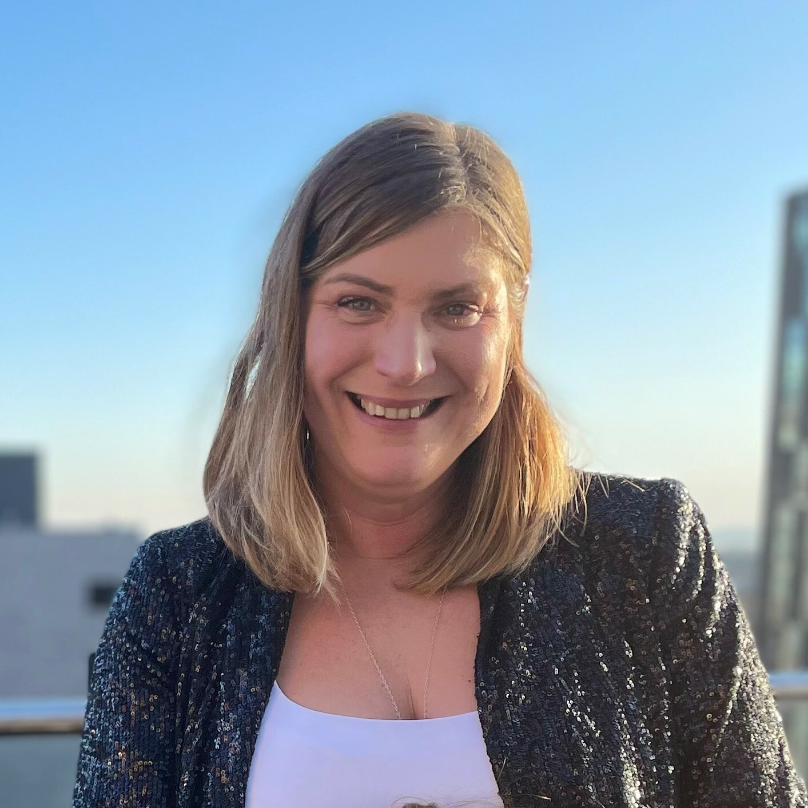
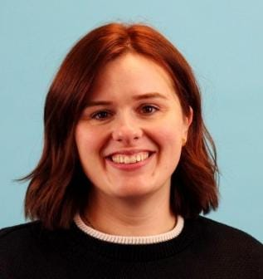
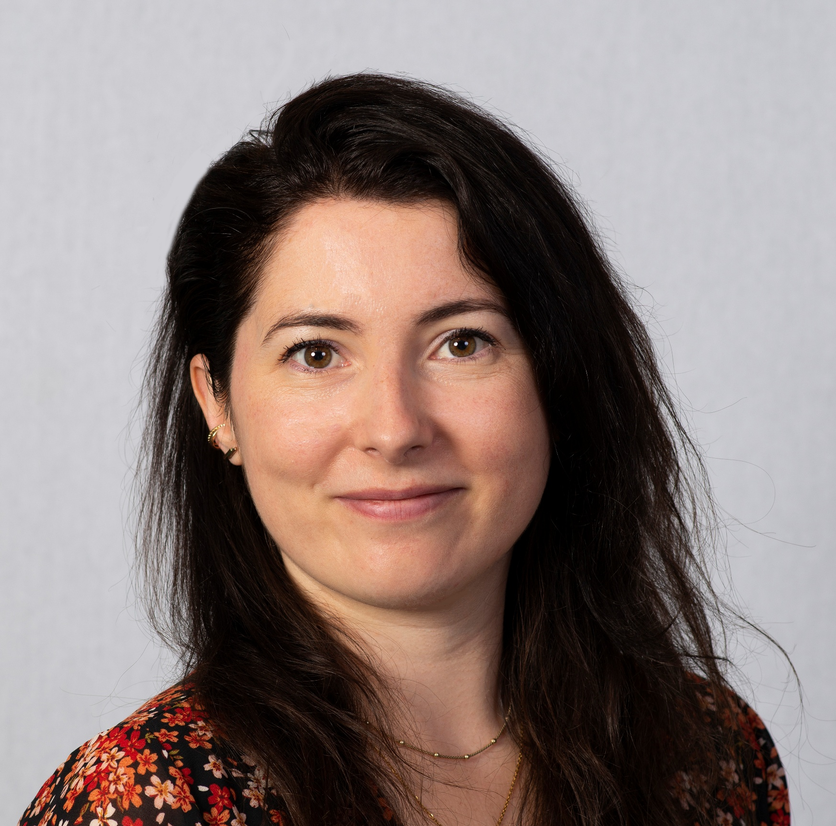
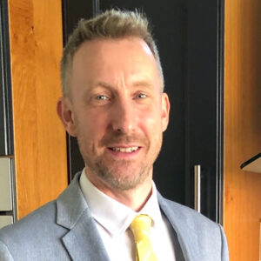
Our Steering Committee
Coordinator
Anke Friedrich
GÉANT
Clare Casey
Jisc
Judith Dix
Jisc
Laura de Kievit
SURF
Andy Byrne
HEAnet

Slide 56

Our Focus
Environmental
&
Social
Sustainability

Slide 57




Challenges
Maturity
Regulations
Geopolitical changes
AI

Slide 58
Opportunities
Help consider sustainability in your operations
Collaborate on workshops
Join Steering Group or community

