Slide 1


Community Events 101
Nadelina Sandu
GCP Workshop - Prague
15 May 2025

Slide 2
Do’s & don’ts throughout event phases
Pre-event
During an event
Post-event
Hypothetical example: SIG-Internet wants to organise its first meeting. Help them with the do’s and don’ts.

Slide 3
Pre-event do’s & don’ts – host expectations
⓵
⓶
Meeting host should take care of:
Venue/meeting room rental and any A/V equipment required.
Preferably catering for coffee breaks and lunch
Optionally organizing or paying for a group dinner and/or social activity.
Providing information before event on how to reach the venue and recommended hotels.
Meeting host should take care of:
Venue/meeting room rental and any A/V equipment required.
Mandatory catering for coffee breaks and lunch.
Mandatory organizing and paying for group dinner and/or social activity.
Booking accomodation for all participants.

Slide 4


Pre-event do’s & don’ts – host expectations
Meeting host should take care of:
Venue/meeting room rental and any A/V equipment required.
Preferably catering for coffee breaks and lunch
Optionally organizing or paying for a group dinner and/or social activity.
Providing information before event on how to reach the venue and recommended hotels.
Meeting host should take care of:
Venue/meeting room rental and any A/V equipment required.
Mandatory catering for coffee breaks and lunch.
Mandatory organizing and paying for group dinner and/or social activity.
Booking accomodation for all participants.

Slide 5


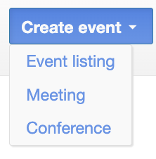
Pre-event do’s & don’ts - Indico
SIG-Internet wants to create registration forms + call for proposals in their Indico event. Which selection offers both these features?
1. Event listing
2. Meeting
3. Conference

Slide 6
Pre-event do’s & don’ts - Indico
SIG-Internet wants to create registration forms + call for proposals in their Indico event. Which selection offers both these features?
1. Event listing
2. Meeting
3. Conference

Slide 7
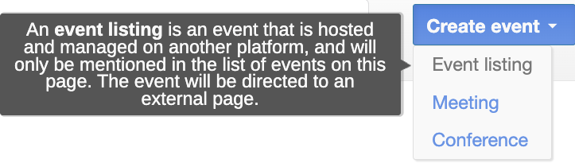
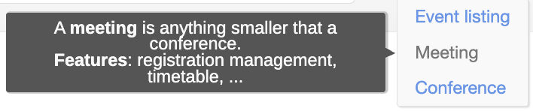
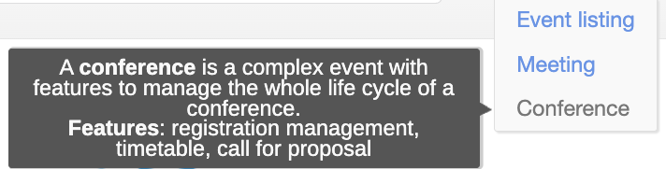
Pre-event do’s & don’ts - Indico

Slide 8
Pre-event do’s & don’ts - Indico
Find 4 differences!

Slide 9
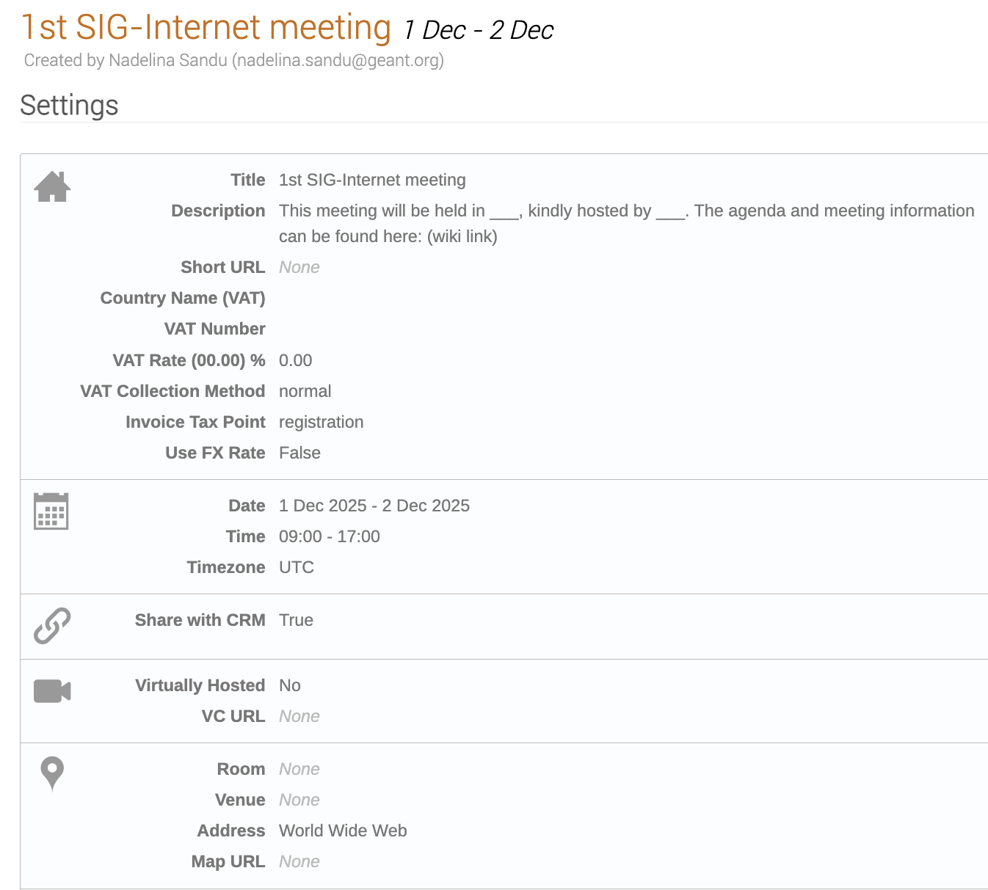
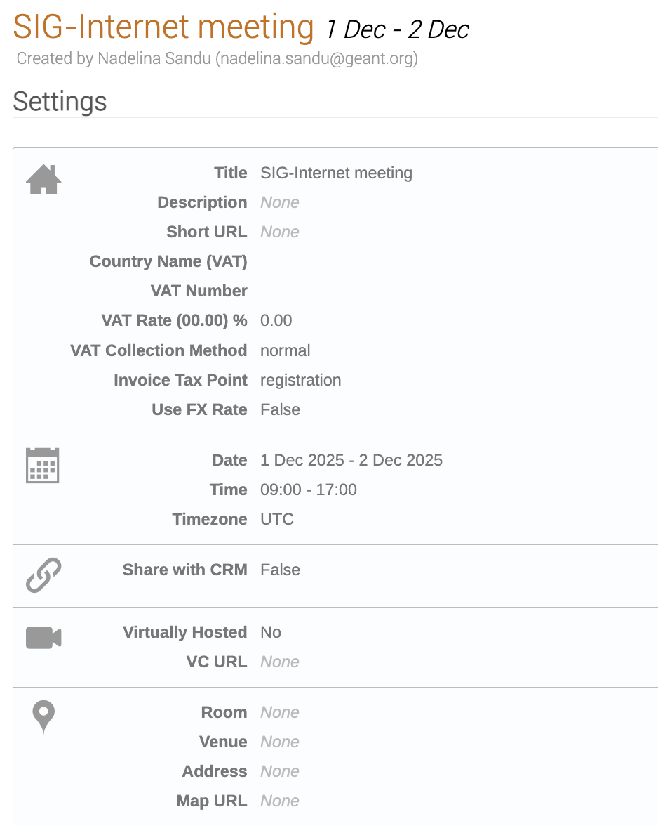
Pre-event do’s & don’ts - Indico

Slide 10
Pre-event do’s & don’ts - Indico

Slide 11
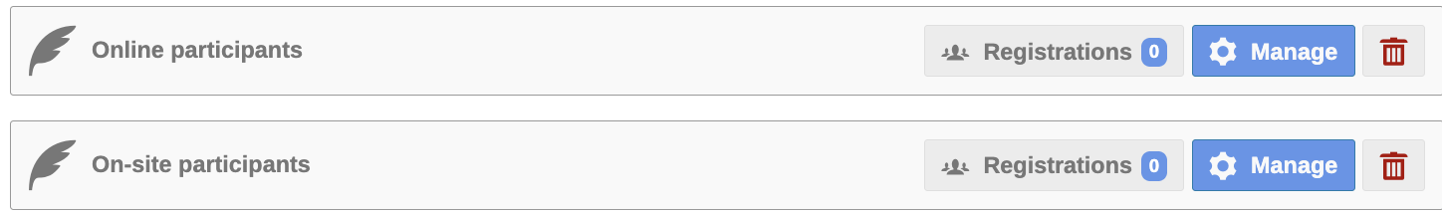
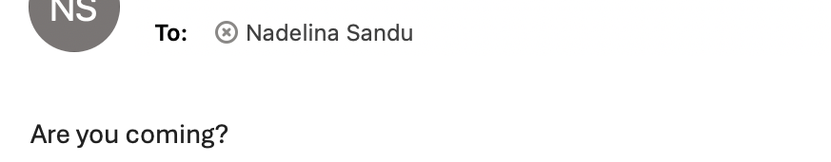
Pre-event do’s & don’ts - Indico
⓵
⓶
⓷

Slide 12
Pre-event do’s & don’ts - Indico
⓵
⓶
⓷

Slide 13
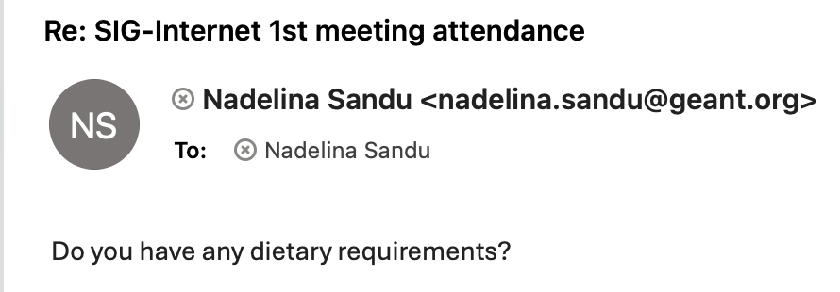
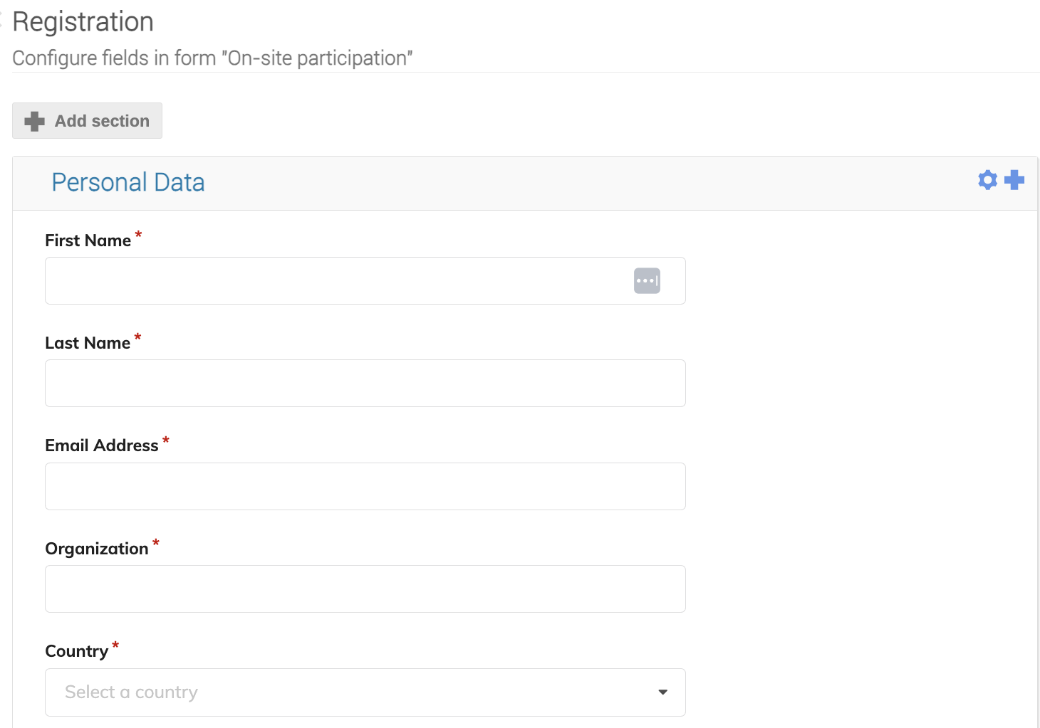
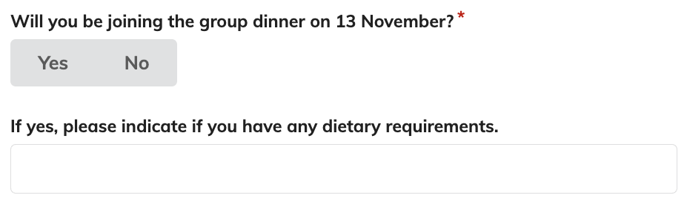
Pre-event do’s & don’ts - Indico
Contacting participants individually
⓵
⓶
Including question in registration form

Slide 14
Pre-event do’s & don’ts - Indico
Contacting participants individually
Including question in registration form

Slide 15
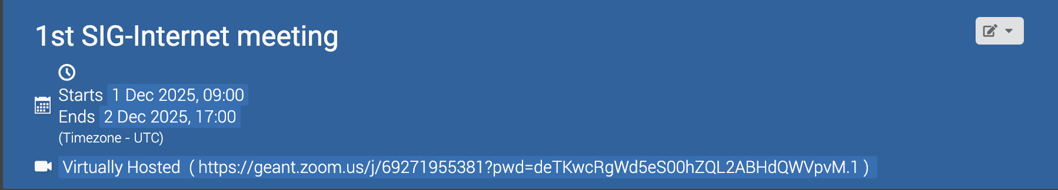
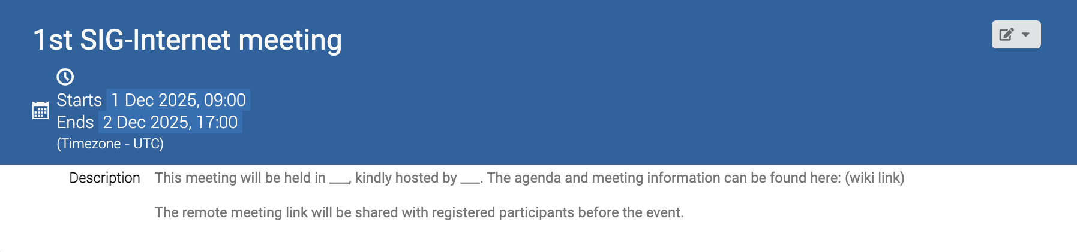
Pre-event do’s & don’ts - Indico
Including remote meeting link on Indico page
Emailing remote link to registered participants a few days before the event

Slide 16
Pre-event do’s & don’ts - Indico
Including remote meeting link on Indico page
Emailing remote link to registered participants a few days before the event

Slide 17
During event do’s & don’ts
SIG coordinator’s time & expenses are covered in the following way:
A | B
C | D
By GÉANT and charged to WP3T4 – up to 1 Person Months per year.
By their own organisation.
By GÉANT and charged to WP3T4 – up to 2 Person Months per year.
Time covered by GÉANT but expenses by own organization.

Slide 18
During event do’s & don’ts
SIG coordinator’s time & expenses are covered in the following way:
A | B
C | D
By GÉANT and charged to WP3T4 – up to 1 Person Months per year.
By their own organisation.
By GÉANT and charged to WP3T4 – up to 2 Person Months per year.
Time covered by GÉANT but expenses by own organisation.

Slide 19
During event do’s & don’ts
SIG Steering Committee member’s time & expenses are covered in the following way:
A | B
C | D
Time covered by their own organization but expenses by GÉANT.
By GÉANT and charged to WP3T4.
Time covered by GÉANT but expenses by own organisation.
By their own organisation.

Slide 20
During event do’s & don’ts
SIG Steering Committee member’s time & expenses are covered in the following way:
A | B
C | D
Time covered by their own organization but expenses by GÉANT.
By GÉANT and charged to WP3T4.
Time covered by GÉANT but expenses by own organisation.
By their own organisation.

Slide 21
During event do’s & don’ts
Recommendations during event
Show QR code directing people to sign up to the mailing list.
Keep track of who attends and who doesn’t both online and on-site. Use the Indico check-in feature.
Take pictures!
Have a survey at the end of the meeting to gather feedback.

Slide 22
During event do’s & don’ts
Survey questions recommendations
Apart from rating & feedback questions, please include the following:
How did you find out about this event/meeting? (GÉANT Connect newsletter, social media, wiki page, word of mouth, etc.)
Which country are you traveling from?
What is the mode of transportation you used to get to the meeting location?

Slide 23
Post-event do’s & don’ts
Fill in the blanks!
A SIG meeting overview article is required to be published on the GÉANT _____________________. This is a requirement for GN5-2 reporting!

Slide 24
Post-event do’s & don’ts
Fill in the blanks!
A SIG meeting overview article is required to be published on the GÉANT _____________________. This is a requirement for GN5-2 reporting!
CONNECT BLOG

Slide 25
Post-event do’s & don’ts
Fill in the blanks!
A SIG meeting overview article is required to be published on the GÉANT _____________________.
Speaker materials (i.e. presentations) should be made publicly accessible if given consent either on the event ________ page or the document storage platform __________.
CONNECT BLOG

Slide 26
Post-event do’s & don’ts
Fill in the blanks!
A SIG meeting overview article is required to be published on the GÉANT _____________________.
Speaker materials (i.e. presentations) should be made publicly accessible if given consent either on the event ________ page or the document storage platform __________.
CONNECT BLOG
WIKI
ZENODO

Slide 27
SIG events do’s & don’ts
• Create wiki page with agenda and details. • Use SIG meeting Indico template. • For hybrid events, enable in-person and virtual participation. • Ensure all participants are added to mailing list. • Use NREN hosts to keep costs down and increase participation. • Strive for dynamic in-person meetings – interactive sessions, breakouts, etc. • Consider co-location with other SIG meetings, conferences. • Consider sustainability (travel, catering). • Conduct post-meeting survey. | Include zoom link on Indico event page, always email to registered participants. Track registrations through informal communication channels. Make sure all attendees are registered in Indico, including speakers and any last-minute joiners. Create agenda without call for proposals to mailing list. Double book your event, always check Indico events page first. Expect dinners to be covered by hosting NREN participants typically need to self-pay. Only coffee breaks and lunches can be claimed by hosting NRENs. Forget to submit post-meeting report to Marcomms. This is the basis for GN5-2 reporting!

Slide 28
SIG Guide – will be shared with you soon!
We will be launching a SIG Guide – a clear, structured roadmap for individuals creating and/or managing a SIG and to serve as a key resource for anyone needing more information on SIGs.
You will find information such as:
Setting up a new SIG
Step-by-step checklists for setting up a SIG meeting
Meeting host expectations & meeting cost support
Costs overview and allocation
Guideline on using GÉANT tools & channels for managing SIGs and SIG meetings
And much more

Slide 29
Thank You
Any questions?

