Slide 1
Best Practice
for Communications
Grace Cooper
Communications Specialist
Géant
GCP Workshop, Prague
14th – 15th May 2025
Notes:
Hi everyone just to re introduce myself my name is Grace and I'm part of the Marcomms teams at GÉANT, specifically the communication side of things and we're just going to talk about best practises for communications as a whole.
Within our Marcomms team we are all responsible for different areas, and one of mine is the GCP. So what we're going to look at is how do we reach existing community participants in addition to new ones.

Slide 2
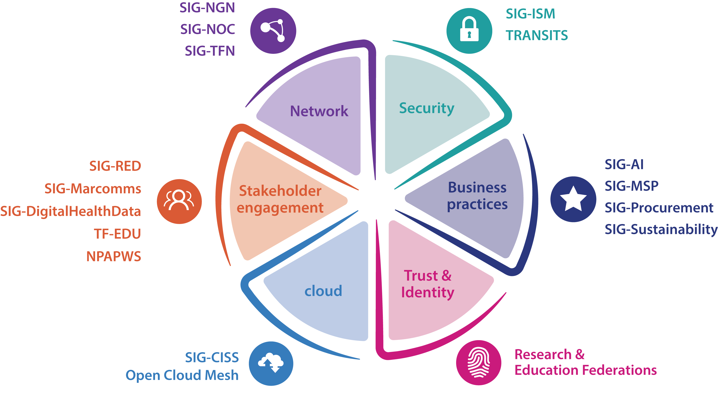
Notes:
I just wanted to show those of you who.may not have seen it yet – this is our new thematic wheel! We have updated the community page, which is also where you can locate the thematic wheel on the top left for you to download and use in your presentations.

Slide 3
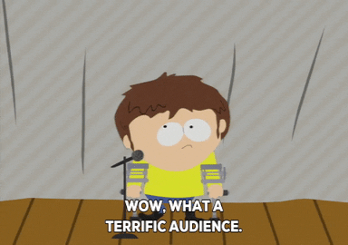

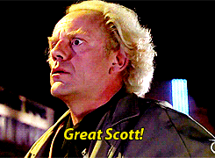
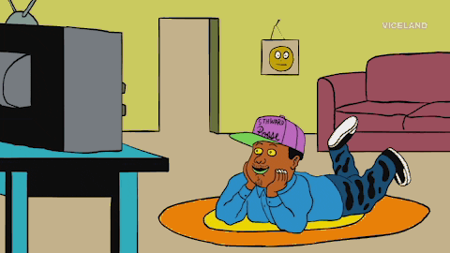
Right
Audience
Right Message
Right Time
Right Channel
Who do you want
to speak to?
What do you want to tell them?
Early
and often!
How do we reach them?
Notes:
So how do we reach existing community participants in addition to new ones.
Right Audience – Who do you want to speak to? Existing members? New members? NREN staff? University staff? Commercial participants? Each of these need different approaches.
Right Message – What do you want to tell them? What is the call to action? Is it attending or presenting as an example?
Right Time – Getting the right balance of communications is key – early and often! Continuous engagement is important to keep momentum going and to keep everyone informed.
Right Channel - The previous three Rs then help to determine this. Social Media can struggle with getting you access to new members (as they don’t know you so won’t follow you), similar to emailing. So how do you reach them? Can you leverage other channels to reach new people?

Slide 4
PMO newsletter
CONNECT newsletters
You
Community Programme page
Wiki and SIG mailing lists
Social Media
Notes:
Here are some examples of the different channels we use to promote GCP activities. Here we have Tryfon’s weekly PMO newsletter, the wiki, SIG-mailing lists, weekly CONNECT newsletters, dedicated Community Programme page on CONNECT online. I’m currently carrying out feature interviews with SIG groups to feature in our CONNECT magazine to support promotion of these groups and their activities, starting with the new SIGs.

Slide 5
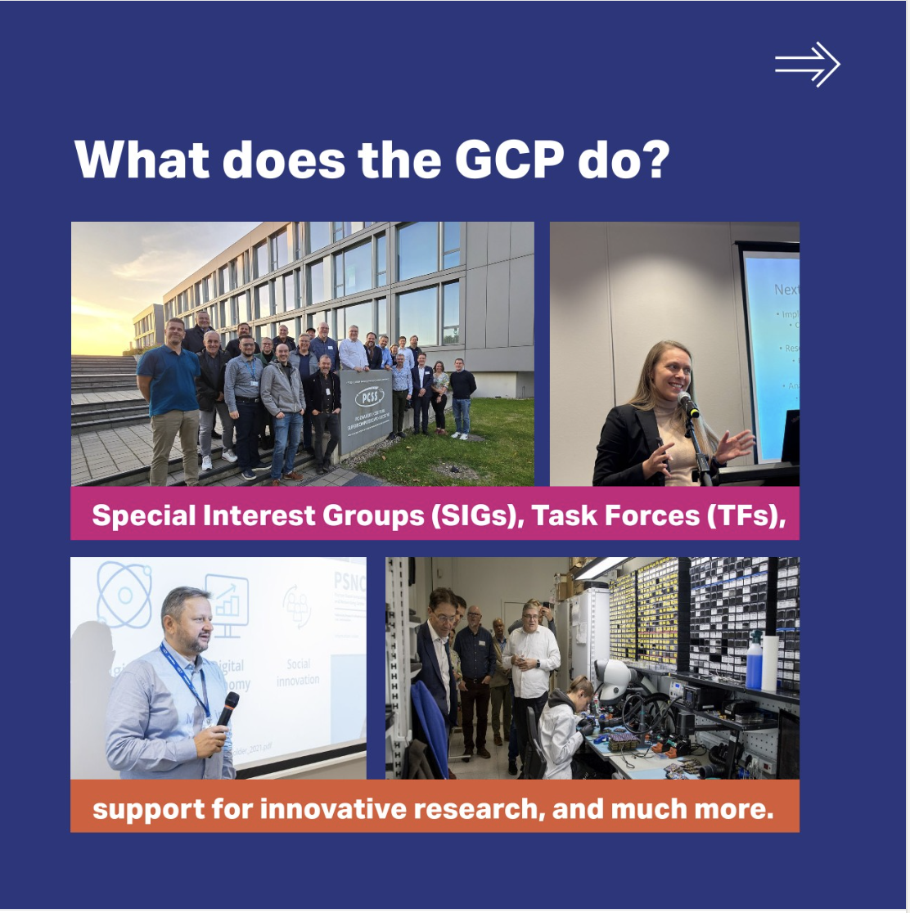
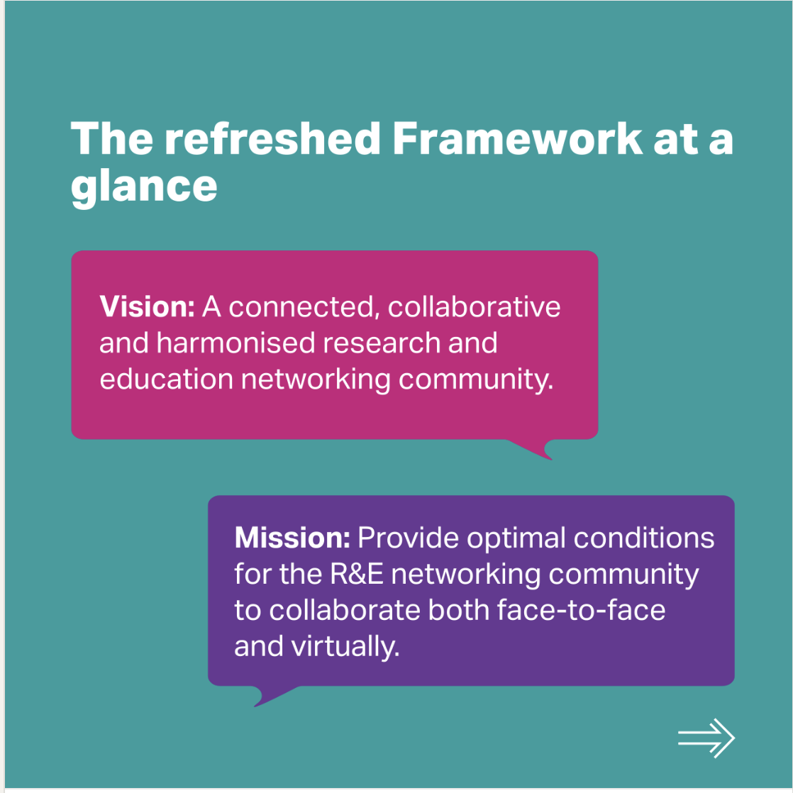
Notes:
Here are some examples of what our social media posts now look like when promoting GCP activities. Here is an example of when we promoted the new GCP framework

Slide 6
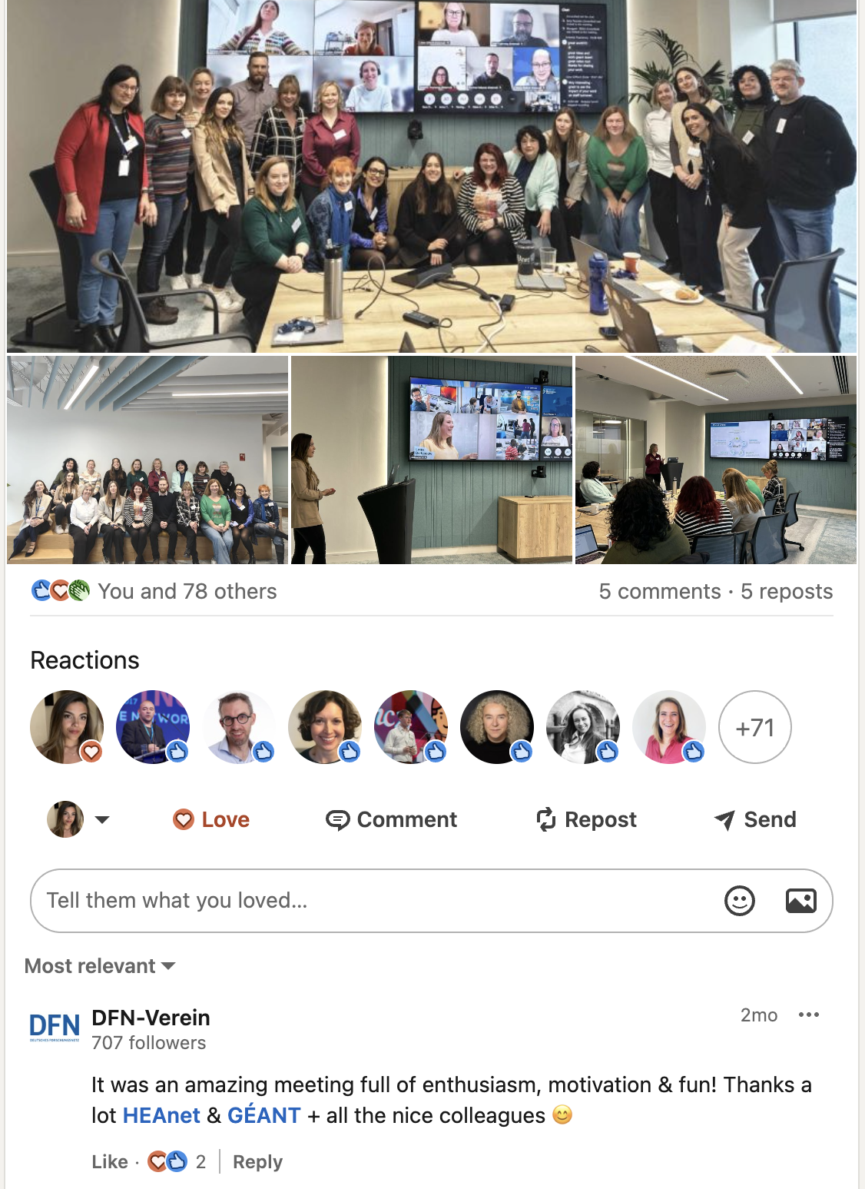
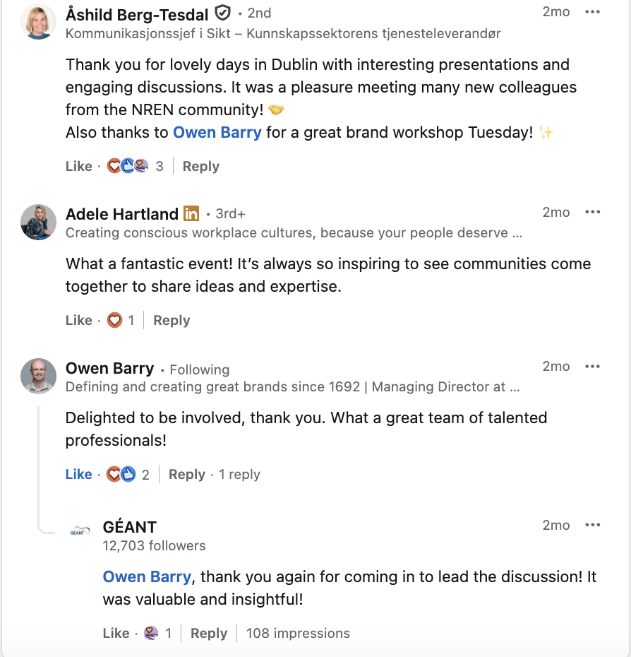
Notes:
Here are some examples of our successful posts, focusing on LinkedIn as this is our man social media platform. Our SIG-marcomms post received a large amount of impressions and reactions, which was increased by reposts and comments, so interact with us! Sometimes we promote SIG meetings individually, but we have also been trialling grouping them together which is why it is increasingly important that I am notified as soon as possible.

Slide 7
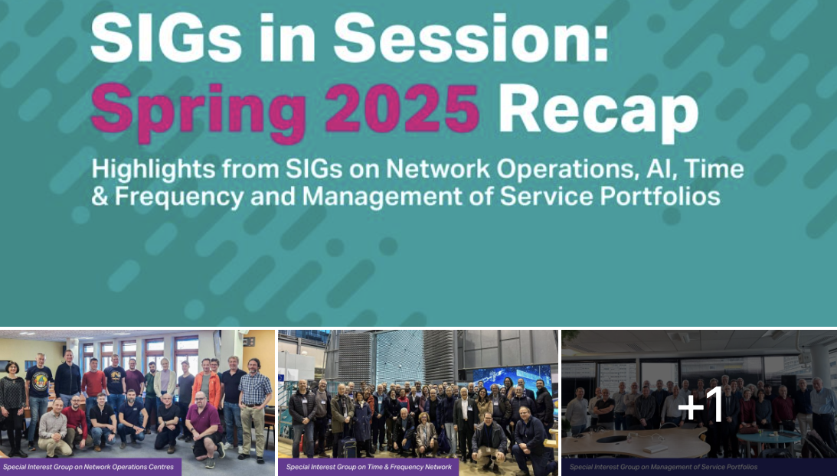
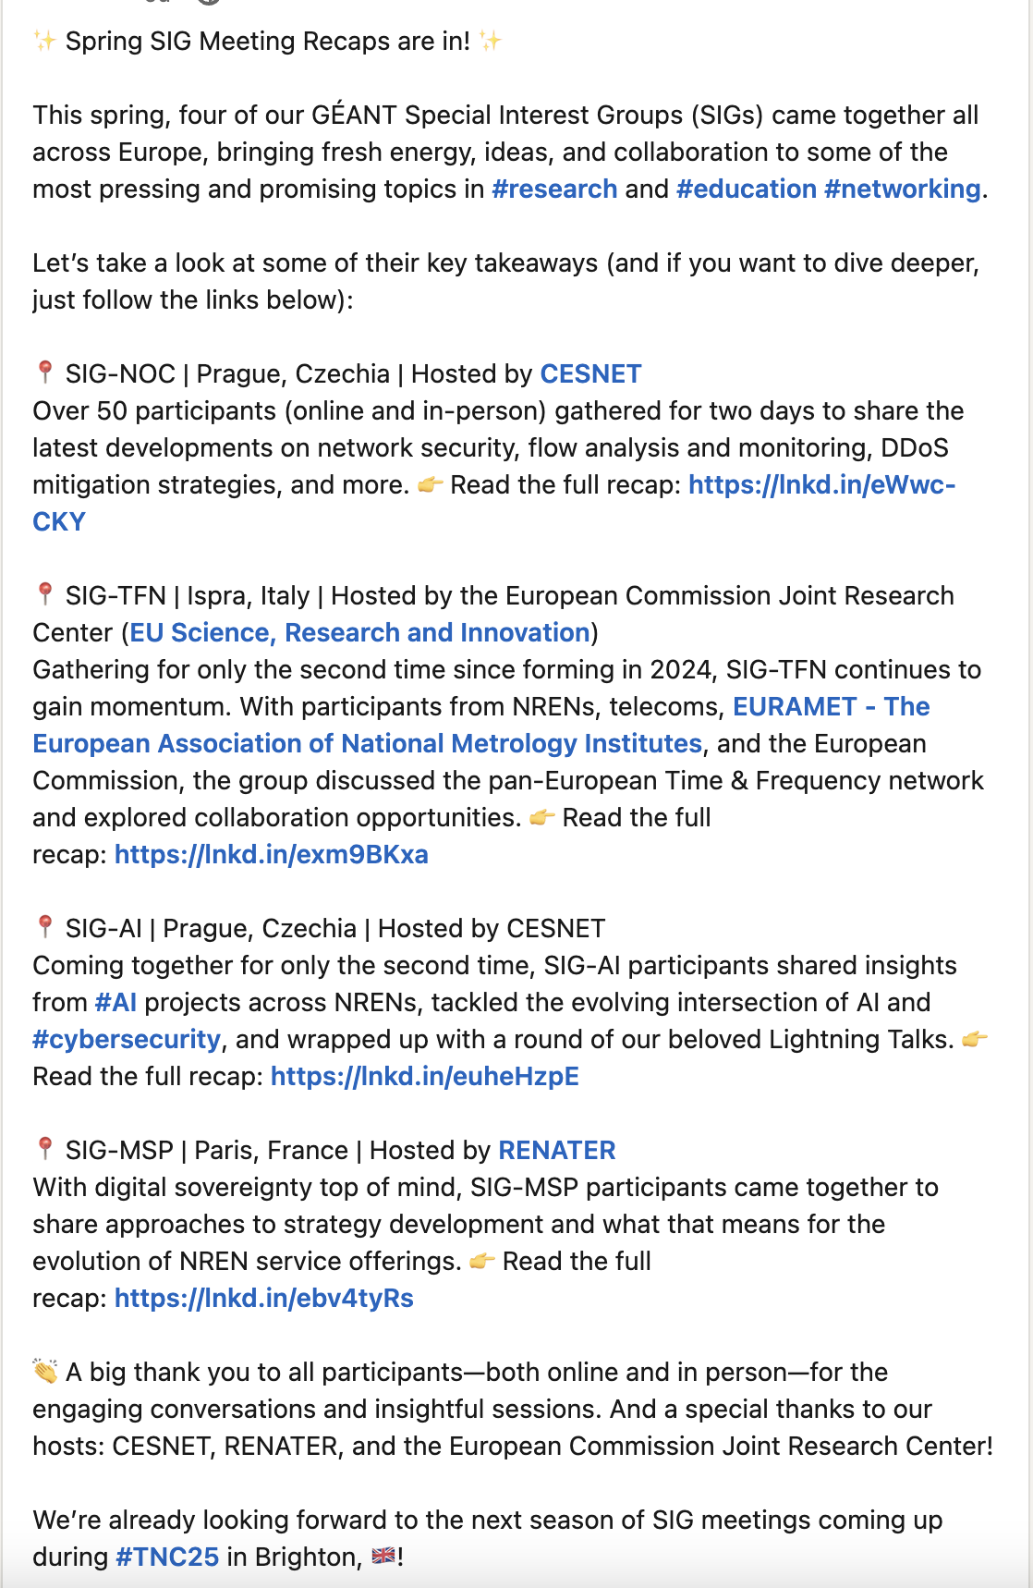
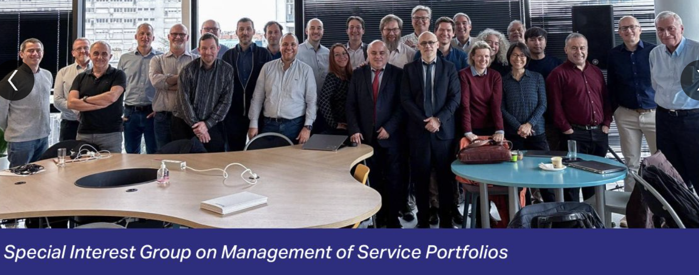
Notes:
Here is an example of how we grouped together the most recent SIG Spring meetings within one recap.

Slide 8
Best practice for YOUR social media posts
2
3
4
Tag GÉANT!
Use LinkedIn
to post about
your activities
Ask for collaboration
from other comm teams
1
Inform me beforehand
if possible
Notes:
What is the best practise for your social media posts? Inform me as soon as you can, so I can keep an eye out we can interact with our GÉANT account.

Slide 9
Best practice for YOUR social media posts
2
4
Tag GÉANT!
3
Ask for collaboration
from other comm teams
1
Use LinkedIn
to post about
your activities
Inform me beforehand
if possible
Notes:
Tag us so we can repost!

Slide 10
Best practice for YOUR social media posts
4
2
1
Tag GÉANT!
Ask for collaboration
from other comm teams
3
Inform me beforehand
if possible
Use LinkedIn
to post about
your activities
Notes:
Make it personal! When you are on LinkedIn, we want to hear genuine thoughts, feelings, stories from event, not just the agenda!

Slide 11
Best practice for YOUR social media posts
4
2
1
Ask for collaboration
from other comm teams
Tag GÉANT!
Inform me beforehand
if possible
3
Use LinkedIn
to post about
your activities
Notes:
We can help drive new members, and continue momentum with various GCP activities if we all collaborate on this!

Slide 12
Think WHY
Why are we promoting these activities?
Raise awareness of what we do
Increase involvement of the community in these activities
Raise our community profile
Drive registrations to the meetings and participation in the different activities
Notes:
Most important, we need to think about the why!
We want to raise awareness about our events and impact,
we want increase involvement of the community in these activities.
It’s important for us to also raise our community profile
This will then increasing registration to meetings.

Slide 13
BEFORE the event.
How do you make sure your event is seen and promoted across our comms channels?
Reach out to me.
I can support you with drafting a news item to promote the event across GÉANT channels and in Tryfon’s weekly PMO newsletter
I will not be monitoring the events page so I will need to be notified
Notes:
Before the event, it’s important to reach out to me so I can support you with drafting an article to publish on CONNECT and promote on our other channels.
But I do not monitor the events page so I will need to be notified.

Slide 14
DURING the event.
How do you make sure your event is seen and promoted across our comms channels?
Take pictures during the event, ideally landscape so they can be used on CONNECT
Reach out to me if you want pictures and some highlights to be posted on social media during the event.
Notes:
During the event, you can take landscape pictures to be included within the follow up article.
It’s also an option to post during an event so let me know if this is something you would like to happen.

Slide 15
AFTER the event.
How do you make sure your event is seen and promoted across our comms channels?
Write the post-event report/summary immediately after the meeting and send it to me for publication and promotion (one of our KPIs)
What is the report about?
A summary of the event: give some context on the topic/theme and list the main highlight of topics discussed.
Most importantly it should describe the impact/outputs of the meeting and include any call to action
What is an impact?
New collaboration opportunities
Deliverable or written output
New areas of interest unlocked
Training delivered
Notes:
After the event, something we need to improve on is the follow up article which is part of our KPIs. As soon as the meeting has finished, I need a summary of the event, including main highlights of topics discussed, insight into themes of conversations, and what the outcomes were. Please do not send me the agenda as this is not personal.

Slide 16
Something to consider
To support continuous engagement in between SIG meetings what can we do?
Interviews?
Infoshares?
Video content?

Slide 17
Thank You
Any questions?

