Slide 1
7th Board Meeting
Erik Kikkenborg
NORDUnet / GÉANT
16 December 2019

Slide 2
Agenda
Outcomes of the GA
Amendment:
  Status
  Budget changes
  Tasks until the end of the project
Sustainability
Closed session with only board members to discuss confidential issues

Slide 3
Outcomes of 5th GA
Casper Dreef
GÉANT

Slide 4
Stabilized SSO and other technical constraints discussion
12 issues raised
Reinforce the usage of GitHub
  GitHub: https://github.com/up2university
  The issue tracking procedure: https://wiki.geant.org/display/UP2U/Issue+tracking
Current status:
  SSO login issues mitigated, but this is not the long-term solution
  Test courses have been removed from production platform
  LA: WP4, WP5 & WP7 work together on plugins on Moodle and development of plugins for external tools
  Minor consent
Notes:
SSO solution: temporarily switched back to PHP 7.0. GWDG will undertake efforts to migrate the SSO instance to a modern PHP Version and SimpleSamlPHP 1.18.1/. Also, GWDG is working on a general theming framework for SSP to make
this migration way easier
At this point in time they cannot provide a timeframe.

Slide 5
Minor consent / GDPR
Recommendations on KWS integration
  Top level integration
  Push consent collection to all tools
  Minimise data loss
Interim solutions
  Gather consent on school level (e.g. Greek pilot)
  Latest version of Moodle (done, only covers Moodle tools)
Currently GWDG is working on the implementation of KWS
  Finalising research (how to implement)
  Will provide information on next steps and timeline in due course

Slide 6
Pilot updates
What makes one pilot implication model more successful than others?
  Badges and certificates
  High quality content
  Using the platform for other purposes: contests, workshops, one-off events
Analysis: why don’t teachers complete the CPD cycle?
  WP7 started analysing CPD results
  Preliminary results: no added value seen against competitive solutions, difficulty using tools, and lack of real support for teachers from their schools that forces teachers to devote their free time to Up2U
Notes:
Pilots: Questions and conclusions from the GA

Slide 7
Pilot updates (2)
Country | Training |  | Pilots
 | Schools | Teachers | Schools | Students
Germany | 2 | 10
Greece | 70 | 220 | 5 | 50
Hungary | 14 | 75 | 6 | 137
Italy | 86 | 124 | 6 | 79
Lithuania | 370 | 790 | 156 | 20,000
Poland | 56 | 70 | 15 | 306
Portugal | 7 | 50 | 7 | 120
Spain | 15 | 30 | 1 | 100
Totals | 620 | 1369 | 196 | 20,792
Notes:
Numbers from November Pilot Progress report
The training schools include existing schools in pilots.
The meaning is "for how many schools we have ever organised trainings" and "how many of them have proceeded to the pilot stage (i.e. with students involved)
Note: a number of schools are still in the CPD Module 1. Therefor these schools can be counted in the training column, but not in the pilot column.

Slide 8
Pilot updates (3)
New pilots within the consortium:
  UK / Open University
  Israel / IUCC & Tel Aviv University
External NRENs:
  Finland / CSC
  Slovenia / ARNES
  Cyprus / CYNET
Support
  Soft CPD: online training materials for teachers provided by WP5

Slide 9
Sustainability
Models identified at the GA:
Centralised
Decentralised
CS3MESH4EOSC
University-as-a-Hub
Agenda item 3

Slide 10
Amendment
Gyöngyi Horváth
GÉANT

Slide 11
Status
Accepted on 09-12-2019
New end date 31 May 2020
Deliverables:
  WP1 D1.2 M36→M41
  WP2 D2.4 M36→M41
  WP3 D3.5 M30→M34
  WP4 D4.3 M30→M39
  WP5 D5.5 M34→M40
  WP6 D6.3 M32→M39
  WP7 D7.4 M36→M41
  WP8 D8.4 M35 →M39
Milestones:
  M19 M28→ M29
  M20 M30→ M31
  M21 M30→ M31
  M22 M34→ M40
  M23 M35→ M38
  M24 M35→ M40
  M25 M36→ M40
  M26 M36→ M39

Slide 12
Budget changes
Partners / organisations | Total Direct Costs | Q9 | Variance | New totals
01: GÉANT Association | 249.499,80 | 178.619,58 | 70.880,22 | 74.691,81
02: OU | 375.200,28 | 166.827,81 | 208.372,47 | 138.372,47
03: UROMA | 286.999,92 | 188.267,51 | 98.732,41 | 98.732,41
04: GARR | 277.999,92 | 266.618,75 | 11.381,17 | 24.445,54
05: NTUA | 207.400,68 | 142.027,91 | 65.372,77 | 90.372,77
06: GRNET | 371.559,24 | 238.780,95 | 132.778,29 | 132.778,29
07: UVIGO | 130.400,28 | 143.964,24 | -13.563,96 | 8.507,94
08: TELTEK | 150.999,84 | 142.307,53 | 8.692,31 | 8.692,31
09: ISEP | 217.299,96 | 134.395,88 | 82.904,08 | 82.904,08
10: FCT | 117.799,92 | 31.318,35 | 86.481,57 | 86.481,57
11: TAU | 156.400,20 | 76.584,19 | 79.816,01 | 79.816,01
12: IUCC | 180.400,32 | 129.420,77 | 50.979,55 | 50.979,55
13: KTU | 143.600,76 | 110.458,86 | 33.141,90 | 37.523,58
14: KIFÜ | 268.900,20 | 148.849,62 | 120.050,58 | 120.050,58
15: PSNC | 329.800,32 | 267.511,17 | 62.289,15 | 72.467,55
16: ownCloud | 79.499,88 | 63.499,60 | 16.000,28 | 16.000,28
17: GWDG | 293.299,56 | 179.329,11 | 113.970,45 | 105.462,51
18: CERN | 299.640,24 | 246.163,87 | 53.476,37 | 53.476,37
Grand Total | 4136701,32 | 2854945,7 | 1281755,62 | 1281755,62

Slide 13
Tasks until the end of the project
Continuity plans finalised:
  GÉANT, PSNC, KIFÜ, TELTEK, GRNET
  Up2U platform main website - GÉANT
    Action plan:
      Operations - PSNC
      WP8: BM1 and BM2 finalisation with integrated GÉANT and key NREN future ecosystem maintenance.
KPIs (WP8 and WP7):
  Original target of 1500 schools, we aim to change this to 1000 schools (penetration inside the schools needs to happen after the lifecycle of the project ended.)
    Extend the scope: Asia, South America and other regions
    Online course / Webinar (recorded with open access to Moodle course) to invite students / teachers / schools.
Evaluation of impact of the three CPD Modules and two pilot iterations (WP5 and WP7)
  Quantitative results – Completed assignments
    Teachers (CPD)
    Students (Pilots)
    Instant feedback
    LA results from the platform
  Qualitative results – questionnaires (questions to be based on information we get from interviews and focus groups)
    Teachers
    Students

Slide 14
Sustainability
Gyöngyi Horváth
GÉANT

Slide 15
Sustainability
Cost model drafted for centralized / national models.
Timeline:
  December:
    Finalizing Cost Model
    Distributing the document to all partners
    Finalizing which model (Centralized or National) would be best in each country
    Regular Sustainability Meetings
  January
    Establishment of both Centralized and National Models
    Establishment of technical exploitation and university as a hub models
    Regular Sustainability Meetings
  February
    Establishment of both Centralized and National Models
    Preparation of D8.4.
    Regular Sustainability Meetings
  March
    Finalizing D8.4 and our Sustainability Plans
Outreach:
  New partners: Finland (CSC), Slovenia (ARNES), Cyprus (CYNET)
  Support from: European Schoolnet, European Parents Association

Slide 16
Sustainability models
Centralized Model:
  Update about the activities
    The cost models has been almost designed
    Would be shared to partners by the end of December 2019
  Who will host the Centralized Model?
    PSNC (also hosting and providing tools)
    GRNET (also hosting and providing the tool - eduOER)
  How to get funded?
    National model funded by NRENs
    Centralised model - options:
      NREN funded
      Government funded
      Other: projects, schools...etc
National Models:
  Lithuanian National Model Status Update
  Update about new project, dedicated by Lithuanian ministry of education.
    2020 will be funded by LITNET
    2021 is looking for governmental funding
  Hungary and Poland National Models Update
    They are still working on getting funds for 5 years.
  Greece
    Planning to establish national model
  Germany
    Planning to use Technical Exploitation Business Plan
  Italy
    Estimate the establishment of centralized or national model
    Working on University as a hub business model
  Portugal and Spain
    Still on the planning phase.

Slide 17
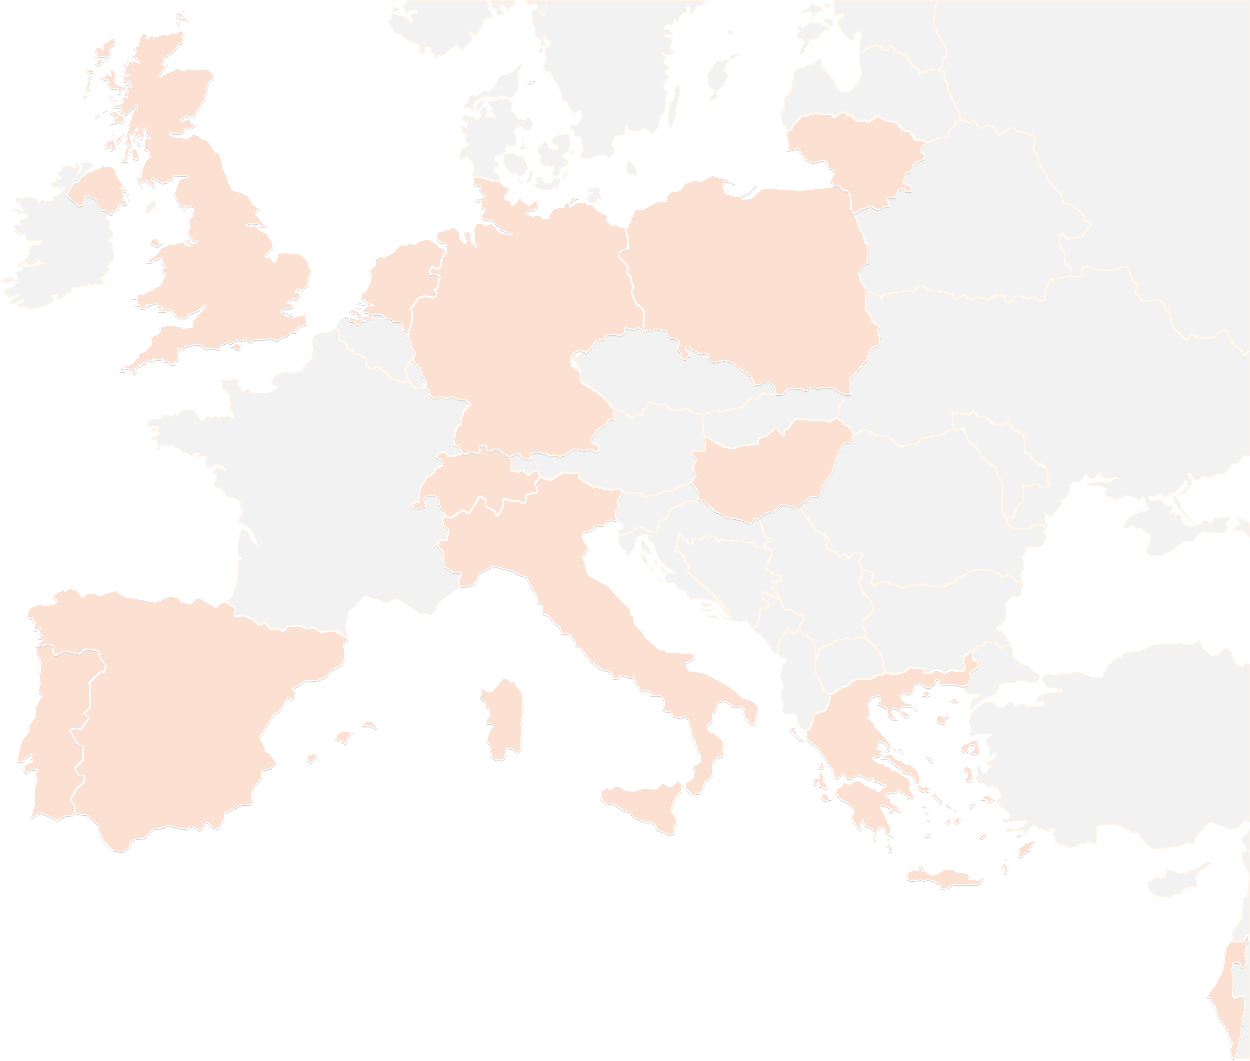
THANK YOU FOR YOUR ATTENTION!
contact@lists.up2university.eu
#up2universe

