Slide 1


Hidden Routes in the Network
Will Barber
Network Engineer in Géant
SIGNOC, Berlin
13 November 2024
Public

Slide 2
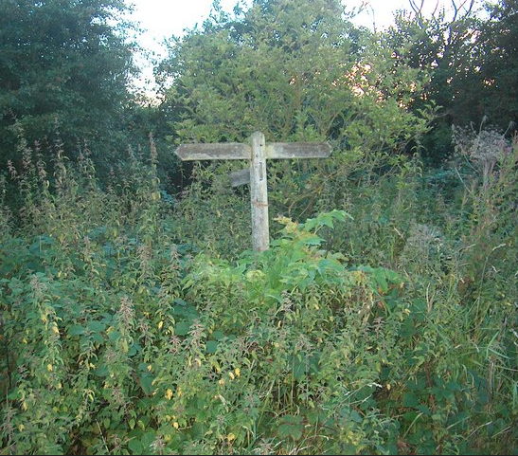
Hidden Routes in the Network
What are they & why are they important?
Problems with hidden routes
How GÉANT is managing them
Identifying Hidden Routes
Evolution of detection

Slide 3

Hidden Routes – Why are they important
GÉANT use RPKI verification and Prefix lists to accept routes
Inaccurate AS-Set lists can lead to rejected routes
Large numbers of hidden routes can indicate problems

Slide 4

Problems to overcome
Which routes are hidden?
Why are they hidden?
Routes hidden in multiple places?

Slide 5

How GÉANT are managing them
Which routes are hidden
Identify why the routes are hidden
Proactively resolving incorrectly hidden routes

Slide 6
Identifying hidden routes
Automating the discovery
Evolution of the script
Routes identified as hidden can be rescued to ensure they are reachable again.

Slide 7

Evolution of the script
Identification of hidden routes on routers (initially ~7500 routes)
RPKI status of the route
Removing routes from report with commercial Ass
Showing the Peer name, not just an AS
Checking reachability
Following these checks we now see ~150 hidden routes
Sending regular reports to review
Future incorporation of new router platform

Slide 8

Thank You
Any questions?
www.geant.org
© GÉANT Association
As part of the GÉANT 2020 Framework Partnership Agreement (FPA), the project receives funding from the European Union's Horizon 2020 research and innovation programme under Grant Agreement No. 856726 (GN4-3).

