Slide 1



Slide 2
DFNs ongoing core network migration from a monitoring perspective
21st SIG-NOC Berlin 2024
Robert Stoy (DFN-NOC)

Slide 3
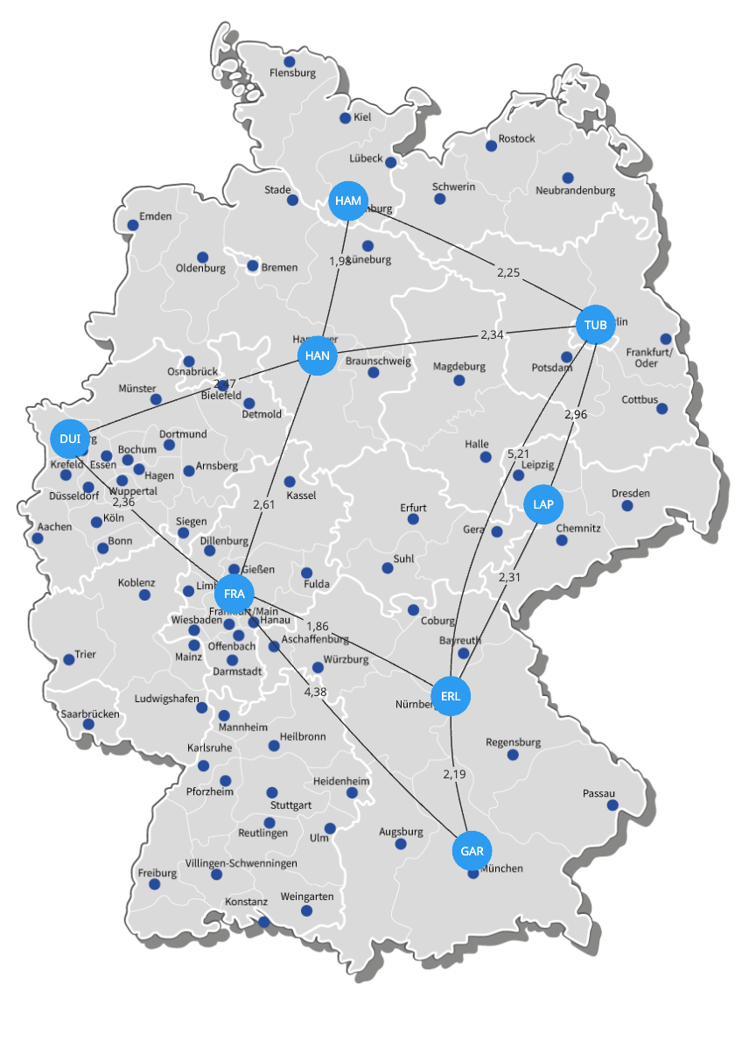
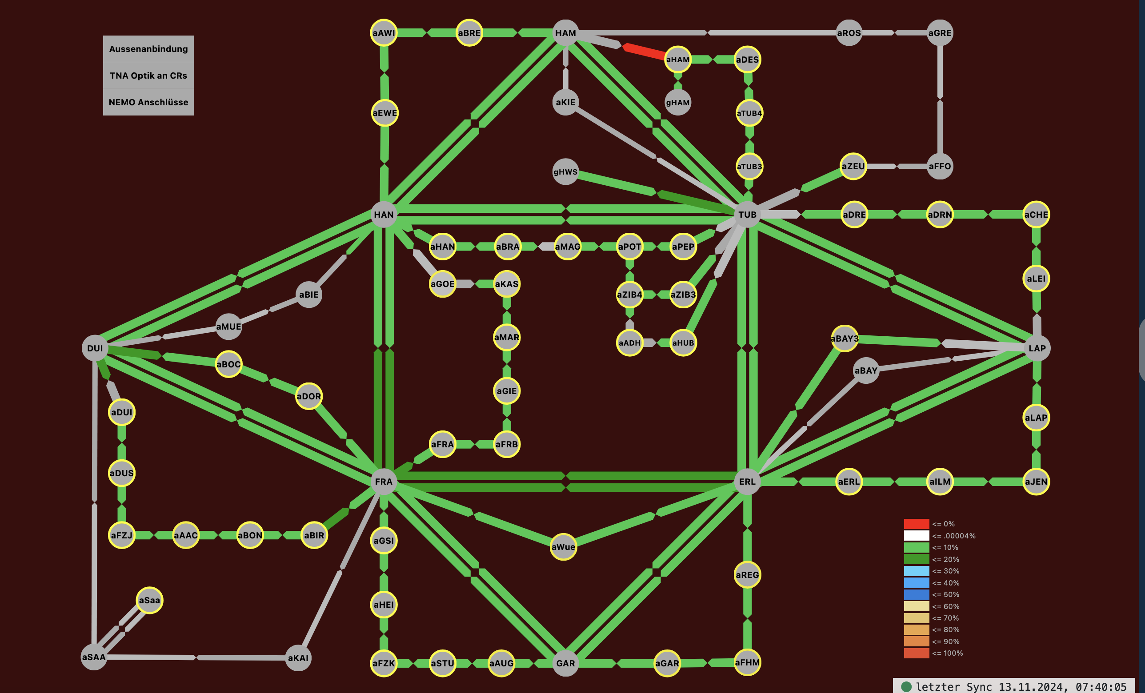
X-WiN before Migration

Slide 4
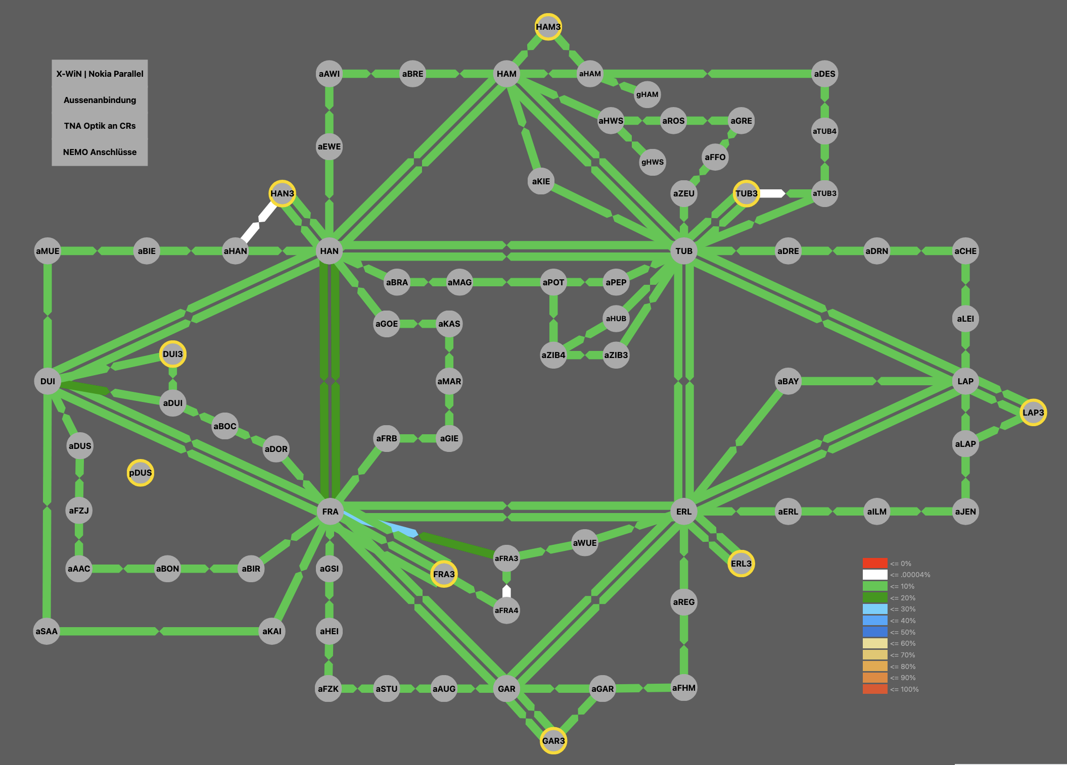
(1) Install and Connect new Core Routers

Slide 5
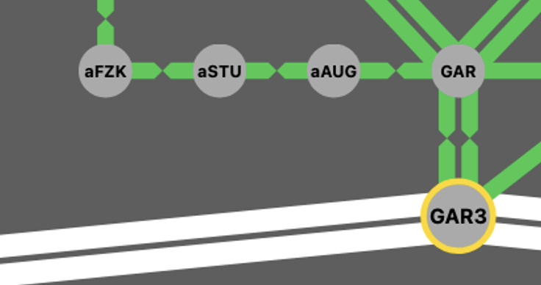
(2) Move Users Access pseudowires (1200) to new CRs
KR : CE Router
aKNK : PE Switch/Router
GAR3 : New PE/P Node GAR
Users access IP Link on stiched
  Physical Line
  Pseudowire (EoMPLS)
KR

Slide 6
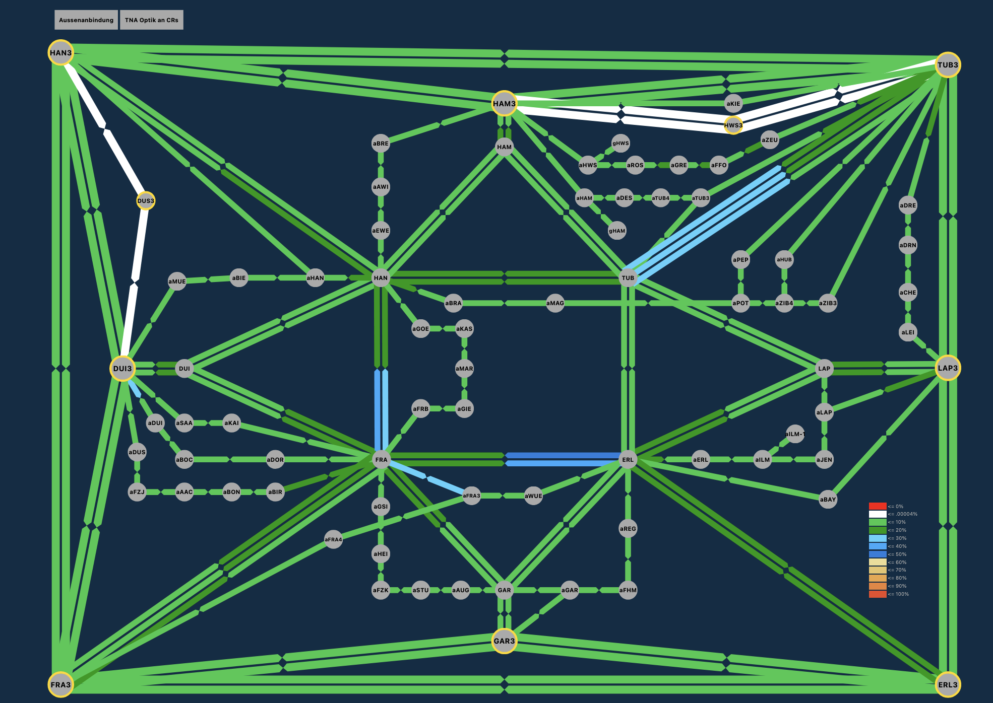
(3) Interim Topology Old+New
Commissioning 2*400GE Services between new CRs

Slide 7
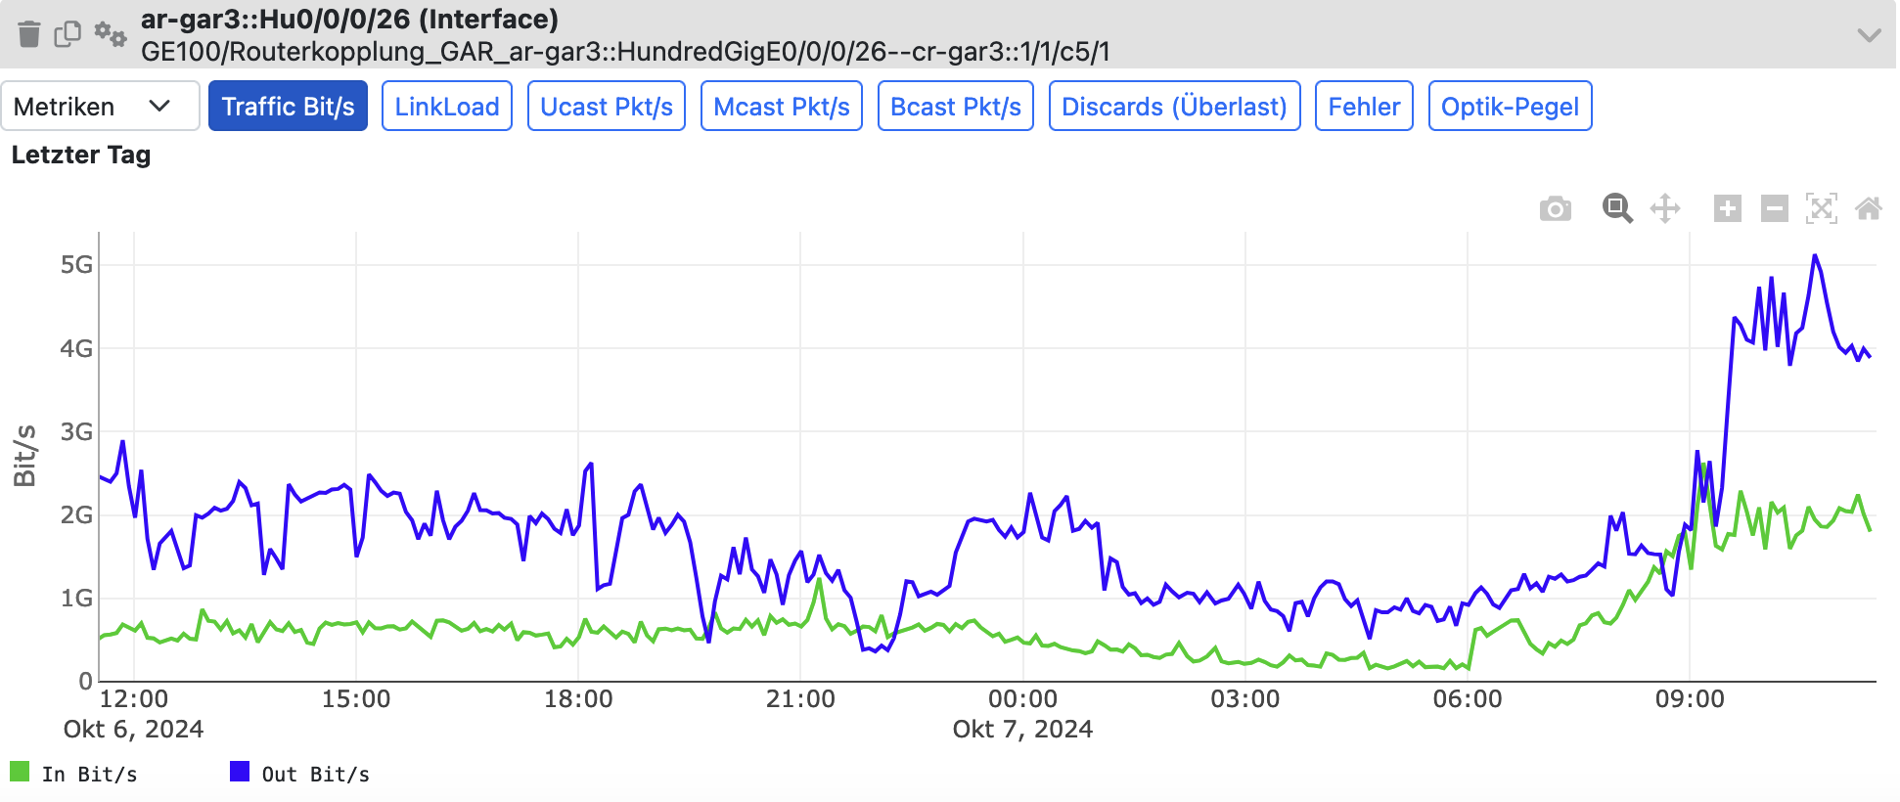
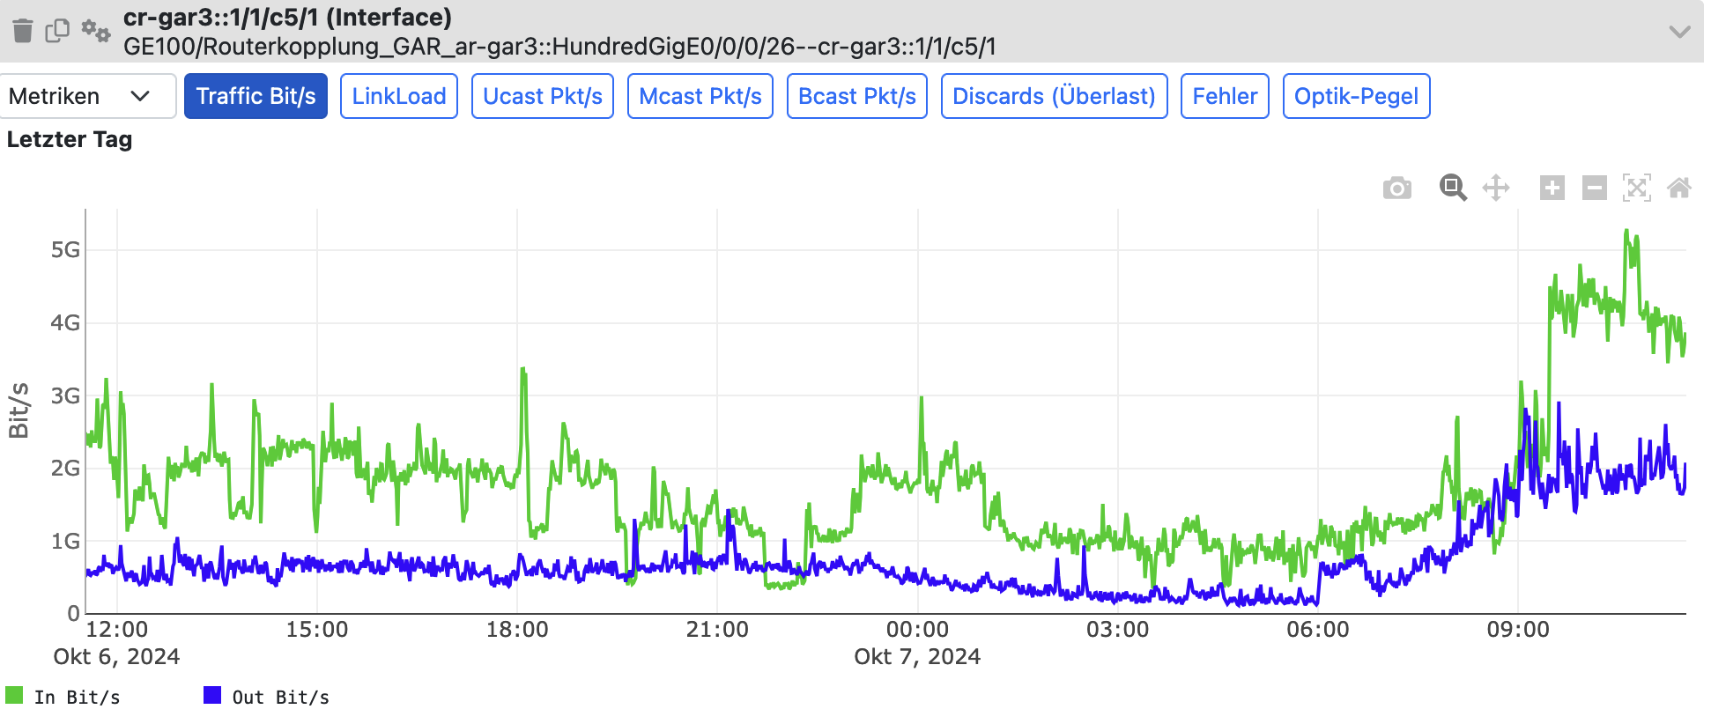
New CRs : Key Figures Monitoring
Streaming Telemetry
Old: SNMP : 5min Intervals
New: Telemetry : 1min Intervals
Telemetry Pro and Cons
  Less Load on Router
  Higher demand on NMS storage speed and capacity
Improved Insights on Traffic Peaks
(here 30% higher)

Slide 8
Insights : Live Demo

