Slide 1


NOC Troubleshooting
Unified View, Automated Action
GN5-1 WP6
14 November 2024, SIG-NOC, Berlin
Mirna Ljubić Tustonjić, CARNET
Daniel Zima, CARNET
www.geant.org

Slide 2
Agenda
Task Premise
Initial Analysis
Architecture Overview
Grafana Dashboard - Visualization Overview
Grafana Dashboard – Demo
NOC Feedback
Next Steps
Q&A

Slide 3
Task Premise
Challenges in NOC:
  Increasing Complexity in NOC Operations
  On average 11.5 different tools used daily
  Impact of Multi-Tool Environment
The goal of this task is to address a key question:
Can we automate NOC troubleshooting processes?

Slide 4
Initial Analysis
Operational Process Analysis
  Mapping existing NOC workflows
Research on Data Used in Troubleshooting
  Identification of key data sources and types essential for issue resolution
Creation of Dashboard Mockup
  Designing a preliminary layout with essential features for an effective dashboard
Discussion on Data Retrieval Automation
  Exploring methods for automating data collection from multiple sources
Conclusion: Grafana as the Chosen Platform for NOC Dashboard

Slide 5
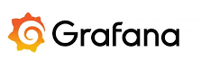

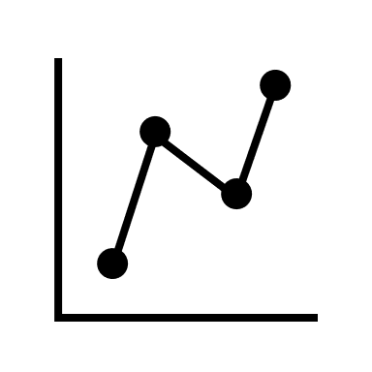








Architecture Overview
Customer Premises Equipment
Data
sources
Grafana
Connections
Visualization
Uplink Throughput
Device Status (UP/DOWN)
.
.
.
.
Loki
Device Logs
Site information
Device information
Link information
Infinity

Slide 6
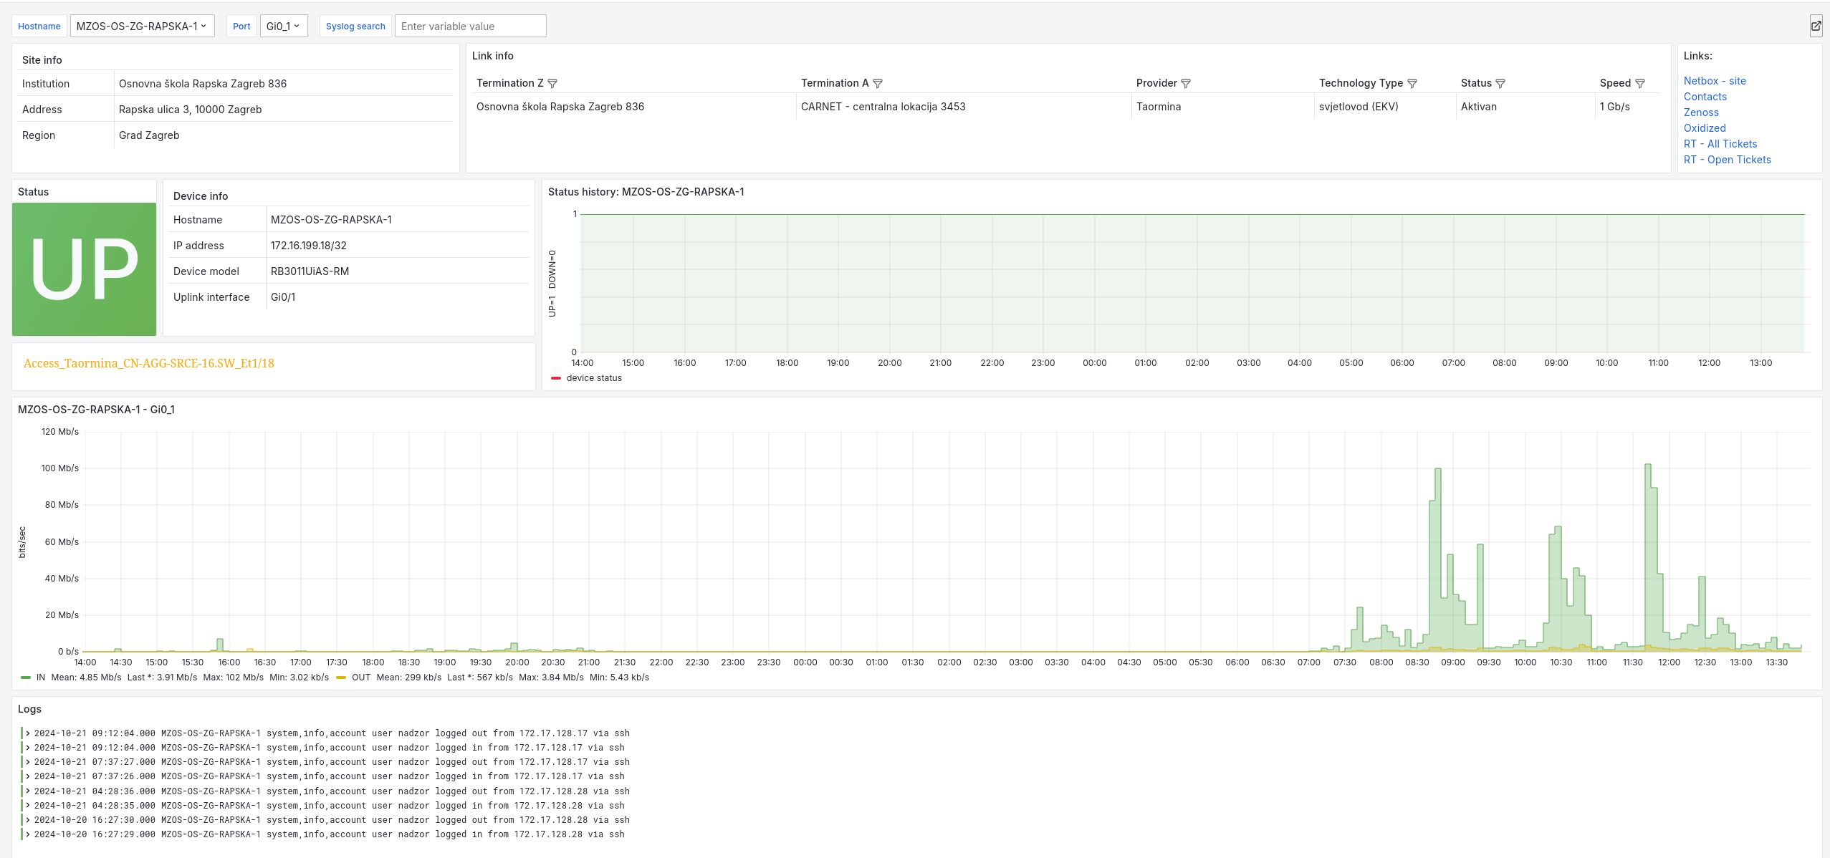
Grafana Dashboard - Visualization Overview

Slide 7

Grafana Dashboard - Visualization Overview (2)

Slide 8
Grafana Dashboard - Visualization Overview (3)

Slide 9
Grafana Dashboard - Visualization Overview (4)

Slide 10
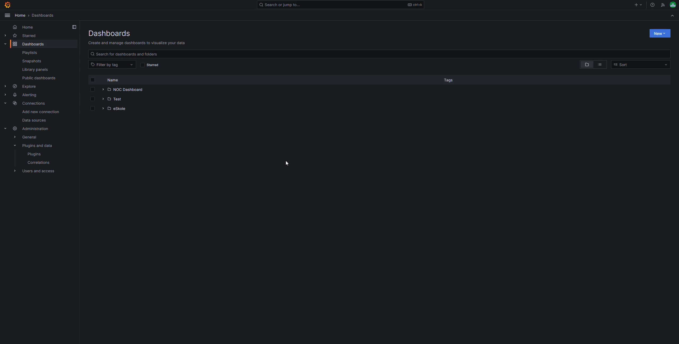
Grafana Dashboard - Demo

Slide 11
NOC Feedback
User-Friendly Experience
  Positive feedback on dashboard usability
Additional Filtering Options
  Filtering by Institution, Institution ID and other criteria
Adjust Interface Layout
  Improve the arrangement of elements for clarity

Slide 12
Next Steps
Implementation of New Features Based on NOC Feedback
  Continuously gather input to enhance usability and functionality
  Research and Implementation of Speedtest on Demand
    Explore methods for integrating real-time network speedtest
  Analysis and Integration of Other Tools into Dashboard
    Assess compatibility and potential benefits of adding more data to dashboard

Slide 13


Thank you
Any questions?
mirna.ljubic.tustonjic@carnet.hr
daniel.zima@carnet.hr
www.geant.org
© GÉANT Association on behalf of the GN4 Phase 2 project (GN4-2).
The research leading to these results has received funding from
the European Union’s Horizon 2020 research and innovation programme under Grant Agreement No. 731122 (GN4-2).

