Slide 1


EuroHPC Hyper-connectivity service
Sebastiano Buscaglione, Network Architect
Enzo Capone, Head of Research Engagement and Support
STF, Berlin (DE)
12th November 2024

Slide 2
Hyper-connectivity
Let’s find out more about Hyper-connectivity:
  “The Joint Undertaking should hyper-connect all the supercomputers and data infrastructures it owns or co-owns with state-of-the-art networking technologies, making them widely accessible across the Union…”
What does Hyper-connected actually mean?
  “‘hyper-connected’ means a communication capability of transferring data at 10 to the power of twelve bits per second (1 Terabit per second) or beyond”
Finally - Who can use them?
  “The use of EuroHPC supercomputers shall be open to users from the public and private sectors and shall focus on civilian applications.”
Source: EuroHPC JU regulation
Notes:
From the EuroHPC JU regulation

Slide 3
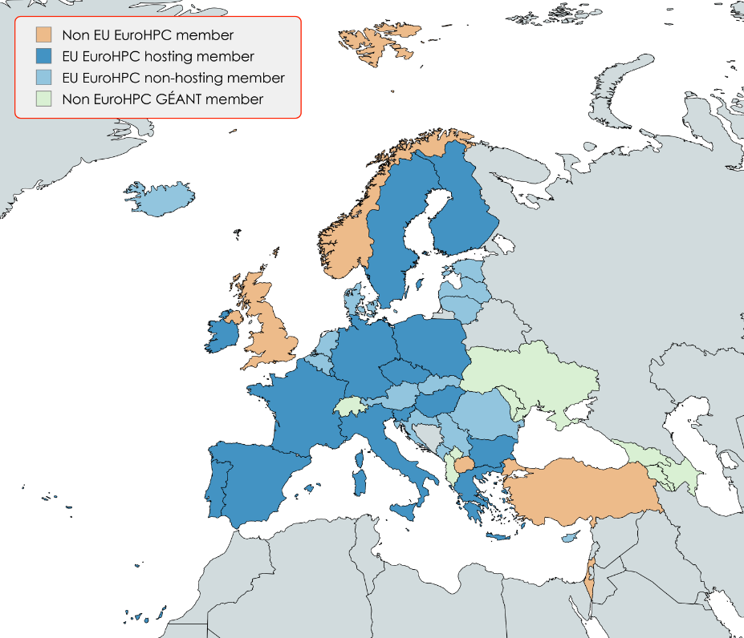
Members of EuroHPC and facilities of the JU
35 Members (all also GÉANT/NORDUnet)
All 27 EU countries + 8 Non-EU
15 HPC Hosting countries - with 3 (HPCs) in the Top10*
  Finland – LUMI*
  Sweden – Arrhenius
  Portugal – Deucalion
  Luxembourg – MeluXina
  Italy – Leonardo*
  Czech Republic – Karolina
  Spain – Marenostrum 5*
  Hungary – Levente
  France – Jules Verne
  Bulgaria – Discoverer
  Ireland – CASPIr
  Poland – EHPCPL
  Slovenia – VEGA
  Germany – Jupiter
  Greece - Daedalus
All HPC facilities are, or will be, (some don’t exist yet!) connected to the respective NREN networks.

Slide 4
To summarise – so far
The HPC JU is acquiring and upgrading a number of Supercomputing Facilities across the Union
The EuroHPC JU will have to connect these facilities via state-of-the-art network infrastructure
The facilities should be accessible to both private and public sector (Industry, SMEs, etc.)
All of these facilities and most of their expected users are, or will be, connected to the NREN networks
We are well positioned to be the Hyper-connectivity network provider for the JU!

Slide 5
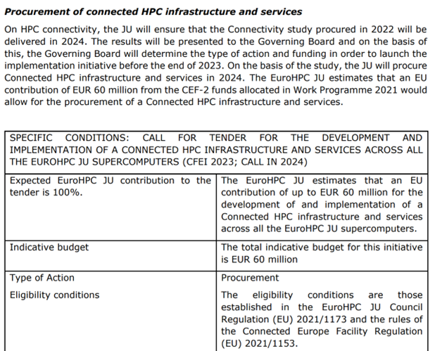
Acquisition process
The JU intends to acquire the Hyper-connectivity service via tender
Consultants hired by the JU to Scope and understand costs
The tender is expected to be released by December 2024
  Initial scope and term is 4 years
  Amount allocated is 60M Euros
  Only EU countries can benefit from CEF
Another 100M EUR procurement (2027-28) will probably extend the scope

Slide 6
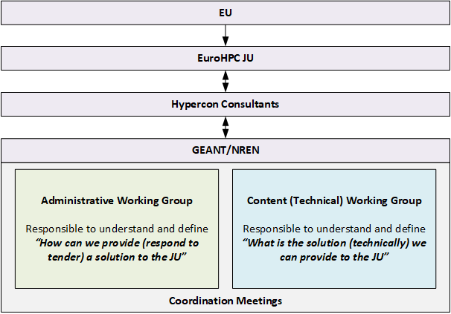
NREN/GEANT structure and interface for Hyper-connectivity
GEANT and the NREN set up a pair of working groups to interface with the consultants and work to answer the specific question related to:
How an answer to the tender can be provided (ie. legal structure, liabilities)
What is the “technical” network service proposal
This structure is in place until July/August 2024.

Slide 7
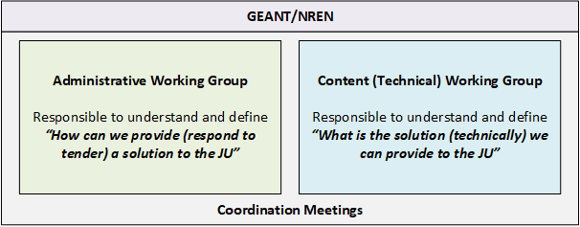
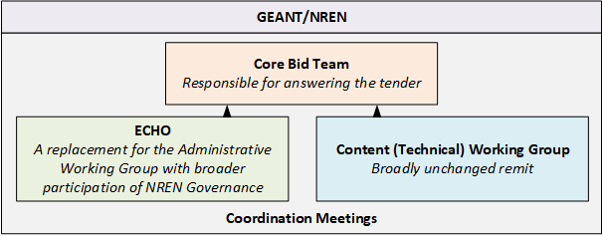
A new structure to respond
Old Structure
A new structure has been recently set-up to prepare to the imminent release of the tender.
This replaces the old structure.
New Structure

Slide 8
Tech Working Group(s)
Group | Who | Scope | Regularity | Comments
GÉANT Tech Core | Enzo, Seb, Keith, Bram, Matthew G., Mick, Alf (others as needed) | Develop “Solution” and understand costing Ensure consistency / completeness Consider Dependencies | Twice a week
NREN Tech WG | GÉANT Tech Core + M. Carboni (GARR) L. Gydé (RENATER) J. Oinonen (CSC) S. Piger (DFN) E. Robles (RedIRIS) R. Tuminauskas (PSNC) | Soundboard, inspire Develop content Viability/Acceptability of concepts | Biweekly | Also individual NRENs follow-up
NRENs Tech | Different channels: NREN Coordination group APM / contacts ECHO | Soundboard Test viability/acceptability | When needed

Slide 9
The story so far
Content and scope of the tender still unknown, in particular:
  Number of client sites requiring upgrades
  Day-zero required capacity
    Expected Nx400Gbps for the main sites
  Timeline and tendering mechanism
    Possibly, could look like this:

Slide 10
Some design considerations
All JU HPCs will be part of the “scope” but is unclear with regards to users and usage
100s of sites are listed among expected users with high-capacity requirement
Not clear what the extent of the actual “Terabit” area will be
Funding is limited, considering the size of the area
Add a Time component – When (2025-2033)?
Not knowing the “boundaries” suggest the use of an R&E Internet service not a VPN
Decouples “Terabit Area” from “Service Area” via Tiering
Preparing for additional phases (and funding) to extend and upgrade the network as demand and needs evolve.

Slide 11
VPN pros & cons
Pros
Cons
Well identified set of resources
Clear boundaries of the service
Simplified monitoring and accounting
Easier troubleshooting
More “secure” (or perceived as such…)
Could allow for better end-to-end throughput
Higher entry barrier for new connectors
More complex configuration
Harder to connect non-R&E endpoints
Need for a specific AUP definition
Additional security enforcement
More complex maintenance

Slide 12
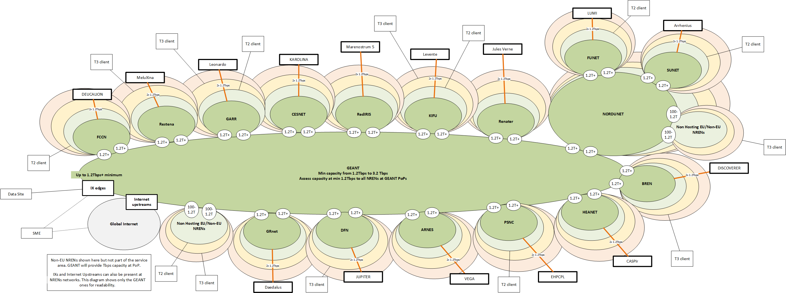
Service area
Notes:
IX and Upstream edges are also present at NRENs and NORDUnet – they are not shown to keep the image readable.

Slide 13
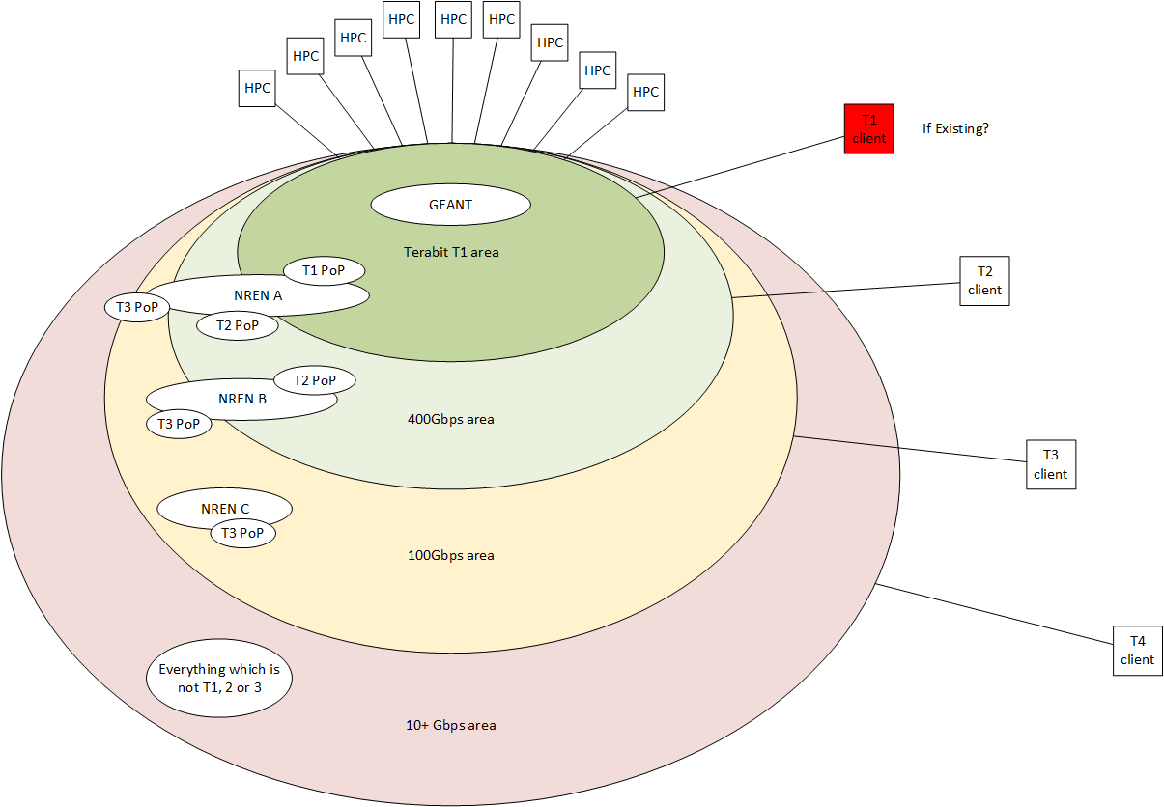
Tiering
NRENs sits across multiple tiers to ringfence the scope of the costly upgrade while maintaining reach for the service.

Slide 14
Zooming in
Clients/Users are connected to any Tier
A fully-redundant Terabit network extends all the way from the sites across NRENs to the Regionals and Back
Users outside of the R&E Network can connect to the edges of The Hyper-connectivity network at capacity up to 1.2Tbps via Internet, IXs, or dedicated circuits

Slide 15
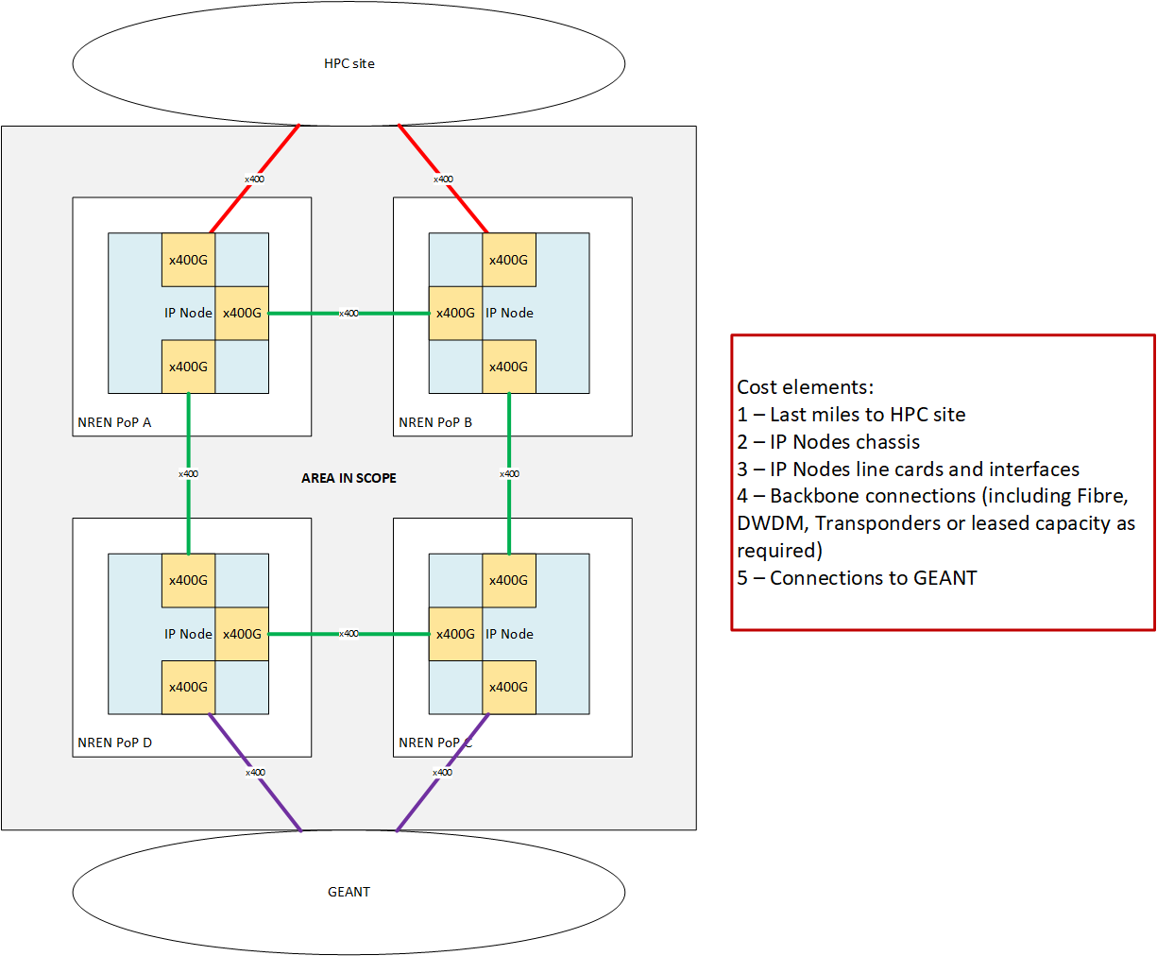
NREN topology blueprint
Area in scope for upgrading using JU funding is the one in between the HPC site and the GÉANT APs
Upgrade to bring the capacity up to the level required for the HPC to have uncongested connectivity at the access capacity to the upstream regional
Upgrade of the IP layer provides the most flexible solution, increasing the return of investment
Upstream regional

Slide 16
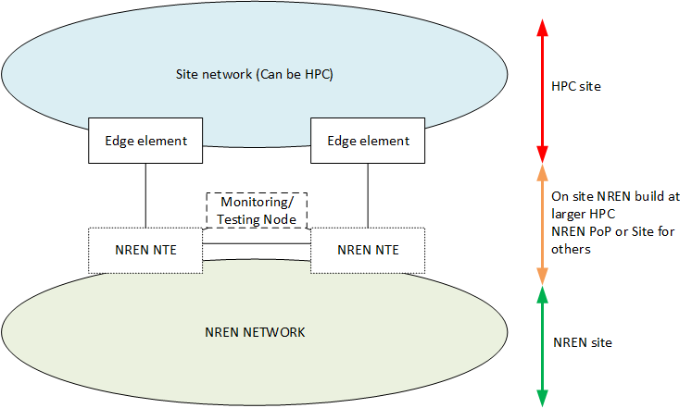
Edge of HPCs
An edge area of the Hyper-connectivity network (service demarcation) will be defined.
Edge area can be based on full CPE build on site (likely for HPCs) or simply function of a PE router port
Monitoring functions will be necessary, either virtual (NFV) or physical (e.g. perfSONAR)

Slide 17
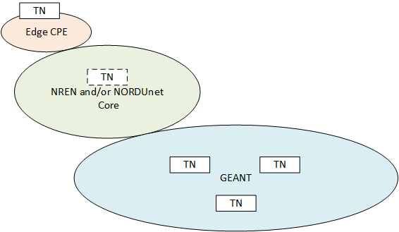
Service testing infrastructure
PM node runs a 400Gbps bandwidth test against NREN reference node.
A set of Testing Nodes could be deployed as part of the NREN Edge structure for major sites (ie. HPCs).
Testing nodes will be present in GÉANT and NRENs to be able to run service validation tests (primarily Bandwidth).

Slide 18
Components of the Service
Main bid lot
SLA framework
Network infrastructure
GÉANT backbone
GÉANT backbone
Monitoring
HPC hosting NRENs
HPC hosting NRENs
NRENs infrastructure
NRENs infrastructure
Reporting
Network Management
Non-hosting NRENs
HPC hosting NRENs (?)
Security framework

Slide 19
Infrastructure Components
Network infrastructure
Scope
Countries/NRENs
end-to-end
Design
Topology
endpoints
EuroHPC sites
R&E sites
Other data locations
Non-R&E
Access points to service
Capacity tiers
NREN access
IX presence
Commodity upstream
Direct peering
BW requirements
Backbone
Access
Resiliency
Redundancy
Diversity
Resources identification
Network elements
Other hardware
Lead times
SLAs
Uptime
Throughput
Packet loss
Time-to-fix
NRENs
GÉANT
Network services
IP
L2/L3 inter-domain VPN
QoS
Best-effort/dedicated circuits
Day 0
Upgrades
Day 0
Upgrades
External
Not only the infrastructure, but also associated elements to monitor the service with SLAs and including Transport security - primarily anomaly detection and DDOS mitigation.

Slide 20
Current works
Project matrix (tasks, responsibility, outputs, status)
  ITIL approach
Service design
Security approach document
Monitoring scenarios
  Different topologies considered
Backbone implementation timelines
Gap analysis
Service Level numbers (SLA, SLT, historical, anything!)
Timelines for national implementations

Slide 21

Thank You
Any questions?
www.geant.org
© GÉANT Association
As part of the GÉANT 2020 Framework Partnership Agreement (FPA), the project receives funding from the European Union's Horizon 2020 research and innovation programme under Grant Agreement No. 856726 (GN4-3).

