Slide 1
Fiber on Access @Arnes
SIG-NOC21
Berlin, 13. – 14. november 2024
Jože Hanc, ARNES

Slide 2

ARNES
Academic and Research Network of Slovenia
NREN, established in 1992 by Slovenia‘s government
Connecting 1467+ institutions, of which 68 research institutions and 36 university locations;
fast connection for scientific and research institutions over the world with the capability of multiple 100 GB/s,
55 PoPs in Slovenija

Slide 3

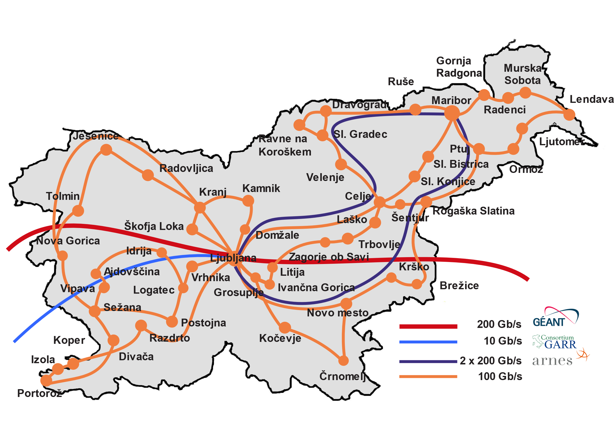
The Backbone of Slovenian Internet

Slide 4
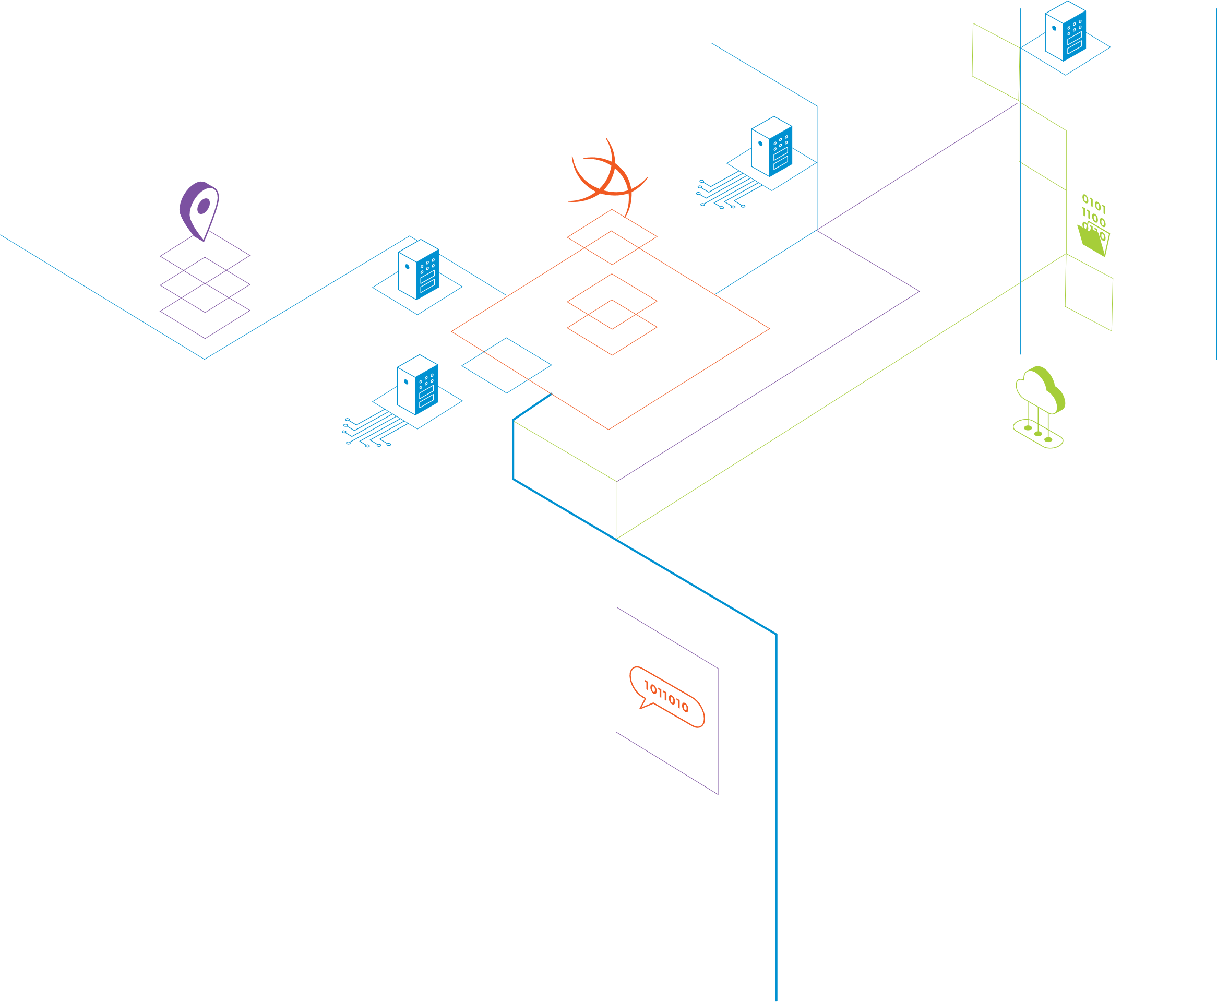

connecting knowledge
A few successful local efforts: campus and “metro” optical networks
First efforts with tenders in 2004 and 2005, political mishaps aplenty
First tender in 2013 2014 2015 – IRoptika1
Second tender in 2023 – IRoptika2
Third tender in 2025 – IRoptika3 (not there yet)
IRoptika
Educational and Research
optical network

Slide 5
IRoptika(1) - 2015
67 research institutes
37 state museums
26 colleges and university locations or 96% of students
146 secondary schools and 97% of students
227 primary schools and 47% of pupils
29 secondary school’s and student dorms
33 music schools
71 libraries
165 kindergartens
IRoptika
Educational and Research
optical network
IRoptika1
775 locations

Slide 6
IR optika 2 – 2023 (and 2024)
11 secondary schools
193 primary schools
Shortest: 414 meters
Longest: 41,3 kilometers
Average price 23.200€ - eight year rental
Price per km: 300 € to 34.000 €
IRoptika
Educational and Research
optical network
IRoptika2
204 locations
Delay
Major flooding in august 2023

Slide 7
IRoptika - modality
Big #nope to IRU in 2013 by local administration
Ownership of fibre pair(s) with easement to the underground ducting - permanent
25 year “warranty” – paid in advance
Intent to renew the contracts with all the suppliers
Positive: Right of way ensures we can use the ducts
Negative: Ownership is a burden in more ways then one
IRoptika
Educational and Research
optical network
IRU
Indefeasible rights of use

Slide 8

The end
SIG-NOC21
Berlin, 13. – 14. November 2024
Jože Hanc
joze.hanc@arnes.si

