Slide 1


EuroHPC Operations, Administration, and Management
"Driving Excellence in HPC: Seamless Operations, Administration, and Management for Europe's Future"
Keith Slater
Senior Service Manager
STF, Berlin
12th November 2024

Slide 2
The Challenge
Be as ready as we can (and is useful) for the procurement
What is the solution (technical) we can provide to the JU?
35 members – all 27 EU and 8 non-EU. All have different operating models.
Some sites are connected to NRENs, some to Regional networks, some to institutions **
We don’t know exactly what the ask will be yet (but we can take an educated guess)

Slide 3
What have we done so far?
Created a technical working group
  Internal (GÉANT)
  External (sub-set of NRENs)
Started (well on our way) to create technical documentation
  Design
  O, A &M
  Security
  Relationship Management

Slide 4
Assumptions & What We Do Know
Based everything on what we already know (ITIL)
“Tried” to use BAU as much as possible
  Let’s not complicate this any more than necessary
Availability will be a KPI
Capacity management will be needed
Incident Management will be needed
Service Management will be needed

Slide 5





  Example User Case
  Scenario – FUNET end user has problems connecting to HPC site in another country
HPC
NREN
NTE
NREN
PE
NREN
N/W
GEANT
PE
GEANT
N/W
GEANT
PE
NORDU
N/W
FUNET
N/W
FUNET
PE
End
User

Slide 6


  Scenario 1
  GEANT has access to GEANT equipment only
HPC
NREN
NTE
NREN
PE
NREN
N/W
GEANT
PE
GEANT
N/W
GEANT
PE
NORDU
N/W
FUNET
N/W
FUNET
PE
End
User
Pros: Autonomy remains, all parties manage their own equipment only.
Cons: Difficult to troubleshoot layer3 issues outside autonomous region.
Multiple tickets to multiple parties (GÉANT, NREN A, Nordunet, FUNET)
Local visibility of traffic stats only
No visibility of SLA metrics

Slide 7

  Scenario 1.5
  GÉANT have access to GÉANT equipment only but do have a server on-site (PerfSONAR)
HPC
NREN
NTE
NREN
PE
NREN
N/W
GEANT
PE
GEANT
N/W
GEANT
PE
NORDU
N/W
FUNET
N/W
FUNET
PE
End
User
Pros: Autonomy remains, all parties manage their own equipment only.
Global visibility of SLA metrics
Cons: Difficult to troubleshoot layer3 issues outside autonomous region.
Multiple tickets to multiple parties (GÉANT, NREN A, Nordunet)
Local visibility of traffic stats only

Slide 8

  Scenario 2
  GÉANT have access to GÉANT equipment as well as some access to NREN NTE (SNMP) and also have a server on-site (PerfSONAR)
HPC
NREN
NTE
NREN
PE
NREN
N/W
GEANT
PE
GEANT
N/W
GEANT
PE
NORDU
N/W
FUNET
N/W
FUNET
PE
End
User
Pros: Autonomy remains, all parties manage their own equipment only.
Global visibility of SLA metrics
Global visibility of traffic stats
Cons: Difficult to troubleshoot layer3 issues outside autonomous region.
Multiple tickets to multiple parties (GÉANT, NREN A, Nordunet)

Slide 9

  Scenario 3
  GÉANT have access to GÉANT equipment as well as some access to NREN NTE (SNMP) and some access to NREN PE (SNMP, RO CLI / looking glass) and also have a server on-site (PerfSONAR)
HPC
NREN
NTE
NREN
PE
NREN
N/W
GEANT
PE
GEANT
N/W
GEANT
PE
NORDU
N/W
FUNET
N/W
FUNET
PE
End
User
Pros: One party able to troubleshoot layer3 issues through the entire route
Single ticket for single issue
Global visibility of SLA metrics
Global visibility of traffic stats
Cons: Autonomy / political issues?

Slide 10
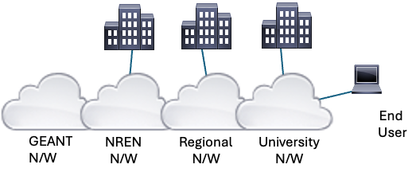
Site connectivity
The challenge….

Slide 11
What do we know we need to do?
Availability
Capacity Management
Best way to do this?
  BGP session to end device (deny-all)
  SNMP RO session
Other ways to do this?
  ICMP / API
>> Minimum Viable Product <<

Slide 12
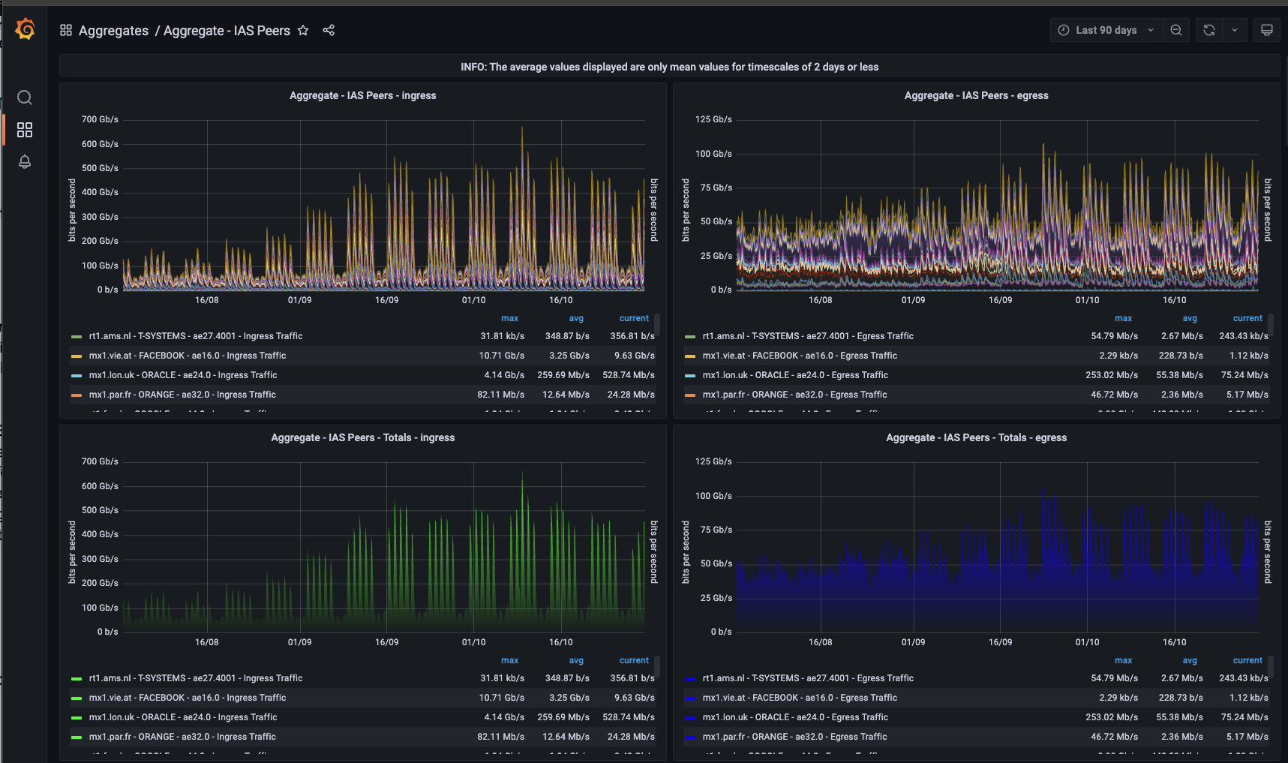
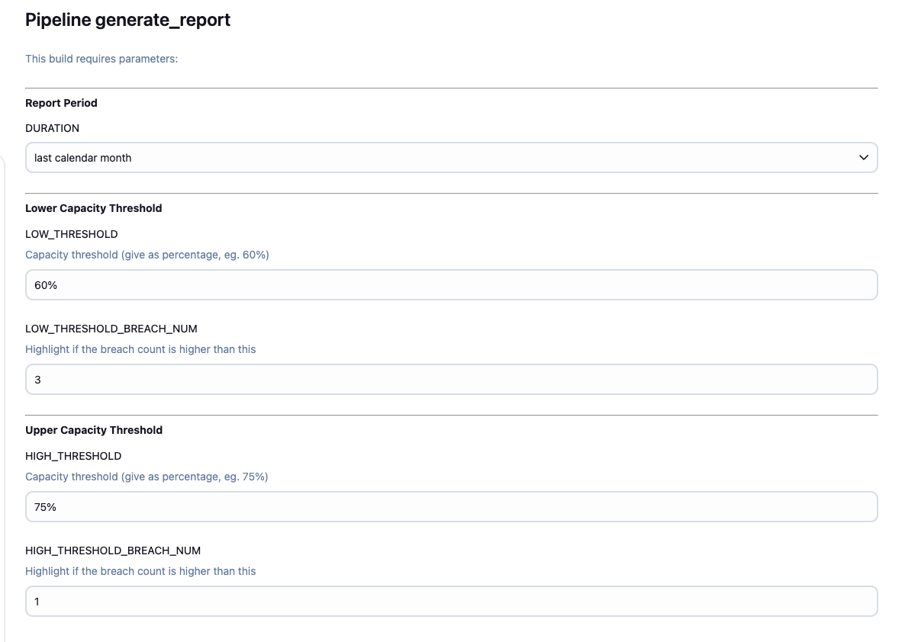
Traffic Stats / Capacity Management

Slide 13
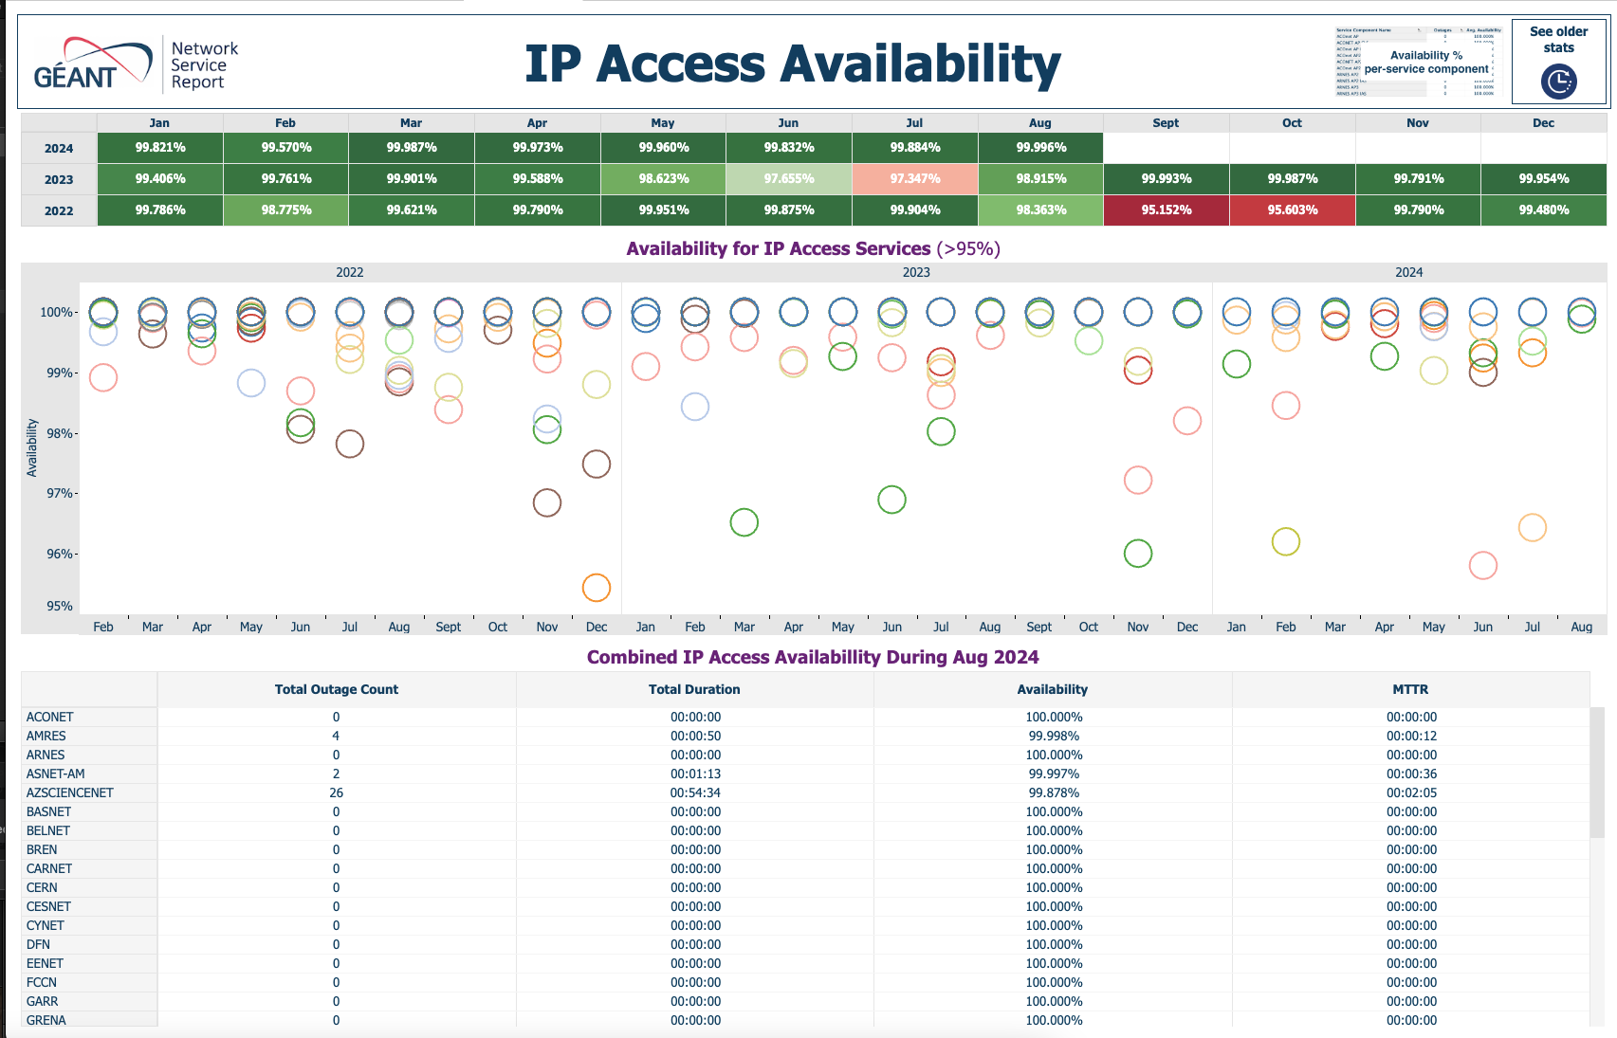
Availability

Slide 14
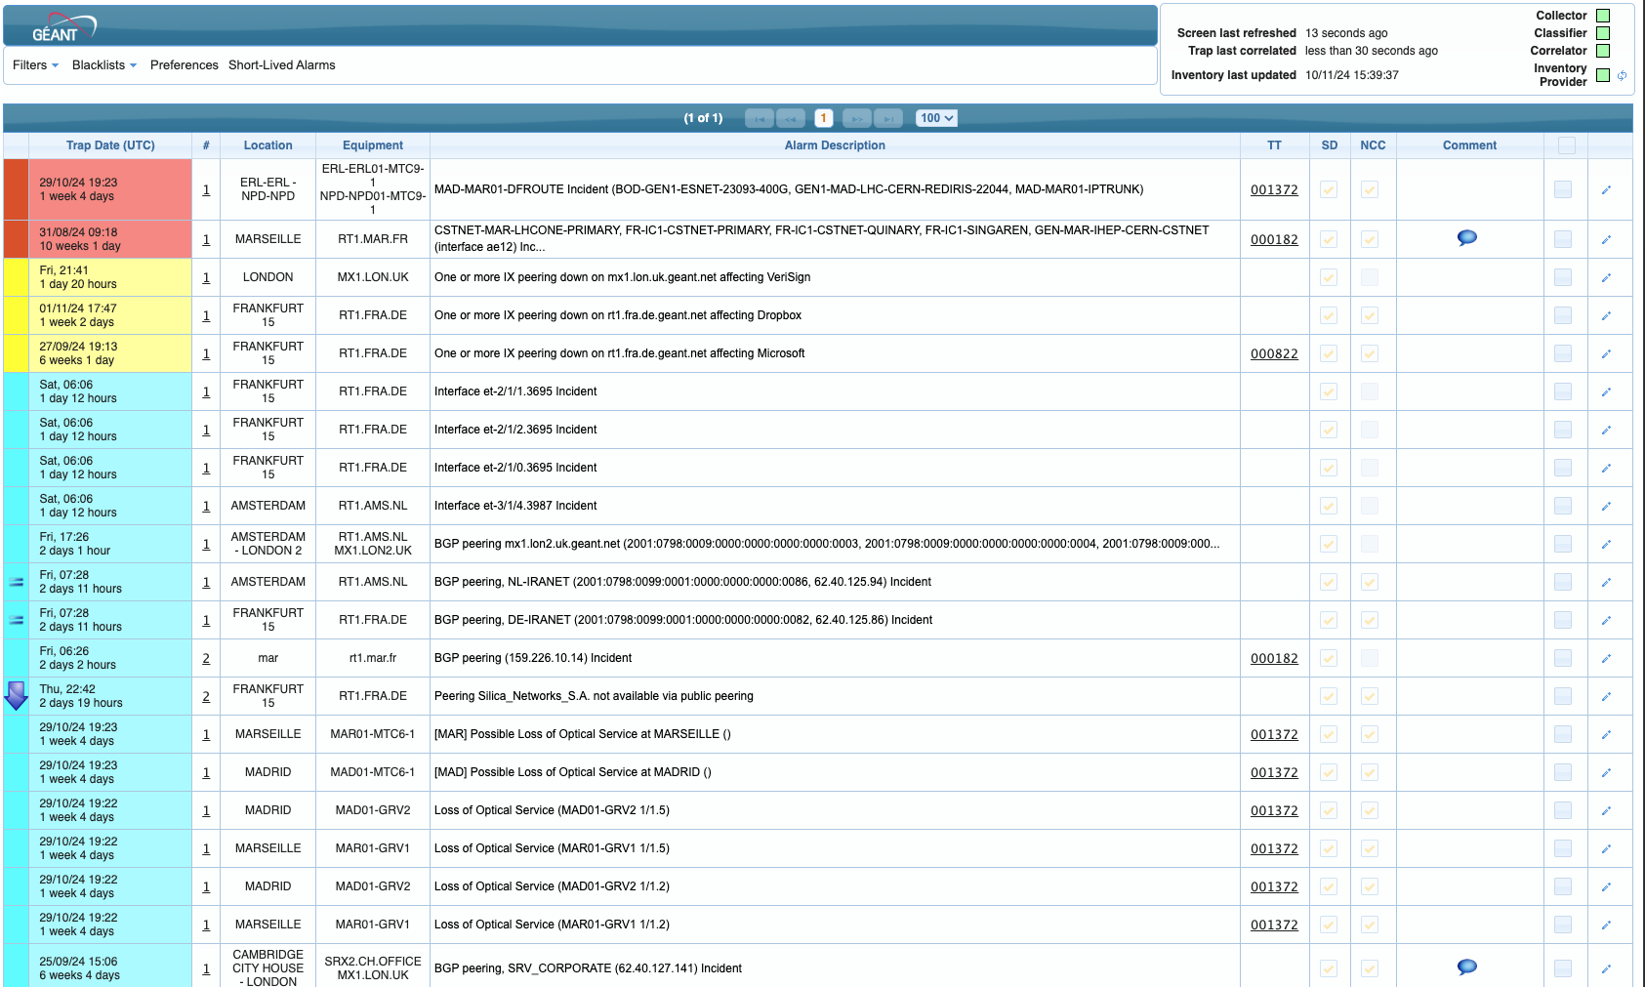
Incident Management

Slide 15
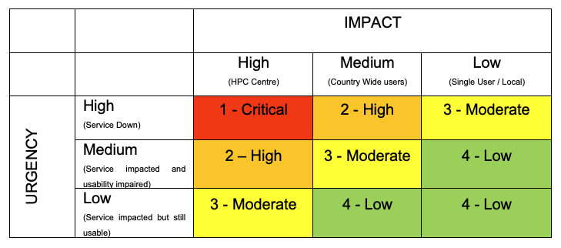
Incident Management
Incident categorisation and prioritisation

Slide 16
Incident Management
Resolution 1st Level (NREN)
  Local / in-country incidents
Resolution 2nd Level (GÉANT OC)?
  IP routing incidents / Access Port incidents
Handling of Major Incidents
  Local / in-country issues can still be Major Incidents
  Major Incident Manager
Incident monitoring and escalation
  Ticketing/alerting
Incident Closure and Evaluation
Incident Management Reporting

Slide 17
Service Management
Dedicated Service Manager
Service Level Monitoring
Reporting
Maintenance of SLM framework
Change Management
Assessment of Change Proposals
RFC Logging and review

Slide 18
Service Validation & Testing
Test model definition
Service acceptance testing
Continual Service Improvement
Service Reviews
Evaluation of Processes
Definition of initiatives
Monitoring of Initiatives

Slide 19
  Other considerations – just a brain dump!
  Monitoring and troubleshooting in NREN location
  Technical characteristics, bandwidth, Jumbo frames etc.
  Design goals – dual fibres, diversity, latency, jitter, packet loss, alarming
  Perfsonar at Tier 1 sites, DTN nodes in the network
  SPOC processes – do we really want a SPOC or should this go to NRENs first?
  3rd party involvement, tails, remote H&Es etc.
  Caveats, assumptions
  Tools, teams, development
  Testing methodology
  SLT design, site support tiers
  Documentation to be developed – design template, SLAs, handover docs, LWIs, RACI,
  Transition plan - phased introduction, day 1
  Service credit regime

Slide 20

Questions / Comments / Input?

