Slide 1
Streaming Telemetry
‘
‘Not everything that can be counted counts and not everything that counts can be counted’
Albert Einstein
Joao_Silva@ASR

Slide 2
HLD in 2019 for -> RCTS 2.0 building blocks
Transport Layer based on Segment Routing (ti-lfa) as Unified Forwarding Plane
Service Layer for Layer 2 (EVPN) and Layer 3 VPN services based on BGP as Unified Control Plan
SDN - Segment Routing Path Computation Element (SR-PCE) to provide simple and scalable inter-domain transport connectivity and Traffic Engineering and Path control
Visibility and Automation
  Streaming Telemetry to enhance visibility and monitoring
  NSO/Ansible for service provisioning with Netconf/YANG data models
We are Here!!!!

Slide 3


Hidden Agenda
In this session we will:
-> Drive your motivation to kill SNMP!
Notes:
Well, not literally, but yeah, to migrated when possible if the hardware supports streaming telemetry

Slide 4
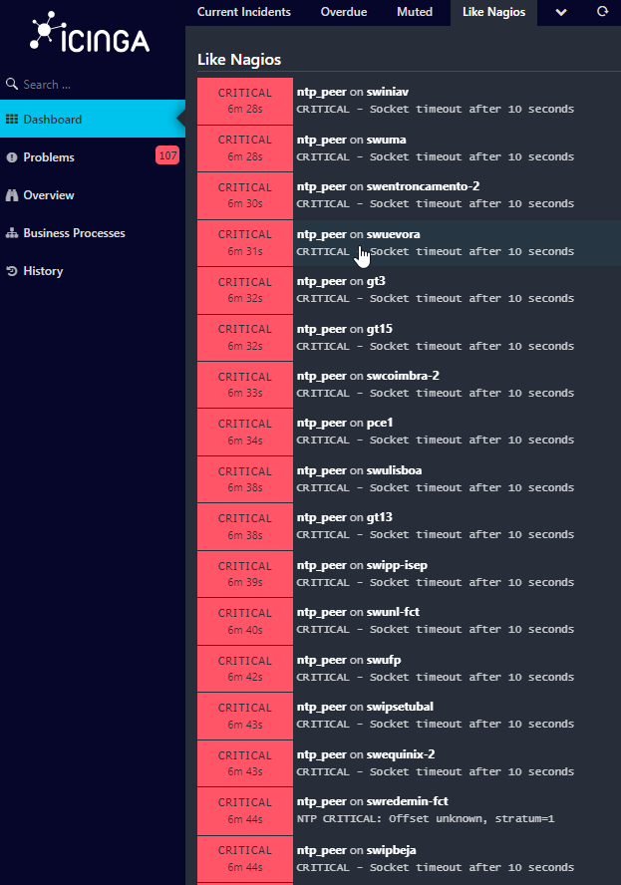
Motivation
How do you monitor your Network?
If this is a picture of your NOC personnel…
You may have a Finger-Defined Network.
Notes:
This was a typical day, everything was fine on the network, but the equipments sometimes failed to respond to snmp messages

Slide 5
Why change
For us, personally:
Switches logs full of messages: “%SNMP-3-RESPONSE_DELAYED: processing GetNext of entSensorType (150023 msecs)”, too many SNMP collectors
Routers: Change of default values in control-plane policies to accommodate the rate of snmp requests
Inability to fetch important data in equipment's, ie: evpn/perf-meas/bgp afi’s-safi’s
Short spaced glitches where very hard to see
Plan in motion to:
-> Improve visibility to help troubleshoot = faster problem resolution
Notes:
Embarc+amos numa viagem no princpio deste ano sobre esta temática, para aprender e experimentar numa primeira fase e depois implementar

Slide 6
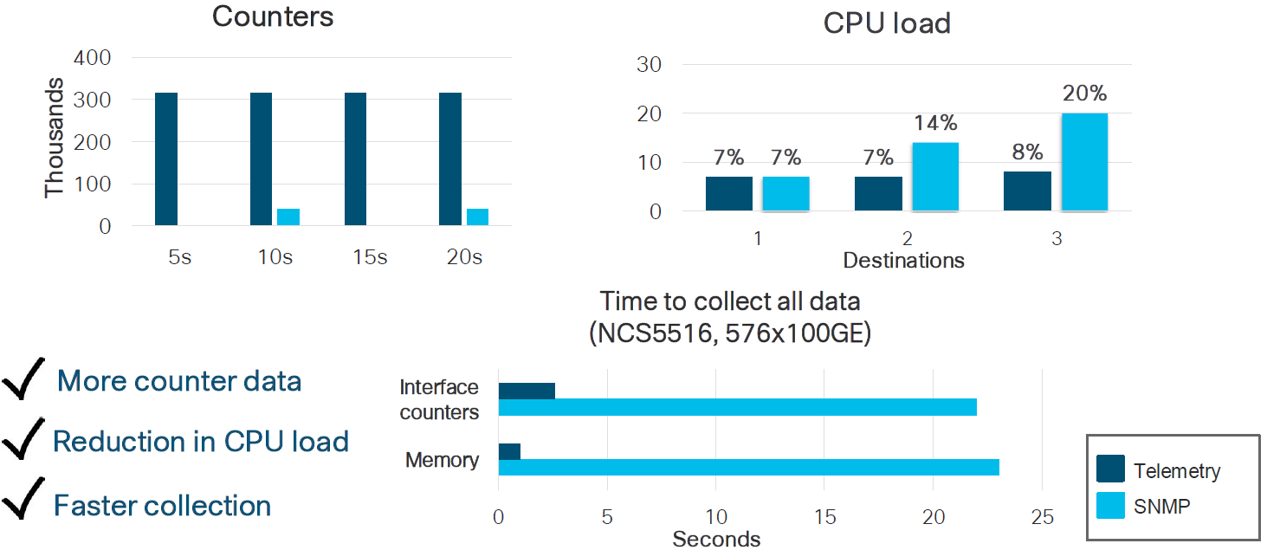
“Pushing” More Data Really Does Work Better

Slide 7
streaming telemetry stack

Slide 8
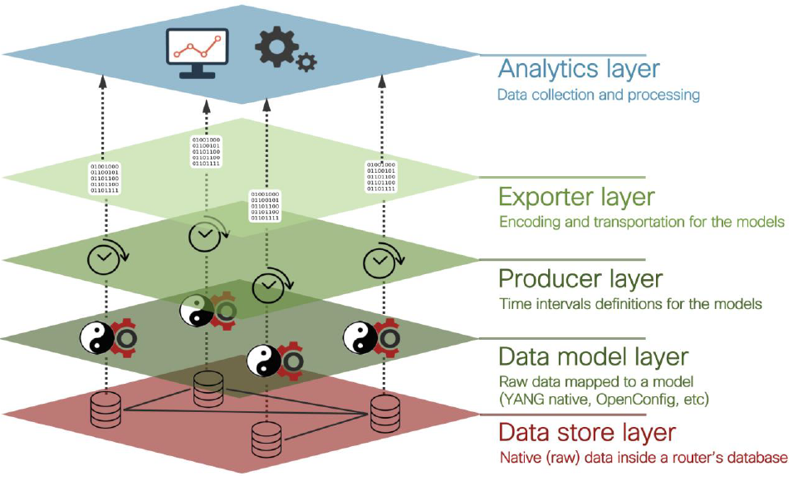
First things, first: Telemetry stack
So, what is all this fuss about Streaming Telemetry…
Real-time data collection and transmission for monitoring.
Continuous and automated delivery of telemetry data.
Faster issue detection and response.
Enables historical data analysis.
Relies on efficient and reliable protocols.
Provides visibility into network and system operations.
Optimizes performance, enhances security, ensures reliability.
“Scream Stream If You Wanna Go Faster”
Notes:
In a lab in cisco live2023 we realized the implementation was not so difficult. We are not going very deep, since this was taken from a hour long presentation on FCCN “TNC” from last year

Slide 9
Data model layer
Raw data maped to a model
(YANG models: Native, OpenConfig, etc)

Slide 10

Yang data models, this is where all begins
Native Models
OpenConfig Models
Aaaa, and IETF too….
In the present day, a router has about 1300 Native models and 100 OpenConfig models
Notes:
Existem ainda modelo o ietf mas possuem ainda uma expressão muito pequena

Slide 11
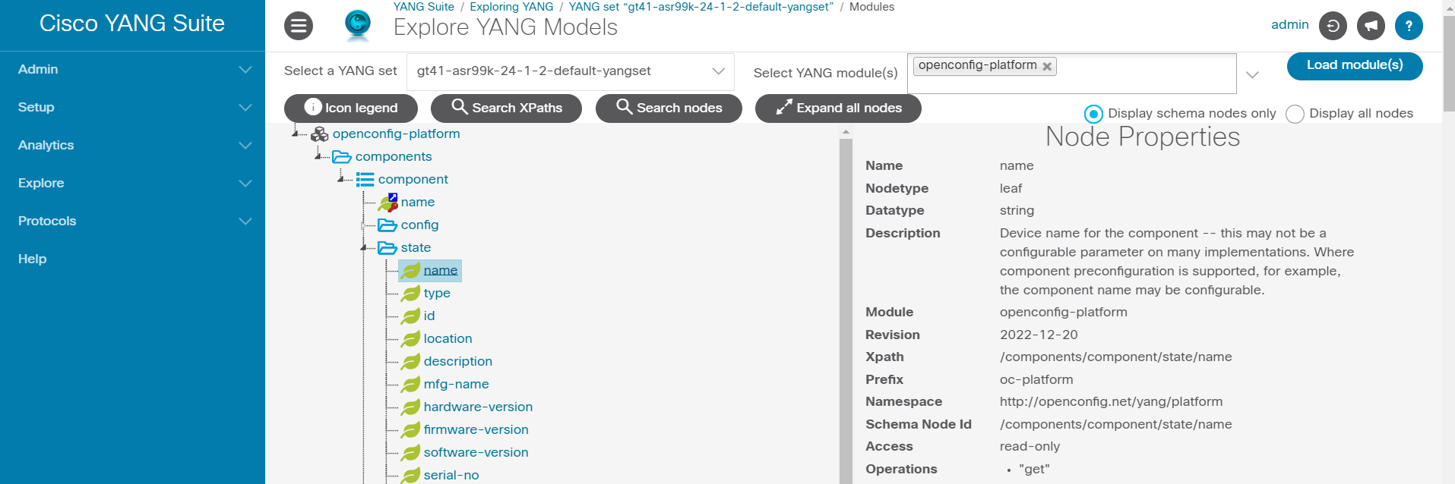
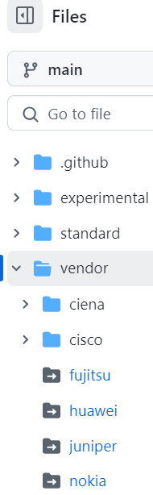
How to explore Yang data models
YangSuite
Notes:
Cisco YANG Suite provides a set of tools and plugins to learn, test, and adopt YANG programmable interfaces such as NETCONF, RESTCONF, gNMI and more.
Its vendor agnostic and you can upload yang models directly from the router or switch, or from github.
Its downloadable in a container, easy to install go try it

Slide 12
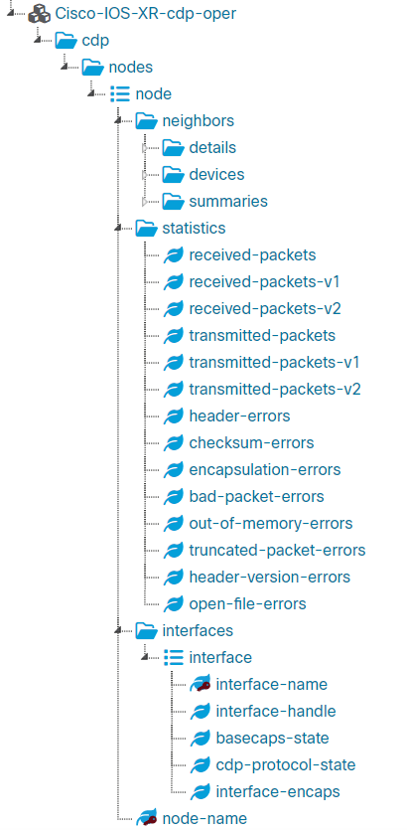
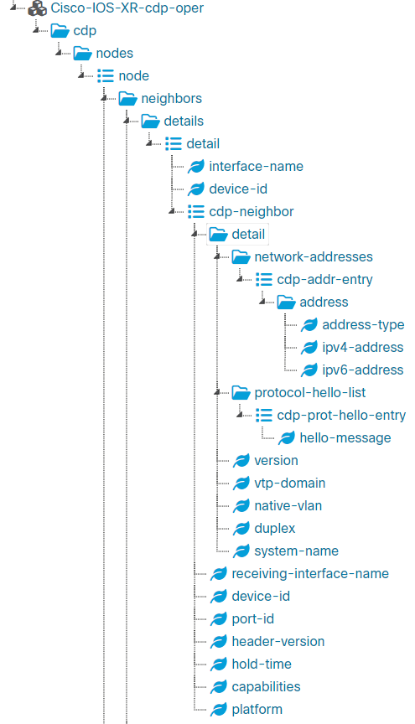
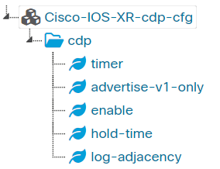
Configuration vs operational
Notes:
Existem ainda modelo o ietf mas possuem ainda uma expressão muito pequena

Slide 13
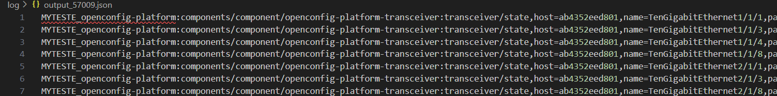
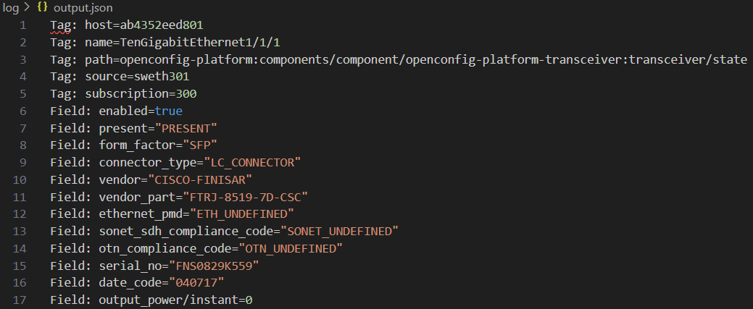
How to explore Yang data models
Notes:
Cisco YANG Suite provides a set of tools and plugins to learn, test, and adopt YANG programmable interfaces such as NETCONF, RESTCONF, gNMI and more.
Its vendor agnostic and you can upload yang models directly from the router or switch, or from github.
Its downloadable in a container, easy to install go try it

Slide 14
producer layer
Time intervals definitions for the models

Slide 15
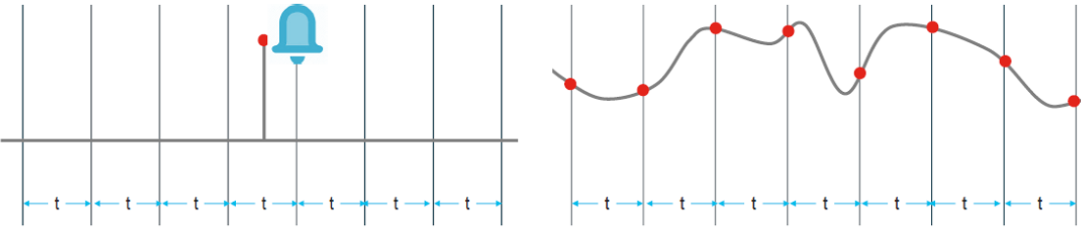
Publication options
On-Change
Periodic
Event notifications (failed login, optics fault, etc)
State and Configuration
Time based publications
Minimum interval 1s

Slide 16

Telemetry taxonomy
Model-Driven Telemetry
Model-Driven Telemetry
Event-Driven Telemetry
Router X
Router X
100 Interfaces UP/ 0 Down
100 Interfaces UP/ 0 Down
100 Interfaces UP/ 0 Down
Time
Time
100 Interfaces UP/ 0 Down
99 Interfaces UP/ 1 Down
99 Interfaces UP/ 1 Down
99 Interfaces UP/ 1 Down

Slide 17



exporter layer
Encoding and transportation for the models
gNMI
gRPC
NETCONF
RESTCONF
SNMP
CLI
It’s all about the
Apey Eyes
APIs
Get it!?

Slide 18
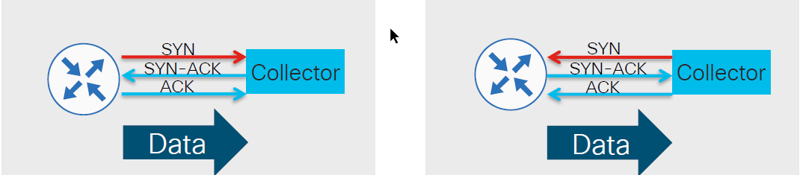
MDT modes, dial-in vs dial-out
Dial-out
Dial-in
Broader flexibility in transport options
No need to open ports for inbound management traffic
Anycast & Load-balancing
A single channel (config and streaming)
Listening port on the router
No MDT configuration on the router
Only gRPC/gNMI available

Slide 19
analytics layer
Data collection and processing

Slide 20







Analytics stack - tig
NETWORK

Slide 21
architecture

Slide 22
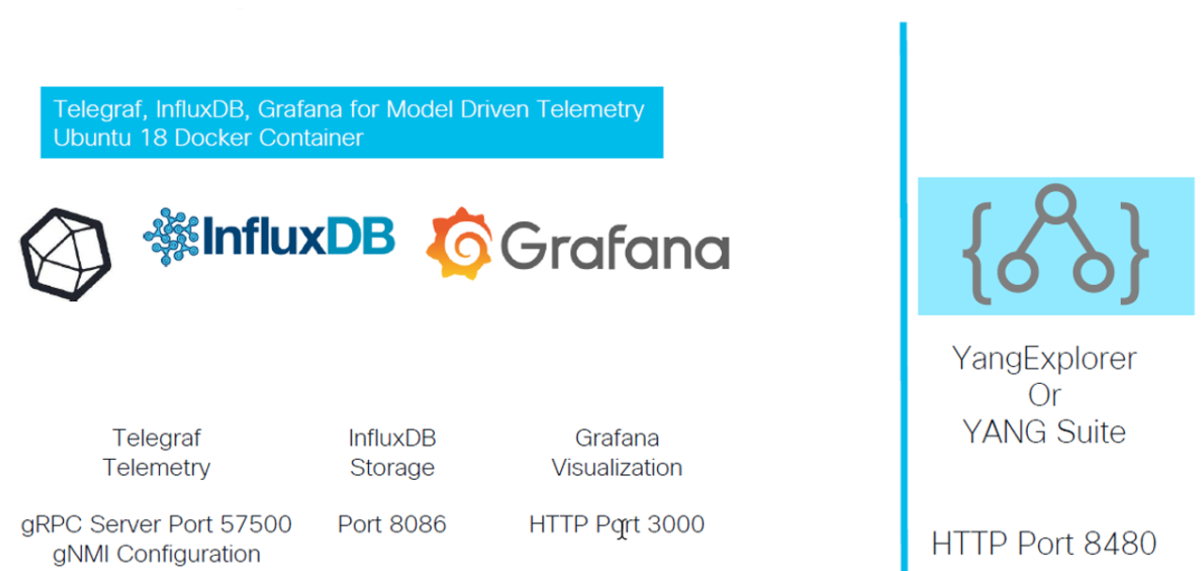
Try it! No, really try it!!
TIG MDT Docker Container
Separate Container
https://github.com/DataKnox/Cisco-MDT-TIG-Docker
https://github.com/CiscoDevNet/yangsuite

Slide 23
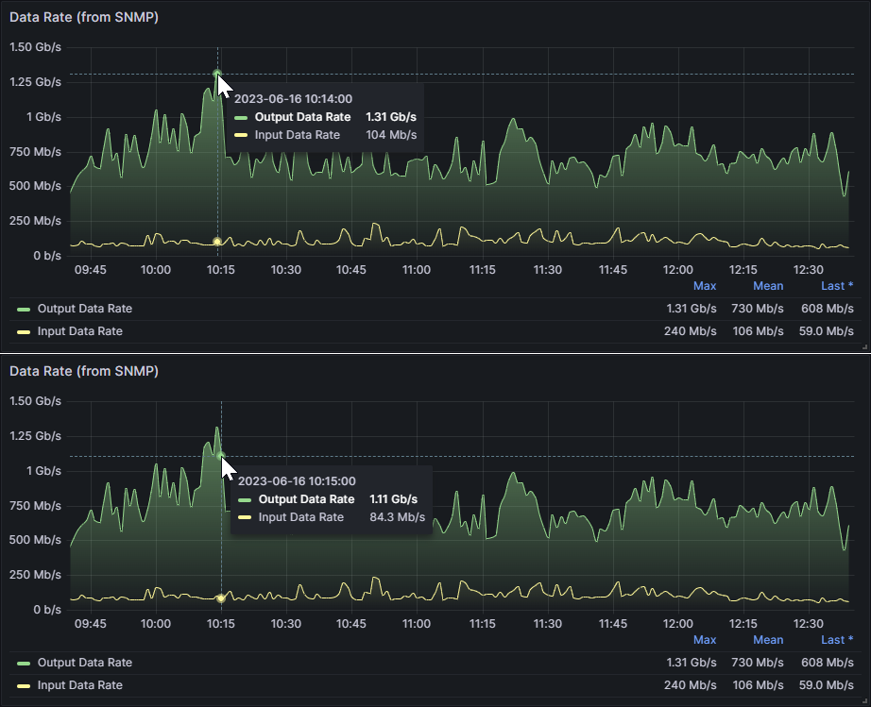
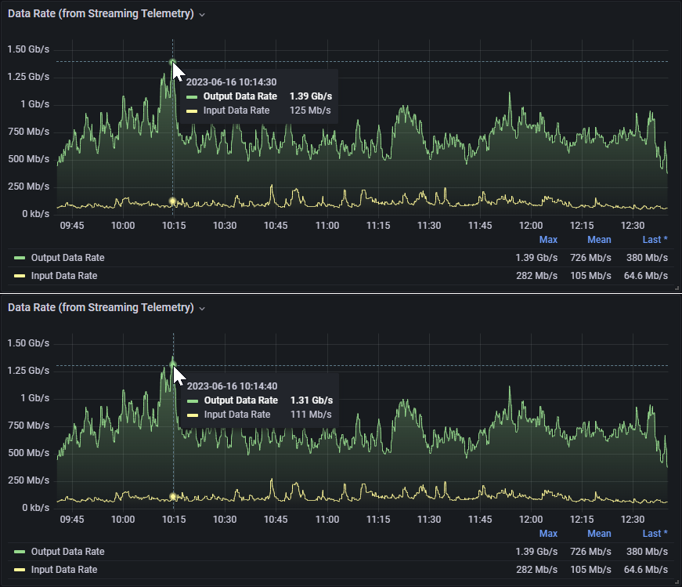
Precision!

Slide 24
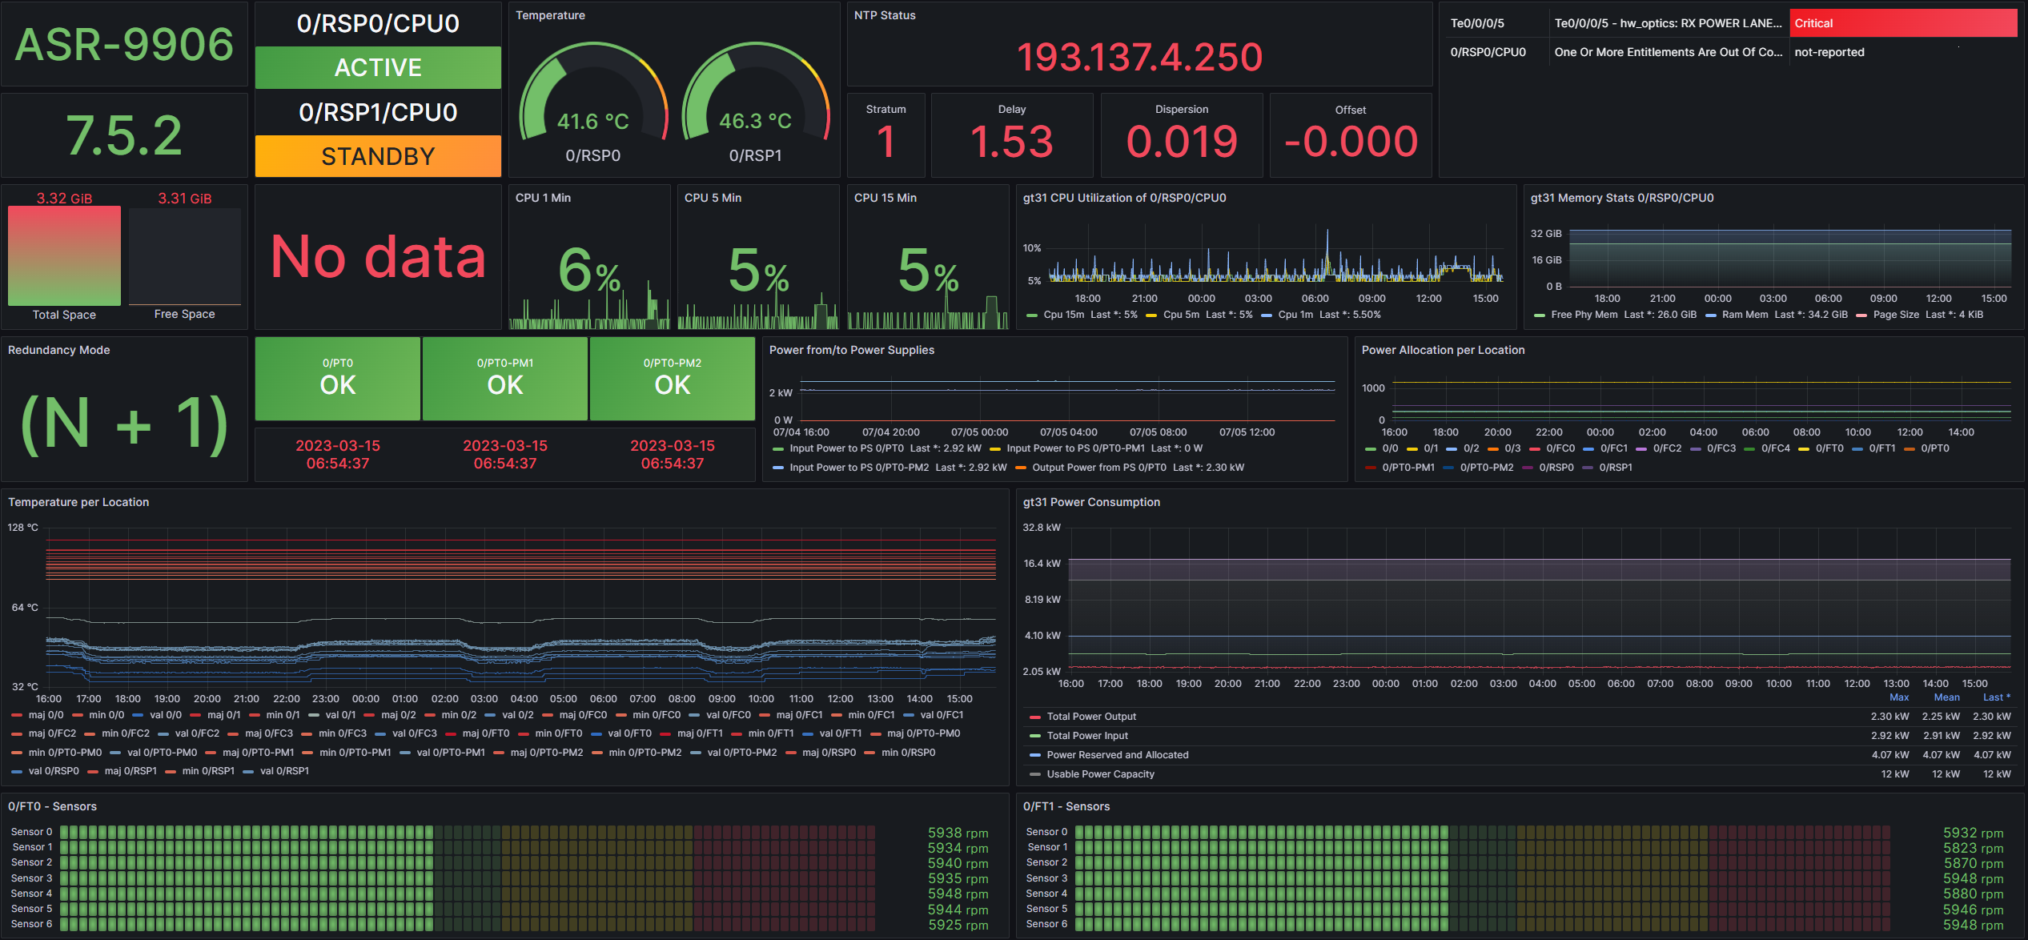
Notes:
Having the ability to query a DB for all the information present in the cli shows commands, the sky is your limit for dashboarding

Slide 25
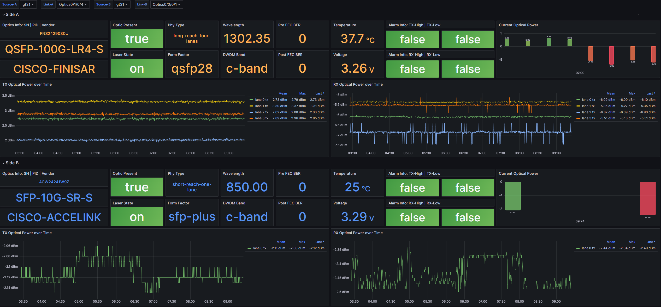

Slide 26
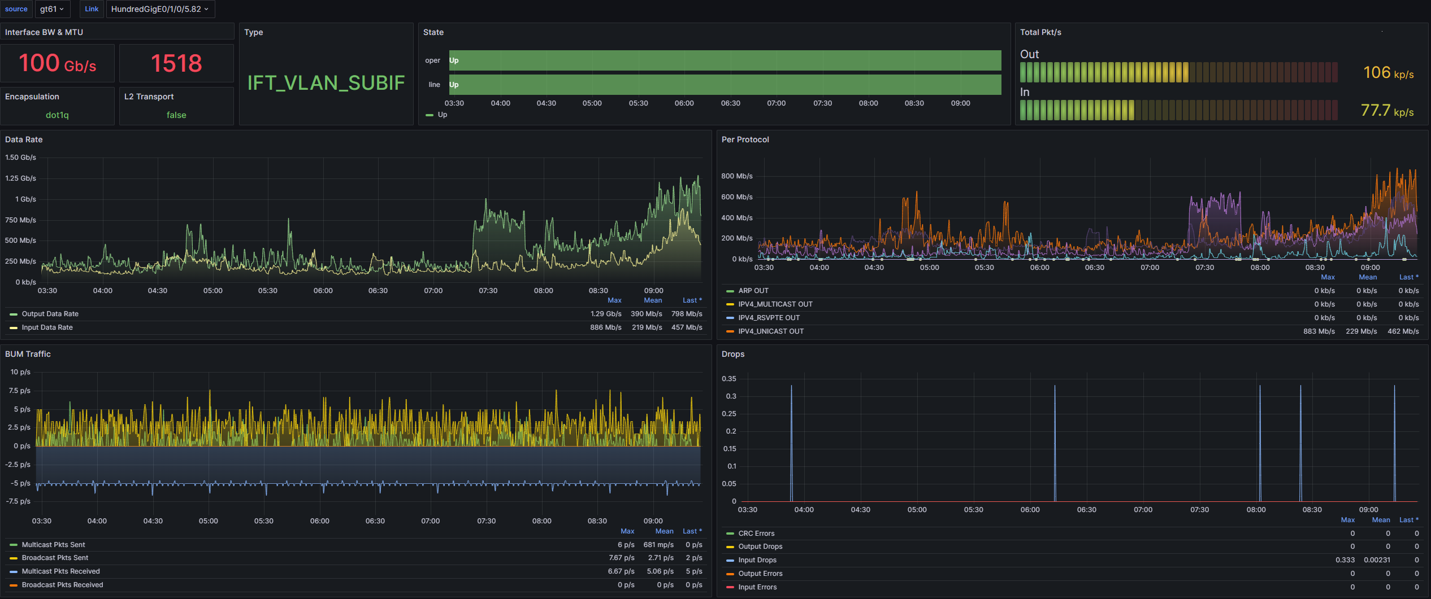

Slide 27
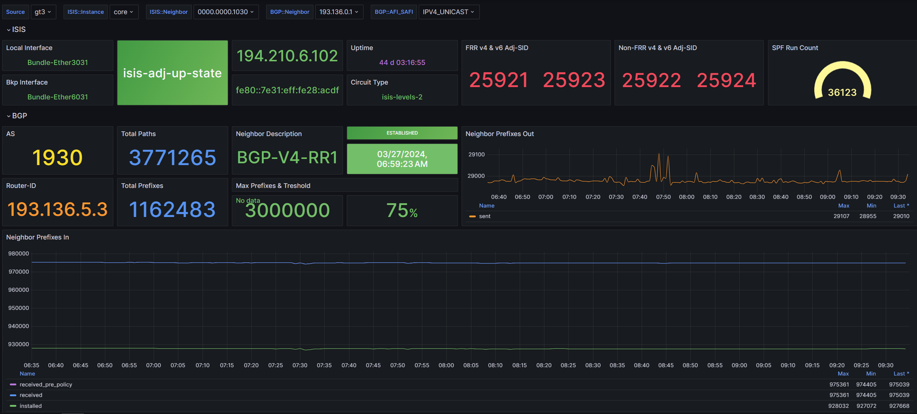

Slide 28
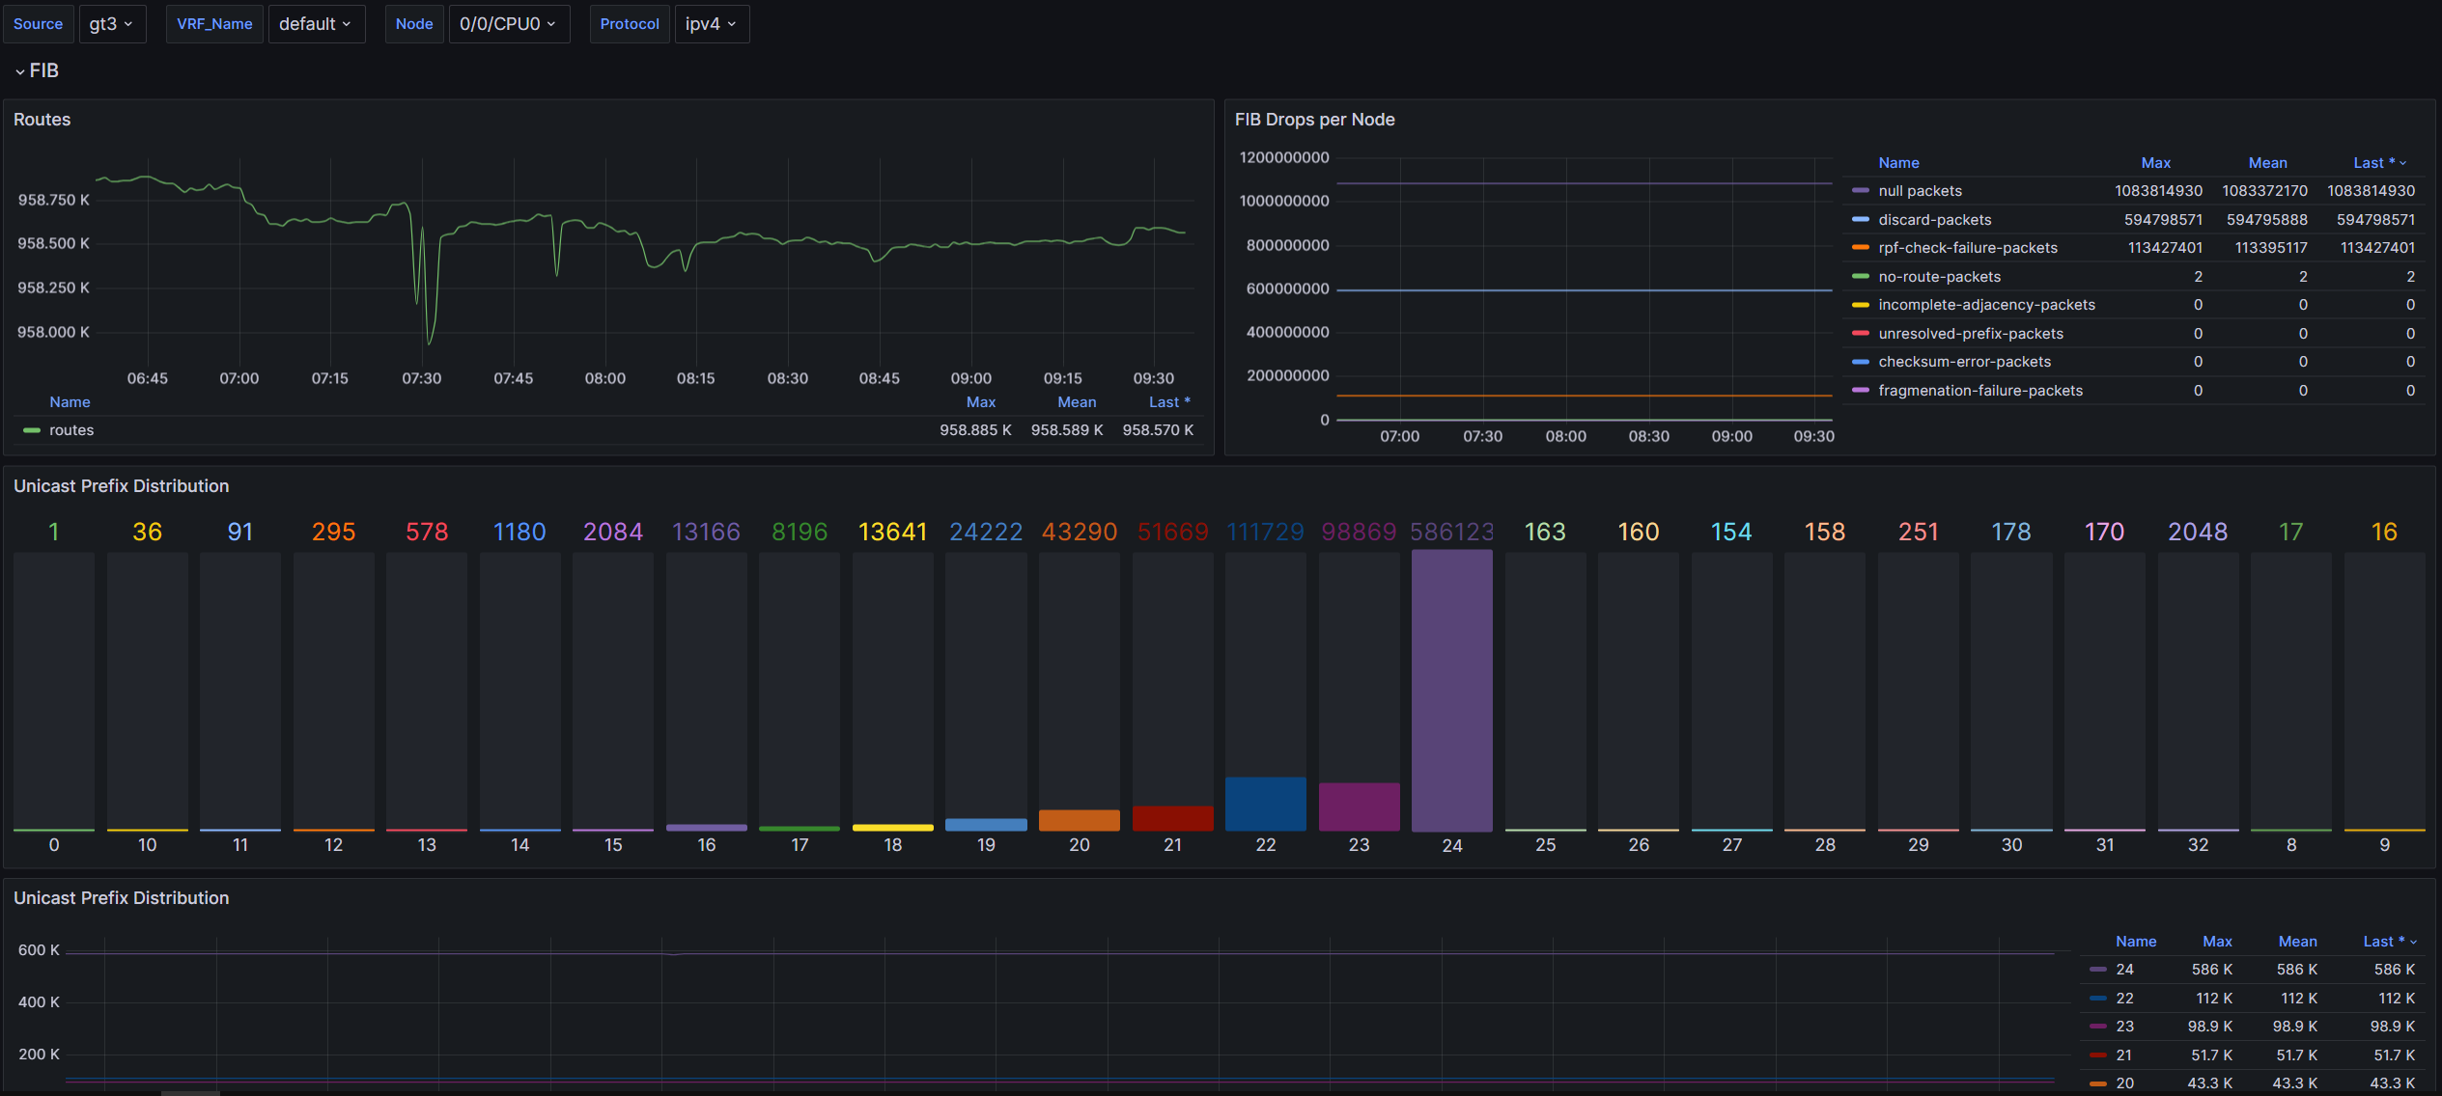

Slide 29
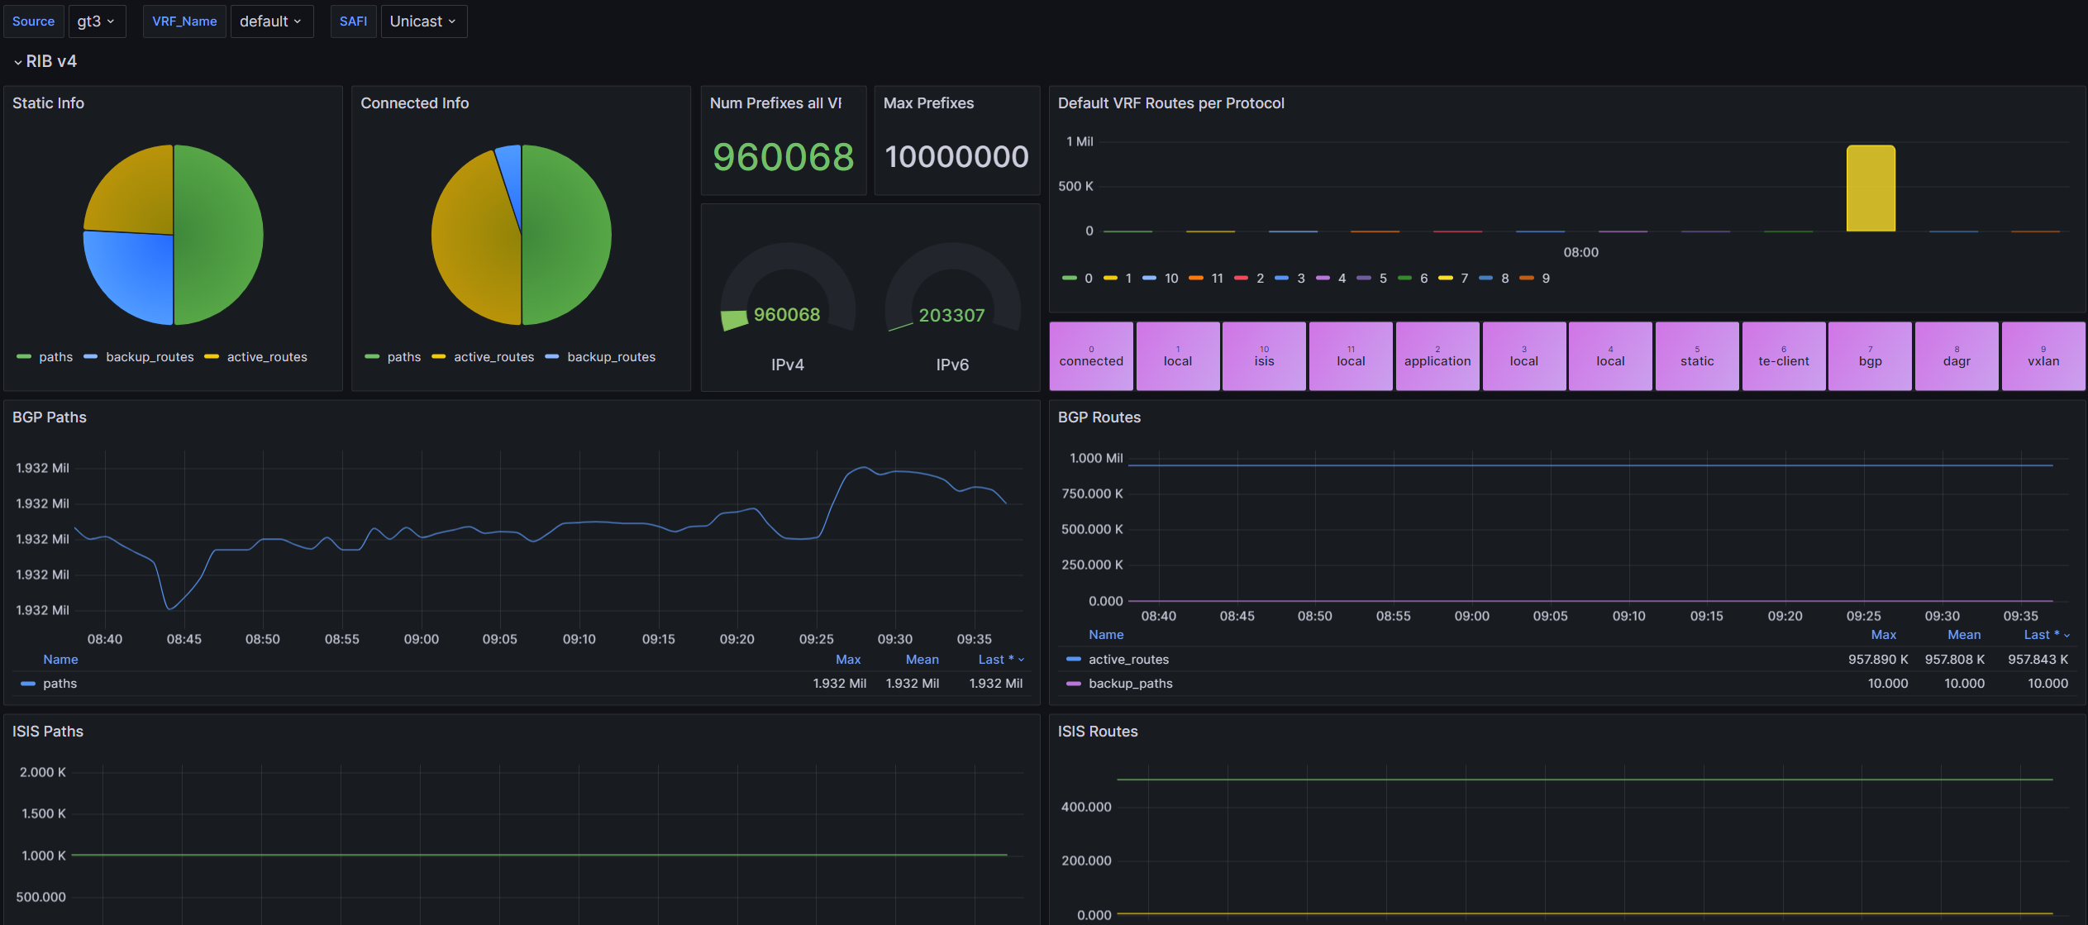

Slide 30
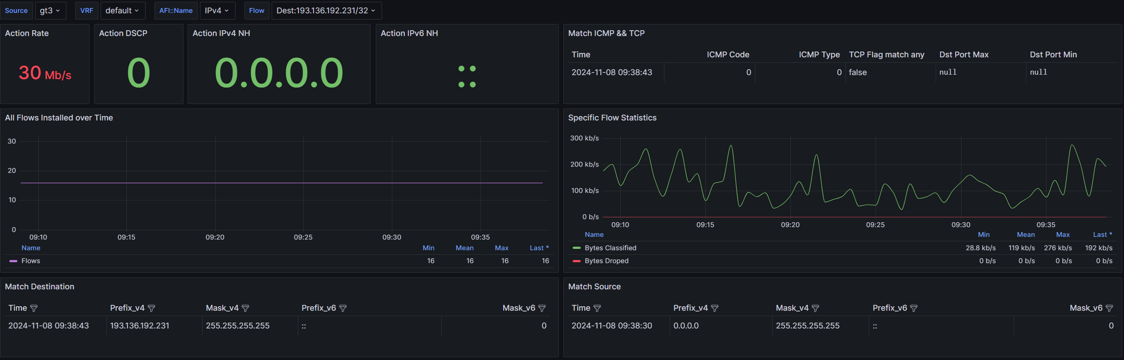

Slide 31
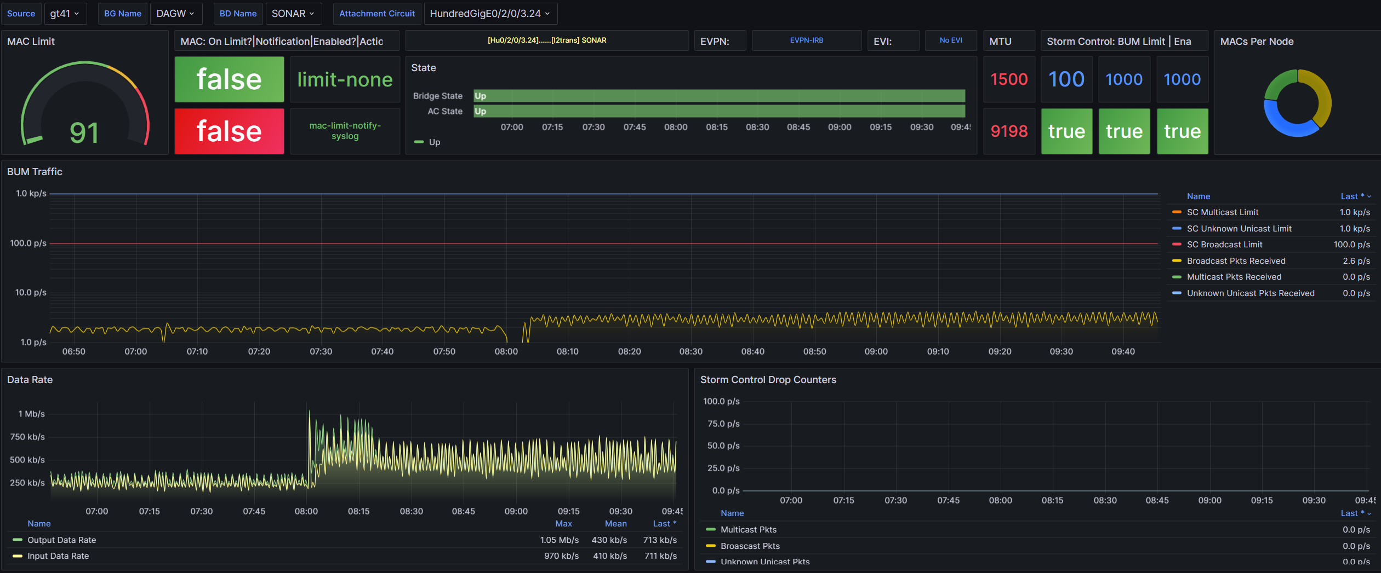

Slide 32
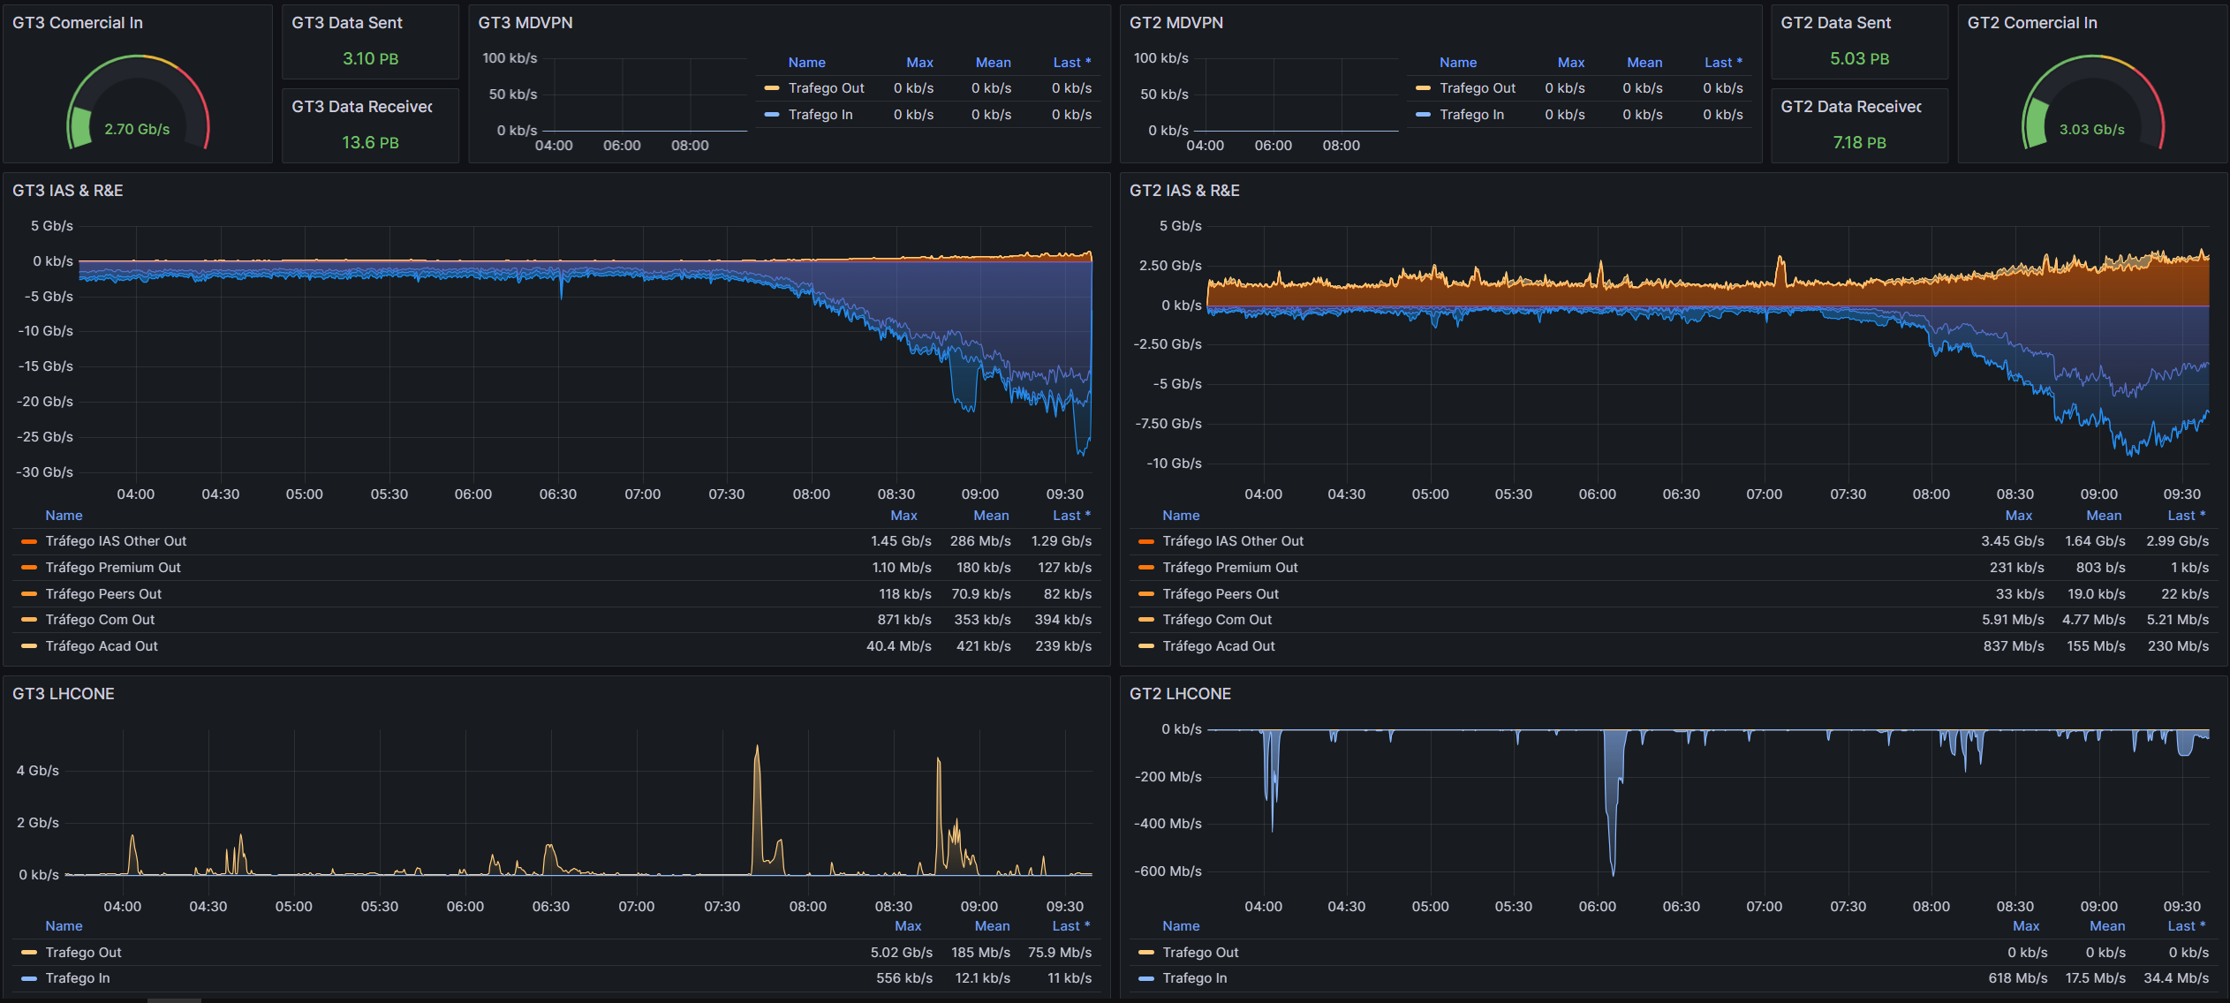

Slide 33
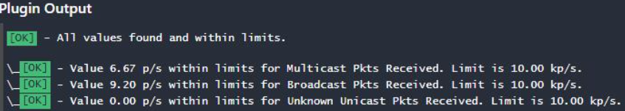
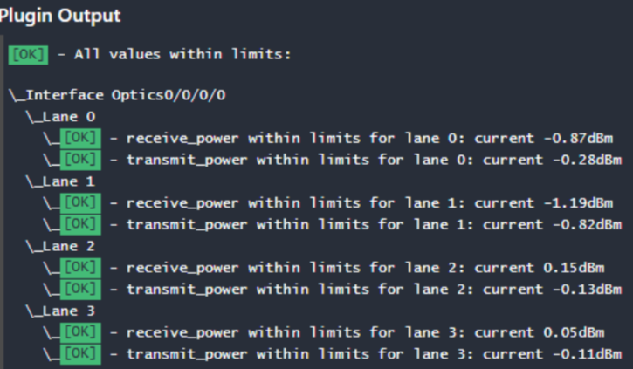
Less intrusive and more agile monitoring
Storm Control
Optics

Slide 34
Performance measurment

Slide 35
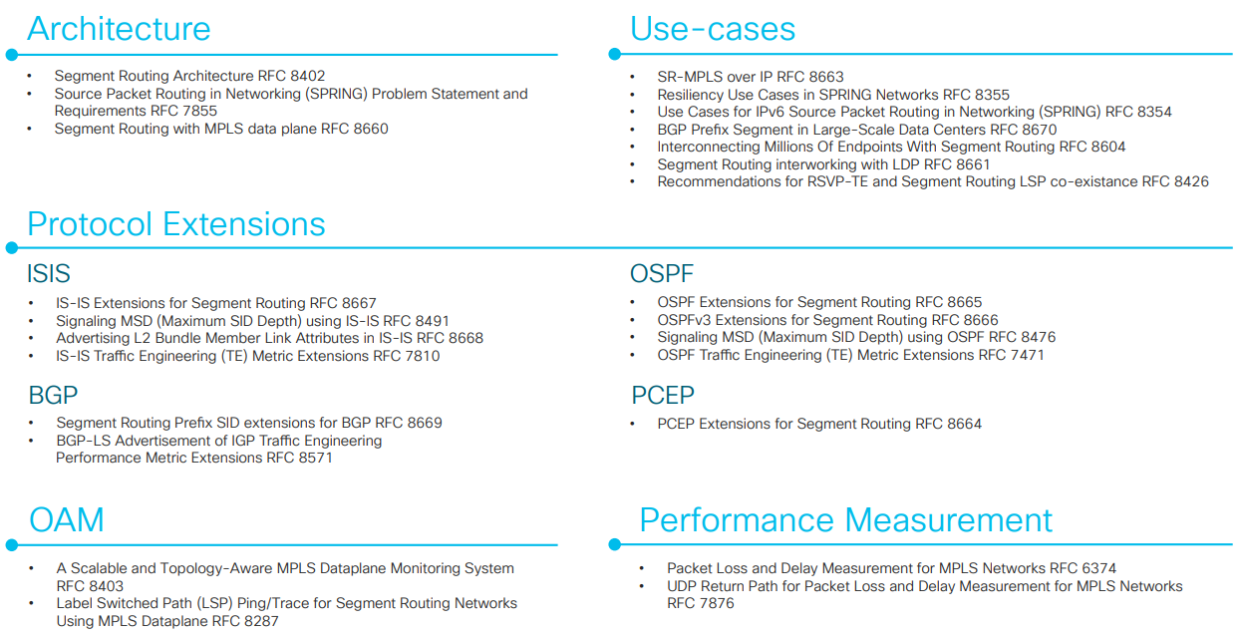
Segment routing feature stack

Slide 36
Performance Measurement
Query's sent every 1s (default 3s)
Probes completed after 10 query's
Timestamps added in hardware
PM Query format: RFC 5357 (TWAMP) or RFC 6374 (MPLS)
Extracted values: Max, Min, Average, Variance, Query's sent/received
Measurement mode:
One-Way (T2-T1)
Two-Way (T4-T1)
Loopback
Probes type:
Interface
Endpoint
SR-TE
TX Timestamp T1
TX Timestamp T2
1
PM Query Packet
2
PM Response Packet
TX Timestamp T4
TX Timestamp T3

Slide 37
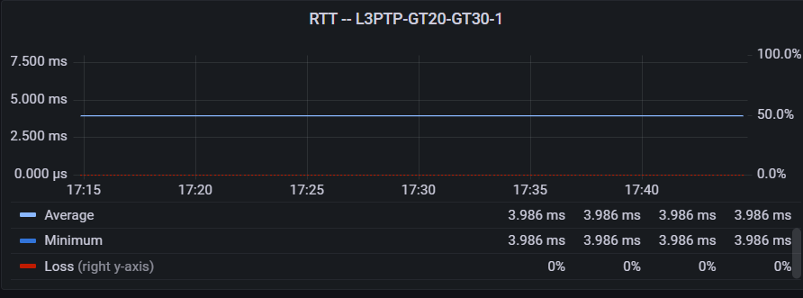
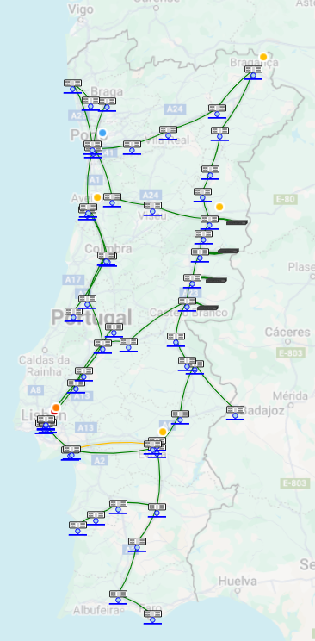
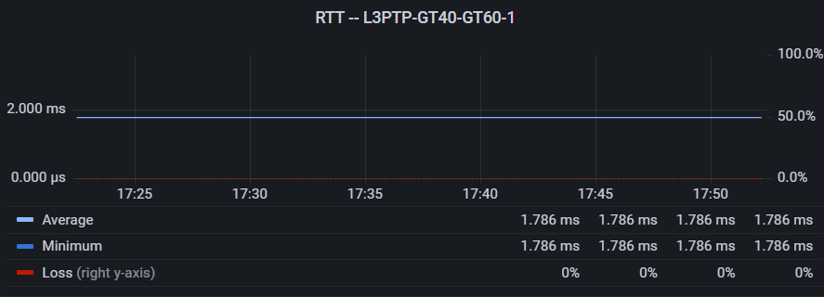
Lisbon-Porto through the coast vs interior of country

Slide 38
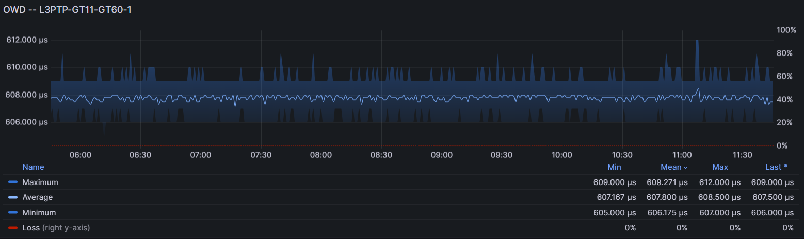
Ncs vs asr plataforms

Slide 39
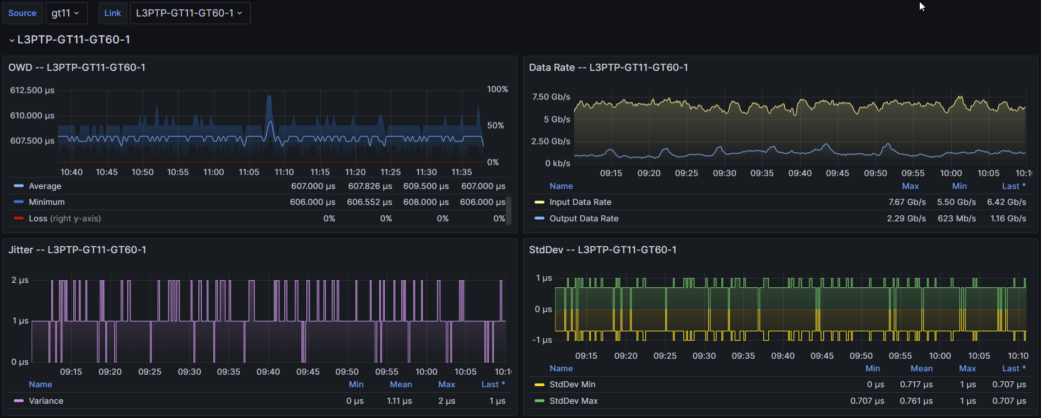
Dashboard interface mode

Slide 40
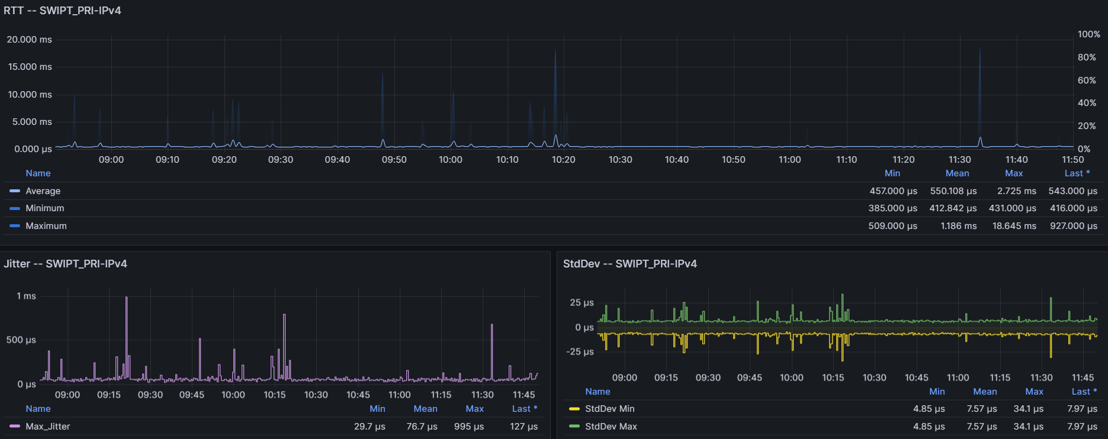
Dashboard endpoint mode

Slide 41
Network map

Slide 42
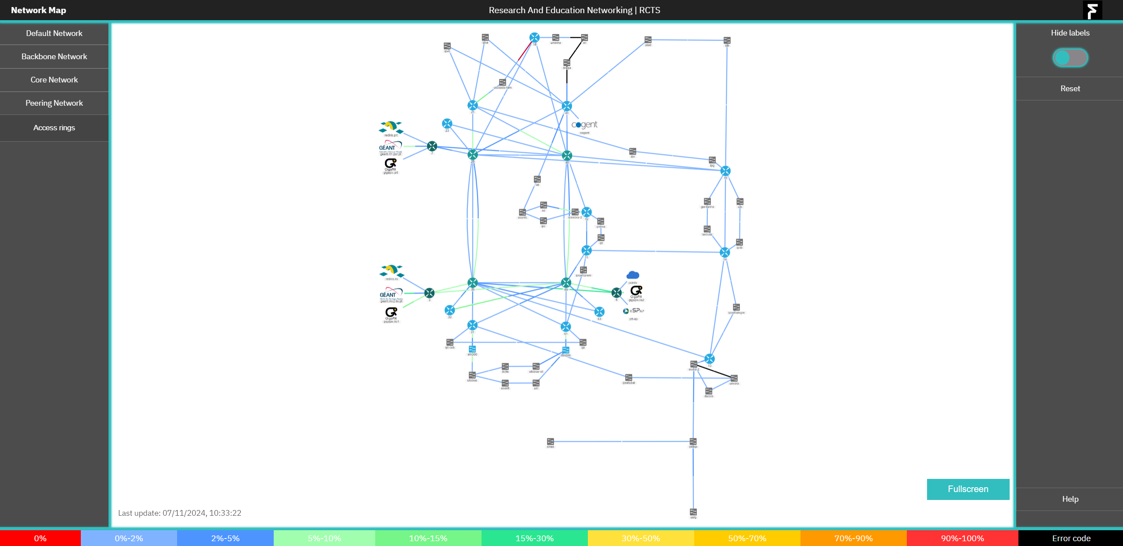

Slide 43
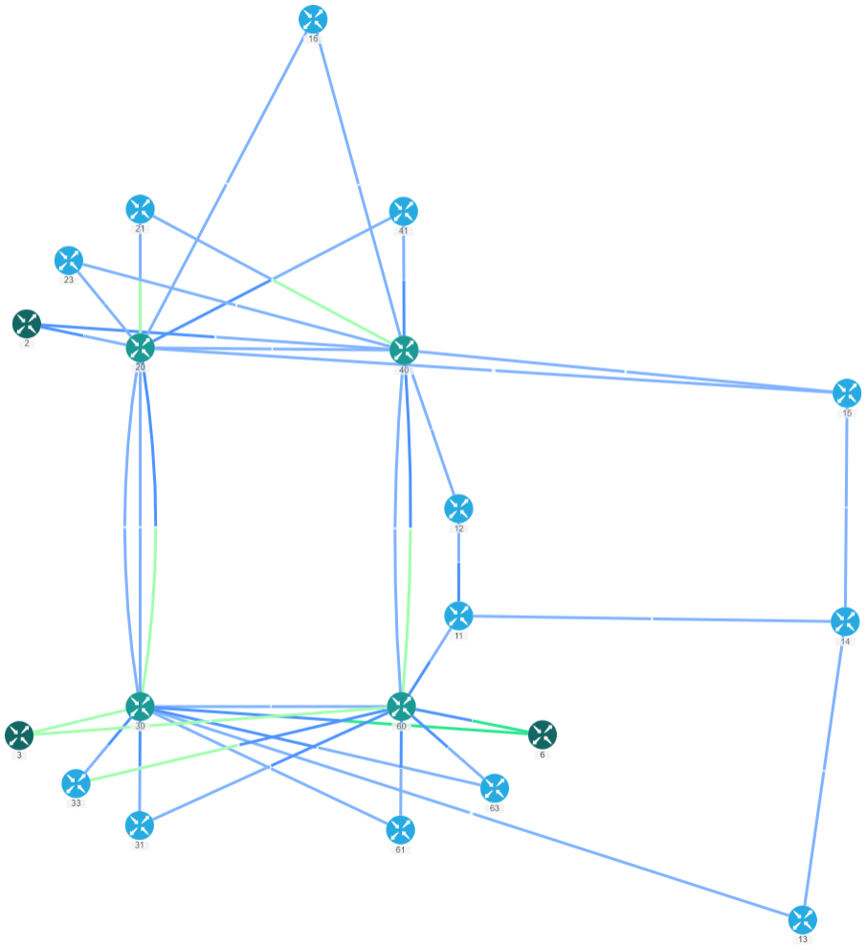

Backbone and core

Slide 44
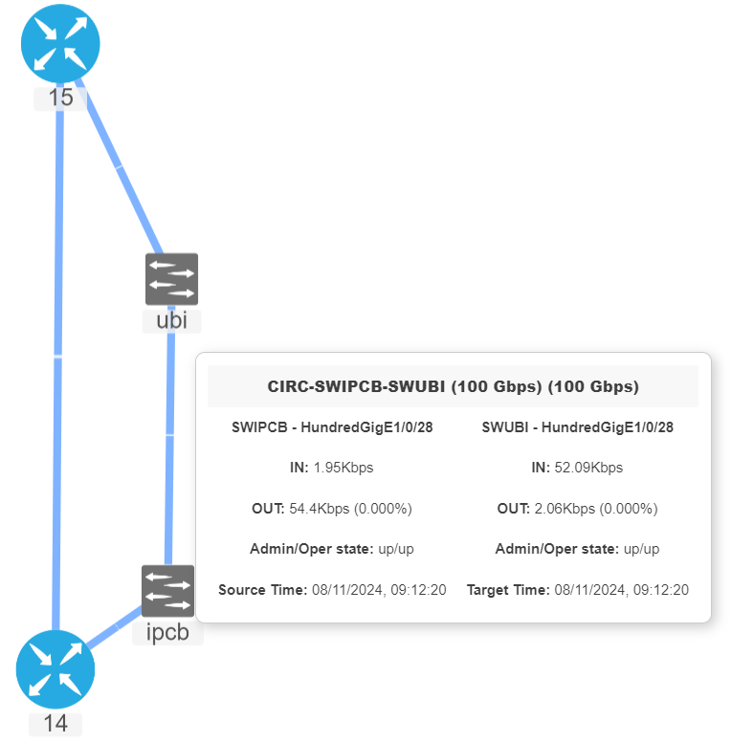
Access ring example

Slide 45
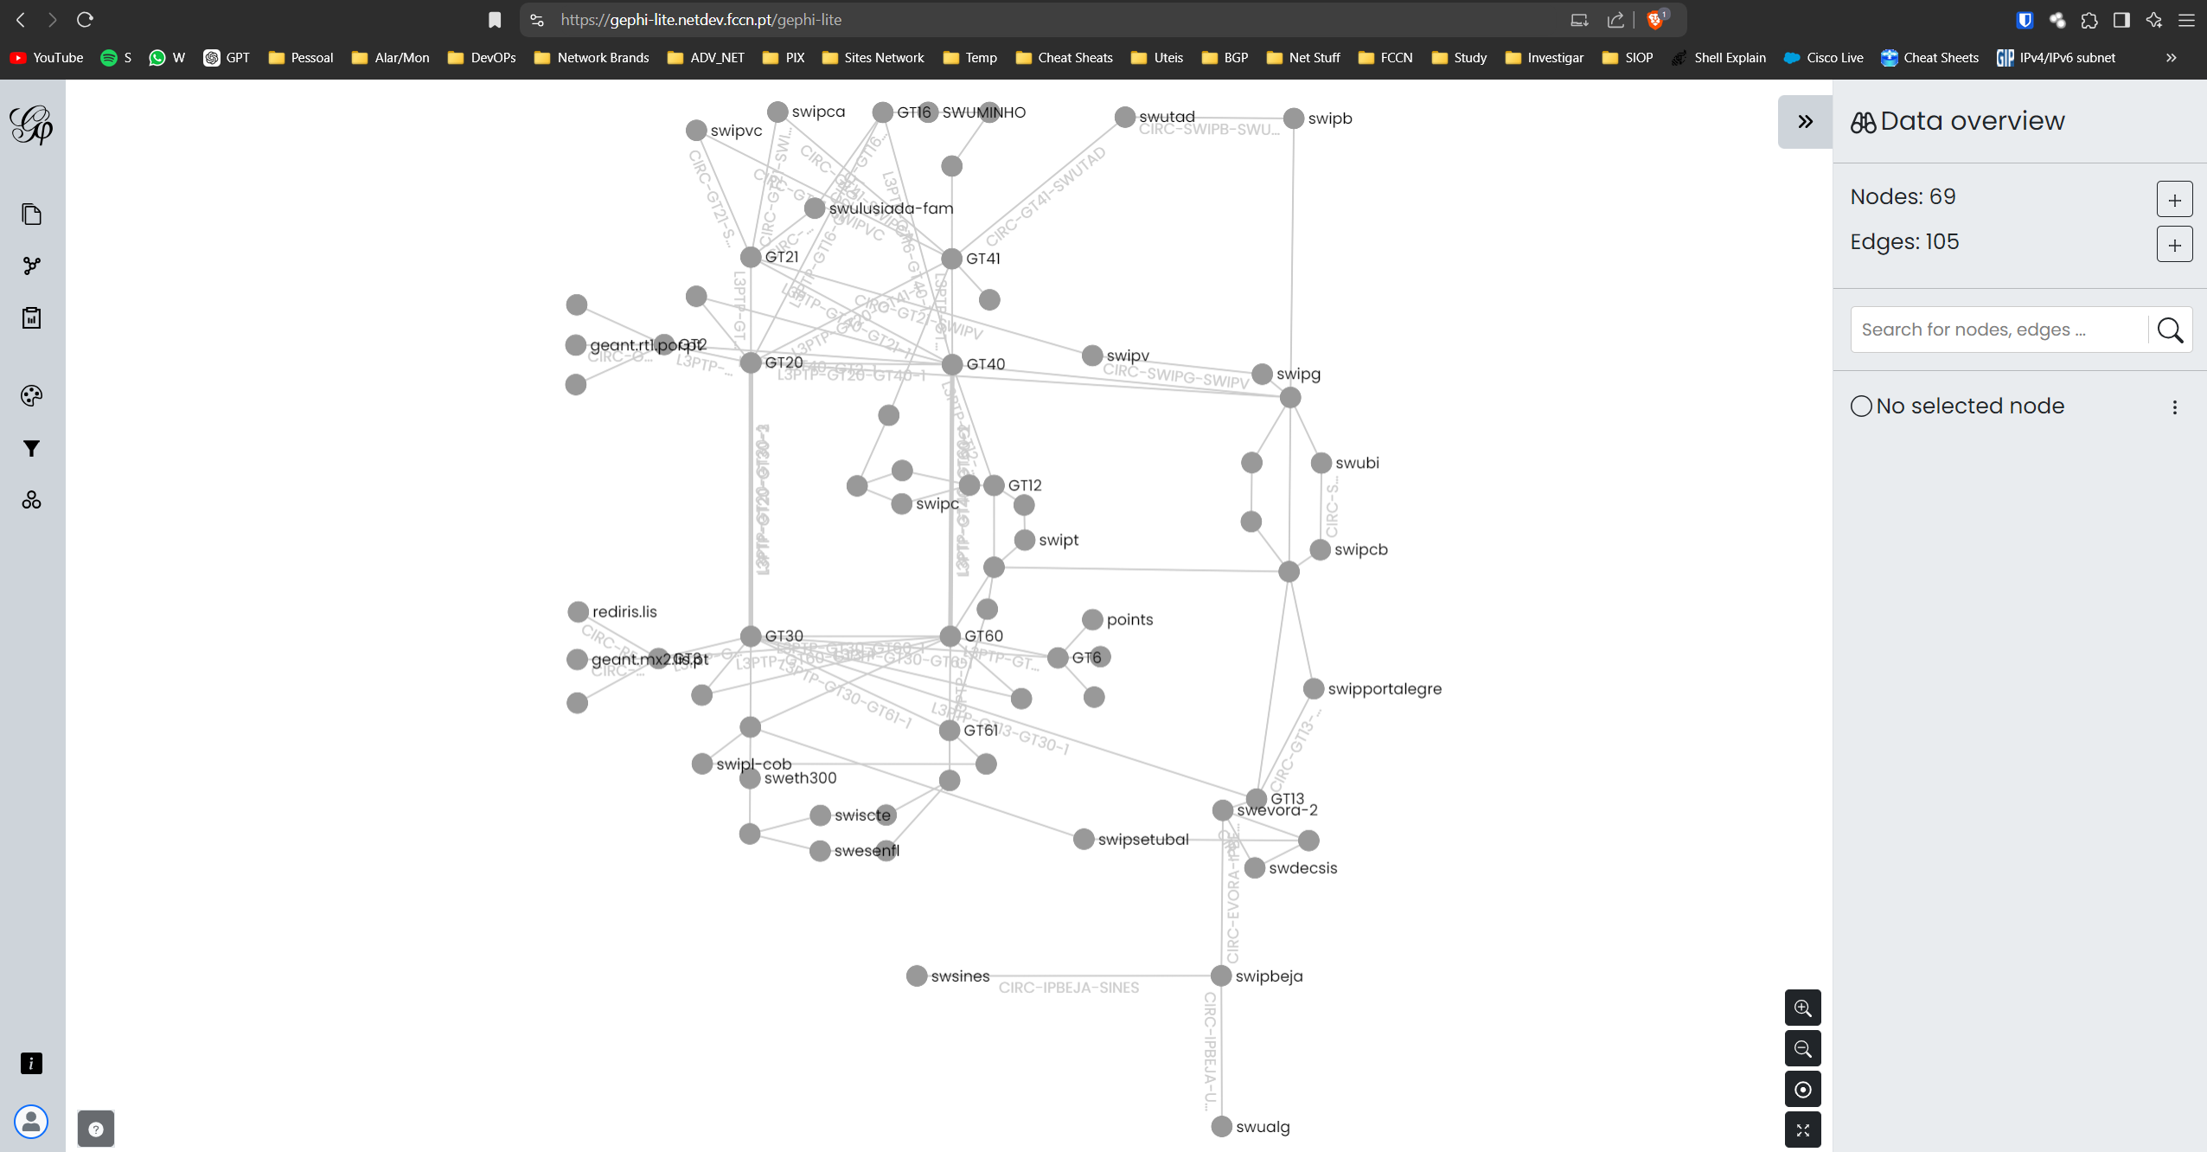

Slide 46






bugs…. ups
In IOS-XR release 7.3.1 perf-meas probes weren’t working on BVI’s interfaces
In release 7.5.2 they didn’t work on ES MH-SFA, MH-AA-PA
For endpoint mode there wasn’t a yang model for last probe result
Beginning 24.1.x release fixed all the above, but broke all ipv6 endpoint probes
IOS-XE Catalyst switches had random drops – fixed in 17.12.1
Many TAC cases opened, a lot of calls and countless hours wasted….

Slide 47
Thank you!
  FCT|FCCN
  Network Services Area Manager
  João Silva joao.silva@fccn.pt
  Over and Out!

