Slide 1
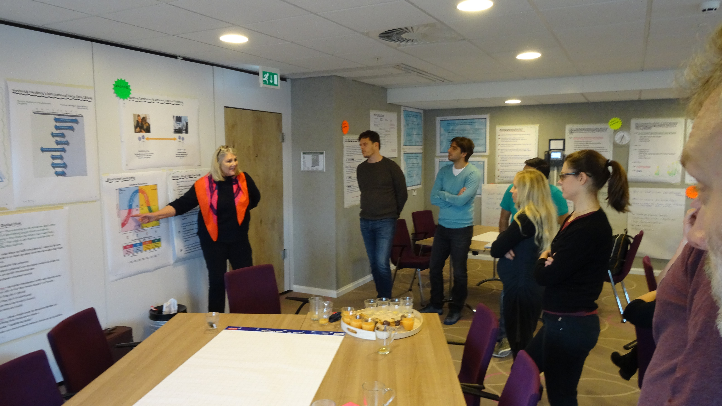
GÉANT 4
Managing People & Performance in Virtual Teams - MPiViT
Session 4 - Virtual Meeting 3
Ref: v4 200217
December 2016 - June 2017

Slide 2

Re-Introductions
__________________________________________________________________
__________________________________________________________________
__________________________________________________________________
__________________________________________________________________
__________________________________________________________________
__________________________________________________________________
__________________________________________________________________
__________________________________________________________________

Slide 3

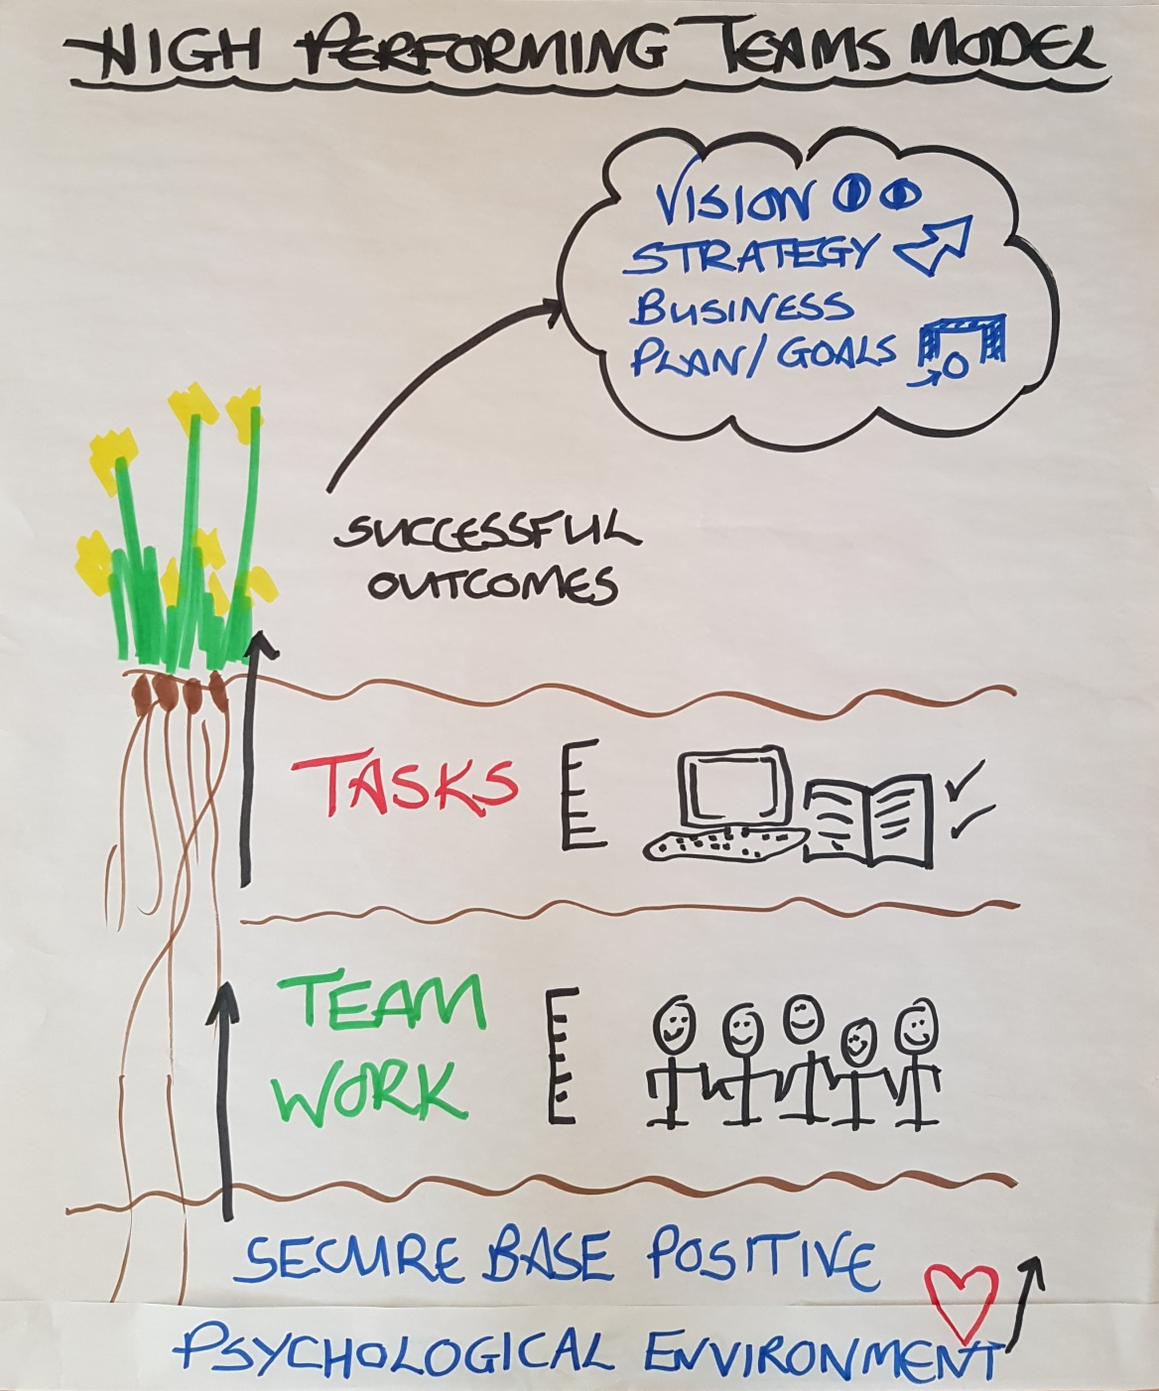
High Performing Teams Model

Slide 4

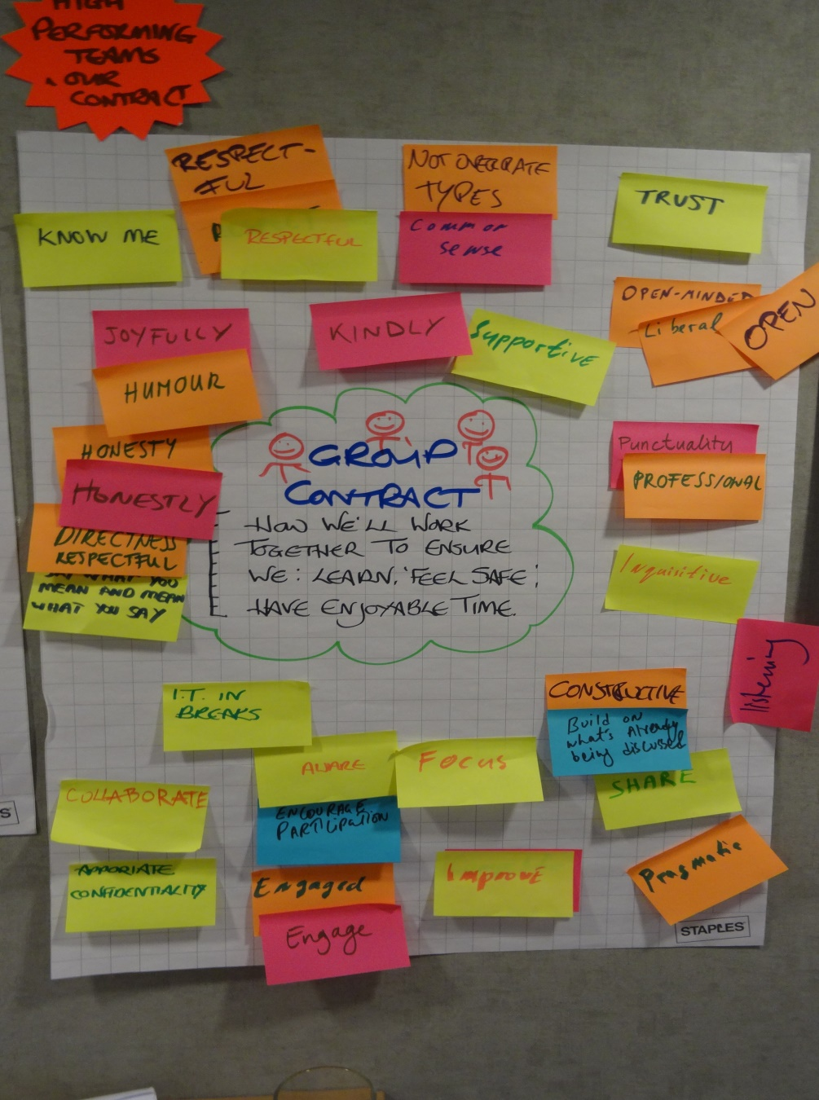
Group Contract

Slide 5
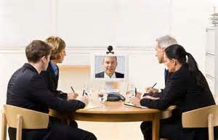
MPiViT Meeting Agenda
In our meeting today we will cover:
Re-visit the overall aim of MPiViT Programme
Work Based Assignment 2 - your Slide 1 re Virtual Meetings
Work Based Assignment 2 - your Slide 2 re Coaching
Briefing for Work Based Assignment & Buddy Conversation 3 - Performance Coaching using GROW
How has the meeting been in relation to the VM Best Practice?

Slide 6

The Overall Aim of the MPiViT Programme
As an individual you are experiencing this programme in your own unique way. From your perspective, from the words below choose the 3 which are coming over to you most strongly.
Develop Human Capital
Effective Virtual Team Meetings
Coaching & Motivation
Enjoying Ourselves
Managing People
Managing Performance
Playing To Strengths
Effectiveness
Efficiency
Relationship Building
Enhancing Performance
Meeting GN4 Strategy

Slide 7
Work Based Assignment 2 - your Slide 1 re Virtual Meetings
Slide 1 - presentation time 1 minute max
What I have learnt about meetings best practice is …
What I am doing differently re meetings is …
My team/the project is benefitting from what I am doing differently re meetings by …

Slide 8
Work Based Assignment 2 - Your Slide 2 re Coaching
Slide 2 - presentation time 2 minutes max
What I have learnt about coaching is ..
What I am doing differently re coaching is …
My team/the project is benefitting from what I am doing differently re coaching by …

Slide 9

Running Order for WBA 2 - Your Slides re VM & Coaching
xxx
xxx
xxx
xxx
xxx
xxx

Slide 10

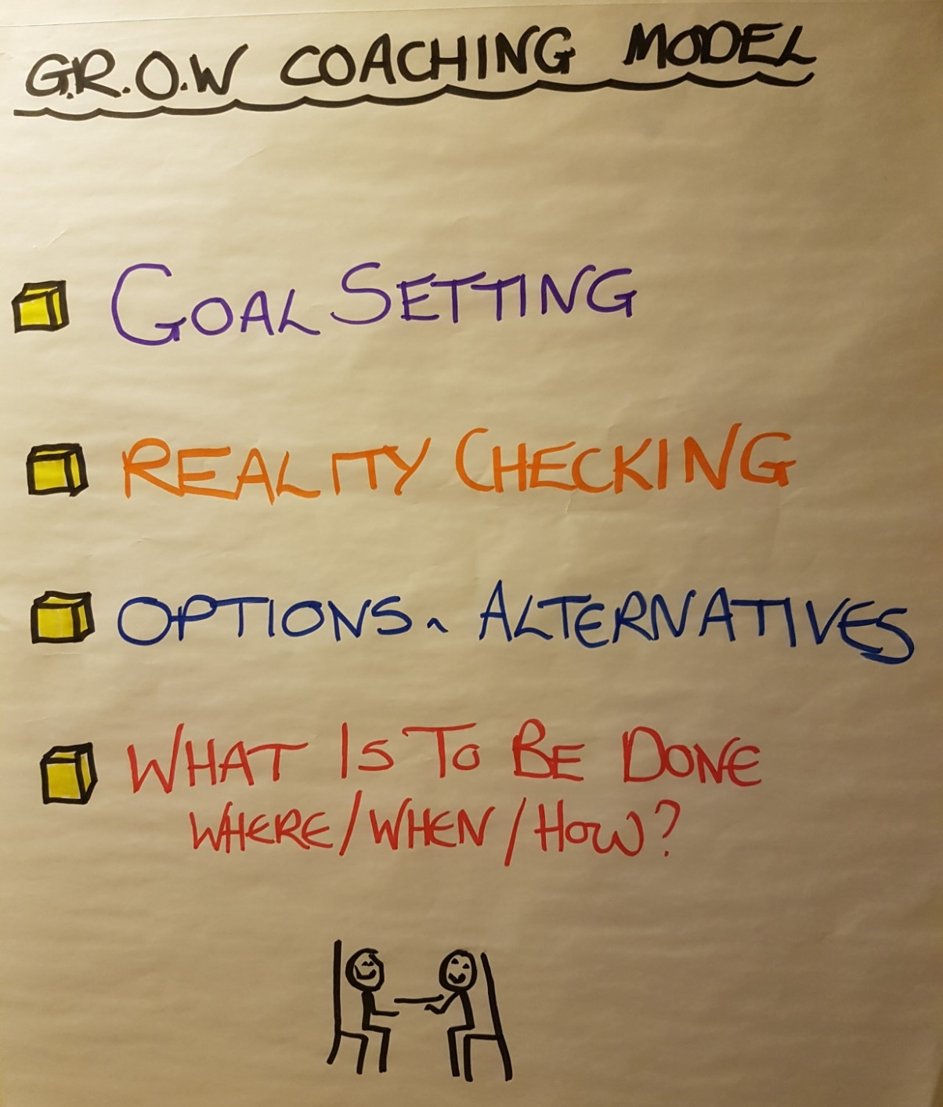
GROW Performance Coaching

Slide 11
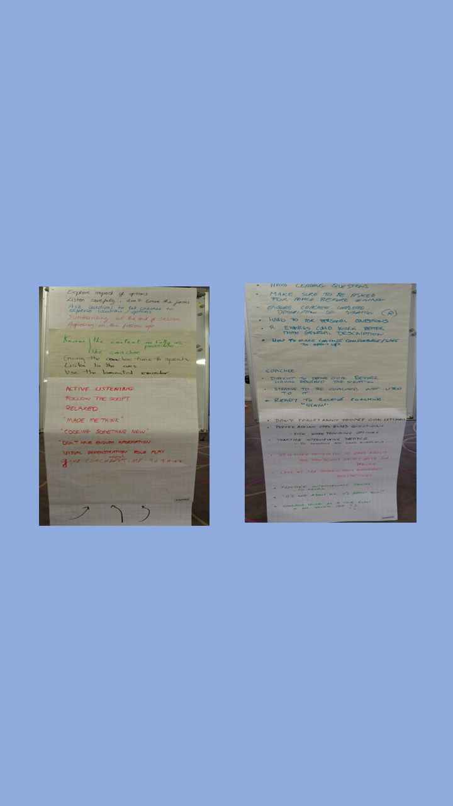
My Key Learning re Coaching
Be in a calm, focused, relaxed State
It’s about ‘You' not ‘Me’
Listen
Observe cues
Give Coachee enough time to think/speak
Really clarify the Goal
Use open ended questions
Explore the ‘problem’
Explore impact of options
‘Cooking something new together’

Slide 12
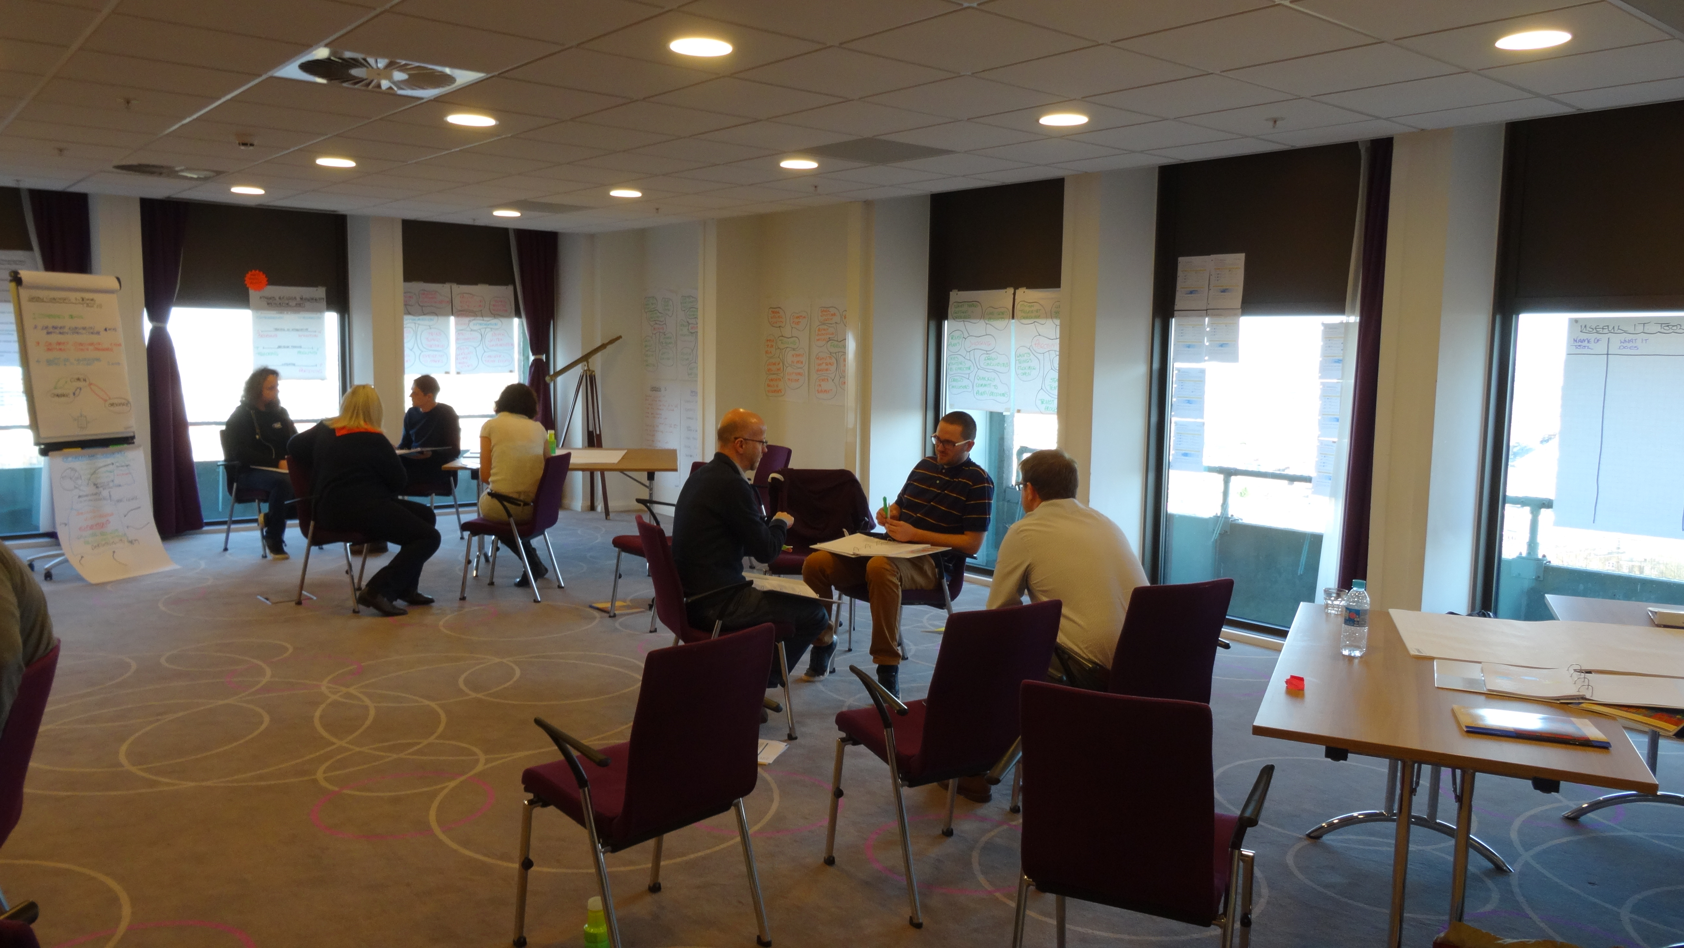
My Key Learnings re Coaching

Slide 13

Work Based Assignment 3 - Parts 1 & 2 and
Buddy Conversation 3
Work Based Assignment 3 – Part 1
Identify one of your team members whose performance needs enhancing.
Make a few notes about the situation in relation to the G and R of the GROW model in preparation for your buddy conversation.
Buddy Conversation 3 – Using the GROW Performance Coaching Model
Agree equal timing. Coach each other about the enhancement of the performance of each of your respective team members, using the GROW Performance Coaching Model.
Thank your buddy as this will be the last time you have a buddy conversation, unless you agree to connect up again.

Slide 14
Work Based Assignment 3 - Parts 1 & 2 and
Buddy Conversation 3
Work Based Assignment 3 – Part 2
Coach your team member using your learnings from the session with your buddy.
Remember to explain to your team member/coachee that you are using the GROW Model, which is about enhancing their already good performance.
Explain you will ask them for some informal feedback on your coaching.

Slide 15
Work Based Assignment 3 - Your Preparation for
VM Session 5 (March 21 & 22)
Prepare 2 Slides to present at our next VM - 2 minutes max
Slide 1
What I learned about the performance of my team member …
What actions they and I have put in place to enhance their performance …
Slide 2
What I have learnt about coaching is ..
What I am doing differently re coaching is …
My team/the project is benefitting from what I am doing differently re coaching by …
Please send your slides to Ian by Friday 17th March at the latest – please send in PowerPoint format not pdf

Slide 16

Virtual Meetings - Best Practice
1. Preparation - Facilitator Determine purpose of meeting (as per TCP) Send out clear agenda & timings Invite participants Plan opportunities to engage participants Send any additional material ahead of time Plan technical requirements Back-up plan 3. Meeting Etiquette - Participants Respond to meeting notices Arrive in good time Know how to use meeting technology Limit background noise Use mute unless contributing Identify yourself Stay focused - speak clearly, be polite Contribute | 2. Technical - Producer Arrange technical requirements Check audio/visual Carry out prior check Ensure Technical Support available 4. Facilitating - Facilitator Verify connectivity with participants Run through agenda & etiquette Instruct participants on processes/tools for providing input Encourage discussion & maintain control Evaluate meeting Verify date for next meeting (as per TCP) 5. Follow-up - Facilitator E-mail minutes & actions Provide clear actions Contact absentees

Slide 17
Feedback on our VM Today
__________________________________________________________________
__________________________________________________________________
__________________________________________________________________
__________________________________________________________________
__________________________________________________________________
__________________________________________________________________
__________________________________________________________________
__________________________________________________________________

