Slide 1
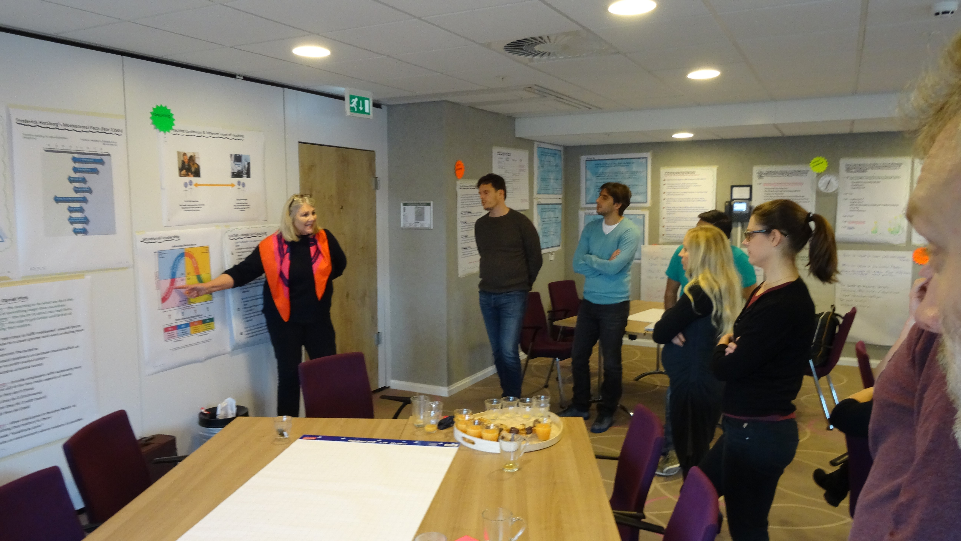
GÉANT 4
Managing People & Performance in Virtual Teams - MPiViT
Session 3 - Virtual Meeting 2
Ref: v7 240117
December 2016 - June 2017

Slide 2

Re-Introductions
__________________________________________________________________
__________________________________________________________________
__________________________________________________________________
__________________________________________________________________
__________________________________________________________________
__________________________________________________________________
__________________________________________________________________
__________________________________________________________________

Slide 3
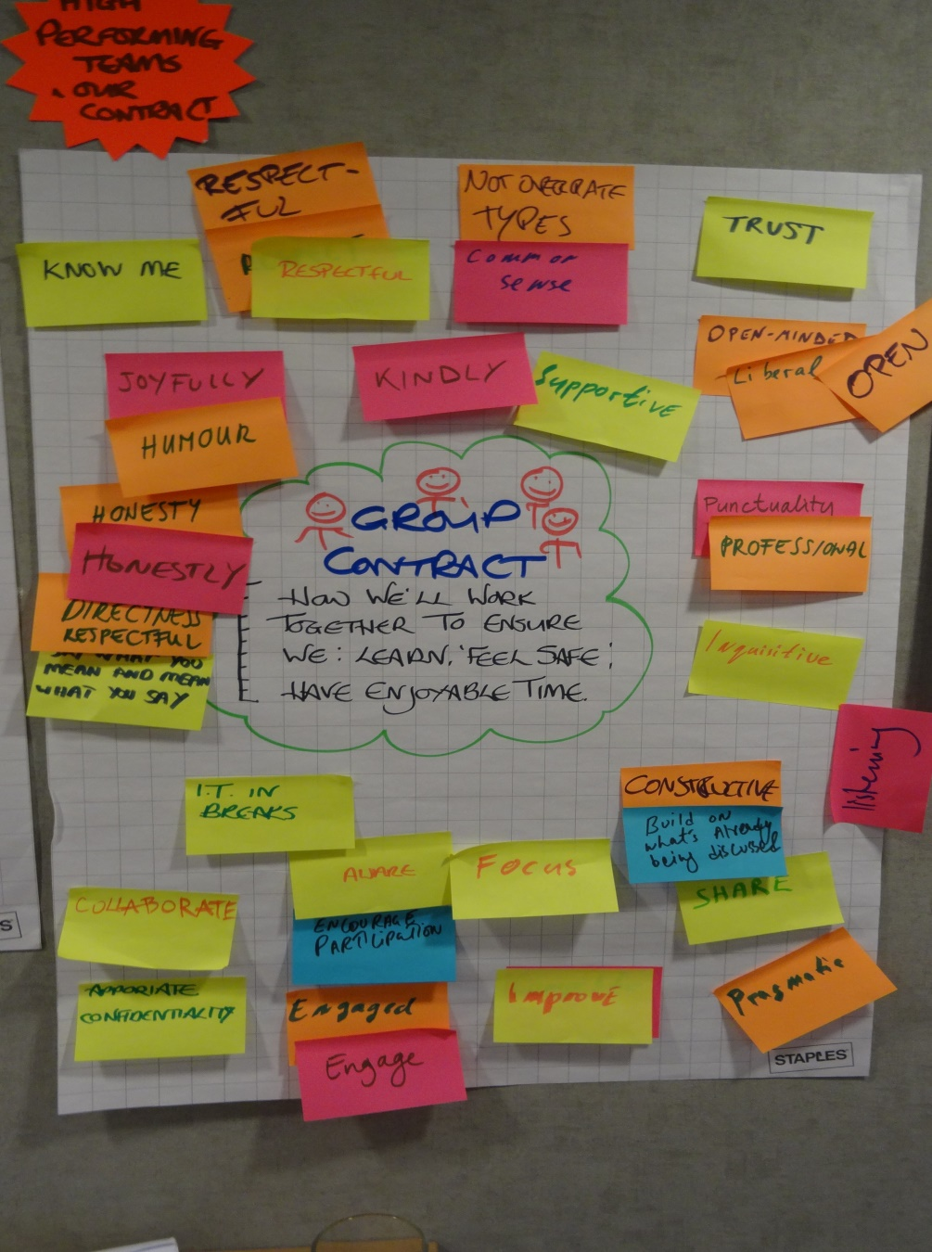
Group Contract

Slide 4
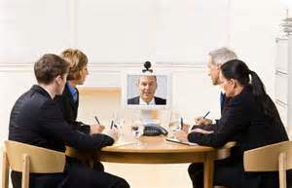
MPiViT Meeting Agenda
In this meeting we will:
Revisit MPiViT Programme Aims & Outcomes
Picture gallery of key concepts from Amsterdam
Check-in – 2 mins Your Learnings & Actions from Amsterdam
Work Based Assignment 2 and Buddy Conversation 2
How has the meeting been in relation to the VM Best Practice?

Slide 5
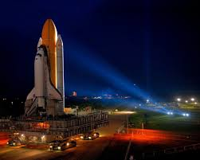
The Aims of the MPiViT Programme
GN4-2
Performance
Efficiency
Effectiveness

Slide 6
The Aims of the MPiViT Programme
GN4-2
Performance
Sharing Best Practices re L&M People
Efficiency
Effectiveness
Relationship Building
Performance Coaching
Planning & Facilitating VMs
People Playing to Their Strengths
Leading & Managing Virtual Teams

Slide 7

GÉANT Meeting Survey Results
Question 1a: On a scale of 1 - 10, please rate how effectively and efficiently Virtual Team Meetings are currently run.
Question 1b: On a scale of 1 - 10, please rate how interested, inspired and motivated you currently feel during Virtual Team Meetings:
Average score 5.2
Score range 2 to 9
Average score 5.4
Score range 1 to 10

Slide 8

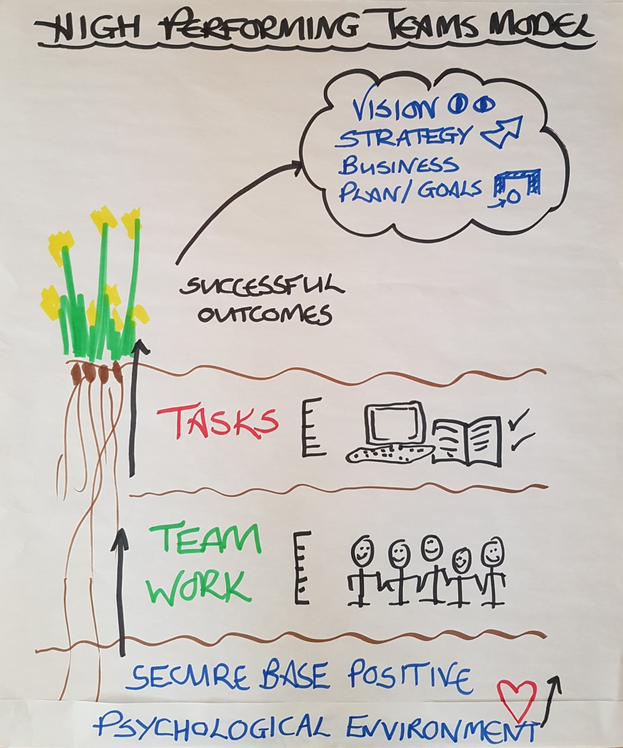
Picture Gallery from Amsterdam - High Performing Teams Model

Slide 9

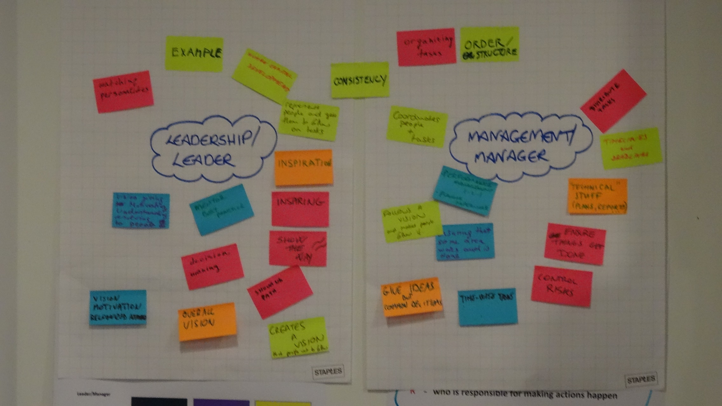
Picture Gallery from Amsterdam – Leader Manager

Slide 10

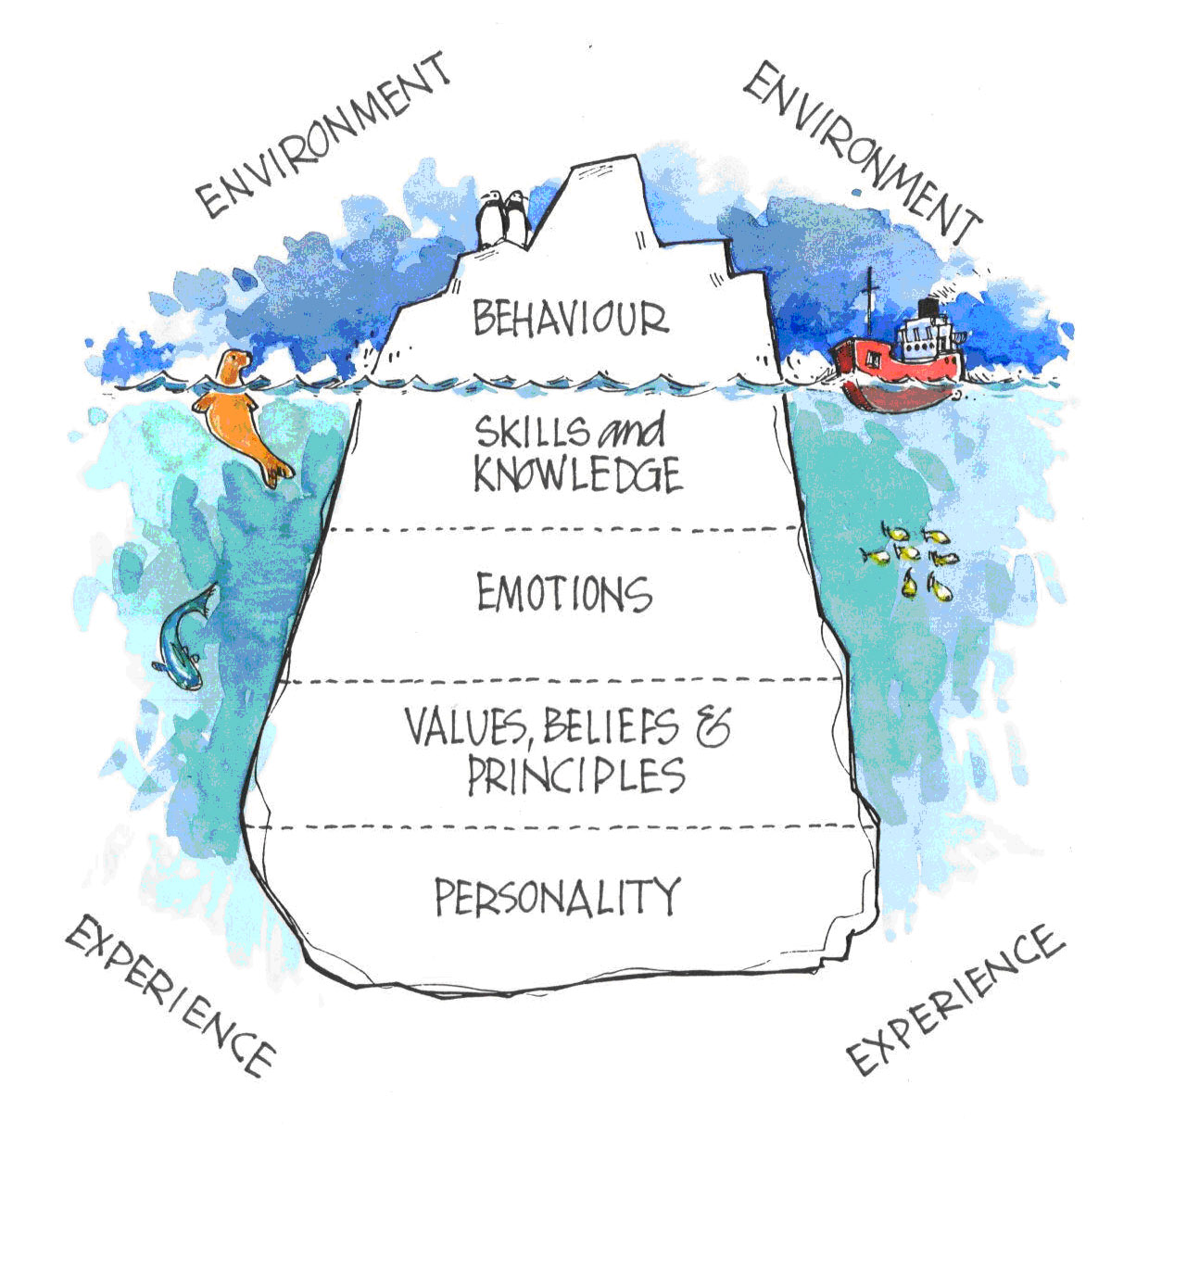
Picture Gallery from Amsterdam - Behaviour Iceberg

Slide 11

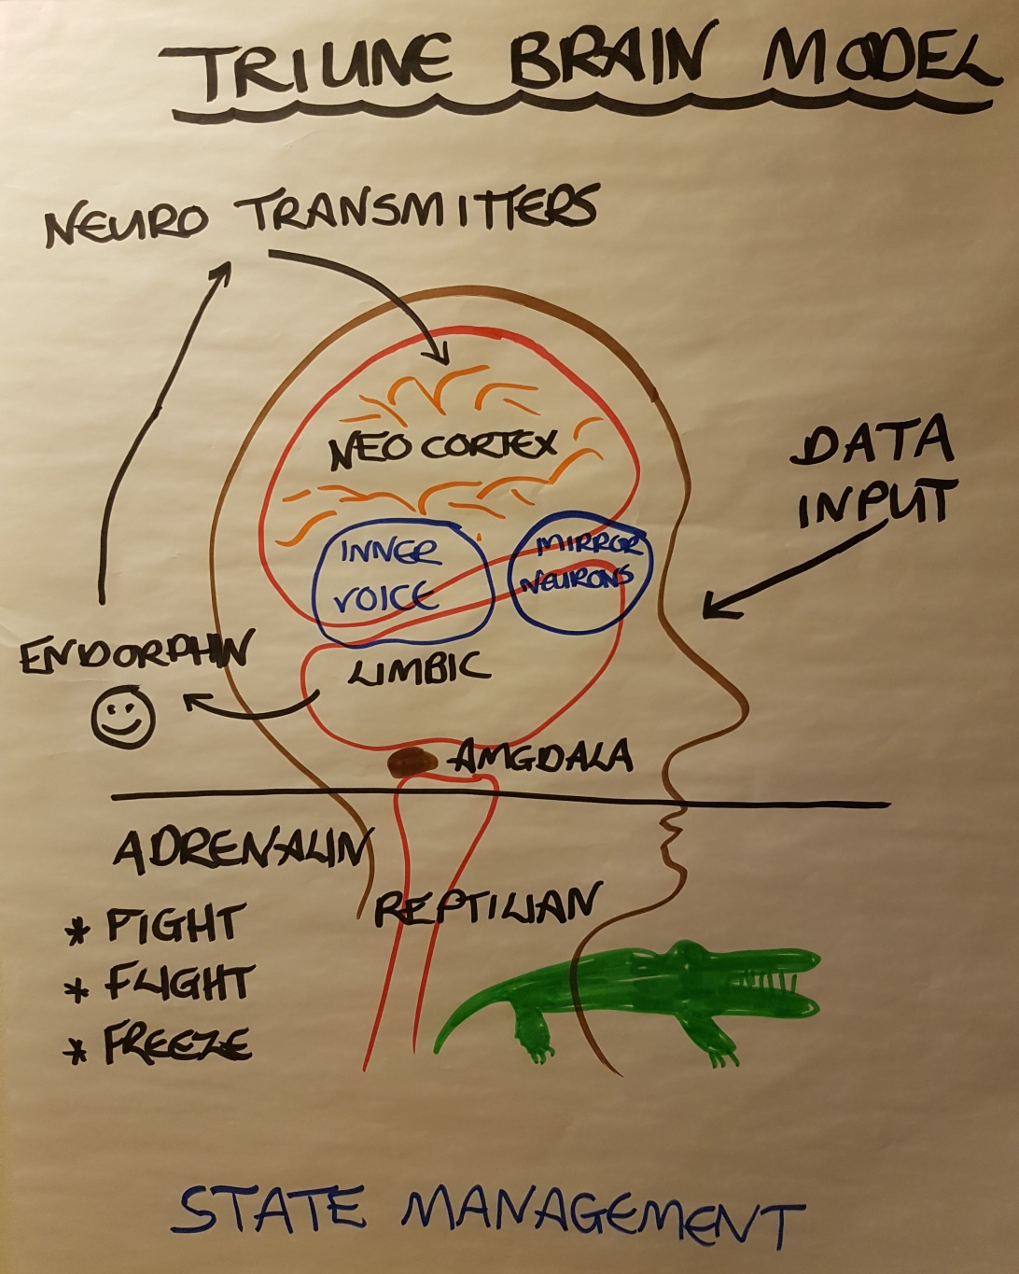
Picture Gallery from Amsterdam – Triune Brain Model

Slide 12
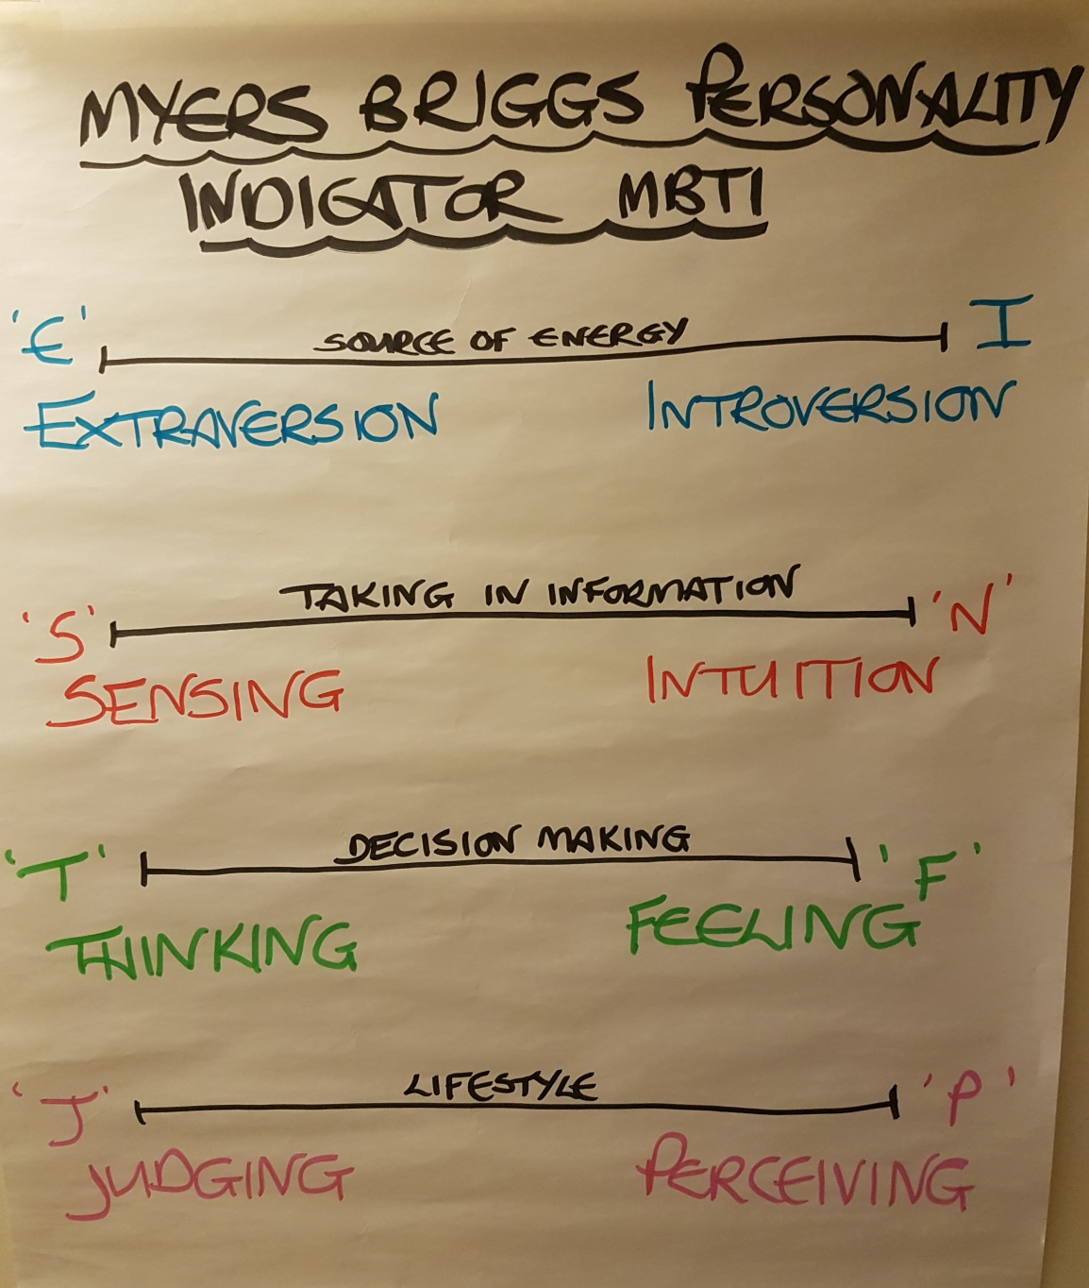
Picture Gallery from Amsterdam – Myers Briggs

Slide 13

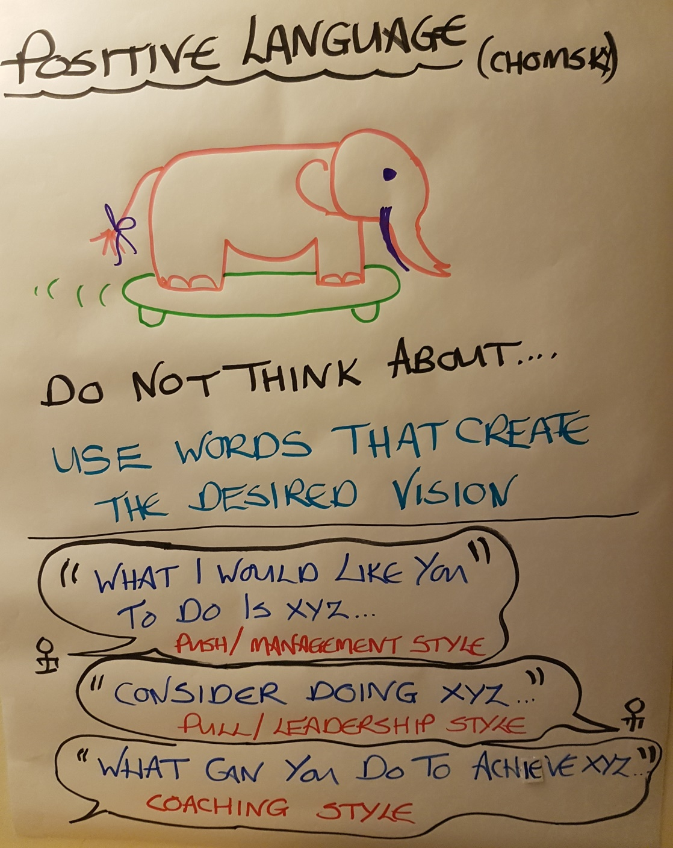
Picture Gallery from Amsterdam – Constructive & Positive Language

Slide 14

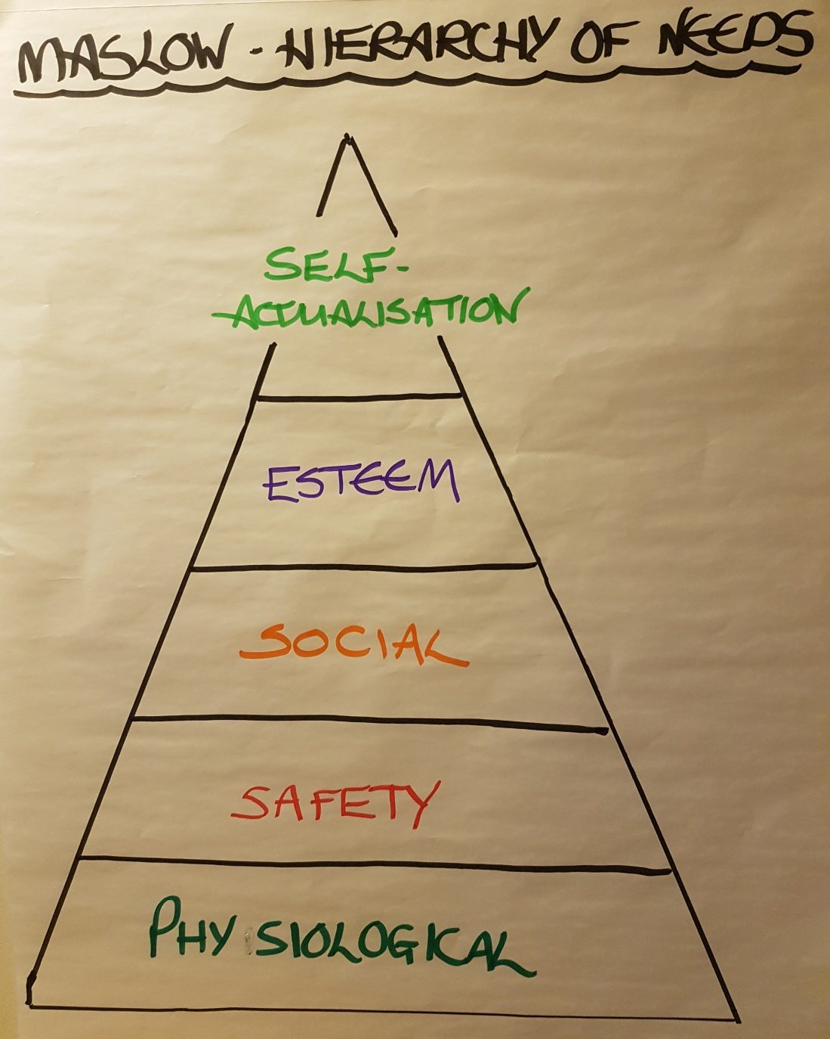
Picture Gallery from Amsterdam - Maslow

Slide 15
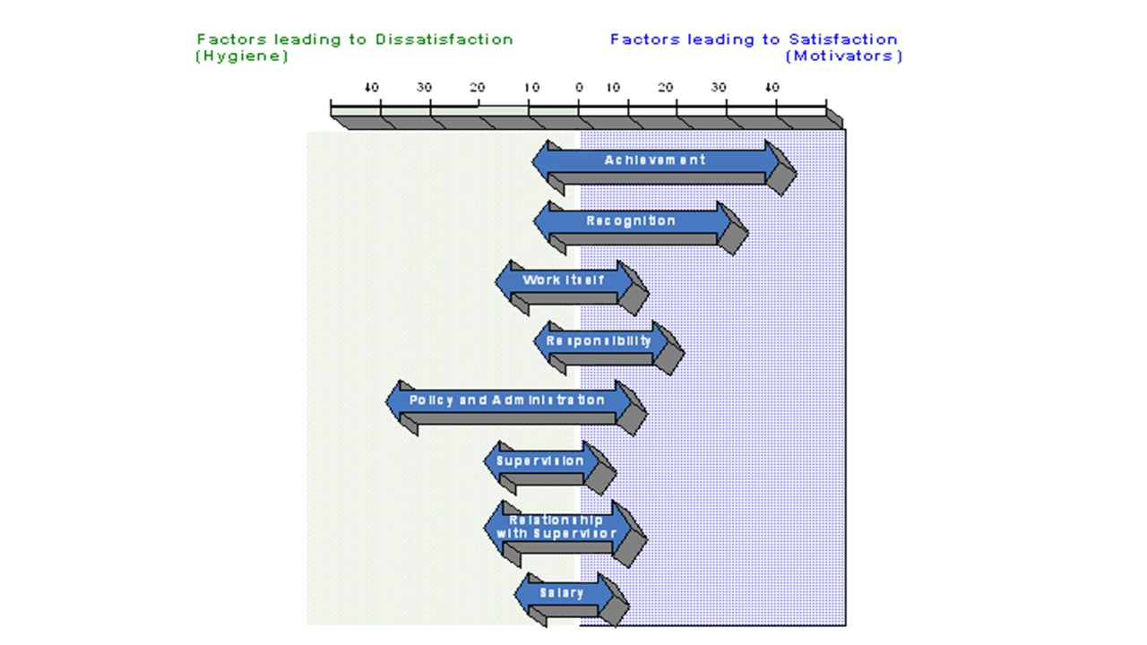
Picture Gallery from Amsterdam - Herzberg

Slide 16

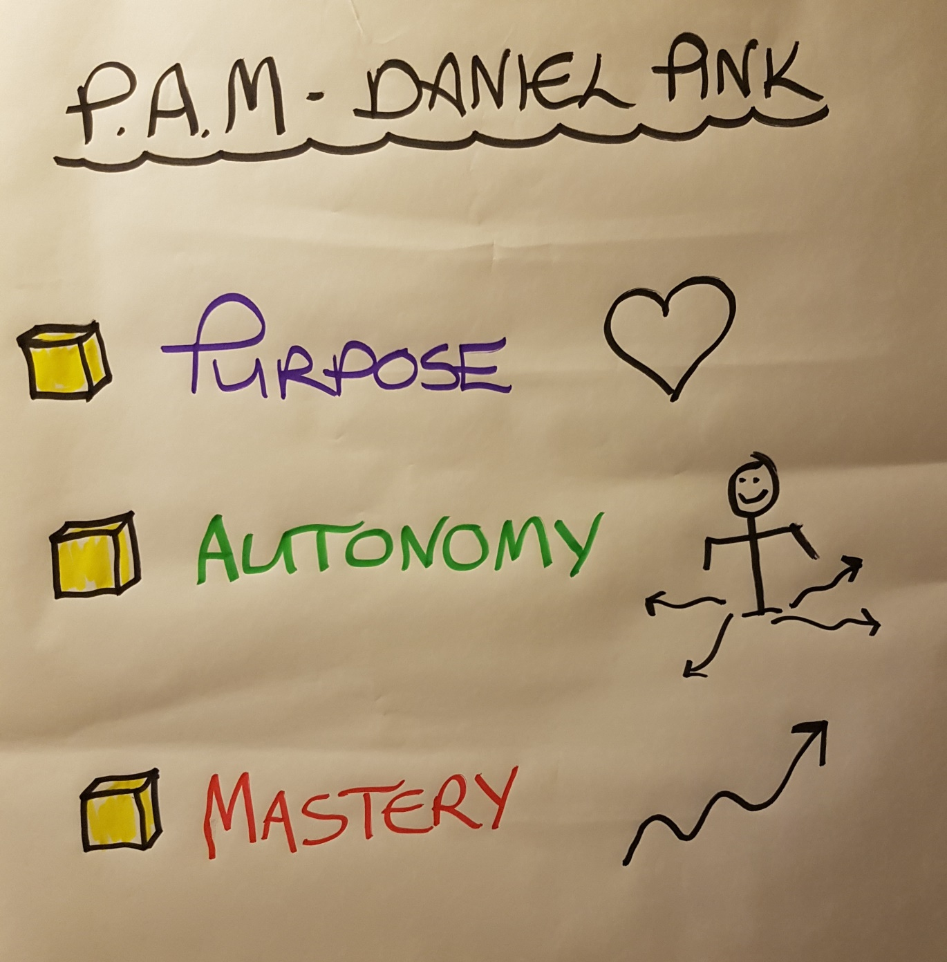
Picture Gallery from Amsterdam - Daniel Pink PAM

Slide 17
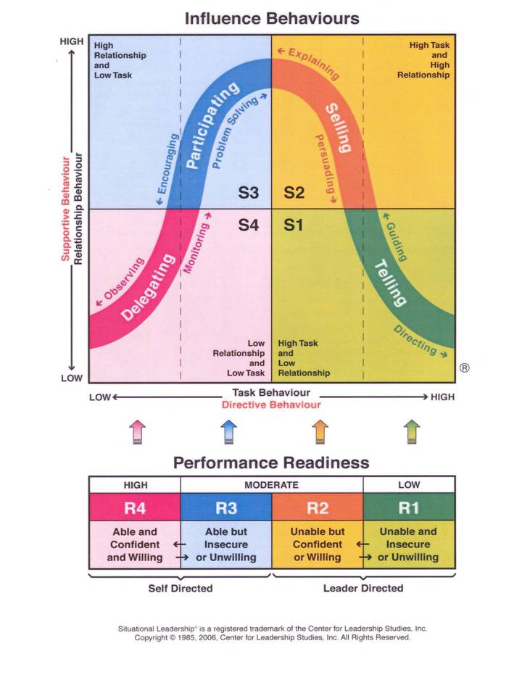
Picture Gallery from Amsterdam – Situational Leadership

Slide 18

Running Order for the Personal Check In
‘My Learnings & Actions from the Amsterdam Workshop’
2 mins each
Mian Usman
Craig Volp
Pavel Skoda
Sergio Andreozzi
Janusz Ulanowski
Gyongyi Horvath

Slide 19

Work Based Assignment 2 - Parts 1 & 2
Buddy Conversation 2
Work Based Assignment 2 – Part 1
Set up and prepare for a real VM that you need to run. Prepare the plan, slides and other material that you need.
Buddy Conversation 2 – Using the GROW Model
Run through the prepared meeting with your Buddy using the GROW Model. Offer each other constructive feedback on both the meeting preparation and on the coaching of the coach. Ensure you allocate equal time for each other.

Slide 20

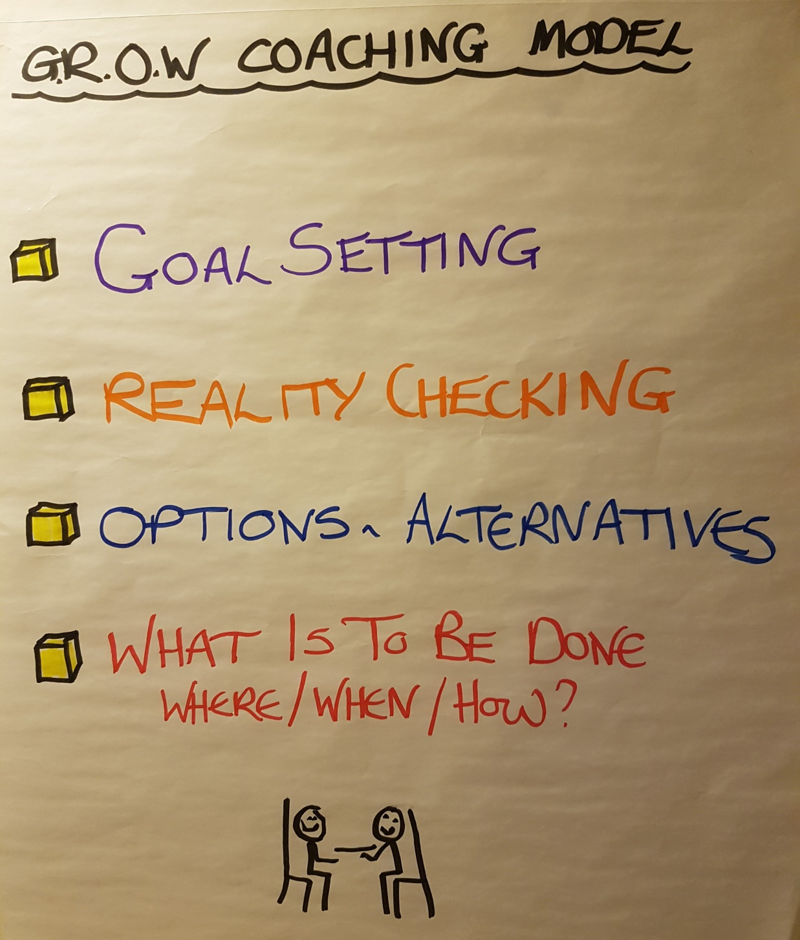
Review of GROW

Slide 21
Work Based Assignment 2 - Parts 1 &2 and
Buddy Conversation 2
Work Based Assignment 2 – Part 2
Facilitate your VM and obtain feedback from the participants in relation to the VM Best Practice Guide.
Let them know at the start of the meeting that you are going to ask them for this feedback and outline what is in the Best Practice Guide.

Slide 22
Virtual Meetings - Best Practice
1. Preparation - Facilitator Determine purpose of meeting (as per TCP) Send out clear agenda & timings Invite participants Plan opportunities to engage participants Send any additional material ahead of time Plan technical requirements Back-up plan 3. Meeting Etiquette - Participants Respond to meeting notices Arrive in good time Know how to use meeting technology Limit background noise Use mute unless contributing Identify yourself Stay focused - speak clearly, be polite Contribute | 2. Technical - Producer Arrange technical requirements Check audio/visual Carry out prior check Ensure Technical Support available 4. Facilitating - Facilitator Verify connectivity with participants Run through agenda & etiquette Instruct participants on processes/tools for providing input Encourage discussion & maintain control Evaluate meeting Verify date for next meeting (as per TCP) 5. Follow-up - Facilitator E-mail minutes & actions Provide clear actions Contact absentees

Slide 23
Work Based Assignment 2 - Your Preparation for our Next VM Session 4
Prepare 2 Slides to bring to our next VM
Slide 1
What I have learnt about meetings best practice is …
What I am doing differently re meetings is …
My team/the project is benefitting from what I am doing differently re meetings by …
Slide 2
What I have learnt about coaching is ..
What I am doing differently re coaching is …
My team/the project is benefitting from what I am doing differently re coaching by …

Slide 24
Feedback on our VM in Relation to
VM Best Practice
__________________________________________________________________
__________________________________________________________________
__________________________________________________________________
__________________________________________________________________
__________________________________________________________________
__________________________________________________________________
__________________________________________________________________
__________________________________________________________________

