Slide 1
GÉANT 4-2
Managing People & Performance in Virtual Teams - MPiViT
Meeting 1
Ref: v7 311016
July 2016 - February 2017

Slide 2

Who Are We?
Name & Role in GÉANT
__________________________________________________________________
__________________________________________________________________
__________________________________________________________________
__________________________________________________________________
__________________________________________________________________
__________________________________________________________________
__________________________________________________________________
__________________________________________________________________

Slide 3
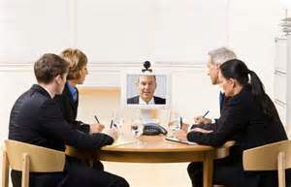
MPiViT Meeting 1 - Agenda
60 mins
Introductions
Meeting 1 Agenda
MPiViT Programme Overview
Personal Objectives
GÉANT Virtual Meetings Survey Results
Virtual Meetings Best Practice
Amsterdam Workshop
Review Against Virtual Meetings Best Practice

Slide 4

MPiViT Meeting 1 - Objectives
By the end of the meeting you will be able to explain:
Why we are doing the MPiViT Programme
The Structure of the Programme and what you want to gain from it
How effective and efficient our Virtual Meetings are
Identify simple but practical ways of enhancing the way you run meetings
Outline what we’re going to do in Amsterdam

Slide 5
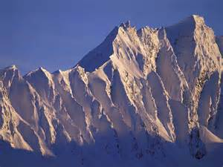
MPiViT Programme & GN4-2 Strategy
- Why Are We Doing This?
Develop human capital through “providing training in the management of geographically distributed teams” and “sharing best practice amongst partners”.

Slide 6

Programme Outcomes
MPiViT aims to enhance your efficiency and effectiveness in delivering project objectives through enhanced:
Leadership & management of our task/team members
Performance coaching
Planning & facilitation of virtual meetings
Sharing of best practices in relation to leading & managing people
Relationship building across the community

Slide 7

Programme Overview
The Programme comprises:
5 x 1 hour Virtual MPiViT meetings using Adobe Connect
1 x 2 day Residential Workshop – Amsterdam
4 x Individual Work-based Assignments (WBA 2 and 3 each have 2 parts)
3 x 1 hour Buddy Conversations/Coaching sessions
1 x Long-term Evaluation Session 7 TBA

Slide 8
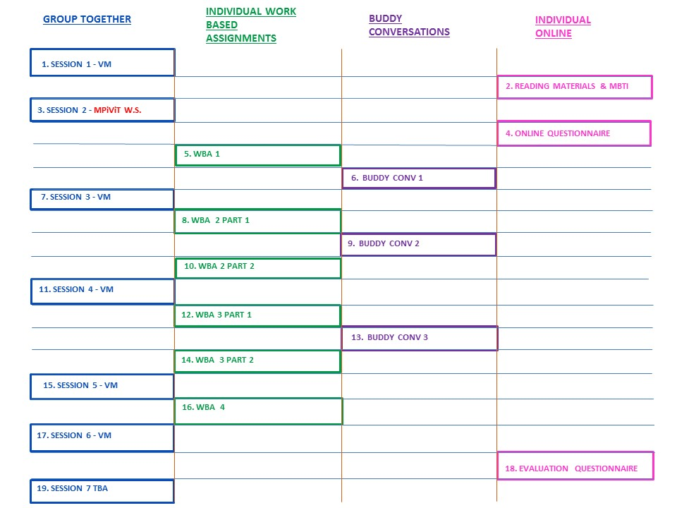
Programme Schedule

Slide 9

What Do You Want to Learn / Gain / Do Differently From Taking Part in the MPiViT Programme
____________________________________________________________________________
____________________________________________________________________________
____________________________________________________________________________
____________________________________________________________________________
____________________________________________________________________________
____________________________________________________________________________
____________________________________________________________________________

Slide 10
GÉANT Virtual Meeting Survey Results
Question 1a:
On a scale of 1 - 10, please rate how effectively and efficiently Virtual Team Meetings are currently run.
Question 1b:
On a scale of 1 - 10, please rate how interested, inspired and motivated you currently feel during Virtual Team Meetings:

Slide 11
GÉANT Virtual Meeting Survey Results
Question 1a: On a scale of 1 - 10, please rate how effectively and efficiently Virtual Team Meetings are currently run.
Question 1b: On a scale of 1 - 10, please rate how interested, inspired and motivated you currently feel during Virtual Team Meetings:
Average score 5.2
Score range 2 to 9
Average score 5.4
Score range 1 to 10

Slide 12
GÉANT Virtual Meeting Survey Results
Question 2
List the three most significant things which you think make current Virtual Team Meetings not as efficient, effective, motivational, inspiring and interesting as they could be.
Technical Issues
Poor Preparation
Interpersonal Issues
Poor Facilitation
Attendee Problems

Slide 13
GÉANT Virtual Meeting Survey Results
Question 2
List the three most significant things which you think make current Virtual Team Meetings
not as efficient, effective, motivational, inspiring and interesting as they could be.
Technical Issues
Poor Preparation
Interpersonal Issues
34%
8%
21%
Poor Facilitation
Attendee Problems
19%
18%

Slide 14

GÉANT Meeting Survey Results
Question 3
List the three most significant things which make Virtual Team Meetings more efficient, effective, motivational, inspiring and interesting?
Travel Saving
Good Preparation
Effective Facilitation
Good use of Technology
Time Saving

Slide 15
GÉANT Meeting Survey Results
Question 3
List the three most significant things which make Virtual Team Meetings more efficient, effective, motivational, inspiring and interesting?
Travel Saving
Good Preparation
Effective Facilitation
10%
20%
36%
Good use of Technology
Time Saving
22%
12%

Slide 16

Virtual Meetings - Best Practice
1. Preparation - Facilitator Determine purpose of meeting (as per TCP) Send out clear agenda & timings Invite participants Plan opportunities to engage participants Send any additional material ahead of time Plan technical requirements Back-up plan 3. Meeting Etiquette - Participants Respond to meeting notices Arrive in good time Know how to use meeting technology Limit background noise Use mute unless contributing Identify yourself Stay focused - speak clearly, be polite Contribute | 2. Technical - Producer Arrange technical requirements Check audio/visual Carry out prior check Ensure Technical Support available 4. Facilitating - Facilitator Verify connectivity with participants Run through agenda & etiquette Instruct participants on processes/tools for providing input Encourage discussion & maintain control Evaluate meeting Verify date for next meeting (as per TCP) 5. Follow-up - Facilitator E-mail minutes & actions Provide clear actions Contact absentees

Slide 17
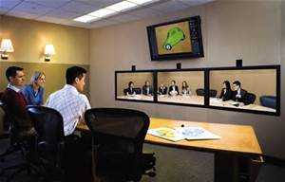
Team Communication Plans (TCP)
Do you use a TCP? Use top drop-down bar √ or X.
What is a TCP? Use Chat.

Slide 18
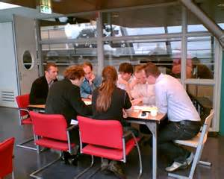
Purpose of Team Communication Plan
“To define the communication requirements for the team and how information will be distributed, to ensure all members of a virtual team are fully engaged in the project.”
Project Management Handbook

Slide 19
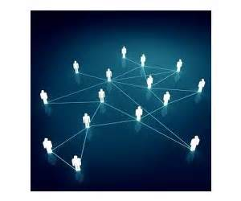
Team Communication Plan
The basic information is always the same:
Who will discuss what, with whom, by when and how it will be recorded.

Slide 20
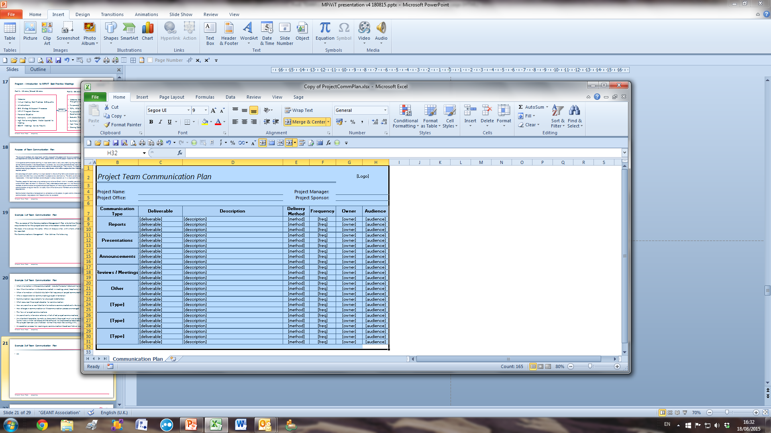
Team Communication Plan Example

Slide 21

Top Tips for Creating and Using TCPs as Part of Virtual Meetings in our Community
Keep it simple and as straight forward as possible
Use a common format that all can work with easily
Agree it prior to project start
Enforce it (in a nice way)
Record formal communications on key issues.

Slide 22
What Do You Need to Put in Your Team’s TCP?
____________________________________________________________________________
____________________________________________________________________________
____________________________________________________________________________
____________________________________________________________________________
____________________________________________________________________________
____________________________________________________________________________
____________________________________________________________________________

Slide 23
Virtual Meetings - Best Practice
1. Preparation - Facilitator Determine purpose of meeting (as per TCP) Send out clear agenda & timings Invite participants Plan opportunities to engage participants Send any additional material ahead of time Plan technical requirements Back-up plan 3. Meeting Etiquette - Participants Respond to meeting notices Arrive in good time Know how to use meeting technology Limit background noise Use mute unless contributing Identify yourself Stay focused - speak clearly, be polite Contribute | 2. Technical - Producer Arrange technical requirements Check audio/visual Carry out prior check Ensure Technical Support available 4. Facilitating - Facilitator Verify connectivity with participants Run through agenda & etiquette Instruct participants on processes/tools for providing input Encourage discussion & maintain control Evaluate meeting Verify date for next meeting (as per TCP) 5. Follow-up - Facilitator E-mail minutes & actions Provide clear actions Contact absentees

Slide 24

Next Steps Before MPiViT Workshop
Create and start using a Team Communication Plan with your group or team
Run Virtual Meeting(s) using Adobe Connect, or similar, using ideas from this meeting
Informally evaluate your Virtual Meetings in relation to the Virtual Meetings Best Practice
Complete the Myers-Briggs Personality Type Indicator (MBTI) Questionnaire we will send to you. Final completion date
16th November 2016.

Slide 25
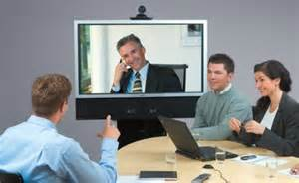
Next Time - MPiViT Amsterdam Workshop
Day 1 9.00 - 6.00 Pre-Dinner Drinks at 7.00pm
Day 2 8.30 - 4.00
Day 1
Introductions
Learning Review re Virtual Meetings Best Practice
Principles of High Performance Leadership/Management
MBTI & Teams & Talent
Day 2
Learning Review
Engagement & Motivation
Coaching for High Performance/Situational Leadership
Positive State, Language & Constructive Feedback
GROW Coaching
Role of the Buddy Partnerships & Learning Transfer

Slide 26
Virtual Meetings - Best Practice
1. Preparation - Facilitator Determine purpose of meeting (as per TCP) Send out clear agenda & timings Invite participants Plan opportunities to engage participants Send any additional material ahead of time Plan technical requirements Back-up plan 3. Meeting Etiquette - Participants Respond to meeting notices Arrive in good time Know how to use meeting technology Limit background noise Use mute unless contributing Identify yourself Stay focused - speak clearly, be polite Contribute | 2. Technical - Producer Arrange technical requirements Check audio/visual Carry out prior check Ensure Technical Support available 4. Facilitating - Facilitator Verify connectivity with participants Run through agenda & etiquette Instruct participants on processes/tools for providing input Encourage discussion & maintain control Evaluate meeting Verify date for next meeting (as per TCP) 5. Follow-up - Facilitator E-mail minutes & actions Provide clear actions Contact absentees

