Slide 1


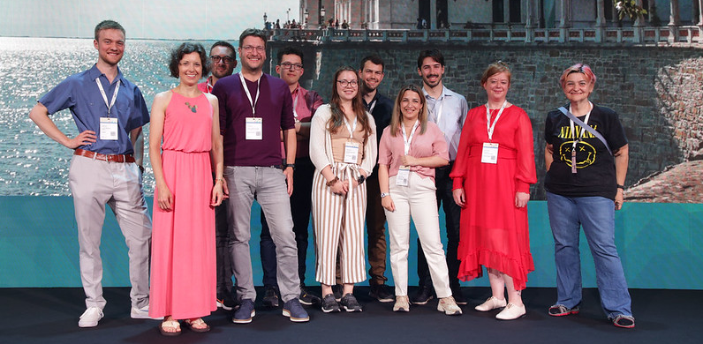
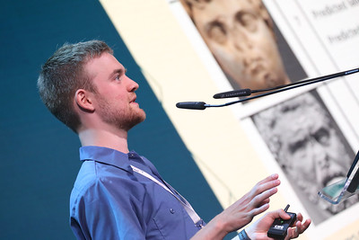
Future Talent Programme FAQ for STUDENTS & YOUNG PROFESSIONALS
GÉANT’s Future Talent Programme (FTP23) gives students and young professionals from GÉANT-affiliated organisations the opportunity to receive expert presentation coaching and present at the prestigious TNC23 conference.
What is the Future Talent Programme (FTP)? The Future Talent Programme is a learning programme designed for students and young professionals in technology-related areas. Participants are given expert presentation coaching to help them deliver high impact presentations. Coaching involves a series of webinars in small groups and 1:1 with the coach. This skill will be of use to participants throughout their career. Participants are also given individual feedback on how to submit a strong application to deliver a Lightning Talk at GÉANT’s TNC conference.
What is the Lightning Talk Challenge? Students and young professionals who are accepted onto the Future Talent Programme can submit a proposal to present their idea or research to an audience of specialists and peers at GÉANT’s prestigious annual networking conference, TNC.
Why should I join? The programme offers an excellent opportunity to develop presentation skills, share your research with an international audience and network with subject matter experts and other young professionals on the programme.
How can I participate? To participate, you must be nominated by a GÉANT NREN. You can find your local NREN on the GÉANT member page. Please contact your local NREN directly or if in doubt, email glad@geant.org
IMPORTANT DATES
1
Get registered by your local NREN by
28 February 2023
Submit your Lightning Talk proposal to TNC by 10 March 2023
Attend presentation coaching webinars between March and May 2023
If selected to deliver a Lightning Talk, take centre stage at TNC23 between 5-9 June 2023
2
3
4
What is GÉANT? GÉANT is the pan-European network that delivers high-performance connectivity and advanced services to more than 50 million Research and Education (R&E) users across 39 European countries. GÉANT interconnects its members through a high-bandwidth, highly-resilient backbone and links them to over 100 countries worldwide enabling collaboration on projects ranging from biological science to earth observation and arts & culture. geant.org
What is an NREN? National Research and Education Networks (NRENs) are specialised internet service providers dedicated to supporting the needs of the research and education communities within their own country.
What is TNC? TNC is the largest and most prestigious Research and Education Networking conference, with more than 800 participants attending this annual event. TNC brings together decision makers, networking specialists, universities and industry representatives. TNC23 will take place on 5-9 June 2023 in Tirana, Albania. tnc23.geant.org

Slide 2
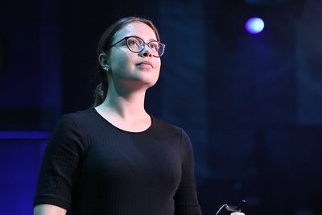
REQUIREMENTS
Eligibility This challenge is open to individuals who are studying at a university or learning provider affiliated with one of the GÉANT Project partners (NRENs) or to young professionals working at a GÉANT NREN.
Nominations All participants must be nominated by the NREN in a GÉANT Project Partner country.
Abstract Upon registration all proposals must include title, participant name, educational institution, short biography, five keywords, and short introduction to their idea (max. 500 words). Abstract must be marked [FTP-student + title].
Webinars Participants must commit themselves to attending three presentation coaching sessions in small groups. They must have access to a computer with a webcam in order to join the webinar.
Presentation Selected participants will present at TNC23. All participants will record their talks.
Language English language proficiency is required.
Social Media All participants are invited to share their experiences on social media.
What type of ideas can I propose? Your presentation can be a research project or new idea you have been working on that addresses a technical, economic, legal, security or environmental aspect in any IT and network field. Examples of past topics are here.
If I participate in the FTP, will I automatically go to TNC23? No, you need to submit your Lightning Talk proposal to the TNC Programme Committee. This is separate from your application to the FTP. If your proposal is selected, you will be prepared for a superb delivery at the conference and your travel, hotel and conference attendance fees paid. Finalists receive full financial support for delivering their talk at the TNC.
If your proposal is not selected you will still receive expert presentation coaching and have an opportunity to showcase your learning with a self-recorded 5-minute video presentation that could be published on GÉANT’s media channels.
When will the webinars take place and how can I join? After close of registration nominated participants will be scheduled for 3 x Group Training Webinars of 60-90 minutes each. Webinars will run between March and April.
When will I be notified if my proposal is accepted? After a timely submission [11 March] you will be notified on the acceptance of your proposal by the TNC Programme Committee.
If I am invited to present at TNC, how should I arrange my travel?
Your local NREN will cover the costs of your travel to TNC and claim those costs from GÉANT’s GN5-1 Project. Ask your NREN contact whether you should make the booking yourself or whether they will book for you directly.
GÉANT will book and pay for your hotel and conference attendance fees.
Keep your receipts of food and travel expenses during TNC and claim the cost back from your local NREN. Expenses must align with GÉANT’s policy, as set out in the Volunteer Agreement.
1
What's expected from me as a young professional? If you register for the programme you are required to:
1
Be reachable and responsive throughout the programme.
Meet the important deadlines.
Attend all presentation coaching. Exact dates will be organised after joining.
Develop and rehearse your presentation between coaching sessions. Record a 5-minute presentation on your laptop or phone.
If accepted to present at TNC, you will be asked to sign a Volunteer Agreement with GÉANT.
2
2
3
3
4
Have more questions?
Contact your local NREN or
Email: glad@geant.org
5
PLACEHOLDER NREN CONTACT DETAILS

