Slide 1
Understanding deployment issues on the Supply Chain
Ann Harding, SWITCH, Nicole Harris, TERENA
Cambridge
July 2014

Slide 2


Understanding implications on the supply chain
Interactive Session
  Technical briefing
  Interactive discussion
  Review of ideas
Topics
  Levels of Assurance
  Attribute Release
  Attribute Aggregation
  Monitoring and Accounting

Slide 3
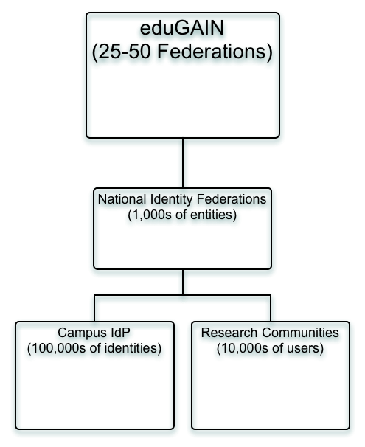
To the whiteboard!

Slide 4
Assurance and Trust
TRUST
Behavioural Trust - IdP
Behavioural Trust - SP
Technical Trust - IdP
Technical Trust - SP

Slide 5
What assurances?
Organisational
Security Management
Notices and User Information
Operational
User Registration
Password strength
Infrastructure
Service Maturity
Maintaining logs
Revocation
{
Externally
Audited

Slide 6


The Problem Statement
The Research Community/SP view
  Our resources are ‘special’ are we need to know they are protected properly.
  We need to know that you have taken care to make sure the right people are registered.
  This should be the responsibility of the infrastructure providers, not projects.
The Campus/IdP view
  Reasonable level of trust through federation – you know us.
  Assurance is EXPENSIVE and you are asking us to bear the cost.
  Different SPs want different things all the time.
  There are no clear use cases as to WHY you need this.

Slide 7

Let’s discuss

Slide 8
Attribute Release – the Problem Statement
The Research Community/SP view
  Different communities and different SPs need different attributes
  Need to identify individual’s personal informtion e.g. ethical committees need names etc.
  Negotiation with individual IdPs does not work and does not scale
The Campus/IdP view
  An IdP takes a risk when it releases attributes
  Intentional or accidental misuse of information by SPs
  Data Protection legislation typically encourages a minimal release policy without specifying what minimal is
  Dealing with requests from many quarters burdens overworked IT departments

Slide 9
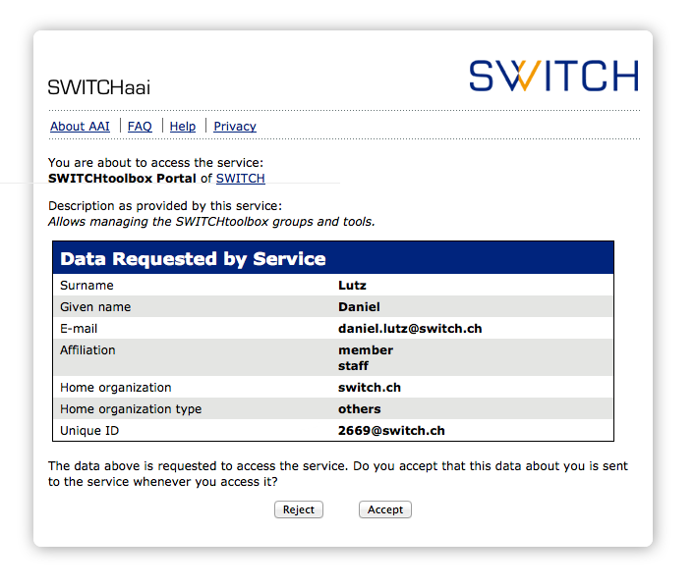
Attribute Release – uApprove
Automated workflow for user approval for attribute release
Consent not considered sufficient in many EU jurisdictions
Shibboleth IdP extension

Slide 10
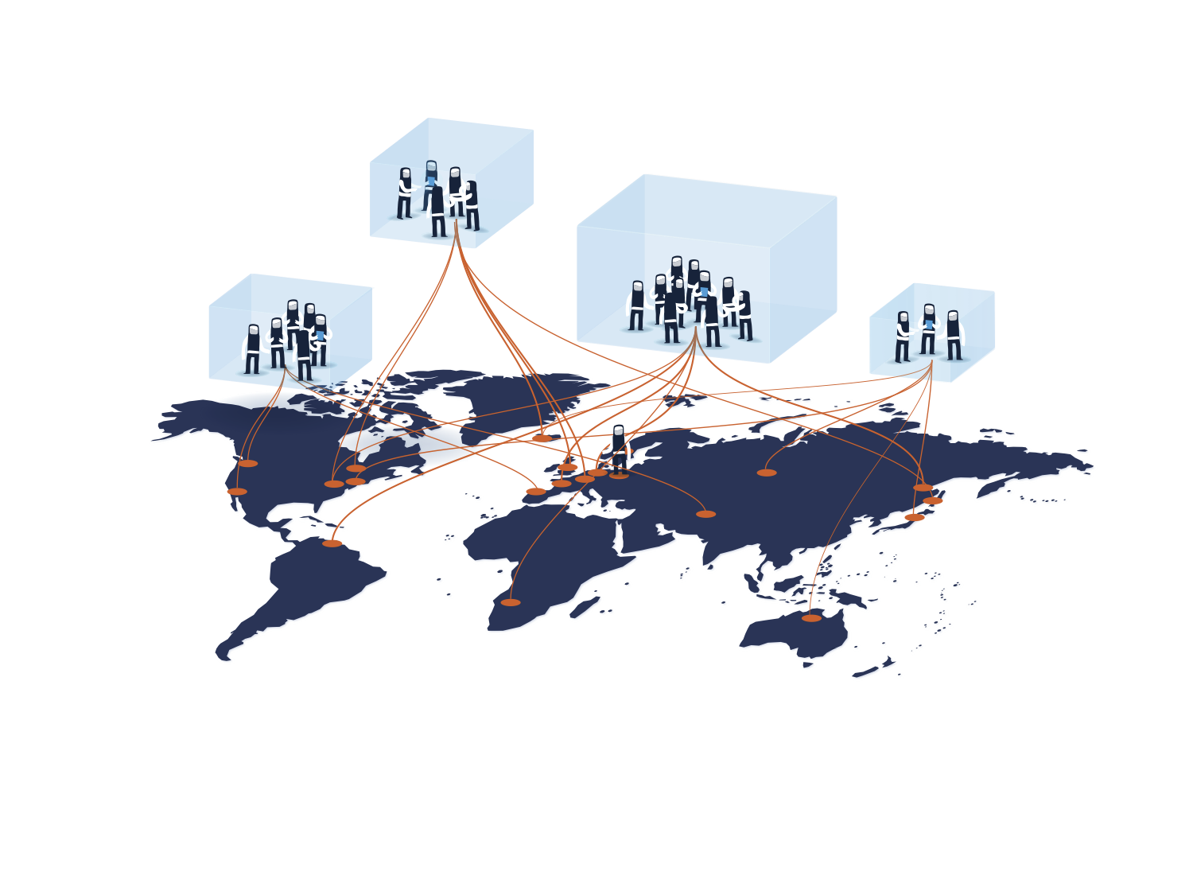
Attribute Release – Entity Categories
Group federation entities that share common criteria.
Facilitate IdP decisions to release a defined set of attributes to SPs without the need for detailed local review for each SP
IdP makes a release decision based on the criteria detailed in each SP entity category specification
Release is *facilitated* not *mandated*
Example Entity Categories
  Code of Conduct (CoCO)
  Research and Scholarship (R&S)
  Early days for deployment
SP’s registrar (typically the Federation) checks for compliance at registration

Slide 11
Let’s discuss

Slide 12
Attribute Aggregation
The “Scott Cantor is a Member of IETF” Problem.
Affiliation
Professional Body
University
Charity
Research Project

Slide 13
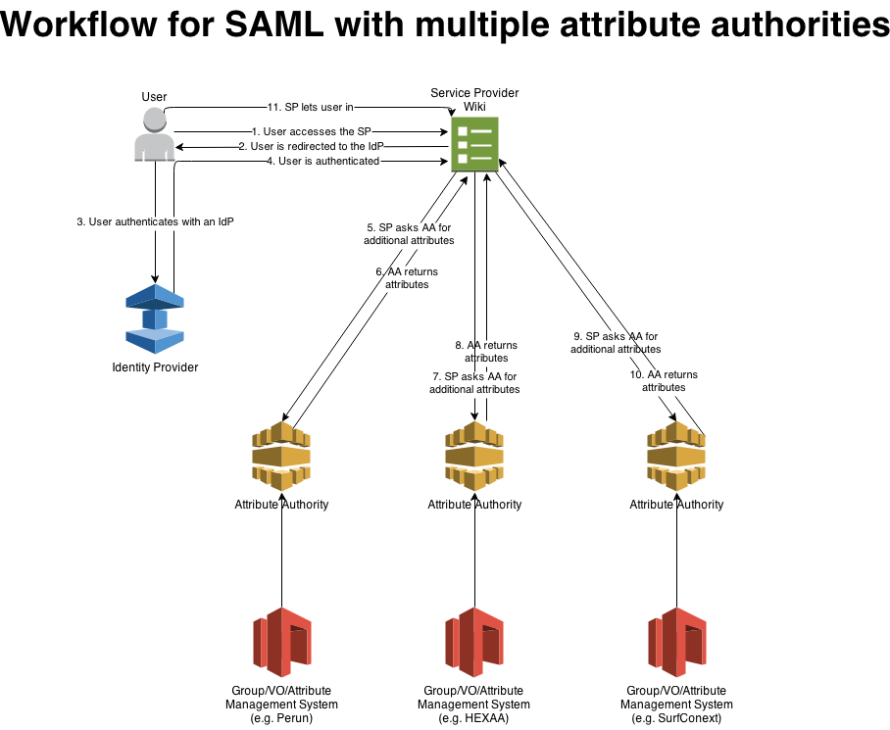
Attribute Aggregation

Slide 14
Let’s discuss

Slide 15

Monitoring and Accounting – what eduGAIN knows

Slide 16

Monitoring and Accounting – What Federations know
Some know more than others
  Hub and Spoke vs Full Mesh
  Few if any standard tools
  Scalability and standard specs a big issue
Raptor, f-ticks, AAIeye, AMAAIS, custom scripts to Nagios, Icinga, in-house tools and nothing
Learn from the perfSONAR experience and not leap in with a ‘solution’ from above

Slide 17
What IdPs and SPs know –
Shibboleth Example
idp-access.log
request time, remote host making the request, server host name and port, and the request path
idp-audit.log
event time, IdP and relying party IDs, request and response binding, communication profile ID, request and response ID, principal name, authentication method, and released attribute of the current user.
SP Transaction/Audit
Each session that's created or removed
Login, Logout, AuthnRequest
Older versions show lack of error if an attribute was not provided
contains a log entry for each time the IdP is accessed, whether information was ever sent back or not.
contains a log entry for each time the IdP sends data to an SP

Slide 18
Let’s discuss

Slide 19

Back at 11:30

Slide 20
Thank you!

