Slide 1
NREN Trust and Identity Strategy
Ann Harding, SWITCH
Cambridge
July 2014

Slide 2


Context
Identity is highly strategic to some commercial providers, who are trying to control the space. An anchor service such as a social network or email service often makes these providers attractive to users. Services are also moving onto Cloud platforms that feature easy integration with the operator’s AAI. This is leading to the adoption of non-interoperable AAI.
Trust is becoming a significant issue. While the network creates many positive opportunities it also introduces risks, particularly with the growth of Cloud. Users (or their organisations) do not trust some of these entities, and some actors are even considered hostile.
In an increasingly constrained budgetary environment, funders are consolidating funding on horizontal activities such as eID. Positioning and communicating our T&I work is more critical than ever; the NRENs must articulate how we add value, given these other activities.

Slide 3

Mission
The European NREN community will facilitate an environment where Trust & Identity (T&I) are ubiquitous. We will begin this by facilitating an open global cross-sector Authentication & Authorisation Infrastructure (AAI) that meets the needs of our research & education (R&E) community and their global partners; and by developing and operating other capabilities necessary for our users to trust us for their R&E endeavours.

Slide 4

Goals
Enhance collaboration within the global R&E community by meeting users’ needs for T&I for networks, services and applications.
Enable collaboration between the R&E community and other sectors, on terms favourable to the R&E community, and so reduce costs and risks to the R&E community by facilitating the use of vendor solutions that are interoperable with the NRENs’, while mitigating the risk of vendor “lock in” and monopolistic-like outcomes, particularly on Cloud platforms.
Support the needs of other strategic NREN interests, such as e-Infrastructures, ESFRI projects , Cloud, and life-long and government eID .

Slide 5

Approach
1/3
Harmonise our national T&I initiatives
by agreeing common strategies, policies, operational practices, development roadmaps, communications and marketing where necessary to meet user and operational needs.

Slide 6

Approach
2/3
Operate T&I systems for global R&E by integrating our national initiatives, and supplementing these where necessary, working with other NRENs and community providers of ICT, by:
1. Operating Trust & Identity systems in Europe and elsewhere, such as eduGAIN, eduroam, and similar initiatives, that meet user needs.
2. Consolidating and providing representative executive governance of these to all global NRENs, and including user representation .
3. Developing these further in response to user requirements.

Slide 7

Approach
3/3
Facilitate open global cross-sector systems for Trust & Identity
by working with governance and industrial stakeholders and by using global R&E’s scale to incentivise the market to provide solutions suitable for our users. This will facilitate R&E’s adoption and use of these, to include commercially available solutions, adding additional value where necessary to meet the specific needs of our community.
A cross-sector T&I framework and engagement activity to facilitate interoperability between NREN, government, and commercial operators.
Strategic alliances and partnerships with commercial entities on initiatives, products & services that support the community’s needs.
Community support to R&E communities, such as ESFRI projects, and the populous but dispersed R&E communities that are less well served today.

Slide 8

Organisation
The agents to deliver these are GÉANT and TERENA, and their partners.
GÉANT will focus on service delivery, development, and support; TERENA on outreach and best practice.
Both will report to a sub-committee of the NRENPC, which will oversee their work, balance strategic, and approve their annual operating plans.
It will be accountable and report to the NRENPC.

Slide 9
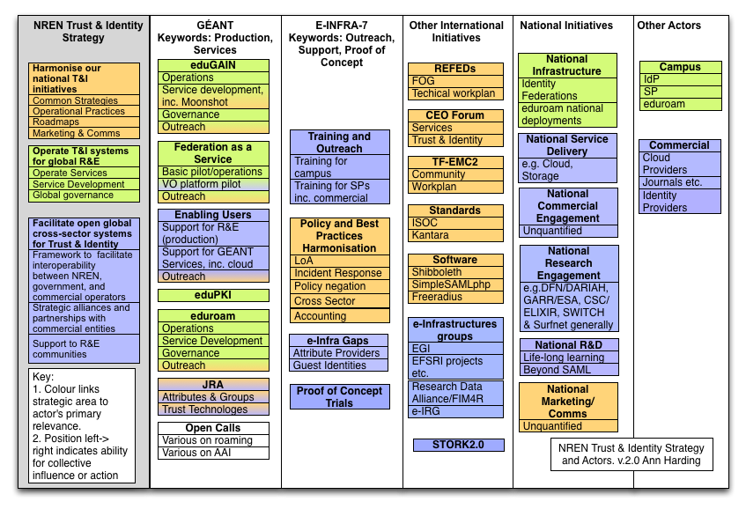
Implementation?

Slide 10
Three Key Coordination Points
Everyone with a piece of the problem
EINFRA Call/AARC
REFEDS
GÉANT 4
Best Practises
Policy
T&I Harmonisation
LoA
Operational Practises
eduGAIN
Training on policies
Federation Harmonisation
FaaS/VO Platform
Proof of Concepts
Moonshot
Pilot Services
Outreach
eduroam
Support for R&E communities
Research Work
Supporting Tools
Guest IdPs
Enabling Users

Slide 11


Nearly there…

Slide 12
Thank you!

