Slide 1
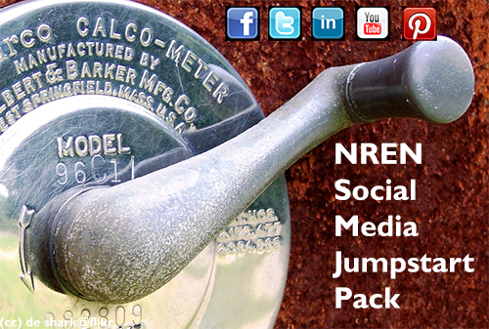
Jumpstart pack – what‘s next?
Domen Božeglav, Arnes
TF-CPR, Poznan
5.10. 2012

Slide 2
WHAT‘S NEW?
Rewritten after the BoF
8 sections for quick Social Media start
To-Do reminder
Drill down for additional info on WIKI
Glossy look ☺
Notes:
The structure of the document was changed
It should help you as a guideline whether you are starting from the scratch or just want to improve your Social Media presence
You can use it as to-do reference if you decide you will deploy things on your own
On a lot of subjects jumpstart pack links to additional info on TERENA wiki
What was also added are pictures from real NREN cases

Slide 3
ON TERENA WIKI
https://confluence.terena.org/
Notes:
Let‘s go quickly through the document (present the sturcture and the content)

Slide 4

NOW WHAT?
Publish on PeaR and make a
Maintenance - > 3m, 6m, 12m, when necessary?
New topics
  Security Policy in Social Media,
  New Twitter home
  …
Notes:
At the moment we considered the document finalized. Laura will publish the document also on PeaR.
And yes, that‘s a checkmark on our Social media work item on TF-CPR terms
The Social Media is changing rapidly so the document itself will have to be maintained on the frequent basis. I am not sure whether ideal refresh span would be 3, 6 or 12 mounths. Best scenario would include something like when something new occures and we find time to work on it.
In the last week we already found 2 new interesting topics – Security Policy and New Twitter home page options, that are not included in the document. Though it will happen all the time!

Slide 5
DEBATE
(some) Positive feedbacks! THANKS!
Is it forth the effort?
Maintenance – any volunteers?
Interesting Social Media topics worth covering – any volunteers?
Notes:
To help us dicide what to do from now on we need a bit of you help. I already got some possitive feedbacks and many thanks for that.
The main queistion I have is „Is it worth the effort“. Do you think you will be able to use this or was this jumpsart pack just a shot in the dark?
I‘ll try to keep an eye on the jumpstart pack but only when I find the spare time to do it. Would any one vounteer to take the ownership of the jumpstart pack and keep it up to date?
How about new topics:
Common NREN guidelines
Security Policy in Social Media
New Twitter home
User-support on Social Media
Advertising on Social Media

