Slide 1
WiFiMon @ TNC19
Nikos Kostopoulos
Ph.D. Candidate at NTUA, Greece
&
GN4-3 WP6 T3 WiFiMon Team Member

Slide 2
WiFiMon Milestones @ TNC19
Demonstration of WiFiMon capabilities in measuring the performance of WiFi networks
Comparison between crowdsourced measurements and deterministic measurements (HW Probes)
Deploying WiFiMon HW Probes in an event for the first time
Discussing with participants about potential enhancements and the future steps of WiFiMon

Slide 3
Available Equipment
5 Raspberry PI 3 Model B+, 64-bit quad-core ARMv8 CPU, 2.4 & 5 GHz, 802.11b/g/n/ac Wireless LAN, Bluetooth 4.2 & BLE
Laptops & Smartphones of WiFiMon team members
Why not TNC19 participants?
GDPR issues
WiFiMon was late to include its purposes in TNC19 privacy notice
Definitely in the future

Slide 4
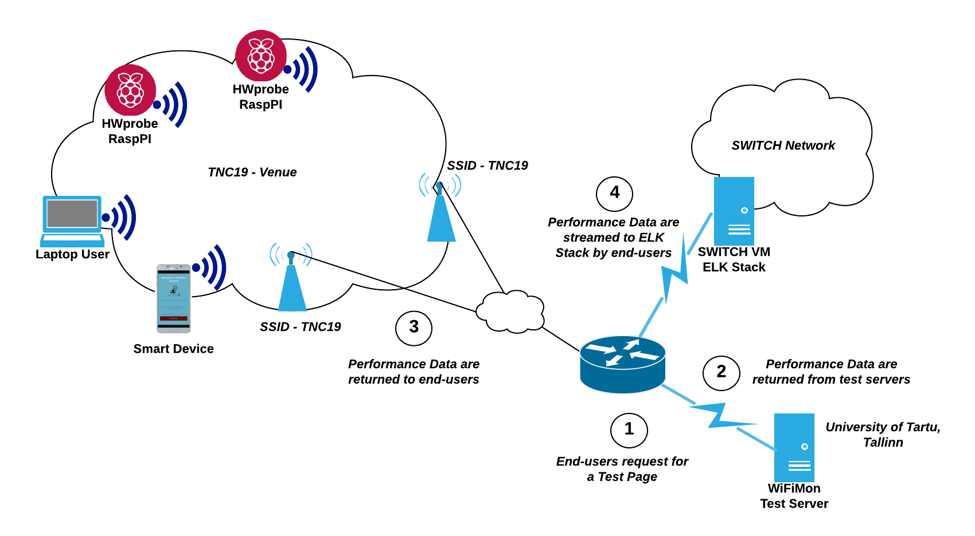
Overall Testbed

Slide 5
Available Test Tools
NetTest
Boomerang
Speedtest
10 available test pages per test tool (NetTest-x, boomerang-x, speedtest-x):
5 dedicated to each of the HW Probes
5 assigned to WiFiMon team members

Slide 6
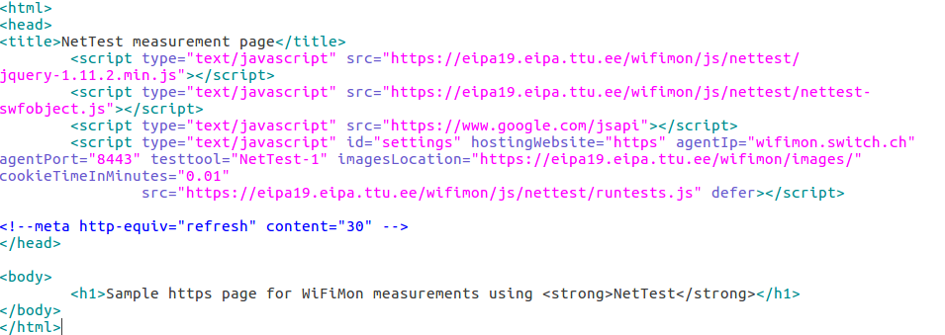
Sample Test Page (NetTest-1)

Slide 7
Monitored Rooms
Small Hall & Small Hall Balcony (Posters)
Black Box room during the 1st round of lightning talks
Cauldron Hall
Atrium Hall
D- Hall

Slide 8
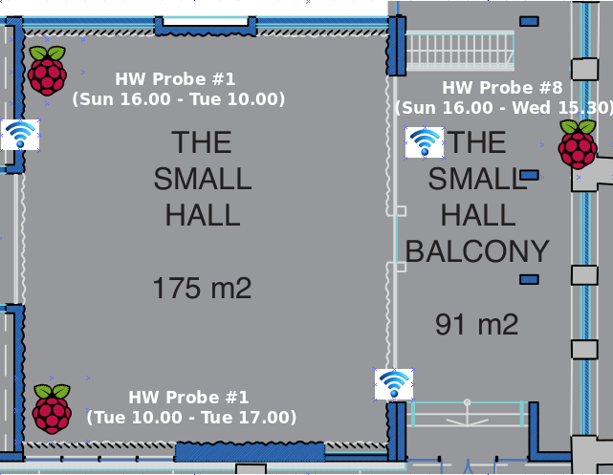
Small Hall & Small Hall Balcony (Posters)
HW Probe #1: Sunday 16.00 - Tuesday 10.00 (upper left corner)
HW Probe #1: Tuesday 10.00 - Tuesday 17.00 (lower left corner)
HW Probe #8: Sunday 16:00 - Wednesday 15.30 (poster area)

Slide 9
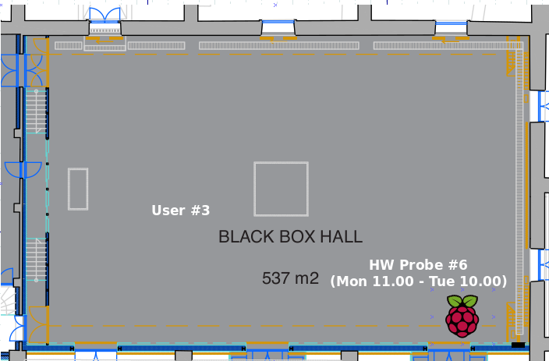
Black Box room
HW Probe #6: Monday 11.00 - Tuesday 10.00
User #3: Monday 14.00 - Monday 15.30 (1st lightning talks round)

Slide 10
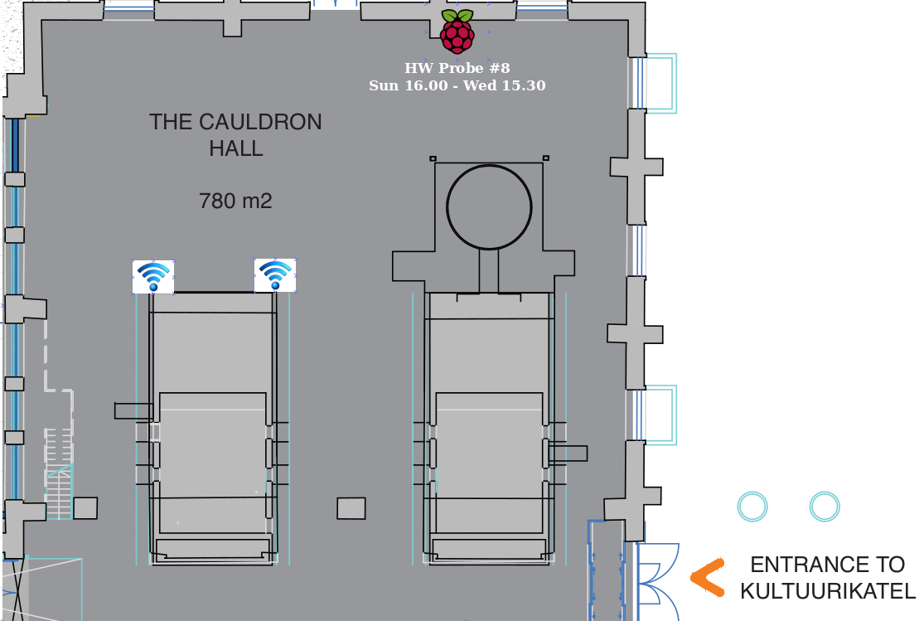
Cauldron Hall
HW Probe #8: Sunday 16.00 - Wednesday 15.30

Slide 11
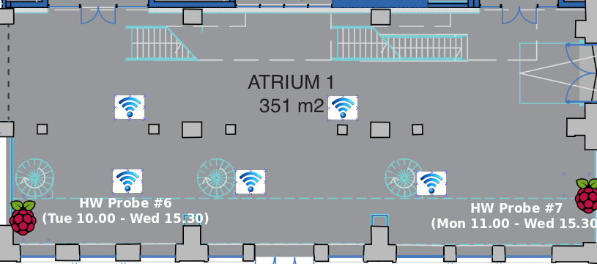
Atrium Hall
HW Probe #6: Tuesday 10.00 - Wednesday 15.30
HW Probe #7: Monday 11.00 - Wednesday 15.30

Slide 12
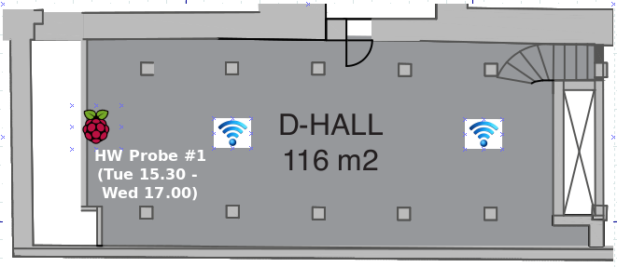
D-Hall
HW probe #1: moved to D-Hall in Tuesday 15.30

Slide 13
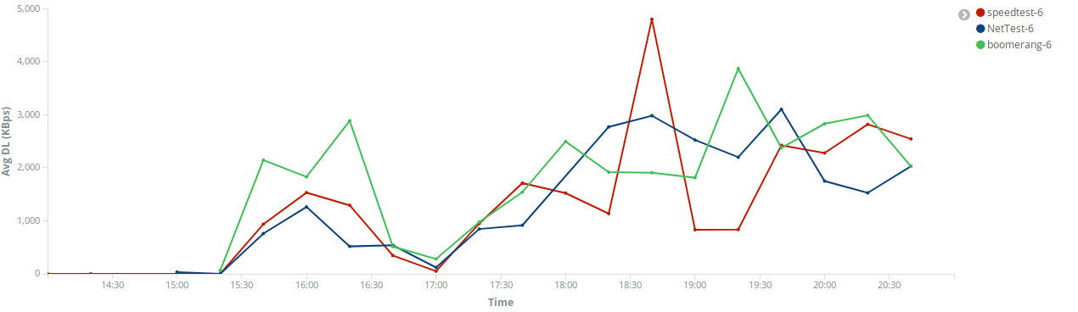
Download Throughput HW Probe #6 in Black Box, Monday (14.00 - 21.00)
WiFi unavailable during lightning talks (14.00 - 15.20)
WiFi gets back in the afternoon when lots of people left the venue
WiFi degrades again during the opening reception
WiFI gets back in the evening

Slide 14
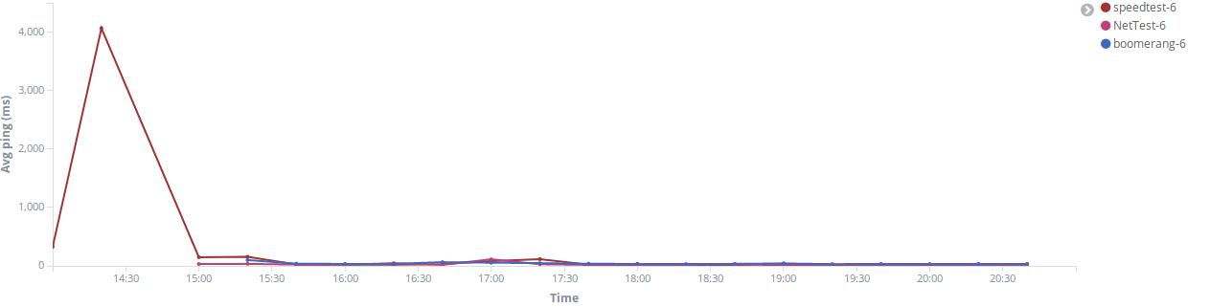
Average Ping Time by HW Probe #6 in Black Box, Monday (14.00 - 21.00)
During the lightning talks (14.00 - 15.30), we see again that WiFi is sometimes really slow or even unavailable

Slide 15
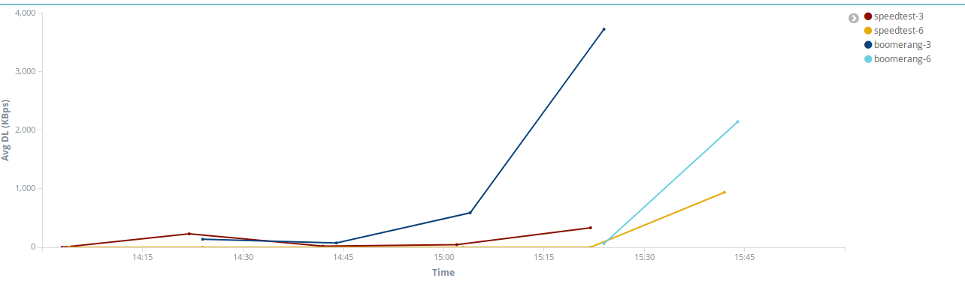
Comparison of crowdsourced measurements with HW Probe #6 during lightning talks on Monday (Download Throughput)
Both kinds of measurements follow the same trends

Slide 16
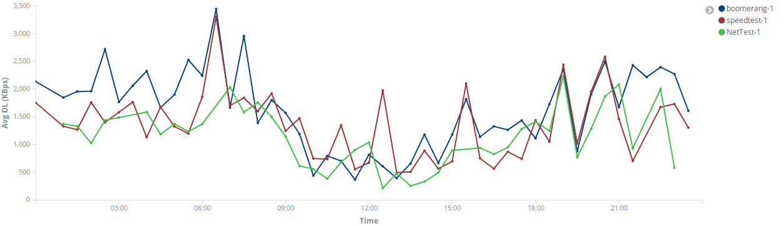
Download Throughput of HW Probe #1 in Small Hall, Monday (all day)
WiFi performance degrades when people come to the venue
WiFi is quite unstable in this room

Slide 17
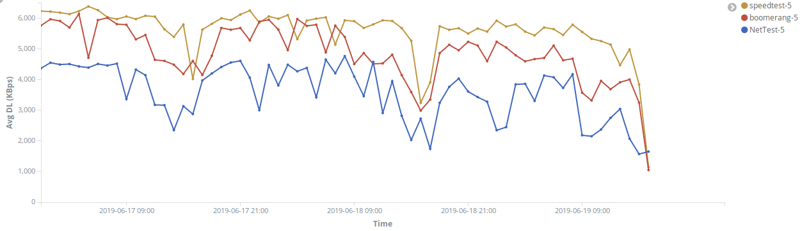
Download Throughput of HW Probe #5 in Small Hall Balcony,
Monday, Tuesday, Wednesday till 15.30
WiFi performance degrades during coffee breaks

Slide 18
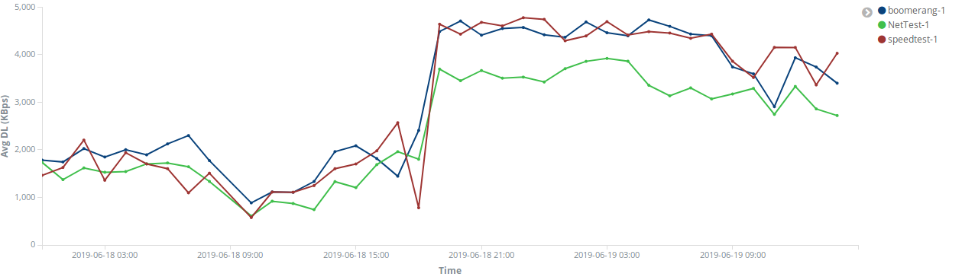
Download Throughput of HW Probe #1 moved from Small Hall to D-Hall
WiFi connectivity in Small Hall is worse than in D-Hall

Slide 19
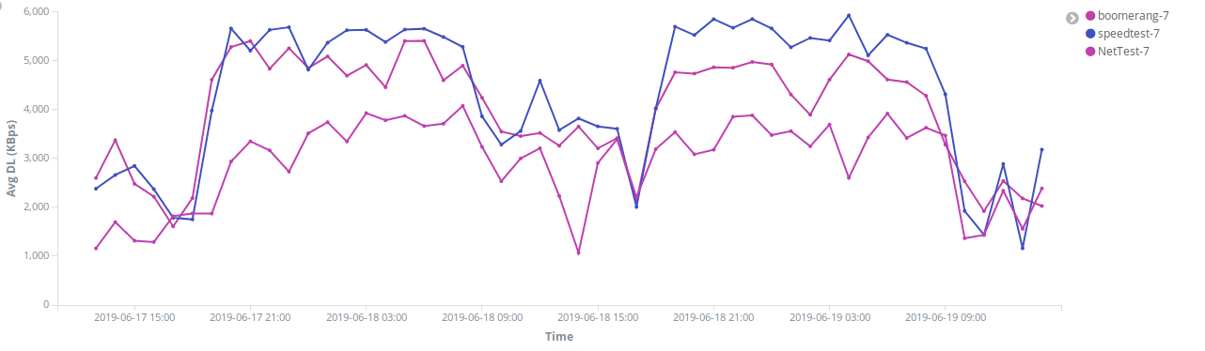
Download Throughput of HW Probe #7 in Atrium Hall,
Monday 11.00 till Wednesday 15.30
WiFi performance is affected by the number of people in the venue

Slide 20
Conclusions
WiFiMon can detect performance degradation in WiFi networks and network unavailability
WiFiMon can confirm that WiFi connectivity in a room is worse than that in another room
WiFiMon can confirm that a WiFi network is capable of handling a number of simultaneous connections
WiFiMon can assess how WiFi performance is affected by the number of end-users
WiFiMon can reach valid conclusions using either the crowdsourced or the deterministic approach (HW Probes)

Slide 21

Questions

Slide 22
DIY
https://eipa19.eipa.ttu.ee/wifimon/measurements/nettest-X.html
https://eipa19.eipa.ttu.ee/wifimon/measurements/boomerang-X.html
https://eipa19.eipa.ttu.ee/wifimon/measurements/speedtest-X.html
where X = 1, 2, ..., 10

