Slide 2
Outline
Mobile Crowd Sensing Systems
Basics on Wireless Crowd sourced Performance Monitoring Verification (WiFiMon)
Web-based Opportunistic Measurements
Mobile Application Measurements
Hybrid Approach / HW Probes Measurements
Discussion Security and Privacy (based on End-User Meeting in Zurich – May 2017)
Conclusions and Future Work
Measurement page:
https://wifimon.switch.ch/wifimon/
Notes:
Mobile Crowd Sensing System: An example and how Wifimon could proceed
WCsPM: Discuss several points to understand WiFiMon functionality (i) Concept Overview, (ii) Process, (iii) Architecture Building blocks, (iv) walk through (Data Flow Diagram), (v) GUI screenshots
Mobile application measurement: (i) Architecture, (ii) Mobile Measurements process
Hybrid Approach: (i) Prerequisites, (ii) Setup procedure
WiFiMon Security & Privacy: Beyond WCsPMV – eduroam SP and IdP policy/Process/
Results discussions End-User Meeting in Zurich (May 2017)

Slide 3
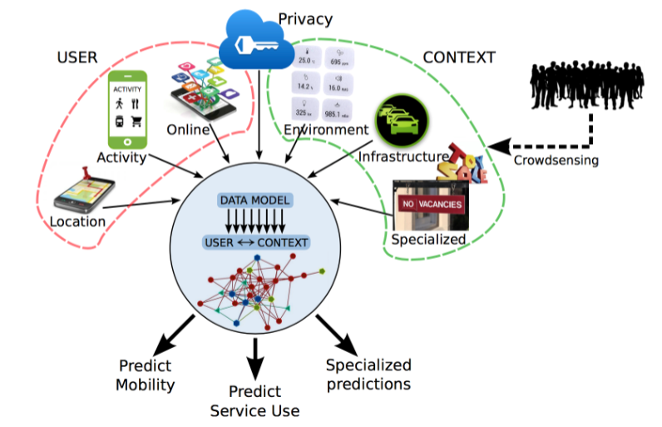
Mobile Crowd Sensing Systems
Prediction - Wireless
Network Performance
opportunistic, and
objective measurements?
Source: WiFiMon End-User Meeting
https://goo.gl/8FousQ
Notes:
WiFiMon tries to collect measurements from “various users (devices)” that are correlated with Identification information, such as “AP information” under a system with privacy requirements.
If we use all these data in a complex software system (java based with usage of different technologies, such as Spring boot, hibernate, javascript, html, thymeleaf, elasticsearch, kibana, logstash), we may define the requirements
In our case we can make predictions about (user) mobility, the service delivery, special predictions like performance behaviour on a wireless campus

Slide 4
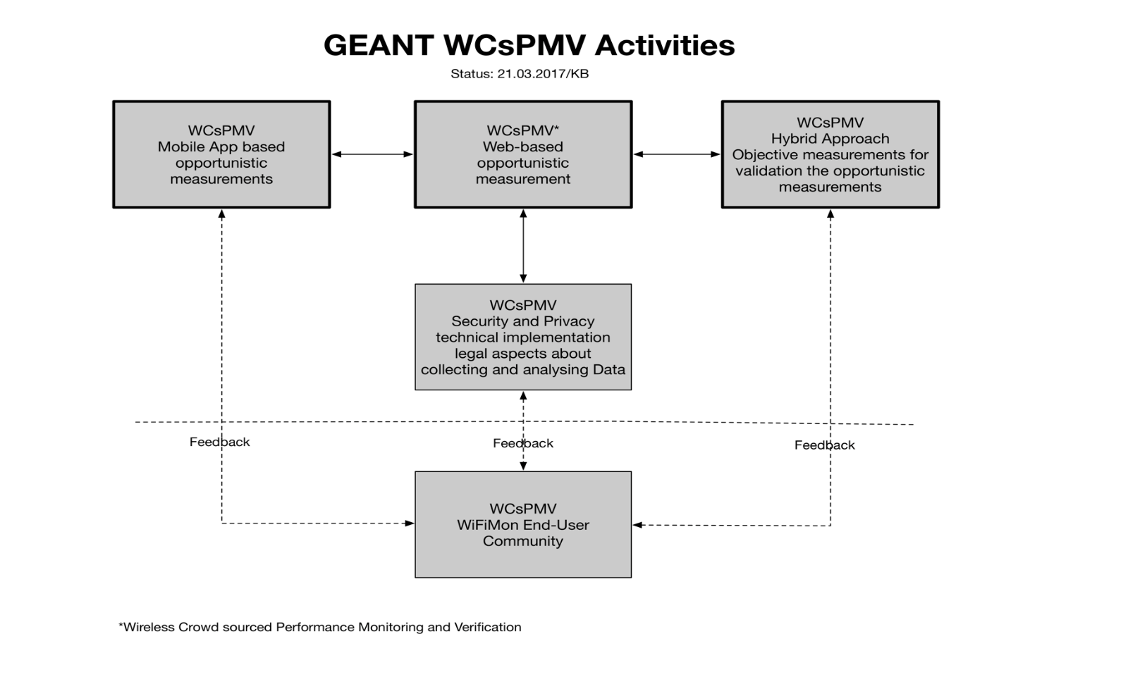

WiFiMon Concept – Modules
Basis
GN4-3-WP6-T3 WiFiMon
Notes:
WiFiMon is a MODULAR project:
WiFiMon basic (web-based javascript measurements)
WiFiMon Mobile App Measurement
WiFiMon Hybrid Approach / HW probes
WiFiMon Security
WiFiMon End-User Community
So let us start with WiFiMon basic

Slide 5
Introduction WiFiMon
Mission Statement:
“…It is possible to gather data from multiple
Sources, including browser-based measurements,
in addition to traditional monitoring, and extract
Meaningful information on the performance of
a WiFi network from that data…”
WiFiMon Prototype:
Architecture design
Java Script distributed to essential web-sources
NetTest/Boomerang servers configured
Upload- / Download Images
…and non-invasive…
Notes:
Generic statement:
Gather data from multiple sources,
Browser based measurement in addition to traditional monitoring
Extract Data: Accurate enough so that we can propagate a “Performance statement for a WiFi campus”
So we figured out a problem statement…

Slide 6
WiFiMon - Problem statement
Measuring and verifying the performance of a WiFi network is challenging there are no tools that:
Cover all aspects of performance monitoring and verification
Determine how end-users experience WiFi at a given place on the network, at a given time
At present, information for wireless networks can be reported in three ways:
Mobile End-User Device
Wireless Access Points (WAP) / WiFi-Controller
Network Management Systems (NMS)
These sources allow “only” determining the wireless network is overall OK (e.g. up/down)
HW probes collect performance measurement but are installed at fixed locations

Slide 7

WiFiMon Process
COLLECT DATA
STORE DATA
ANALYSE DATA
CONSUME and VISUALIZE of DATA
WiFi Interface
Focus: WiFi /eduroam enabled infrastructure
on Smart Devices
Temporary Data
Persistent Data
- Raw data from data sources
- Reference data correlated
Real Time Analysis:
Correlation: RADIUS Accounting/Performance data
Mobility Prediction (future)
  Focus Network Performance
  Focus Crowd prediction etc.
Web-UI
- Visualization: View Snapshot)
- APIs
Multiple
Iteration Process
7
Notes:
The aim of our approach is to record network performance measurements by using collected raw data (data source) on WiFi and to visualize them. ==========
Temporary Data – Raw data from the data source
Persistent Data – Correlated data
==========
Only correlated data will be stored and analysed
Mobility prediction and focus is possible, so the correlation with the AP helps us to provide a localized statement to the network performance.
==========
The Web-User Interface is the Network Administrators view, about their own data. In our concept use Kibana (for visualization) and Elasticsearch (as a DB).
It is worth mentioning that previous WiFiMon versions used Grafana/InfluxDB and PostGresql

Slide 8
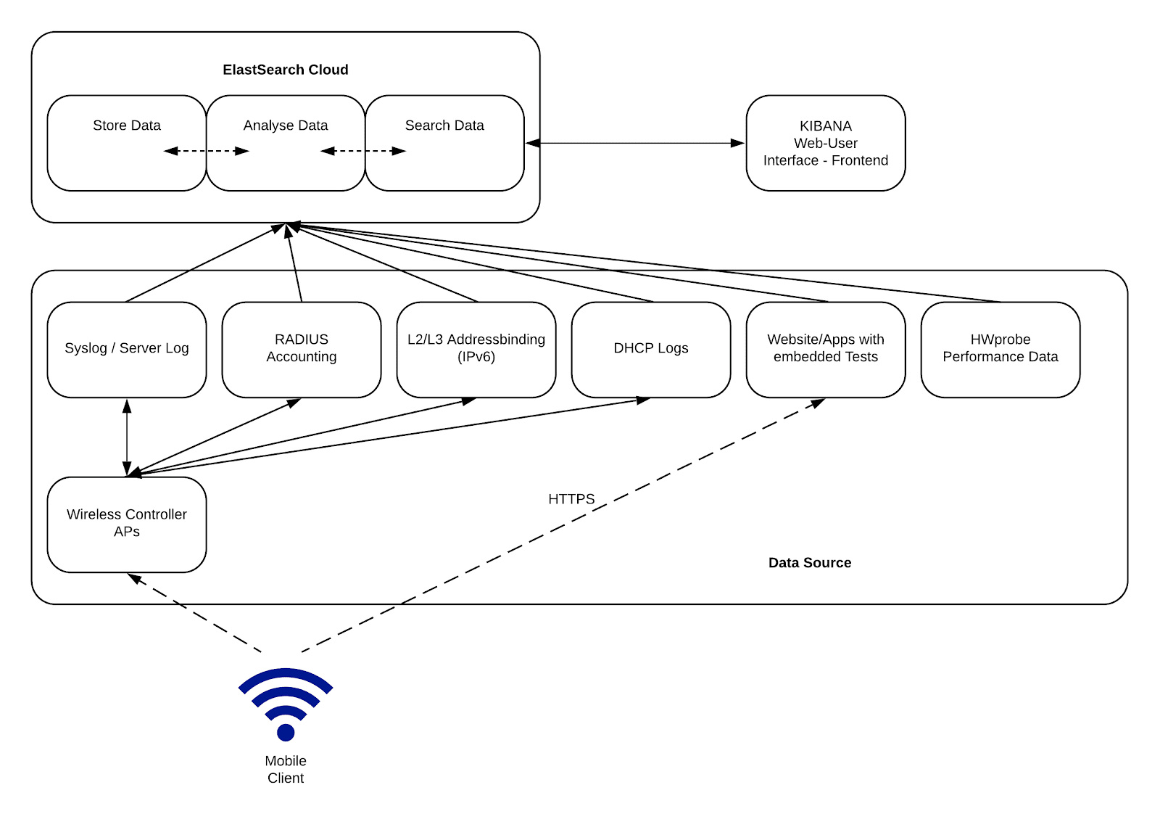
WiFiMon Architecture
Mobile Client
  End-User device (tablet, mobile phone, etc.)
Data Source
  Generates raw data and Exports raw data from data source collectors
Elastic Cloud
  Stores measurements (Elasticsearch)
  Pipeline raw data to Elasticsearch
  (logstash, filebeat)
Web User Interface (Web-UI)
  Allows real-time visualization
  options
Notes:
Mobile Client: In WiFiMon we have the mobile client connecting through eduroam to the WiFi network on the campus.
Data Sources: The data sources block includes:
(A) collected reference data generated by network performance tools (Boomerang, NetTest and HTML5) utilizing JavaScript code embedded on chosen web sources, running tests without client-intervention and performance data retrieved when the HW probes visit these web sources, and
(B) raw data from data sources (collectors) like Syslog, Server Log, RADIUS Accounting, DHCP logs that can help us identify the AP that the measurements were triggered from
Elastic Cloud: The raw data, will be automatically collected and feeded into the WiFiMon agent (Java based), where they are correlated and stored in the Elasticsearch database. Elasticsearch allows leveraging and accessing data at very high speeds and making it appropriate for WiFiMon. In addition, the Elastic cloud uses technologies such as “logstash” and filebeat to pipeline the raw data from the Data sources simultaneously, transform these data and send it to Elasticsearch. For scalability and security issues, the raw data from all APs will be sent to one database per site/campus.
Web-UI Interface: Raw and reference data from the Elastic Cloud accessible through a network admin Web-UI that allows querying and customized status checks of the wireless network. This block of the architecture is for projecting the collected data and allowing real-time visualisation options, such as: Collected data for a specific time period, collected data for a specific AP, min-max-mean values of download/upload/latency measurements, maps for measurements visualizations, Top/Bottom AP performance.

Slide 9
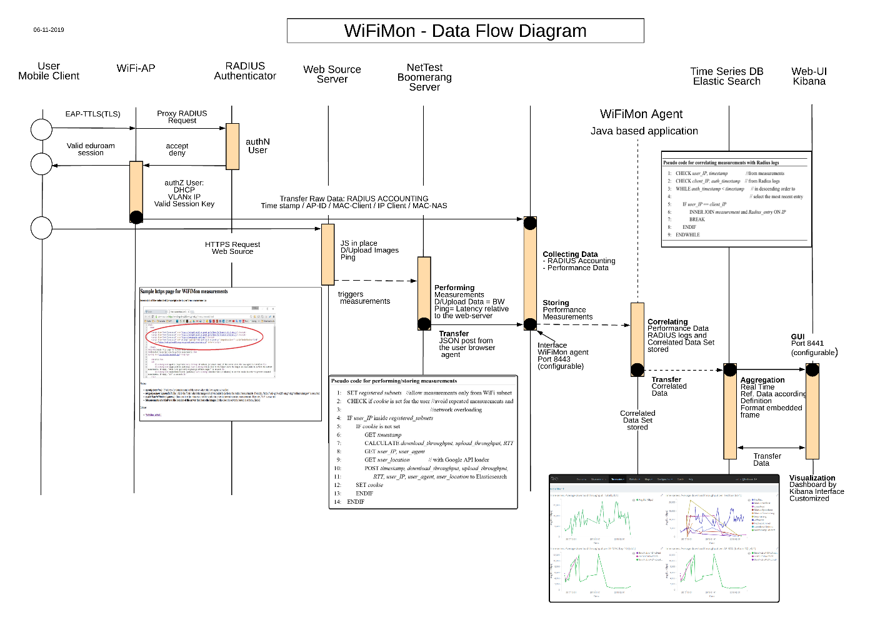
WiFiMon – Data Flow
Notes:
Mobile Client connects to the WAP with EduRoam.
The AP is proxying this request to the authentication identity (Radius Server)
After a successful authN, a Radius log entry (with time-stamp) takes place, and the an IP-address is assigned to the mobile client. The Radius log entry includes additional information such as Client MAC and IP address, AP MAC and IP, etc
The RADIUS accounting are streamed to the Elasticsearch database using technologies such as “logstash” and filebeat.
Once the Mobile Client visits a wifimon-enabled webpage (or wifimon app) performance tests (using open source approaches such as NetTest and Boomerang) are triggered automatically (using javascript). Once the measurements are completed, a JSON post is performed to send the results to the WiFiMon agent, where the performance tests are corellated with the Radius accounting data.
The Web-UI allows real-time visualisation options.
NetTest performance data, bandwidth (upload/download images)), and latency (RTTs (ping) will be correlation relevant for correlation – Time stamp / AP-ID / Mobile Client IP – only correlated data sets will be stored.

Slide 10
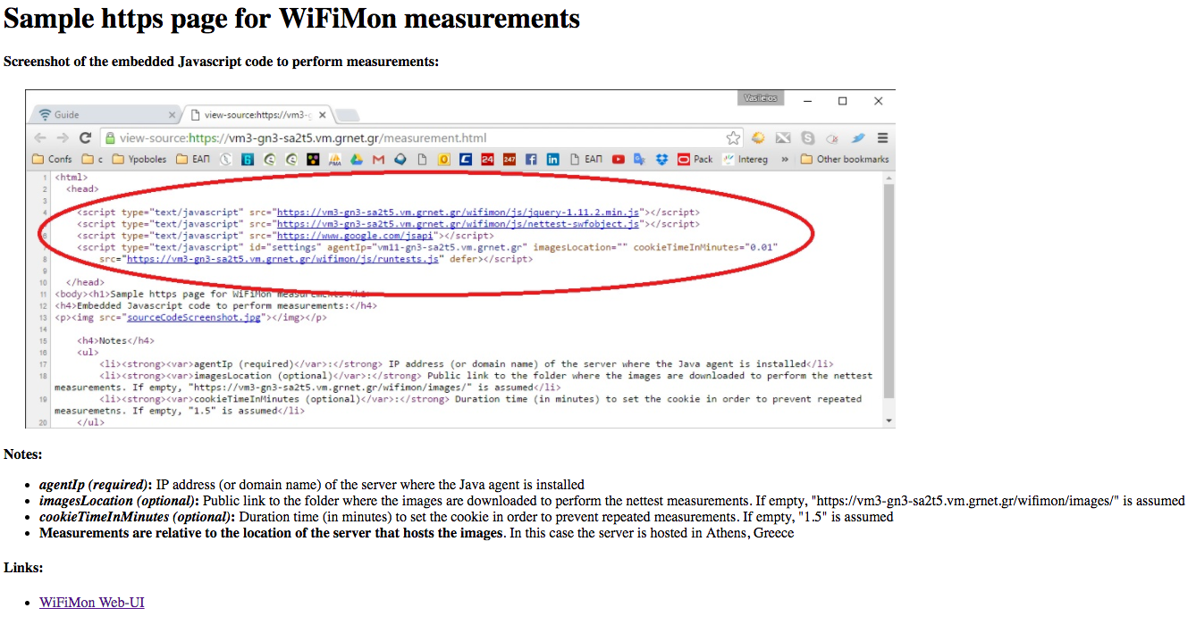
WiFiMon – eduroam enabled WiFi Infrastructure: Walk Through
The end user is required to visit a web page with JavaScript installed
User Information
Notes:
To the 1st step. -- web-server JS:
The Domain Name (e.g. www.switch.ch) or the IP of the web-server is needed
The location path of the images is important (location where the NetTest servers is running – Grnet)
Cookie time is essential, as we don’t like to affect the network --- non-invasive
Additional information:
The JS lines should be embedded at a frequently-visited web page (conference program, university website, etc)
The web page can be hosted anywhere without affecting the results
The agent could be installed anywhere, however it is advised to be installed near the conference venue or the university campus. The agent performs the correlations and stores the correlated measurements.
The measurement results are relative to the location of the web server, where the images are hosted.
The website, the WiFiMon agent and the test tool servers can be located at a different physical infrastructure. Only the test tool servers location affect the measurement results!!

Slide 11
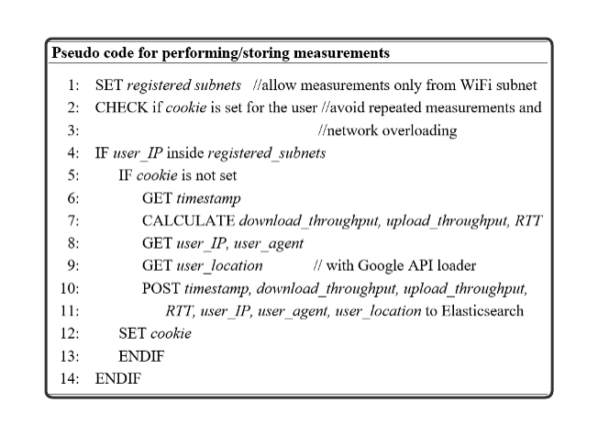
WiFiMon - Performing / Storing measurements
Notes:
To the 2nd step - performing and storing of measurements at the database:
Per configuration:
Sub-Net defined => Measurements only from the sub-nets
Check is Cookie set, YES/NO => Expiration time after the measurements done – 1.5’

Slide 12
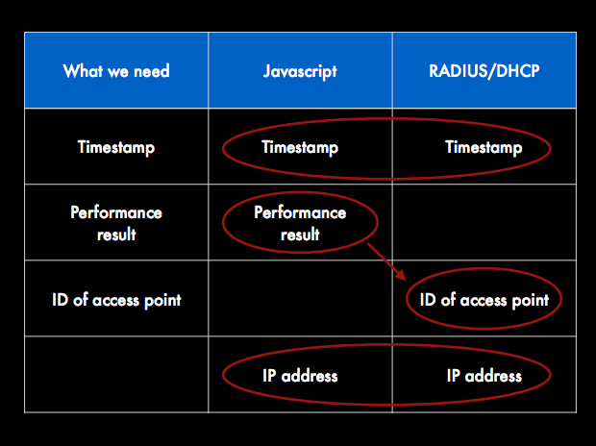
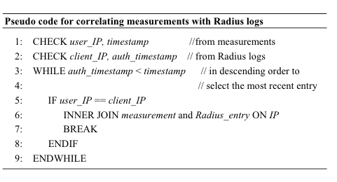
WiFiMon - How we manage/correlate performance data
Notes:
To the 3rd step:
Correlation Performance Data with RADIUS accounting:
Element:
User IP from measurements (javascript)
Client IP from authN/Z

Slide 13
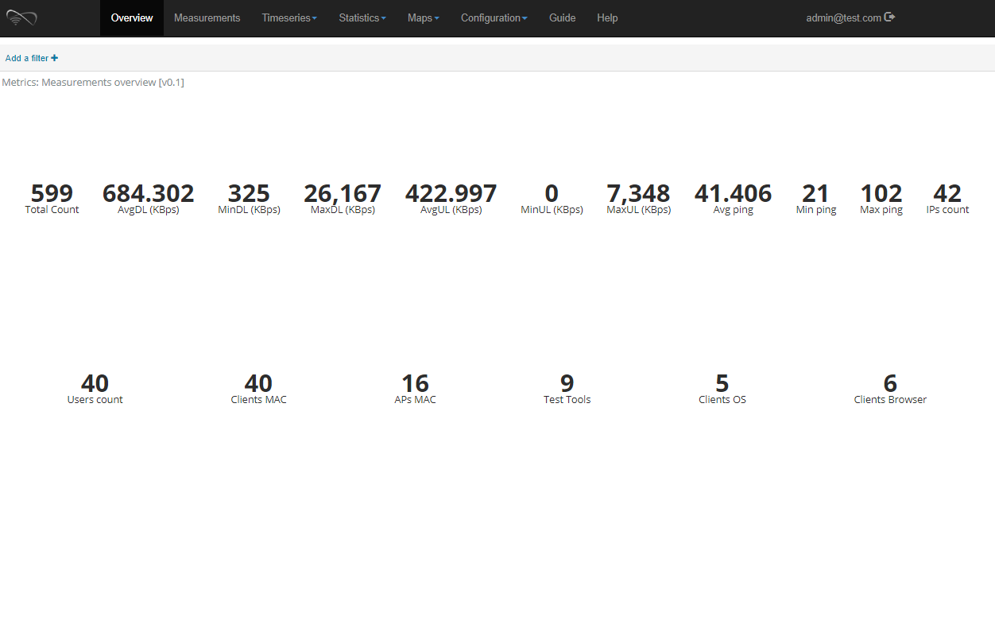
WiFiMon - Web-UI (overview tab)

Slide 14
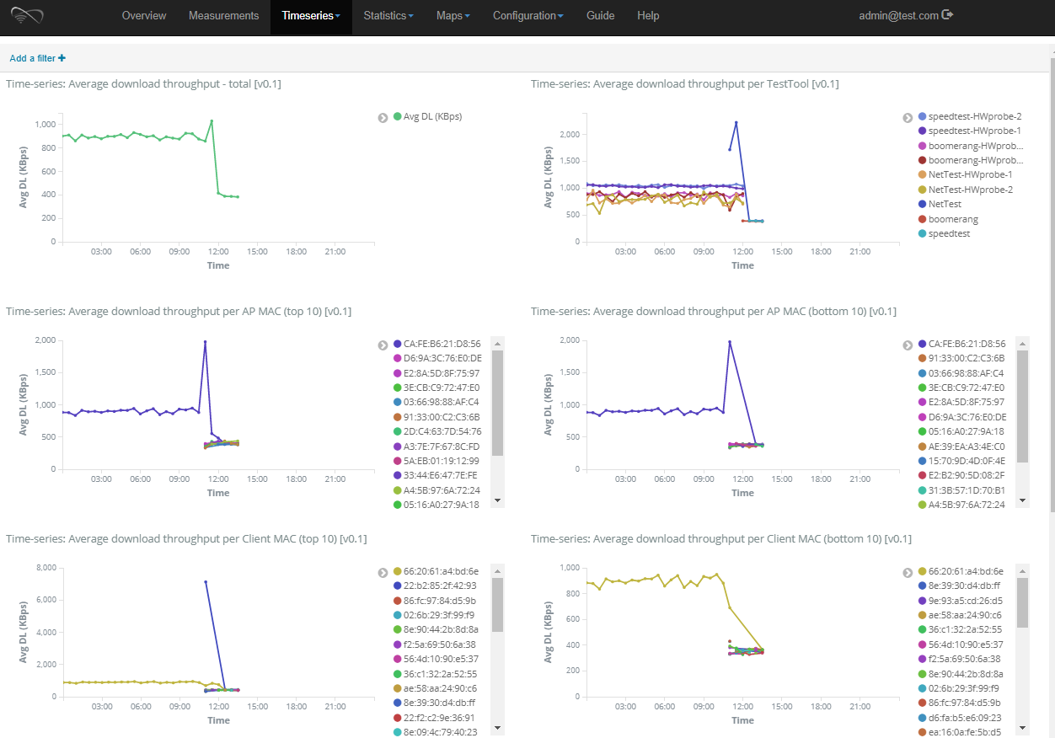
WiFiMon - Web-UI (timeseries tab)

Slide 15
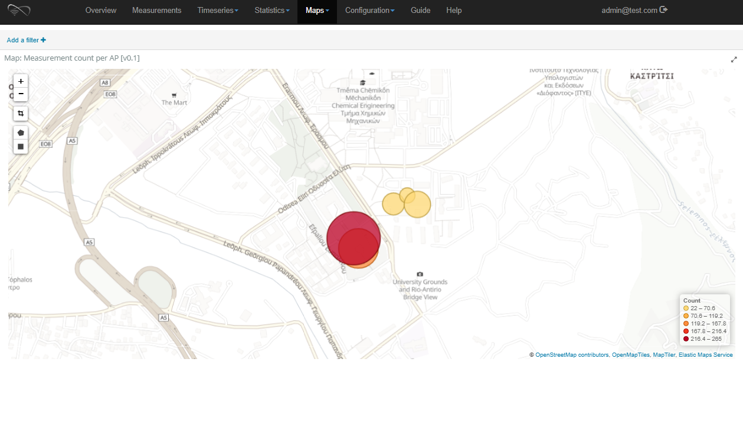
WiFiMon - Web-UI (maps tab)

Slide 16

WiFiMon Concept - Overview
Mobile
GN4-3-WP6-T3 WiFiMon
Notes:
The next concept is the Mobile App Based WiFiMon
The aim of this concept is to gather experience in Performance Monitoring by handhelds devices.
The result is a JS Library that can be integrated on the app-deployment, e.g. in a University App.
The App is available only for devices that run Android.

Slide 17
WiFiMon - Mobile App Architecture - Description
The GEANT JavaScript library and Java-based tools:
Allows to enable Spring Boot Framework (Application and Metrics and analysis)
The WiFiMon Application:
Requires the images location, User agentIP and Cookie time
Download the .js from the GEANT JS Library to Trigger NetTest
Send the results to the WifiMon agent
Informs the user for the results
Mobile OS using the appropriate APIs
to build the mobile application
Notes:
The Architecture has three elements:
The GEANT JS library pool with the necessary APIs
The WiFiMon Application
1.) .js will be downloaded from the GEANT JS library pool
2.) during the .js downloads, the HTML triggers the measurements inside the app
3.) the Measurement, collecting and storing procedure is similar to the Web-based measurements
4.) user is informed about the measurement results
C) Mobile OS: Java Script plug-ins use HTML and JSON technology
Currently available only for Android, plans for iOS devices

Slide 18
WiFiMon - Mobile App Architecture – Building Blocks
Fig 2 – WiFiMon Application
The .js-images will be downloaded (Fig 2)
HTML triggers the measurement (Fig 2)
Download (.js) done - the measurement will be started ( see Fig 1)
Fig 1- Web-based measurement
Notes:
Only selected IP ranges will taken up for measurements
The cookie will be set (today 1.5 Min)
The time stamp will be set
The image will be uploaded/downloaded
➔ relative throughput (bandwidth) / latency (RTTs) will be measured
➔ results will be posted to the Elasticsearch and Kibana for visualization

Slide 19

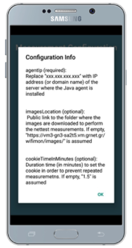
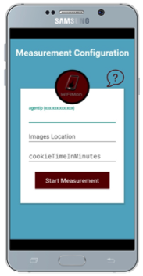
WiFiMon - Mobile App Measurement Process
Step 1: Download the WiFiMon App and install it
Step 2: Open WiFiMon App. Through a friendly User Interface - UI (see Fig 1) . User has to configure measurement options (see Fig2)
Step 3: Click on Start Measurement button and wait for the response, until monitor performance has been completed (see Fig 3). Users will receive a notification if measurements are completed.
Fig 1
Fig 2
Fig 3
Notes:
Figure 1 to Figure 2: , user has to configure measurements options, e.g. before the process begins for first time. The configuration includes setting:
(1) the IP address (domain name) of the web-server where the Java agent (JS) and the database are installed,
(2) the public link to the folder where the images are downloaded to perform the measurements, and
(3) the expiration time (in minutes) of the cookie that prevents repeated measurements.
Figure 3: During this period, the application initiates a series of services through html (such as download and upload file requests to nettest server) and stores the results on Elasticsearch. In each case user will receive a notification message of the condition of the measurements
The procedure is the same as the web-based measurements

Slide 20
WCsPMV Concept - Overview
GN4-3-WP6-T3 WiFiMon
Notes:
Hybrid solution that combines
Static infrastructure performance information (HW probes objective measurements)
Dynamic performance behavior, thanks to the end-users (mobile clients)
With the hybrid approach the WiFiMon concept comes up with a Validation of measurements.

Slide 21
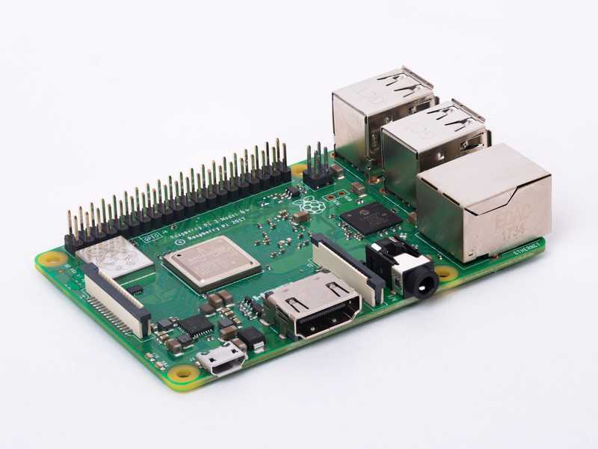
WiFiMon – Hybrid Approach
Prerequisites
A Raspberry Pi 3 Model B+
A micro SD card with at least 16GB size
WiFiMon Raspberry Pi operating system image. Size ~ 3.6 GB

Slide 22
WiFiMon – HW Probe setup steps
Step 1: Write the image to the micro SD card
Follow the instructions at the official Raspberry Pi. Skip the "Download the image" step and use the WiFiMon Raspberry Pi operating system image instead.
Step 2: Start the RPi
Insert the microSD in the RPi
Plug the USB keyboard and USB mouse
Connect the monitor cable to the Pi's HDMI port
Plug the power supply into a socket and connect it to the micro USB power port
The Pi will boot up into a graphical desktop
Step 3: Configure the RPi
Connect to the wireless network you want to measure.
Set which tests will be executed and how often
That's all! Unplug keyboard, mouse and monitor and let the HW probe measure your network!
Instruction page:
https://wifimon.switch.ch/wifimon/hw-probe-setup.html

Slide 23
WiFiMon Concept - Overview
GN4-3-WP6-T3 WiFiMon
Notes:
In parallel to the WiFiMon development we discussed - Security and Privacy.
Security:
Beyond WiFiMon ➔ eduroam (authN/Z data), personalized data
Raw data and analysing them: Process - Collecting, storing, analysing and visualization (consuming data)
Technical aspects:
EU law – focusing to the process
Analysing logs for correlations
Proper disclosure of WiFiMon process /data kept

Slide 24
WiFiMon – Security and Privacy
Process Data Management
  Legal aspect of Collecting, Storing, Analysing, Consuming and Visualizing of data
    Exercising caution when processing personal data (Management at SWITCH)
  EC point of view about Privacy and Security to WiFiMon ➔ Legitimation
    EU General Data Protection Regulation
Technical aspects
  From beyond WiFiMon to concrete implementation of features
    Collection process:
      End-User dialog through popups (agree / disagree measurement)
    Storing: Only correlated information (raw data will not be stored)
    Web site – proper disclosure on WiFiMon process / data kept
    Possibility to store only non-user related data
    Hash user-related data
Notes:
Mitigation (various approaches):
Different dashboards
Hash the username (anonymization)
Proper disclosure of WiFimon process/data kept
Consent to participate / Opt-out
Measures based on AP only

Slide 25
WiFiMon Concept - Overview
GN4-3-WP6-T3 WiFiMon
Notes:
Feedback from the End-User Community is very important
The last Event in Zurich from May 2017 provided us an informative basis
What might be measured – opportunistic/objective measurements
What’s about security – real facts
What’s the benefit combining opportunistic/objective measurements

Slide 26
WiFiMon End-User Meeting – Discussion
What might be measured?
Opportunistic measurements
  (Dynamic), web/app based, Java Script, measurements/WAP,
  (Radius Accounting) Data correlation (Valid Session (time stamp) / WAP-ID / User-IP)
  Measuring quality of device,
  ⇒ User Experience (trends)
Objective measurements by HW probes
  Static measurements
  RTT, Throughput measurement
  ⇒ Infrastructure (locally, status)
How objective measurements could support
opportunistic measurements and vice versa?
Collaboration - Hybrid approach
  Combine collected data to a “complete”
  picture
  User Experience data combined with Infrastructure, environmental data
  Validation of user measurements
  with static measurements
How Security and Privacy has to be considered ?
End-User information needed? Yes /NO ?
  Measuring performance quality at the WAP
  End-User Device Information

Slide 27


WiFiMon - Dissemination
TNC2015 – Porto
IEEE: ICT-2017, Limassol
May 2017
TNC2016 - Praha
IEEE: ICUMT- Lisbon
October 2016

Slide 28
Conclusions and future work
The expertise gained so far revealed that it is possible to:
Measure specific parameters of a wireless network through JavaScript
Correlate these measured raw data from various log files
Monitor and validate the performance of WiFi as experienced by end-users
Future steps:
Verification of JavaScript measurements accuracy (comparison with HW monitoring probes)
Mobile app development to allow measurements (expand browser-based measurements, iOS support)
Explore privacy issues so as to be in accordance with campus policies
  Inform the end-user through pop-ups, approve performance tests
  Links or pop-ups that explain the process of data collection.
  If tests are performed without user intervention, ensure that sensitive data will be analysed with caution.
Data Analysis (Elastic Search)
  To process a long time history
  To elaborate a “PERFORMANCE Benchmark”
Design a Service (roll out to the most of the NRENs)
  Commercial aspect in focus of our investigations
Notes:
As a conclusion, we are able today:
To measure specific parameters, to correlate them
Make a quality statement through the end-user behavior
With Hybrid approach to validate our measurements
In the Future:
To force Data Analysis (Big Data Management)
With Data Analysis to understand better measured data
To design a service

Slide 29
Contact us
gn4-3-wp6-t3-wifimon@lists.geant.org

