Slide 1


WiFiMon: Overview & Results from Symposium Pilot
Pavle Vuletić, UoB/AMRES
Kurt Baumann, SWITCH
Nikos Kostopoulos, NTUA/GRNET
Network Monitoring Session
Ljubljana, Slovenia
4-5 February 2020

Slide 2

Agenda
WiFiMon Overview
  Introduction
  Data Collection Technology
  Correlation with RADIUS Logs
  Hardware Probes
  Data Flow
WiFiMon Pilot in GÉANT Symposium
Conclusions
  Summary
  Looking Ahead

Slide 3
WiFiMon: Introduction
Mission Statement:
“…Is it possible to gather data from multiple sources, including browser-based measurements, in addition to traditional monitoring, and extract meaningful information on the performance of a WiFi network from that data?…”
Determine how end-users experience WiFi at a given place on the network, at a given time.
HW probes collect performance measurements but are installed at fixed locations. Crowdsourced measurements are also required.
Notes:
Generic statement:
Gather data from multiple sources,
Browser based measurement in addition to traditional monitoring
Extract Data: Accurate enough so that we can propagate a “Performance statement for a WiFi campus”
So we figured out a problem statement…

Slide 4
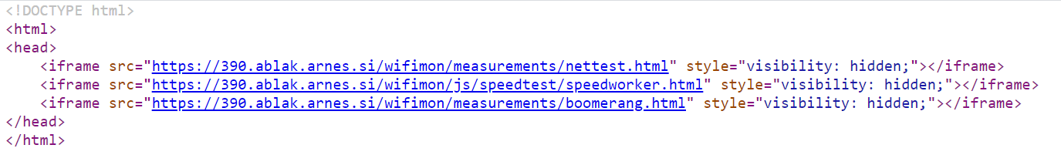
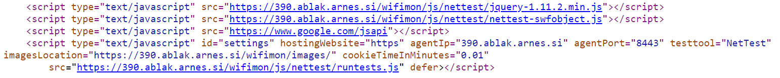
WiFiMon – Data Collection Technology
The end user visits a web page and measurements are triggered based on JavaScript scripts
Available Test Tools: NetTest, Speedtest, Boomerang
Example for NetTest:
User Information
Notes:
To the 1st step. -- web-server JS:
The Domain Name (e.g. www.switch.ch) or the IP of the web-server is needed
The location path of the images is important (location where the NetTest servers is running – Grnet)
Cookie time is essential, as we don’t like to affect the network --- non-invasive
Additional information:
The JS lines should be embedded at a frequently-visited web page (conference program, university website, etc)
The web page can be hosted anywhere without affecting the results
The agent could be installed anywhere, however it is advised to be installed near the conference venue or the university campus. The agent performs the correlations and stores the correlated measurements.
The measurement results are relative to the location of the web server, where the images are hosted.
The website, the WiFiMon agent and the test tool servers can be located at a different physical infrastructure. Only the test tool servers location affect the measurement results!!

Slide 5
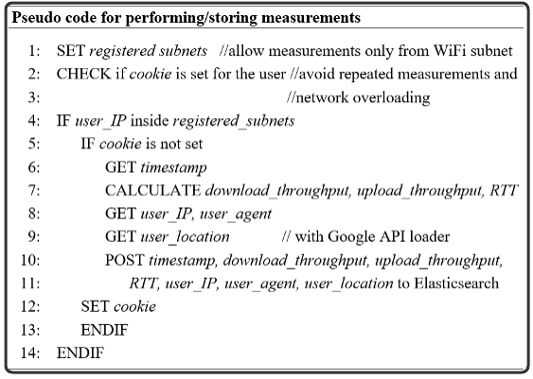
WiFiMon - Performing / Storing measurements
Network Overloading Avoidance:
Measurements accepted only from registered subnets
Cookie: repeated measurements in short time intervals are not permitted
Notes:
To the 2nd step - performing and storing of measurements at the database:
Per configuration:
Sub-Net defined => Measurements only from the sub-nets
Check is Cookie set, YES/NO => Expiration time after the measurements done – 1.5’

Slide 6
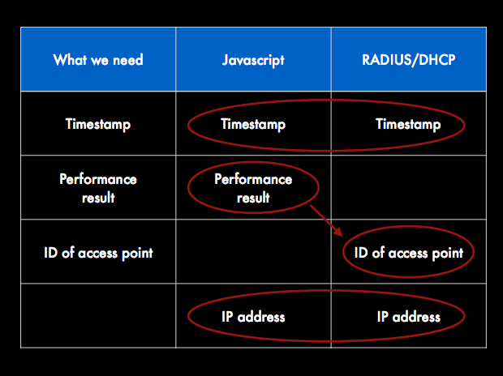
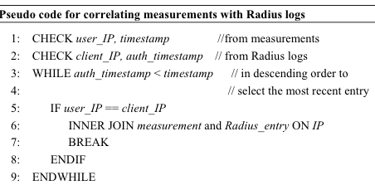
WiFiMon – Correlation with RADIUS Logs
Notes:
To the 3rd step:
Correlation Performance Data with RADIUS accounting:
Element:
User IP from measurements (javascript)
Client IP from authN/Z

Slide 7
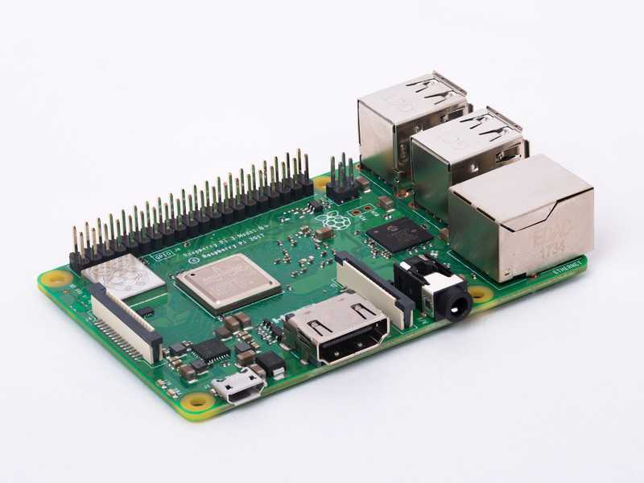
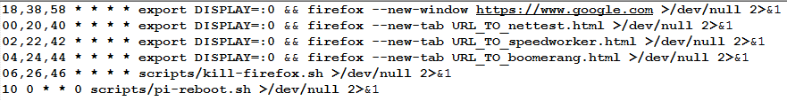
WiFiMon – Hardware Probes
Hardware Probes:
A Raspberry Pi 3 Model B+
A micro SD card with at least 16GB size
WiFiMon Raspberry Pi operating system image
(Size ~ 3.6 GB)
Indicative crontab:

Slide 8
WiFiMon - Data Flow
Real Time Analysis:
- Performance Data Parsing
Correlation of Performance
Data with Accounting Data
Mobility Prediction (Future Work)
- Focus: Network Performance
- Focus: # Users Prediction
PERFORMANCE DATA
ANALYZE DATA
IEEE802.1X / eduroam enabled infrastructures:
- End-users: Smartphones, Laptops
- Hardware Probes
Filtered RADIUS
Logs
Correlation Results
ACCOUNTING DATA
STORE DATA
CONSUME & VISUALIZE DATA
RADIUS Logs:
- Data Filtering (Logstash)
Data Storage (Elasticsearch)
- Filtered RADIUS Logs
- Correlated Results: Performance Data correlated with RADIUS Logs
WiFiMon GUI:
- Visualization (Kibana)
- User Options
8
Notes:
The aim of our approach is to record network performance measurements by using collected raw data (data source) on WiFi and to visualize them. ==========
Temporary Data – Raw data from the data source
Persistent Data – Correlated data
==========
Only correlated data will be stored and analysed
Mobility prediction and focus is possible, so the correlation with the AP helps us to provide a localized statement to the network performance.
==========
The Web-User Interface is the Network Administrators view, about their own data. In our concept use Kibana (for visualization) and Elasticsearch (as a DB).
It is worth mentioning that previous WiFiMon versions used Grafana/InfluxDB and PostGresql

Slide 9

Thank you
Any questions?
gn4-3-wp6-t3-wifimon@lists.geant.org
As part of the GÉANT 2020 Framework Partnership Agreement (FPA), the project receives funding from the European Union's Horizon 2020 research and innovation programme under Grant Agreement No. 856726 (GN4-3).​​​

