Slide 1
Firewall on Demand
Introduction
GEANT Information & Infrastructure Security Team
Evangelos Spatharas
Security Engineer
SA3-T1 Meeting
Vienna March 7th 2016

Slide 2

INDEX
DDoS seen by GÉANT
FoD Tutorial
  What Firewall on Demand is
  Why Flowspec?
  Why Firewall on Demand?
  How to subscribe
  Future plans

Slide 3
Who Sees DDoS Attacks?

Slide 4
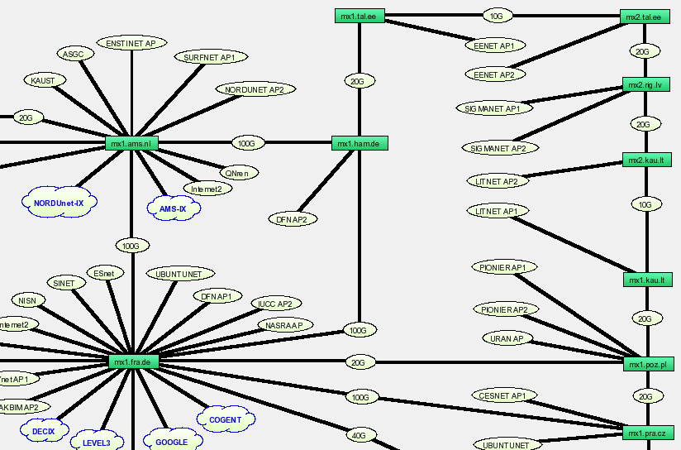
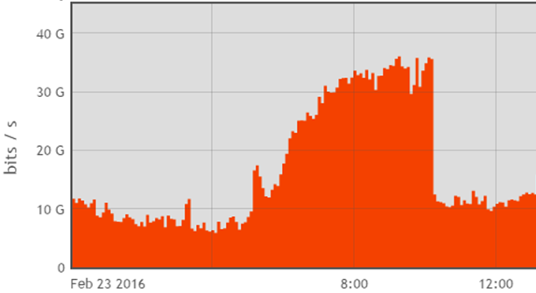
DDoS – Ramifications
36 Gb/s
Network
  Performance degradation
  Services malfunction
  Outages
Staff & Company
  Productivity reduction
  Wasted resources
  Reputation
  Profit reduction
Clients
  Dissatisfaction
  Change upstream?

Slide 5
How to Deal with DDoS?
Firewall filter deployment
  Manual ACLs
    Time Consuming
    Prone to mistakes
    Highly effective
  RTBH
    Fast
    Too coarse
  BGP FlowSpec
    Fast
    Highly effective
DDoS Scrubbing
  Highly effective (if setup correctly)
  Very expensive
Notes:
Or to just disconnect the cable
Firewall filters might be just rate-limiting packets, or be more granular and against ports and src and dst Ips
All firewall filters, would require some CLI configuration, making it difficult to track work, open close tickets.

Slide 6
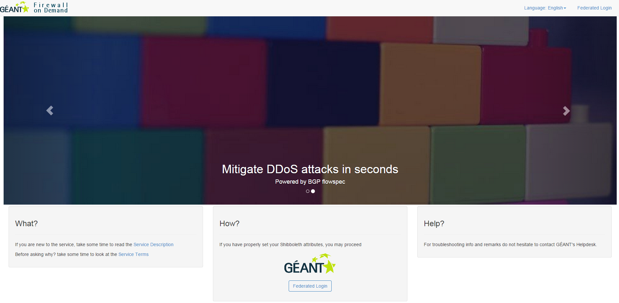

From RFC to a WEB based tool
fod.geant.net
New school rules – Forget CLI and JunOS language
Developed and designed by

Slide 7
What Firewall on Demand is
Firewall on Demand, abbreviated as FoD, is an application with a WEB front which allows subscribed users to disseminate firewall filters easily without any hassle.
The traits that make it unique are multifold:
  Convenience - NREN users can use web portal themselves, or make request by phone or e-mail.
  Simplicity - The web portal uses intuitive, non-vendor specific GUI-based wizard to configure router firewall filters.
The magic of FoD is powered on by the cutting edge flowspec technology as described by the RFC 5575.
*NOC/CERT users can still contact GEANT CERT using the traditional methods to request blocking

Slide 8



Why Flowspec?
Speed
Effectiveness
Efficiency
Notes:
Why FlowSpec?
Speed - No need to spend time on finding the peer where the traffic enters the network, find the correct filter, and then visiting each filter on different routers, flowspec propagates itself within seconds via a BGP update
Efficiency - Blocking the traffic as close to the source, at the borders of GEANT
Effectiveness - Filters are installed on the inetflow.0 table, blocking all BGP IPv4 traffic, at the PFE level
Why FoD?
Value add tool part of the NSHaRP service. NREN's are not anymore restricted on the process of opening tickets with us to block traffic affecting them
Easier audit of flowspec filters - search box finds rules based on a number of attributes
Easier removal - Filters have auto-expire on FoD, which makes sure that the flowspec table won't be 1000 lines after years of usage
Cleaner filters without "temp" terms that piled up after years of operation
In the future, reporting will be supported too

Slide 9
Why Firewall on Demand?
Value add tool part of the NSHaRP service
Easier audit of flowspec filters
Easier removal (auto-expire)
Cleaner traditional filters without "temp" terms that pile up with time
Reporting (to be supported)
What? You want more?

Slide 10
What you CAN do with FoD
Propagate flowspec filters across GÉANT network
Filters CAN have DST address from YOUR administrative IP space
Submit as many filters as you want (TBC)
Have an e-mail sent to yourself or ticketing system for tracking after rule submission/edit/withdrawn
See all rules submitted by you or your colleagues by state (active/deactivated) from past to the most current

Slide 11
What you CANNOT do with FoD
Propagate IPv6 filters (TBC)
Propagate a filter with a DST subnet bigger than /29
Access FoD platform from an IP space other than your NOC’s/GEANT network’s space

Slide 12
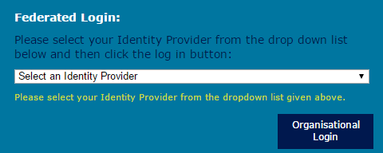
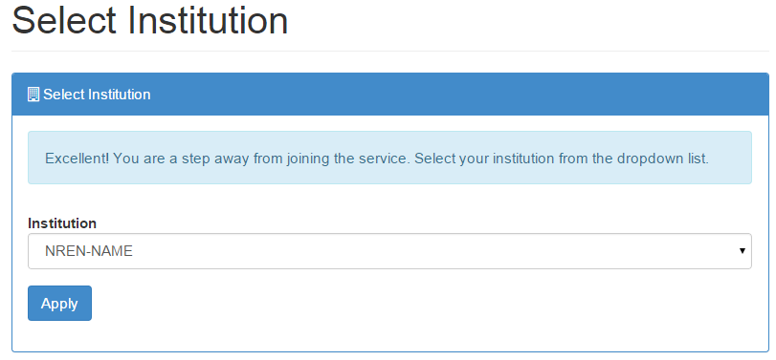
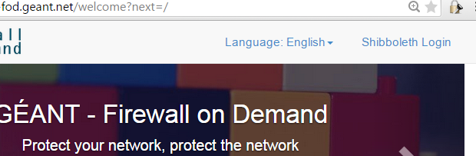
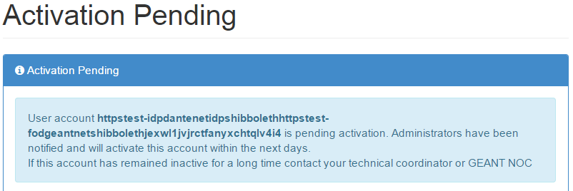
Eligibility and How to Subscribe and Access
All GÉANT member NRENs may subscribe. The subscription process is as follows:
NREN APM fills out the FoD application form (MS Excel based) – NREN authorized users (by e-mail address); NOC subnet (for white-listing); NREN’s AS number or AS-set.
NREN APM sends completed form to GÉANT security team (security@geant.org) and info is entered into FoD
Authorised NREN user, using host in NOC subnet, accesses https://fod.geant.net and clicks at the “Shibboleth Login” button on the top right. Login in using standard eduGAIN method
New user’s account will be activated within 1 business day (assuming login details match info provided by APM)

Slide 13
Shibboleth Attributes
FoD’s Shibboleth module requires the release of the following attributes:
givenName
mail
persistent-id
principalName
Surname (family name)
uniqueID

Slide 14
How to Use FoD
After your account is activated for which you’ll be notified by e-mail, you are ready to start Firewall-ing on Demand. The process is as simple as follows:
Re-visit the https://fod.geant.net page and click on the “Shibboleth Login” button
After supplying with your credentials you’ll have access to 5 main tabs:
  Dashboard
  Rules
  Add Rule
  My Profile
  Admin

Slide 15
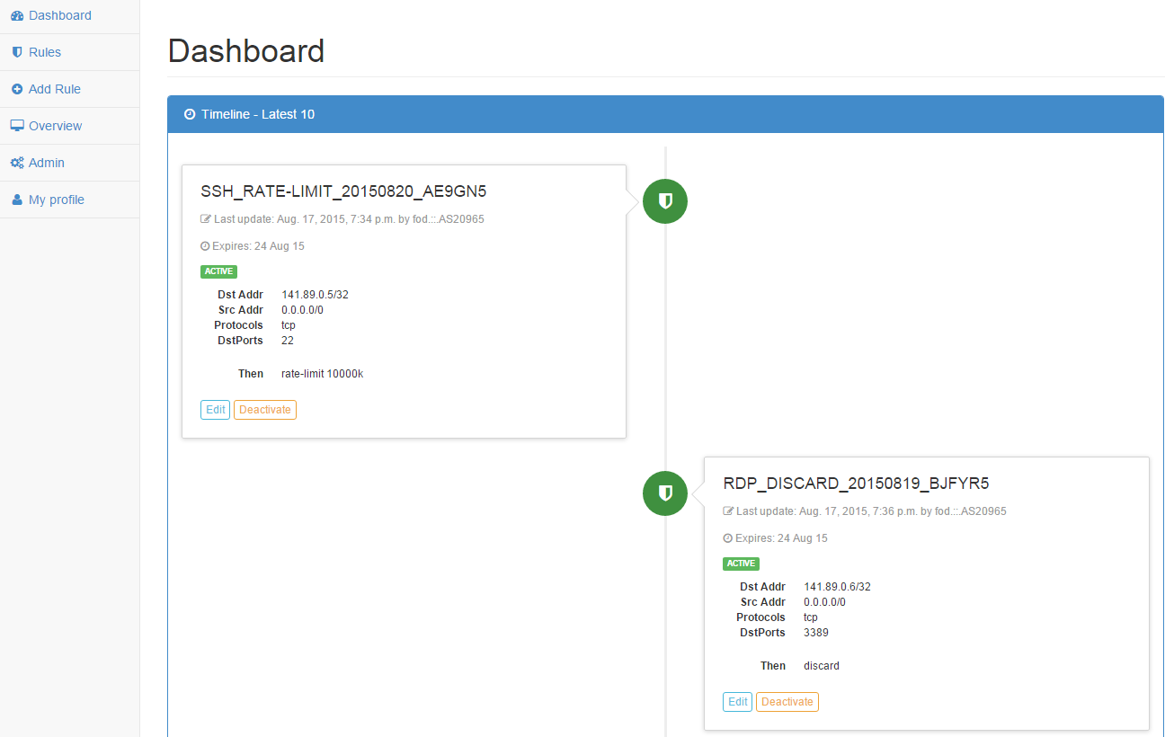
How to Use FoD - Dashboard
Dashboard page displays the latest 10 rules that have been submitted for your Institution along with their current status. Deactivated ones can be re-activated and vice versa.

Slide 16
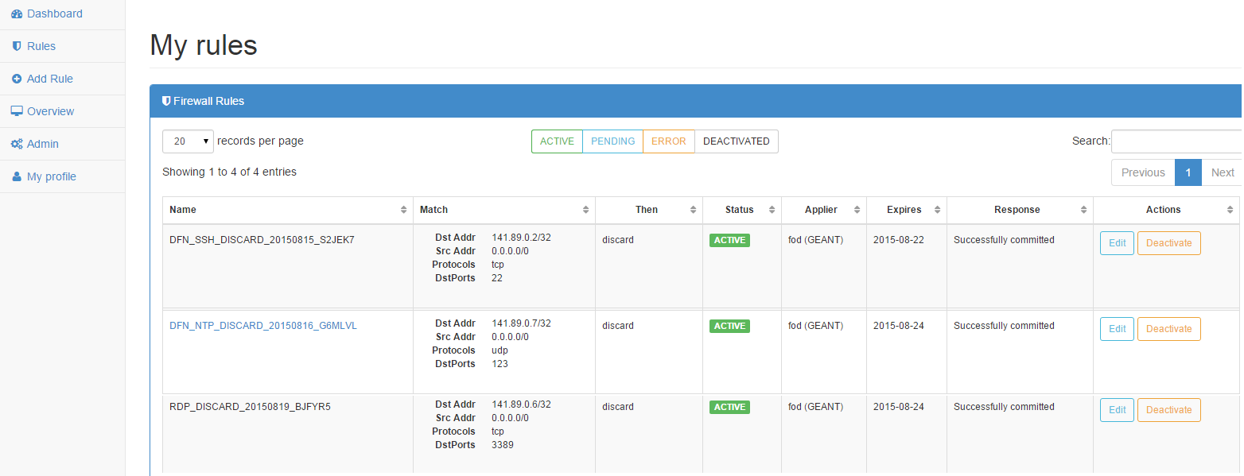
How to Use FoD - Rules
Rules page displays ALL (not just the latest 10) the rules that have been submitted for your Institution, sorted by status. From here, you can reactivate or deactivate rules, or even edit them.
What is more, one can use the search box to look for particular rules and process them further.

Slide 17
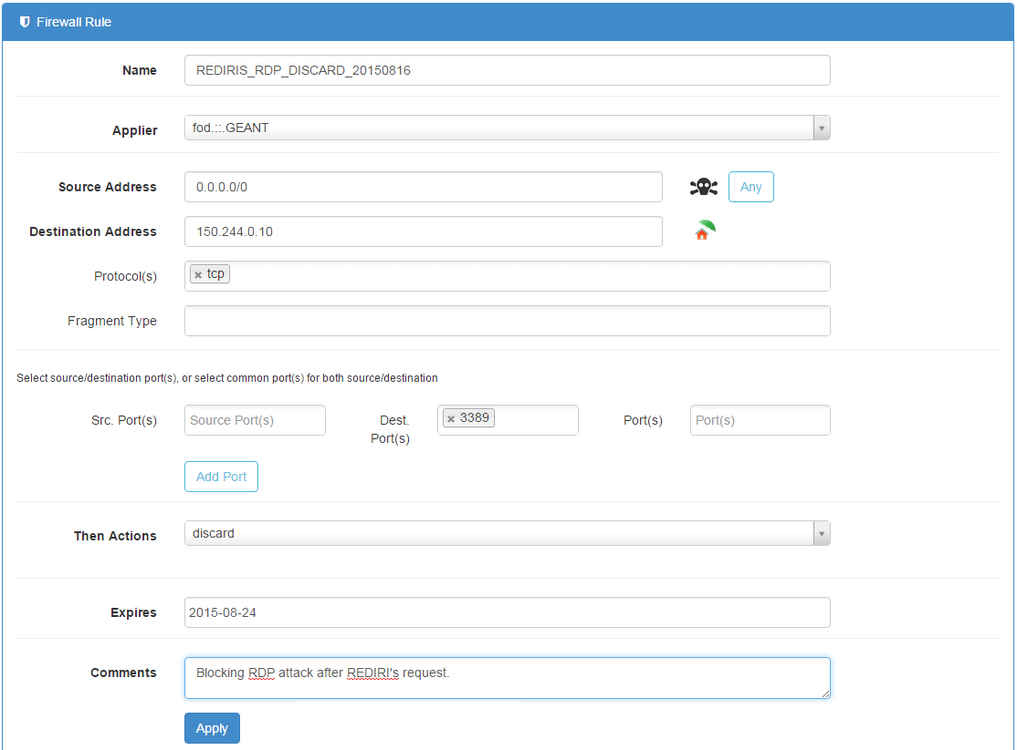
How to Use FoD – Add Rule
Add rule page is the place where you navigate when you first see an attack. To add a rule requires to populate all the necessary fields which are the following:
Name
Source Address
Destination Address
Then Actions
Note: It is recommended that the rule’s name is of the following format:
<NREN/Peering/IC>_<TYPE_OF_ATTACK>_<ACTION>_<DATE>
This will aid you in the future when searching for a rule.

Slide 18
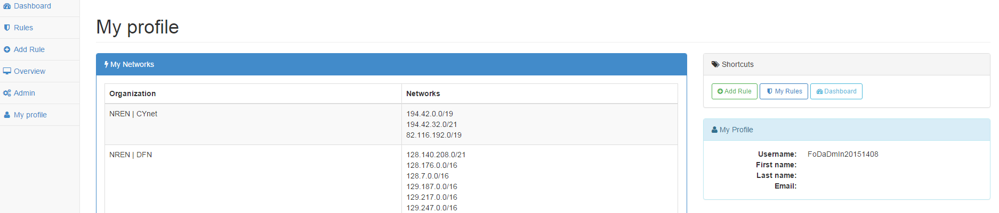
How to Use FoD – My Profile
My profile page displays information that has to do with your subscription such as your administrative networks and name, your username and e-mail.

Slide 19
Under the hood – Current Status
IX A
GÈANT
Internet
NREN A
Flowspec
FoD
IX B
NSHaRP

Slide 20
Upgrade – Future Plans
IX A
GÈANT
Internet
NREN A
Flowspec
FoD
IX B
NSHaRP & RepShield

Slide 21
FoD Roadmap
June 2013
Sept. 2014
Febr. 2015
Aug. 2015
Aug. 2015
Jan. 2016
Febr. 2016
Flowspec testing on GÉANT backbone
FoD test system installation (RHEL)
FoD pilot
Pentest & secure code review
FoD test system installation (Debian)
Resolving FoD issues on RHEL
FoD going live

Slide 22
How to Contact us
In case you have any issues or queries in relation to FoD, please contact GÉANT Infrastructure & Security team at security@geant.org

Slide 23
GEANT OPS Security Team
security@geant.net

