Slide 1


Time for a new SIG
Special Interest Group for Time & Frequency Networks
Guy Roberts
Senior Network Architect
SIG-NGN, Bergen
9/9/2024

Slide 2

SIG-TFN
In February at a meeting of NRENs and metrologists it was agreed to create a new SIG
This will be a new community which brings together NRENs and metrology
There is already strong interest: sig-tfn@lists.geant.org has 100 subscribers

Slide 3
SIG-TFN
GÉANT is the coordinator of SIG-TFN
Web page: https://community.geant.org/sig-tfn/
There are two working groups within the SIG-TFN:
  T/F Sustainability (led by Richard Lui)
  C-TFN technical specification (Led by Guy Roberts)
We will have the first in-person SIG-TFN meeting in Amsterdam on the 16/17th Oct 2024. https://wiki.geant.org/display/SIG/1st+SIG-TFN+meeting+-+Amsterdam%2C+Netherlands

Slide 4
C-TFN sustainability working group
Team
  Richard Lui
  Raphaël Marion
  Christian Chardonnet
  Wojbor Bogacki
  Christian Lisdat
  Davide Calonico
Objectives
Investigate a path to sustainability of the CLONETS-DS C-TFN, both for GÉANT and for participating NRENs and NMIs.
Carry out cost modelling to identify the extent of the future funding needs for fibre and flywheels
Engage EURAMET, NRENs, GÉANT and the European Commission to find solutions to long-term funding.

Slide 5
C-TFN technical specification working group
Team
  Guy Roberts
  Jochen Kronjaeger
  Raphaël Marion
  Krzysztof Turza
  Jacques-Olivier Gaudron
Objectives
Expand on the CLONETS-DS architecture and integrate lessons learnt from PTB-PSNC pathfinder.
Investigate if tiers of flywheel performance are needed e.g NMI flywheel, NREN flywheel, etc.
Prepare a technical specification for the C-TFN flywheels.
Prepare a technical specification for the GÉANT should build their cross-border fibre links.

Slide 6
Summary of use cases
Supplement GNSS with a fibre network to increase reliability of time distribution
Support the redefinition of the SI second being carried out between now and 2030 by NPL, PTB, Syrte and INRIM.
Perform fundamental physics research e.g. gravity wave experiments.
Support European-wide commercial services such as very accurate time stamps for banks to validate high-frequency trading.

Slide 7
So what can GEANT/NRENs do?
National TF fibre networks are fragmented, without a coordinated plan to integrate them into a unified network (CLONETS-DS)
GÉANT and NRENs can build a unified network based on federating existing national time/frequency distribution infrastructures
Invest in coordination between NRENS and NMIs to build a sustainable community
Identify long-term funding beyond 2027

Slide 8
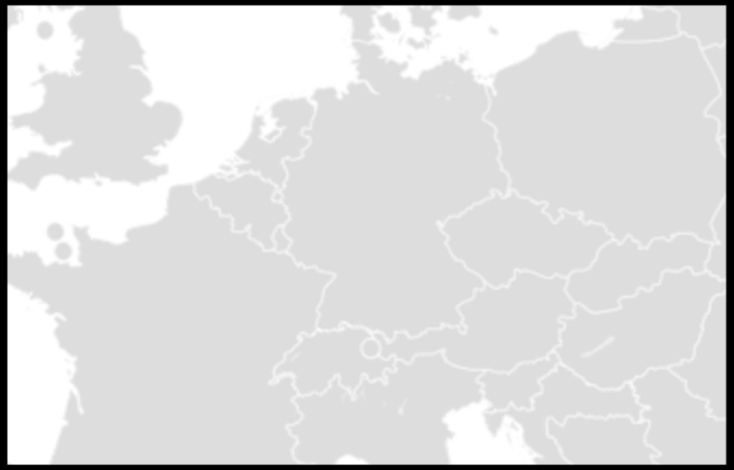




How things stand today
Frequency network:
Green links built by NRENs in collaboration with national NMIs
Blue links built by local NMIs/researchers
NMIs:
Four big NMIs are involved in redefining the SI second highlighted in red
Lithuania
UMK
Torun
PSNC
Poznan
PTB
Braunschweig
Slubice
UvA
VSL
Delft
GUM
Warsaw
NPL
London
Lille
Wroclav
OB
Brussels
IRE
Prague
Hradec
Kralove
ILNAS
Luxembourg
CESNET
Cieszyn
Karlsruhe
Ostrava
OP
Paris
ISI
Brno
Strasbourg
Munich MPI
Basel
BEV
Vienna
NMI Frequency reference
METAS
Bern
Innsbruck
Research institute
CERN
Geneva
Ljubljana
Hut for housing RLS
Grenoble
Trieste
Zagreb
Modane
INRIM
Turin
Milan

Slide 9
What is missing?
Missing:
National based networks need to be interconnected
Eastern and Western islands of frequency services are not linked
A full ring/mesh of the big four NMIs will enable them to complete definition of the SI second
Link will also be needed to Nordics, SE and SW Europe as they develop Optical clocks
Lithuania
UMK
Torun
PSNC
Poznan
PTB
Braunschweig
Slubice
UvA
VSL
Delft
GUM
Warsaw
NPL
London
Lille
Wroclav
OB
Brussels
IRE
Prague
Hradec
Kralove
ILNAS
Luxembourg
CESNET
Cieszyn
Karlsruhe
Ostrava
OP
Paris
ISI
Brno
Strasbourg
Munich MPI
Basel
BEV
Vienna
NMI Frequency reference
METAS
Bern
Innsbruck
Research institute
CERN
Geneva
Ljubljana
Hut for housing RLS
Grenoble
Trieste
Zagreb
Modane
INRIM
Turin
Milan

Slide 10
Proposed solution
Solution:
Red lines are proposed for GN5-2
These will interconnect national ‘islands’ of frequency networks
Support redefinition of the SI second
Primary users are national frequency reference providers
Secondary users are research institutes that connect via their national frequency provider
Lithuania
UMK
Torun
PSNC
Poznan
PTB
Braunschweig
Slubice
UvA
VSL
Delft
GUM
Warsaw
NPL
London
Lille
Wroclav
OB
Brussels
IRE
Prague
Hradec
Kralove
ILNAS
Luxembourg
CESNET
Cieszyn
Karlsruhe
Ostrava
OP
Paris
ISI
Brno
Strasbourg
Munich MPI
Basel
BEV
Vienna
NMI Frequency reference
METAS
Bern
Innsbruck
Ljubljana
Research institute
CERN
Geneva
Grenoble
Hut for housing RLS
Trieste
Zagreb
Modane
INRIM
Turin
Milan

Slide 11
Proposed solution
Solution:
Ring supports the four big NMIs that are part of the campaign for redefinition of the SI second
Lithuania
UMK
Torun
PSNC
Poznan
PTB
Braunschweig
Slubice
UvA
VSL
Delft
GUM
Warsaw
NPL
London
Lille
Wroclav
OB
Brussels
IRE
Prague
Hradec
Kralove
ILNAS
Luxembourg
CESNET
Cieszyn
Karlsruhe
Ostrava
OP
Paris
ISI
Brno
Strasbourg
Munich MPI
Basel
BEV
Vienna
NMI Frequency reference
METAS
Bern
Innsbruck
Ljubljana
Research institute
CERN
Geneva
Grenoble
Hut for housing RLS
Trieste
Zagreb
Modane
INRIM
Turin
Milan

Slide 12


Architecture: services overlay fibre links
NMIs
Build, own and operate the T/F equipment:
  Flywheels, counters, frequency combs
Retain ownership of time/frequency
Generate and measure time/frequency
Terminate T/F services
GEANT, NRENs
build, own and operate transport links:
  fibre, amplifiers, access points, intermediate RLS
Provide a service to NMIs to carry T/F services
RLS
Frequency service instance
RLS
WR
White Rabbit service instance
WR
NMI
Time/freq. service overlay
NMI
flywheel / frequency comb
ELSTAB
ELSTAB service instance
ELSTAB
Ch. 44
flywheel / frequency comb
Ch. 44
Ch. 45
Ch. 45
Ch. 46
Ch. 46
NMI access point
NMI access point
Transport of T/F services
GEANT C-TFN
NREN C-TFN
RLS

Slide 13
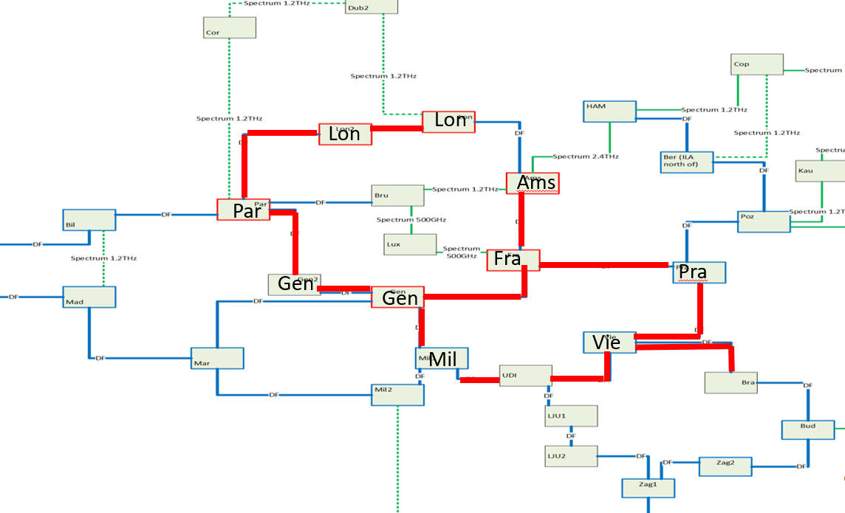
Frequency or White Rabbit on GEANT internet fibre?
After detailed investigation we decided it was not feasible to mix frequency with data on existing GÉANT fibre due to limitations of our DWDM equipment.
For this reason, dedicated fibre is recommended for frequency distribution.
NRENs such as SURF and CESNET are deploying White Rabbit on their dark fibre networks.
Could GÉANT put WR on our network?
  possibly, pending further tests
  either in the L-band links
  or overhead channels
L-band routes in the GEANT network
Because of frequency distribution requirements, the C-TFN will need dedicated time/frequency distribution fibre

Slide 14
Benefits to NRENs of the C-TFN
Enhanced Knowledge Exchange and development expertise
By sharing knowledge and best practices with NRENs, this initiative fosters the development of specialized expertise in time and frequency network deployment and management.
Strengthened Collaboration between NMIs and NRENs
The initiative acts as a bridge, enhancing the flow of information and support between National Metrology Institutes (NMIs) and NRENs.
Direct Engagement with the Research Community:
By working closely with researchers, GÉANT and NRENs can contribute significantly to the development of science data repositories and scientific workflows.
Opportunities for New Services and Applications:
The expanded capabilities of the C-TFN will enable NRENs and GÉANT to explore and offer new non-data services, potentially opening new opportunities for collaboration in diverse scientific and commercial sectors.
Contribution to European Scientific Leadership:
By fostering an integrated European T/F network, this initiative significantly contributes to Europe's standing as a global leader in high impact scientific research and technology.

Slide 15
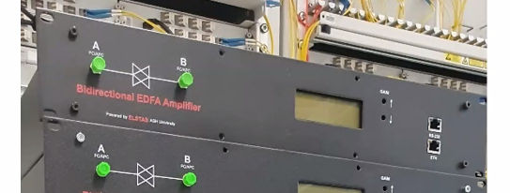
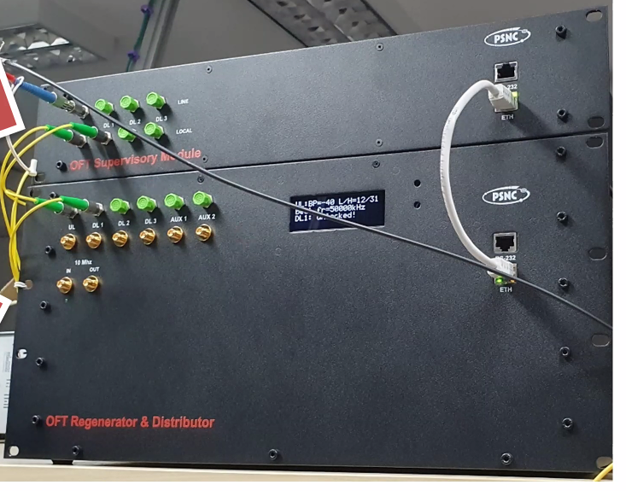
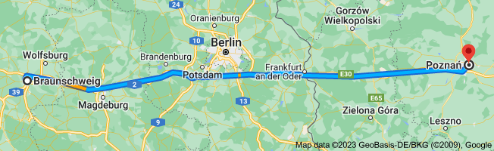
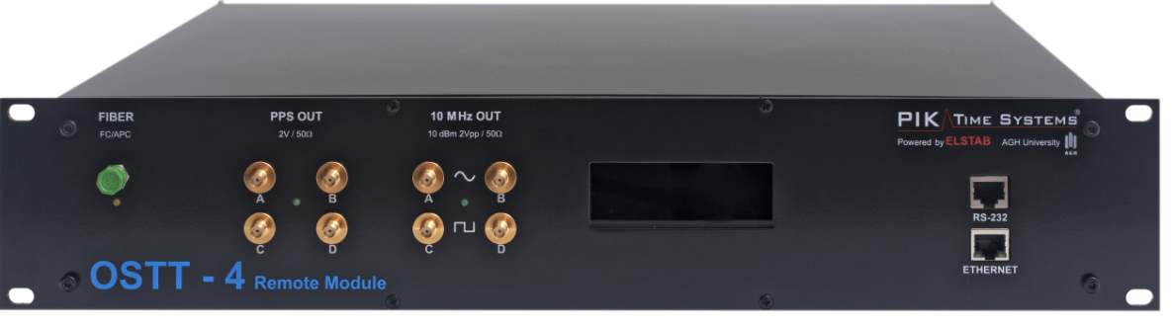
Pathfinder system
First proof-of-concept link for the CLONETS C-TFN, the purpose is to prove both frequency and time transfer
GÉANT fibre is now in place from PTB to the polish border and PSNC fibre to Poznan
Amplifier and RLS equipment installation is happening now
Bi-directional amp
Regenerator laser station
ELSTAB

Slide 16
C-TFN Timeline
2024: build and Pathfinder link and prepare C-TFN
2025 - 2027: Build TFN Phase 1
After July 2027: TFN Phase 2 (funding not yet identified)
2024 (GN5-1)
2025-27 (GN5-2)
Pathfinder link Poznan-Braunschweig
GN5-2 project preparation
Run procurement
C-TFN build, commissioning, operation
April GN5-2T workplan agreed
Q4 2024
GEANT gate for
procurement

Slide 17
Conclusions
GÉANT is building two new fibre links:
  France-Belgium-Netherlands-Germany-Poland in 2025
  Italy-Austria-Germany-Czechia-Poland in 2026
GÉANT coordinates the requirements of both NMIs and NRENs in SIG-TFN along with its specialist sub-groups
Sustainability efforts will identify GÉANT, NREN and NMI funding for 2027 and beyond

Slide 18

Thank You
Any questions?
www.geant.org

